Slide 1
CryptoFlow Event-Driven & Process-Oriented Crypto Portfolio Platform
EDPO Project FS26
St.Gallen | Ioannis Theodosiadis & Cyril Gabriele
1
Notes:
Open confidently. We built CryptoFlow to exercise the full set of EDPO lecture concepts end to end: two communication channels, five microservices, two saga patterns. This slide is just the name card - keep it to ten seconds.

Slide 2
What is CryptoFlow?
CryptoFlow is a portfolio simulation platform for crypto currencies designed to apply as much patterns from the lecture as possible. Users register, observe live market prices, manage portfolios and place simulated trades.
2
Notes:
Keep this brief. The point is that we chose a domain rich enough to require multiple bounded contexts, long-running processes, and eventual consistency - all things we wanted to demonstrate.

Slide 3
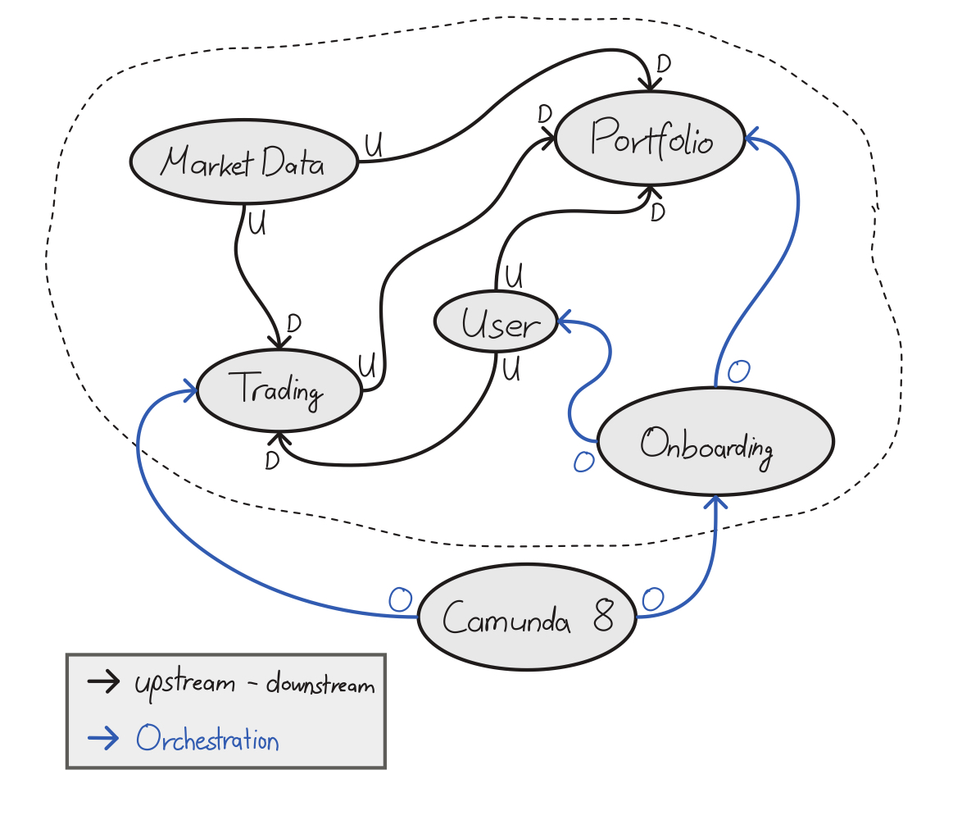
Domain: Five Bounded Contexts
Market Data:
upstream price feed
Portfolio:
holdings & valuation
Trading:
order lifecycle
User:
accounts & confirmation
Onboarding:
saga orchestrator
3
Notes:
Emphasize that the bounded contexts drove the service decomposition. Each context is owned by exactly one service. Cross-context communication is always asynchronous.

Slide 4
Non-Functional Properties
Top 3 drivers
Data integrity: every state change must be durably captured and propagated across contexts without loss
Fault tolerance: services can fail independently; partial failures and outages must not corrupt state or block processing
Availability: contexts remain operational even if others are unavailable → no cascading failures
Also driving
Data consistency (trade-off): no shared database; strict consistency is sacrificed for availability → system converges via eventual consistency (events, sagas)
Responsiveness: state changes reflected with minimal delay
Deployability: services independently developable and releasable
Extensibility: integrations replaceable without changing domain logic
Others considered: scalability, testability, interoperability, recoverability
4
Notes:
Ioannis

Slide 5
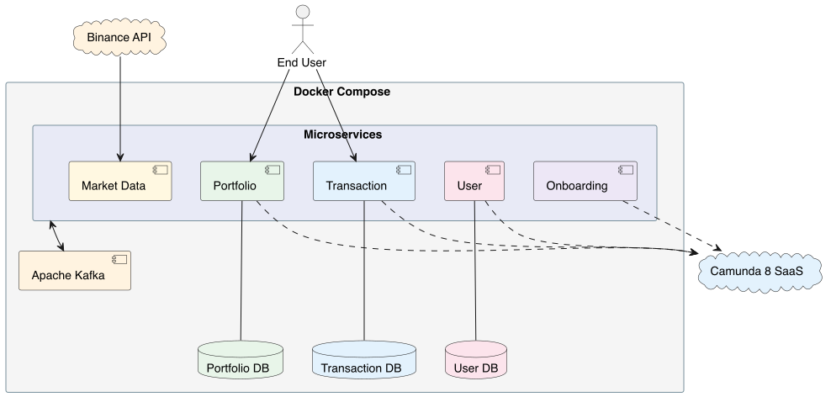
Architecture Overview
Two communication channels:
Kafka + Zeebe
No synchronous inter-service calls
REST only for external clients
Database-per-service where needed
Market Data and Onboarding are stateless
5
Notes:
This is the 30-second mental model. Two channels, five services, no shared databases. Everything else in the presentation builds on this.

Slide 6
Why Camunda 8 / Zeebe?
Two workflows need durable waiting states:
onboarding and
order placement
Why not Camunda 7 / Operaton?
Embedded engine stores process state in the application DB
Many concurrent placeOrder waits would need a shared polling table
Kafka and SMTP require custom application-level client code
Camunda 8 / Zeebe advantages
Partitioned log - each instance waits independently, no job-lock contention
Connector templates - Kafka + SMTP inside BPMN, zero notification code
Camunda Operate - runtime visibility without custom dashboards
6
Notes:
This is not a generic 'Camunda 8 is better' argument. These are project-specific reasons. The partitioned log matters because placeOrder has a non-deterministic wait - many orders can be open simultaneously. The connector templates matter because our flows include email notifications.

Slide 7
Two Saga Patterns: Driven by Wait Semantics
Two orchestrated saga styles: choice driven by nature of the wait
Onboarding: Parallel Saga
Deterministic wait (user clicks confirmation link)
Spans two bounded contexts: User + Portfolio
Needs all-or-nothing consistency
Order Placement: Fairy Tale Saga
Non-deterministic wait (price match from market feed)
Stays inside one bounded context: Trading
Accepts eventual consistency with Portfolio
7
Notes:
This was one of the most instructive decisions. The wait semantics dictated the coupling model, which dictated the saga style. A deterministic wait with cross-context scope → Parallel. A non-deterministic wait within one context → Fairy Tale.

Slide 8
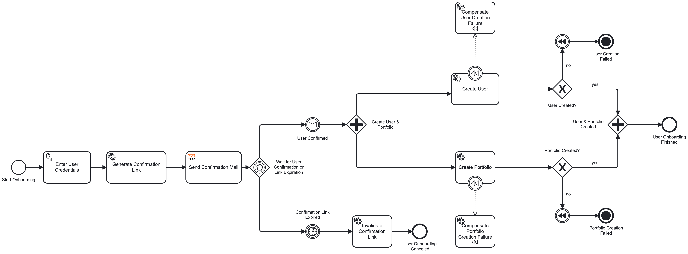
Onboarding: Parallel Saga
8
Notes:
Point to the BPMN diagram as you walk through. Emphasize: three services participate but only one (onboarding-service) owns the BPMN. The workers are stateless - they execute local transactions and report back: prepareUserWorker: generates userId, PENDING link
Camunda email connector sends confirmation
Event-based gateway: click vs. 1-min timeout
Parallel fan-out: userCreationWorker + portfolioCreationWorker
Both must succeed → process completes

Slide 9
Onboarding: Compensation & Flag-Driven Completion
Challenge: One creation succeeds, the other fails. What now?
Flag-driven completion
Workers for the creations always complete Zeebe jobs, report outcome via boolean flags
isUserCreated / isPortfolioCreated drive gateway branches
BPMN errors would short-circuit and bypass compensation gateways
Compensation
Exclusive gateways inspect flags: compensation handlers
Delete local entity + publish compensation request for peer
User/Portfolio CompensationRequestedEvent carries full payload: ECST
Idempotent deletes - safe under at-least-once delivery
9
Notes:
This is where theory meets implementation. The flag-driven pattern is subtle but essential - without it, the BPMN gateway branches become unreachable. The compensation events use ECST so no synchronous callback is needed.
- Flag-driven completion details in: ADR-0012

Slide 10
Onboarding: Individual Service
Originally the BPMN lived inside user-service…
Problem:
orchestrator coordinates work across two bounded contexts
Coupling + mixed responsibilities violates DDD boundaries
Solution:
extract into a dedicated onboarding-service
Owns the BPMN process and Zeebe deployment
No persistent business data - workflow state lives in Zeebe
User and portfolio services keep their domain autonomy
trade-off: 1 extra service but clean separation
10
Notes:
This was an ADR-driven (ADR10) decision mid-project. The original design violated bounded context boundaries. The dedicated service is the most important structural consequence of applying the saga pattern correctly.

Slide 11
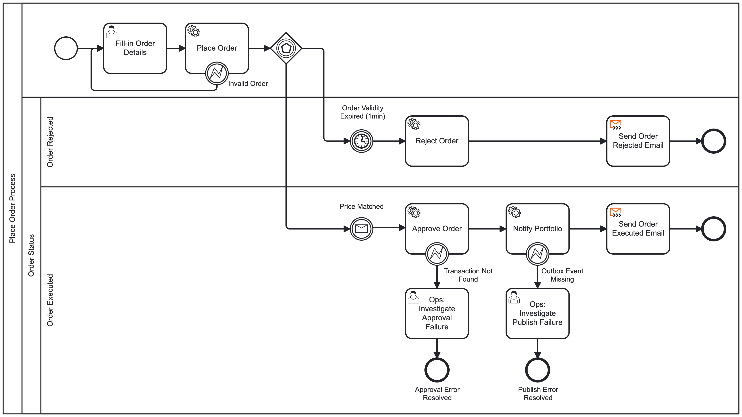
Place Order Process - Fairy Tale Saga
11
Notes:
Ioannis:
Key distinction from onboarding: the approval is terminal in the trading context. Portfolio propagation is a downstream consequence, not a saga step. This is exactly the Fairy Tale Saga trade-off: synchronous within the context, eventual across contexts. order-processing-worker validates user locally, creates PENDING tx
Event-based gateway: price match vs. 1-min timeout
approveOrderWorker writes APPROVED + outbox row in one transaction
publishOrderApprovedWorker publishes to Kafka → email
Portfolio update happens independently via Kafka

Slide 12
Architecture Details: Additional Patterns
Idempotent Consumer
processed_transaction UNIQUE constraint on transactionId
found during integration: 2 BTC order → 4 BTC in portfolio
ECST:
event carried state transfer for compensation in Onboarding
Portfolio updates after order approval
…
Transactional Outbox
Approval + outbox row in one DB transaction
Scheduler republishes stale rows after crashes
Human Escalation
Deterministic failures throw typed BPMN errors
Boundary events route to ops user task in Tasklist
12
Notes:
This is a focused use of CQRS: the write model stays in user-service, the trading context keeps only the projection it needs. Log compaction ensures the read-model survives cold starts.
details: - Idempotent Consumer (ADR-0016)
- Transactional Outbox (ADR-0014)
Human Escalation (ADR-0018)

Slide 13
Insights: Challenges & Lessons Learned
BPMN learning curve:
demanding upfront, reduced implementation effort after
Concepts intuitive in theory, complex in practice:
Orchestration, compensation, ECST multiply downstream decisions
Saga selection only became clear by analyzing the nature of the wait
Integration issues surface late:
deserialization, correlation keys, payloads
13
Notes:
Be honest about the challenges. The key message: the patterns work, but applying them requires many more decisions than the theory suggests. ADRs were essential for keeping those decisions traceable.

Slide 14
Demonstration
14

Slide 15
Live Demo
Demo 1 - Happy-path onboarding
Tasklist form → confirmation email → click → user + portfolio created
Camunda Operate shows the completed process instance
Demo 2 - Happy-path order placement
Tasklist order → price match → APPROVED → portfolio updated
Notification email received
Optional if time permits: timeout scenario, Kafka UI, Operate history
15
Notes:
Keep the demo tight - 2-3 minutes max. Have the Docker Compose stack running before the presentation starts. If something breaks live, switch to Operate to show the instance state - that's still a valid demo of observability.

Slide 16
Summary & Key Takeaways
5 microservices, 2 channels (Kafka + Zeebe), 11 EDPO concepts implemented
Two saga patterns chosen by wait semantics, not by preference
Flag-driven completion keeps compensation paths reachable
Transactional outbox + idempotent consumer + human escalation as a chain
Dedicated orchestration service preserves bounded context autonomy
20 ADRs documenting every architectural decision with rationale
16
Notes:
This is the wrap-up. Reiterate the most distinctive architectural choices. Then open for Q&A.

Slide 17
Questions?
Anticipated backup topics
• Why orchestration rather than choreography?
• Why JSON over Avro for Kafka serialization?
• How would you scale this to production?
• What would you do differently next time?
17
Notes:
Open the floor. If the audience is quiet, prime the pump with the first backup topic yourself.

