Slide 1
Node.js - Callback vs. Async Hell
Cyrille Fauvel – Autodesk
@FAUVELcyrille

Slide 2
Summary
Designing and crafting effective Node.js applications frequently involves a fundamentally different approach than we’ve seen in many platforms of the past. Rather than building monolithic functional structures, Node.js applications are composed of discrete components that complement each other and specialize. We’ll explore what works, and how Node.js applications are different. We’ll also review why asynchronous programming in Node.js is important and discuss nested callbacks and control flow implementation for readability and ease of reasoning.

Slide 3


Cyrille can be described as a spunky problem-solver with a passion for learning. Fortunately, this complements his job well as a developer at Autodesk. Cyrille worked on many Autodesk products, but he is now spending most of his time on Maya and Cloud & Mobile technologies. He has always had a strong affinity for combining technology with creativity and loves the interactivity of web and mobile apps. When not coding, he can be found fighting on Starcraft II / WarCraft III or on a sailboat on French Brittany border.
linkedin: https://fr.linkedin.com/in/cyrillefauvel blog: http://around-the-corner.typepad.com/ @FAUVELCyrille

Slide 4
Agenda
Why Node.js vs others
Importance of non-blocking i/o and async programming
Events vs Callbacks vs Promises vs co-Routines vs …
Technologies/Modules available

Slide 5
Why Node.js vs others

Slide 6
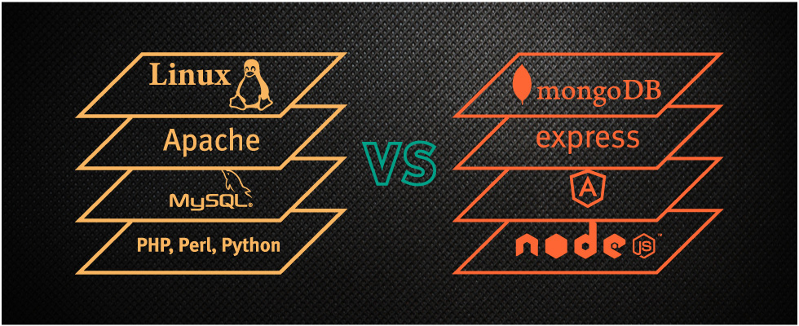
Node.js vs Apache+PHP (or others)
Notes:
Image from http://blog.backand.com/mean-vs-lamp/
The most important thing to understand is that one is "generally" not better than the other. The selection depends on the case in hand.
Apache generally uses PHP as a scripting language, which is extremely easy for the beginners and it is built for Web. Node js is simply a javascript v8 engine which was not originally intended to serve web.
Apache and PHP are old and stable. Everything you need to develop a working web application is available with a lot of support. Node Js is the new kid in the block ( .. not so new.. but still..). It is not essentially built for developing Web applications. http based Web application can be considered as one use of Node Js.
Many famous cms (Wordpress, Drupal, Joomla etc) and development frameworks (Yii, Laravel, Code Ignitor, Cake PHP) are build in PHP. These frameworks are very helpful in organizing the code base for a large application. Node Js also has web frameworks like Express and sails js but they are new and the support is not as readily available as compared to PHP frameworks.
Apache is thread and process based i.e each request is handled by a separate thread or process (depending upon configuration), which means if the process is waiting for the I/O, whole thread is blocked. Node JS has asynchronous, even driven I/O. Every nodejs instance runs in a single thread and due to its asynchronous nature, it can handle far more number of concurrent requests as compared to apache.
Apache is thread based, so if an unexpected problem occurs while processing a request, only that particular thread will crash leaving rest of the requests and threads intact. Node Js handles multiple requests using one single thread. If a problem occurs whole node js instance will crash along with any global data that was stored in javascript variables or arrays. It can be automatically restarted using "forever" or some other modules but the current requests and the data is gone.
when Apache gets a request which is CPU intensive, other request do not get blocked because of the context switching between the threads. whenNodeJs gets a CPU intensive request, all the other requests get blocked till this CPU intensive request stops for an I/O. its a good idea to delegate CPU intensive requests to a worker or some other process while using Node Js.
PHP does not support web sockets natively (to my knowledge). There are libraries which can help implement web sockets, but again due to thread based model, a decent number of live web socket connections will eat up your server's resources. NodeJs is a perfect candidate for real time communication over internet. Combine it with Socket.IO and you will get a good scalable web socket server along with fallback communication mediums such as flash socket and long polling. Its light weight and it can scale pretty good because its all running in one single thread.
Cons of httpd versus node: - httpd is not a runtime environment if you are looking for a runtime environment. Cons of node versus httpd: - node is not an http server if you are looking for an http server. Short story long, httpd is for serving applications and node is for making applications. You could port httpd to node or serve a node application with httpd. Since they can be so related, they are often mistakenly compared to each other. If you are looking to serve content (static or PHP or RTMP stuff or whatever), you should choose something like apache or nginx (which is the one I would prefer), because they are made just for that.
Out of the box, Apache is a general purpose web server. Out of the box it serves static files from disk and saves log files, and with optional modules it can do much more (caching, load balancing, gzipping, proxying, URL rewriting, etc…) Node.js is just asynchronous IO APIs (including HTTP) for JavaScript. To get it to even serve a file from disk you need to write some code. That said, all of the functionality of Apache could be replicated in a program written for Node.

Slide 7
Node.js vs Apache+PHP (or others)
Syntax
Context switch
Modules
Ecosystem
Frameworks
Real-time apps
Database apps
Web servers
Hosting
Performance
C like syntax for both javascript & PHP
Node is javascript only
Robust npm vs Composer for PHP
Node is still young but growing fast
equal
Node + socket.io
SQL vs noSQL debate
PHP, Python need Apache for example
PaaS – several solutions around
Google Chrome V8 engine technology

Slide 8
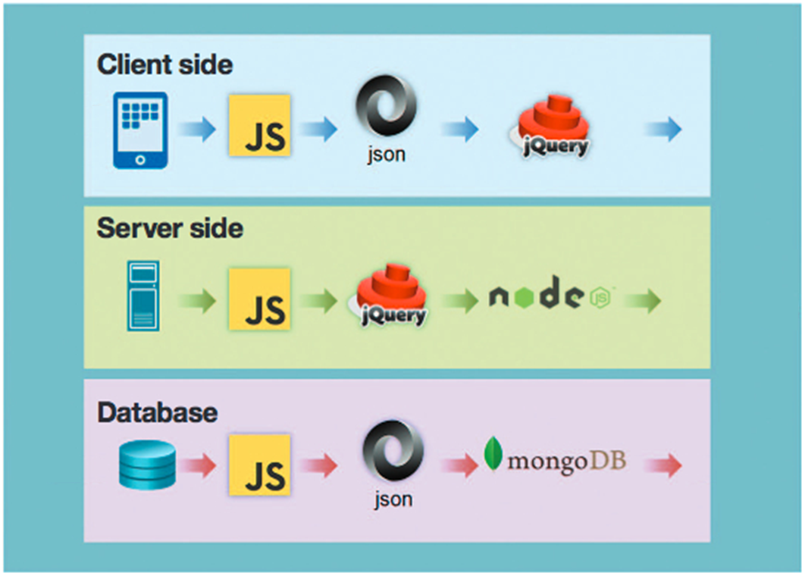
Node.js framework
Notes:
Node.js uses javascript ( which is very simple and familiar to every web developer ) on both the server side, and the client side. Also, when using mongoDB, you receive javascript object (json) as query results, which makes it easy to pass the result on to a client side framework, like knockout / angular etc…

Slide 9
View & Data API sample
http://extract.autodesk.io/
More info on the API – http://developer-autodesk.github.io/

Slide 10
Non-blocking i/o and async programming

Slide 11
Non blocking i/o
What happens if you block?
Keep in mind the Node.js foundations
event loop
one javascript thread
Notes:
What happens if you block? If your code is blocking, you prevent any other request to be honored. Node.js expects you to execute code very quickly and return. Lengthy processing must be async, spawn, … You will not loose any requests, but they’ll be delayed and then executed one by one. A good practice is to stress you code using the Apache ab command or siege
Keep in mind the Node.js foundations
event loop
one javascript thread
See next 2 slides

Slide 12
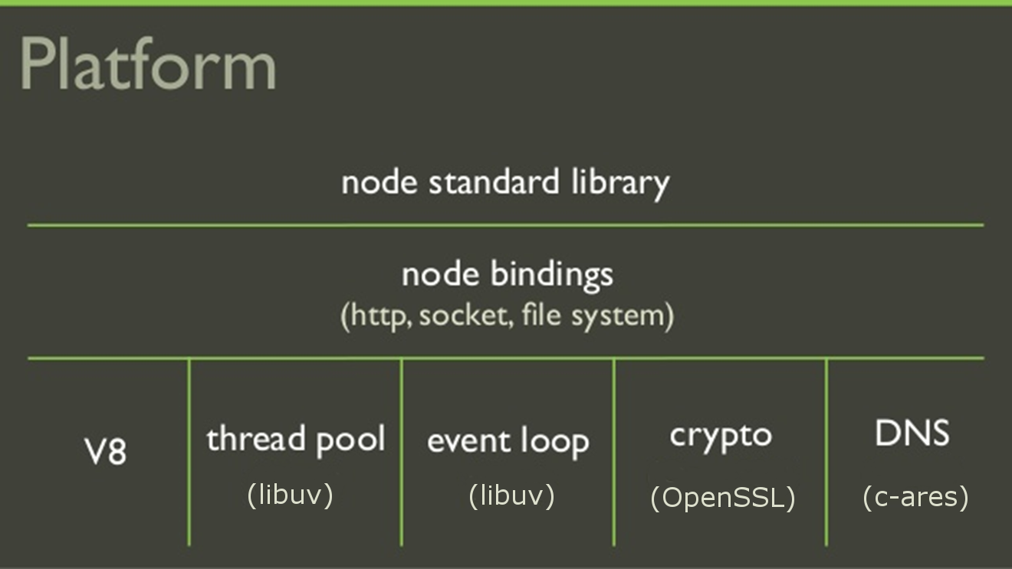
One thread, really?
Notes:
Old framwework - http://stackoverflow.com/questions/10680601/nodejs-event-loop
Libeio is a full-featured asynchronous I/O library for C, modelled in similar style and spirit as libev. Features include: asynchronous read, write, open, close, stat, unlink, fdatasync, mknod, readdir etc. (basically the full POSIX API). sendfile (native on solaris, linux, hp-ux, freebsd, emulated everywehere else), readahead (emulated where not available).
Now using libuv
https://github.com/libuv/libuv
The difference with Apache which starts one thread for each request (does not scale well under pressure), node is having a pool of thread, so manage the same number always. No memory problem, no slowdown to control threads’ lifetime. The event loop is always there to respond to new requests. People says Node.js is one thread only, but one thread for executing your code, multiple otherwise.

Slide 13

The event loop
Notes:
If you’re blocking Node.js in your code, the event look (in its own thread) will continue receiving messages and new requests. Nothing is lost, …. Just delayed because of you.
It is very common for people to assume their code is more important than anything else, or reply things like, their code is fast to not worry about async programming. One of my colleague (a very good programmer on desktop) sometimes reply to me that ‘reading that little file synchronously is not a problem, it is small’. Is that true?
He forgot 2 things, yes it is small to read the content, but this is because it is small, the I/O will spend more time accessing the file than reading it.
Node.js sends tons of messages, but your application can use messages as well by using the EventEmitter
var events =require('events') ; var util =require ('util') ; function MyObject () { events.EventEmitter.call (this) ; } //MyObject.prototype.__proto__ =events.EventEmitter.prototype ; util.inherits (MyObject, events.EventEmitter) ;
MyObject.prototype.myFct =function () { var self =this ; someAsyncCall (function (err, response) { try { if ( response.statusCode != 200 ) throw response ; try { self.emit ('success', response) ; } catch ( err ) {} } catch ( err ) { self.emit ('fail', err) ; } }) ; return (this) ; } ;
Note: all listeners will get the message, message name should be different for each object feature. I.e, if MyObject got anotherFct emitting the same messages, look at this code:
var test =new MyObject ().myFct ().anotherFct() .on ('success', function (data) {
// or test.anotherFct() ;
}) ;
from where is coming the event?
More reading at: https://en.wikipedia.org/wiki/Observer_pattern

Slide 14
Demo
The Fibonacci sample
Notes:
fibonacci.js
#28 - http://localhost/api/fibonacci // Terms=40 2015-06-16T08:59:54+02:00 // Exiting(40): 3.828 synchronous, badly written
#56 – http://localhost/api/fibonacciopt // Terms=40 2015-06-16T09:03:40+02:00 // Exiting(40): 0.002 lot better, but still synchronous and has a global variable which is ok in the context of synchronous
#78 – http://localhost/api/fibonacciasync // Terms(40) - 2015-06-16T09:05:25+02:00 // fibonacci(40) callback // Returning(40): 0 // fibonacci(40) exiting // Exiting(40): 0 fully async, but in this small example, hard to demonstrate it exits before end of computation
#78 – http://localhost/api/fibonacciasyncslow&terms=5 // Terms(5) - 2015-06-16T09:08:38+02:00 // fibonaccislow(5) exiting // Exiting(5): 0.001 // fibonaccislow(5) callback // Returning(5): 5.005 same as async, but slowing down each iteration to show it exit before end of computing.
Still not convinced?
Try test0-5 from index.html #123 mixing blocking and non-blocking code.
Writing async code yourself without library is doable but complex – see asynFct.js examples.
async-samples.js #30 and #46, #98
But do not try to do it yourself – you’ll end up writing a lot of code which won’t be scalable, while there are specialized libs for that.

Slide 15
Events vs Callbacks vs Promises vs Generators vs …
Notes:
Callbacks are commonly used when you have an asynchronous operation that should notify the caller about its’ completion. However a callback can be synchronous sometimes, usually not in Node.js
Promises are a replacement for Callbacks to help you deal with composition of multiple async operations while also making error handling simpler in some cases.
Signals are used as a way of communication between objects. They are mainly used for cases where you need to react to actions that you are not responsible for triggering. These events usually happens multiple times during the application lifetime and might be dispatched at random intervals.
Coroutines are computer program components that generalize subroutines to allow multiple entry points for suspending and resuming execution at certain locations.
EventEmitters are basically an Object that creates/dispatches multiple Signals types on-demand and usually use Strings to define the message name.
The biggest advantage of Events over Signals is that you can dispatch dynamic events during runtime - suppose you want a different event type for each change on your Model class.
node.js uses EventEmitter internally a lot but creates some callback-like APIs to abstract/simplify the process, like the http.createServer method:
http
.createServer(respondToRequest)
.listen(1337, '127.0.0.1');
is exactly the same as:
var server = http.createServer();
server.on('request', respondToRequest);
server.listen(1337, '127.0.0.1');
Be careful not to guess all callbacks have an event behind, when calling in libuv, these are true async callbacks.

Slide 16
Be careful with
Execution timing – do not expect timing to be consistent
Scope – returning a value or handling exception outside your functional block
Variable scope and closures
Globals are your enemies
Notes:
Execution timing – do not expect timing to be consistent remember the demos
Scope – returning a value or handling exception outside your functional block see example in test-ex.html http://localhost/test-ex.html
Variable scope anonymous embedded functions vs named function named function are great for debugging and reading code use function factory can help
Globals are your enemies

Slide 17
Callback hell
var function1 =function (callback) { function2 (function (err, results) { if ( err ) { callback (err); return ; } function3 (result, function (err, results) { if ( err ) { callback (err) ; return ; } function4 (result, function (err, results) { if ( err ) { callback (err) ; return ; } function5 (result, function (err, results) { // ... }) ; }) ; }) ; }) ; } ;
Notes:
Show async-samples.js #152, #172

Slide 18
Callback hell
Instead of: function1 // lots of code function2 // lots of code function3 // lots of code function4 // lots of code function4 // lots of code Aim for: function function1 (arg1, arg2, callback) { // top-level code } function function2 (arg1, arg2, callback) { // top-level code } function function3 (arg1, arg2, callback) { // top-level code } function function4 (arg1, arg2, callback) { // top-level code } function function5 (arg1, arg2, callback) { // top-level code } function businessLogic () { // uses the above to get the work done }
Notes:
Checkout code at
async-samples.js #197 – easier to read
async-samples.js #226 – even easier to read but using the async lib
Now, name your function with meaningful name and take them out the business logic code.
async-samples.js #272
Got parameters? use function factory to overcome the issue
async-samples.js #307

Slide 19
Real Example
// Get the bucket/identifier viewable data as a zip file containing all resources router.get ('/results/:bucket/:identifier/project', function (req, res) { var bucket =req.params.bucket ; var identifier =req.params.identifier ; var urn =new lmv.Lmv (bucket).getURN (identifier) ; if ( urn == '' ) return (res.status (404).end ()) ; try { rimraf ('data/' + identifier, function (err) { if ( err ) throw err ; async.waterfall ([ function (callback_wf1a) { wf1_GetFullDetails (callback_wf1a, bucket, identifier, urn) ; }, // Get latest full details function (data, callback_wf1b) { wf1_GetItems (data, callback_wf1b, bucket, identifier) ; }, // From full details, get all individual elements to download function (results, callbacks_wf1c) { wf1_ReadSvfF2dManifest (results, callbacks_wf1c, bucket, identifier) ; }, // .svf/.f2d/manifest additional references to download/create function (uris, callback_wf1d) { wf1_GetAdditionalItems (uris, callback_wf1d, bucket, identifier) ; }, // Get additional items from the previous extraction step function (refs, callback_wf1e) { wf1_GenerateLocalHtml (refs, callback_wf1e, bucket, identifier) ; } // Generate helper html/bat ], function (err, results) { wf1End_PackItems (err, results, identifier) ; } // Create a ZIP file and return all elements ) ; }) ; } catch ( err ) { console.log ('router.get (/results/:bucket/:identifier/project) exception ' + err) ; } res.end () ; }) ;
Notes:
https://github.com/cyrillef/workflow-node.js-server-view.and.data.api
https://github.com/cyrillef/workflow-node.js-server-view.and.data.api/blob/master/server/lmv-results.js #131
Name your functions
Keep your code shallow
Avoid the ‘Sync’ calls even if it looks easier
Modularize!

Slide 20
Real Example
// Get the bucket/identifier viewable data as a zip file containing all resources router.get ('/results/:bucket/:identifier/project', function (req, res) { var bucket =req.params.bucket ; var identifier =req.params.identifier ; var urn =new lmv.Lmv (bucket).getURN (identifier) ; if ( urn == '' ) return (res.status (404).end ()) ; try { rimraf ('data/' + identifier, function (err) { if ( err ) throw err ; async.waterfall ([ wf1_GetFullDetails (bucket, identifier, urn), // Get latest full details wf1_GetItems (bucket, identifier), // From full details, get all individual elements to download wf1_ReadSvfF2dManifest (bucket, identifier), // .svf/.f2d/manifest additional references to download/create wf1_GetAdditionalItems (bucket, identifier), // Get additional items from the previous extraction step wf1_GenerateLocalHtml (bucket, identifier) // Generate helper html/bat ], wf1End_PackItems (identifier) // Create a ZIP file and return all elements ) ; }) ; } catch ( err ) { console.log ('router.get (/results/:bucket/:identifier/project) exception ' + err) ; } res.end () ; }) ;
Notes:
function wf1_GetFullDetails (bucket, identifier, urn) {
return (
function (callback) {
…
}
) ;
}
function wf1_GetItems (bucket, identifier) {
return (
function (data, callback) {
…
}
) ;
}

Slide 21
The async library
Collections
each, map, filter, reduce, some ...
Control flow
series, parallel, waterfall, compose ...
Notes:
Works in the browser as well
Node.js – npm install async
In the browser – bower install async
<script type="text/javascript" src="async.js"></script>

Slide 22
Modularize
Always expose your package API as callback-based functions!
It’s a standard

Slide 23
Promises
var function1 =function () { return ( function2 () .then (function (data) { // function3 return (process3 (data)) ; }) .then (function (data) { // function4 return (process4 (data)) ; }) .then (function (data) { // function5 return (process5 (data)) ; }) .then (function (results) { res.status (200).send () ; }) .fail (function (err) { return (res.status (500).send (err)) ; }) ) ; } ;
Notes:
According to Promises/A+ specification
„promise is an object or function with a then method whose behavior conforms to this specification (...) [and] represents the eventual result of an asynchronous operation„
See promises-sample.js #30, #48, #62
http://wiki.commonjs.org/wiki/Promises
---
jQuery implemented Promises in version 1.5.
---
http://howtonode.org/promises
Promise Terminology
Fulfillment: When a successful promise is fulfilled, all of the pending callbacks are called with the value. If more callbacks are registered in the future, they will be called with the same value. Fulfilment is the asynchronous analog for returning a value.
Rejection: When a promise cannot be fulfilled, a promise is 'rejected' which invokes the errbacks that are waiting and remembers the error that was rejected for future errbacks that are attached. Rejection is the asynchronous analog for throwing an exception.
Resolution: A promise is resolved when it makes progress toward fulfillment or rejection. A promise can only be resolved once, and it can be resolved with a promise instead of a fulfillment or rejection.
Callback: A function executed if a a promise is fulfilled with a value.
Errback: A function executed if a promise is rejected, with an exception.
Progressback: A function executed to show that progress has been made toward resolution of a promise.

Slide 24
Generators - ES6 feature
var generatorFunction =function* () { // note asterisk var value =yield 1 ; // waits here for „next” call value ; // {} yield 2 ; } ; var gen =generatorFunction () ; gen.next () ; // { value: 1, done: false } gen.next ({}) ; // { value: 2, done: false } gen.next () ; // { value: undefined, done: true }
Notes:
generators-samples.js #30, #45, ( #80, #90 )

Slide 25
Node.js support
Since node v0.11.2
Chrome v8.3.19
Requires either --harmony or --harmony-generators parameters

Slide 26
Notes:
https://github.com/DjebbZ/nodejs-paris-csp

Slide 27
Others
https://github.com/laverdet/node-fibers
https://github.com/maxtaco/tamejs

Slide 28
Q&A
Thank you!

