Slide 1
Nudge ThEorY: WHAT,HOW,Really?
CYRIL NAVES SAMUEL
M1 – International Masters Computer Science, University of Nice Sophia Antipolis

Slide 2
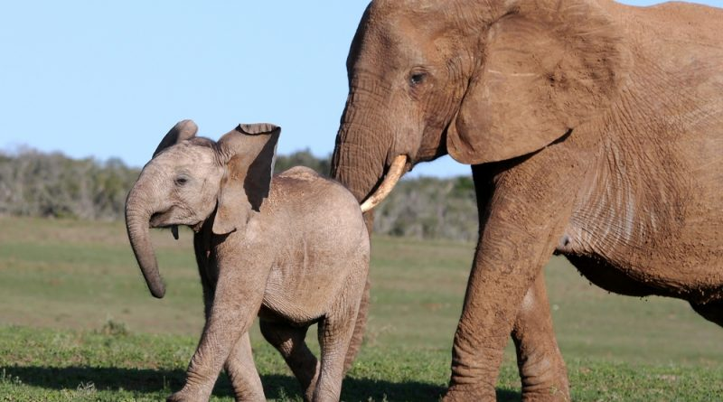
What is Nudge Theory?

Slide 3
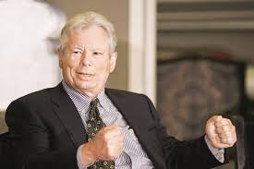
What is Nudge Theory?
A concept of :
behavioral Science & Psychology
Political Theory
Marketing Sales
Won – Nobel Prize Economics 2017 Richard Thaler
SIMPLE TERMS – A PUSH
Considers How People Make decision and how others impact them

Slide 4

Relevance in today’s SCIENTIFIC world…IS IT?
Humans are most rational when making purchase decisions
Like comparing products, their price, features, offers etc…
Searching for most economic benefit
But we aren’t rational, but just because we are nudged
How? Promotion,Price,Place

Slide 5
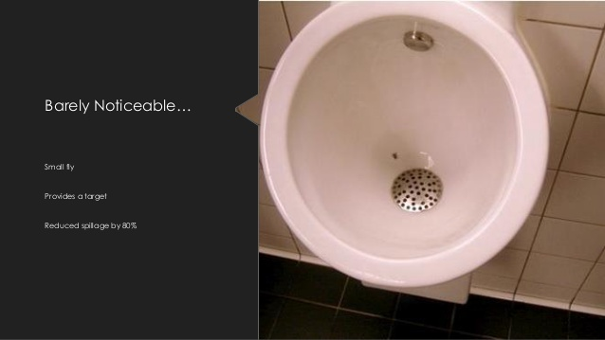
Famous Nudge Theory Examples- Amsterdam Schiphol AIRPORT

Slide 6
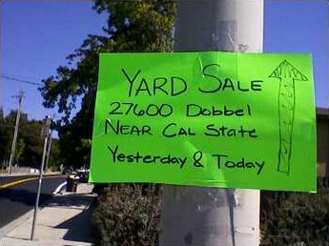

Famous Nudge Theory Examples @NUS Singapore

Slide 7
Nudge Theory Way Forward
Can be used for favorable actions without drastic intervention or penal action or outright bans in public policy
Thaler and Sunstein in their book Nudge: Improving Decisions about Health, Wealth and Happiness has put it, “Putting fruit at eye level counts as nudge. Banning junk food does not.”
Nudge Units @ UK, Germany, OECD, World Bank, UN

Slide 8
Nudge Theory – Future of Tech world..?
Micro Targeting – Pattern Recognition, Behavioral Clustering, Social Graphing, Predictive Analytics using Nudge Theory in real world for marketing
Eg: Mobile Operator Customer Data:
Recharge Behavior, Mobile Usage, Spend per day, Network Activity
IOT Nudging “Nudge Theory” – Google Home, Amazon Echo, Smart Watches

Slide 9
Why Should I care?
Inertia, lack of knowledge, or poor incentives lead us to select sub-optimal choices
Good Nudges: Automatic enrolment of employees into pension schemes in the UK and the opt-out system for organ donation in Spain
Better public healthcare, civic sense and social harmony.

