Slide 1


ACCESSIBLE AND AFFORDABLE
SERVICES

Slide 2

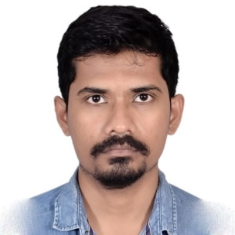
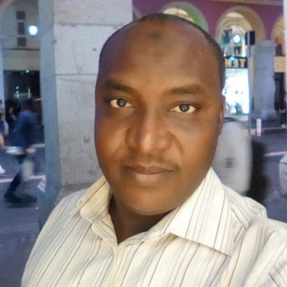


Team
Gabriel Moraes
CEO
Cyril Naves
COO
Mustapha Abdul Kadir
CFO
Cristian Grigoriu
CTO
Company’s strategy development
Ensure the overall growth
Establishing policies that promote company’s philosophy and vision
Financial planning
Risk management
Investment strategies
Consolidate the platform
Exploit and integrate new technologies

Slide 3
Problem
High prices
Find trusted contractors
Language constrains
Flexible work schedule

Slide 4
Advantages
MyTask is unique in its offering with personalized services offering expats and new comers into a neighborhood hunting for services.
Best Price point, online bargain, assured quality services, verified by the company and guaranteed delivery of service.
Solution also offers a job portal for quick cash for unorganized/organized work force in the city offering an employment opportunity.
“Language Offering”—Unicorn in the market with potential to compete with google translate services when offering services in their own language, customizing according to their culture as well as traditional tastes which they carry to a foreign land.
“Serendipity”-Potential to offer as a brand ambassador for a city enticing the customers by offering quality services at best possible satisfaction

Slide 5
Solution
To design a web as well as an app to service the clients and contractors for their mutual business needs as well as the common people.
Ensuring a market place for services where people post their needs, their offering a well as get employed for an offering
Sandwich the service offered online by ensuring the language support, customize the service, bargain at the best possible rate.
Reliability of the service, quality of the service and guarantee of the service post fulfillment, ensuring traction and establishing the brand in the market which will be the early components of the operation design

Slide 6
Product
A mobile as well as a web app for clients, customers, consultants as well as businesses to post their needs and get it fulfilled.
Not so simple as it seems but a quick check! ---Registration, verification via social media to ensure authenticity of person.
Add a Task, Quote the description, Price, Location, time
MyTask Team ensures the details are perfect and handles them with care along with the automated workflow for the contractors, freelancers to attract the best possible fit.
Then the legal team ensures the agreements are aligned with the parties i.e clients and contractors and follows them until the successful delivery.
A Bonus delivery acting as a job board for individuals, students fulfilling their monetary as well as attracting talent from a wide pool of MyTask customers.

Slide 7
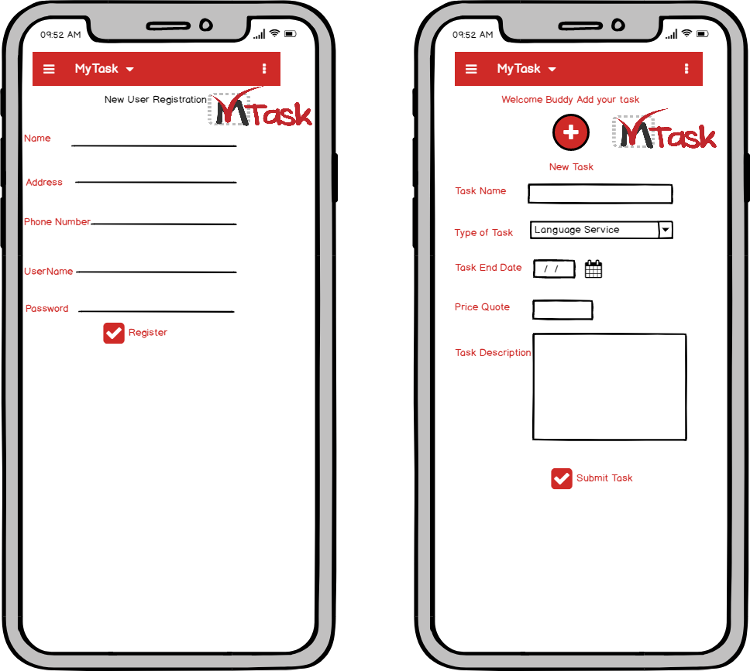
Wire Frame of MyTask App

Slide 8
Target Market
Contractors:
Young specialist
Students
Entrepreneurs
Clients:
Foreign people
Individuals

Slide 9
Traction
We will retain our clients by ensuring
Quality of service
Punctuality
Recommendations
Offers
Brand Establishment

Slide 10
Competitors
leboncoin.com: A platform for sellers to advertise their products and services
expertforexpat.com: A platform that provide advise for people moving to a new country
clacdesdoigts.com: platform where people request for delivery of something

Slide 11
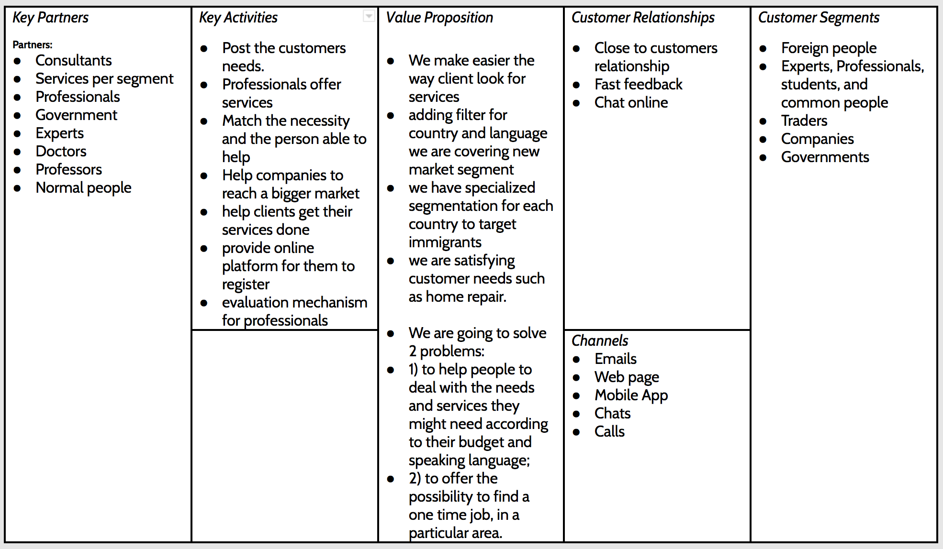
Business Model

Slide 12
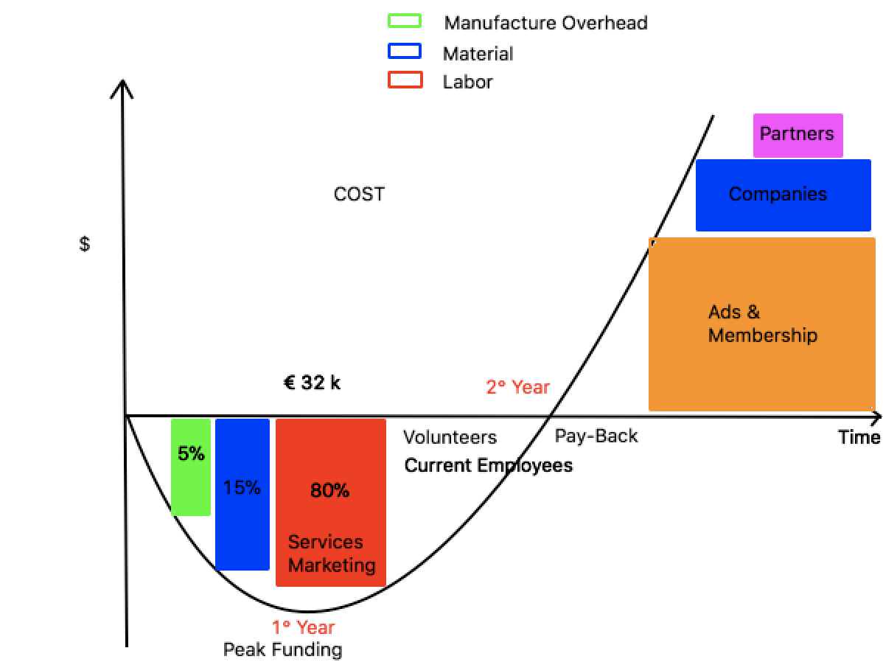
Investing

Slide 13
Contact
innovunicem1@gmail.com
+33 767429793
Our mission is to make services accessible and affordable for most of the people!

