Slide 1
QUANTUM MECHANICS HAZARD and SUPERPOSITION

Slide 2
QUANTUM MECHANICS IS CUNTERINTUITIVE
Qantum mechanics deals with the behaviour of objects so small that we humans are NOT equipped
to visualize them at all
Atoms are frequently used as objects of study (10⁻¹⁰ m = 1 angström)
Our sensory organs are simply not built to perceive the motion of an atom or electron. The best we can do
is to try to understand atoms and their motion as mathematical abstractions
)

Slide 3
QUANTUM ABSTRACTIONS
Different abstractions:
Quantum abstractions are fundamentally different from classical ones.
Operators, states and values
States are represented by different mathematical objects from its classical counterpart
States and measurements:
In the classical world, the labels that describe the state (position and momentum of a particle, for example) are the same labels that characterize measurements of that state.
In the quantum world, this is not true. States and measurements are different things.

Slide 4
SPINS AND QUBITS
Particle have properties in addition to their location in space or momentum.
For example, they may or may not have electric charge or mass. An electron is not the same as a quark or a neutrino.
But even a particule like an electron is not completely specified by its location. Attached to the electron is an extra degree of freedom called its spin (kind of little arrow that points in some direction discovered by Samuel Goudsmit and George Uhlenbeck in 1925 and Pauli)
The quantum spin is an example of the general class of simple systems we call qubits (quantum bits) that play the same role in the quantum world as logical bits play for the state of your computer.
Qubit = superposition of two basics states |0> and |1>

Slide 5
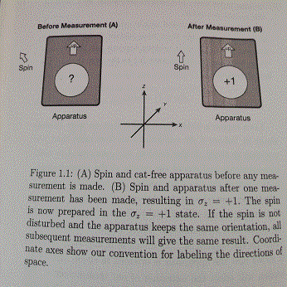
AN EXPERIMENT
We take a « degree of freedom » called σ that can take on two values,
namely σ =+1 and σ= -1
The experiment involves an apparatus A which interacts with the system (the spin) and records the value of σ
The apparatus prepares the spin in one of the two states and subsequent experiments confirm that state.

Slide 6
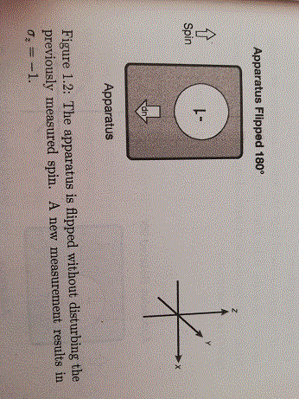
AN EXPERIMENT (2)
After preparing the spin by measuring it with A, we turn the apparatus upside down and then measure σ again.
We find that if we orginally prepared σ=+1, the apparatus records σ=-1 and vice versa
Can we conclude that σ is a degree of freedom that is associated with a sense of direction in space?

Slide 7
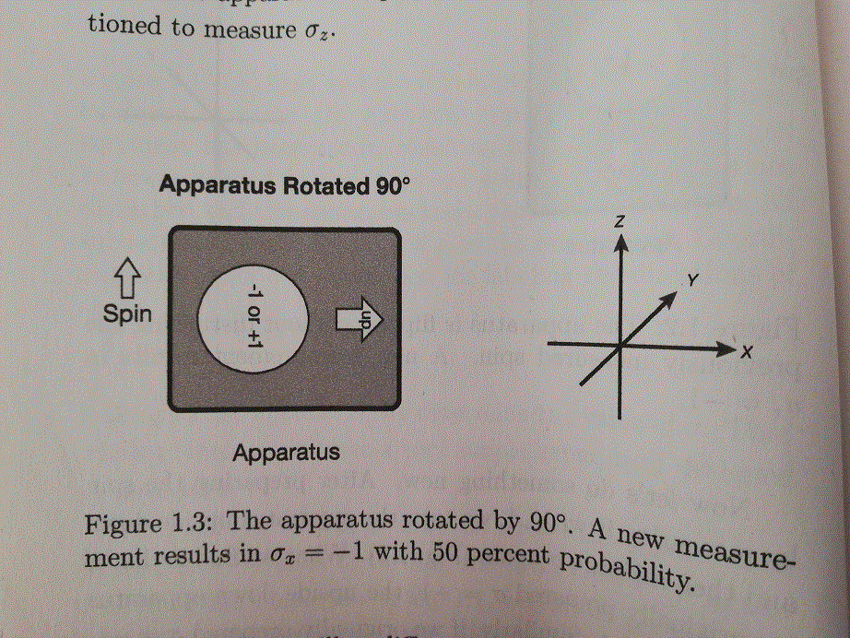
AN EXPERIMENT (3)
If we are convinced that the spin is a vector, we would naturally describe it by three components σ_{x}, σ_{y} and σ_{z}
We rotate the apparatus through an arbitrary angle, say π/2 , along the x-axis and then make a measurement of the x component of σ = σ_{x}
Instead og giving σ_{x}=0 the apparatus gives either σ_{x}=+1 or σ_{x}=-1
Suppose we repeat the operation many times
Prepare σ_{z}=+1
Rotate the apparatus along the x-axis
Measure σ_{x}
=> We will find the number of +1 equals to number of -1.

Slide 8
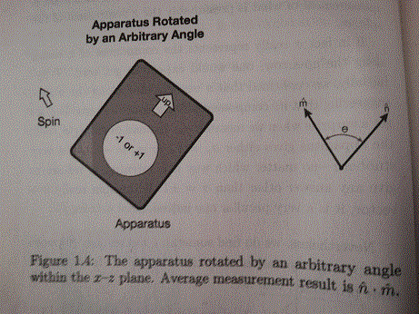
Statistical average of QUANTUM QUANTITY
More generally, prepare a spin so that the apparatus reads +1 in a m direction.
Then without disturbing the spin, rotate the apparatus to the direction n
Then the average will be n.m (vectors)
The quantum mechanical notation for the statistical average of a quantity Q is Dirac’s bracket notation <Q>
< σ > = n.m

Slide 9
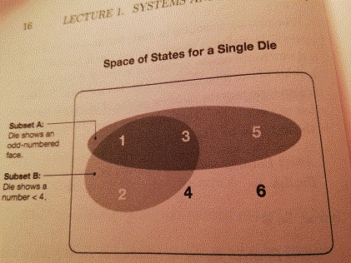
CLASSICAL LOGIC
Subset A represents the proposition « the die show an odd-numbered face »
Subset B represents the proposition « the die shows a number < 4
(A OR B) = (B OR A)
A: the z component of the spin is +1
B: the x component of the spin is +1
(A or B) the order of operations does not change the result.
Suppose σ_{z}=+1 then σ_{x}=+1 or σ_{x}=-1 and the proposition is true in each case.
That’s exactly the same if we start by observing σ_{x}
σ_{x}

Slide 10
QUANTUM LOGIC
A: the z component of the spin is +1
B: the x component of the spin is +1
We prepare the spin as σ_{z}=+1 then σ_{x}=+1 or σ_{x}=-1 and the proposition (A or B) remains true in each case.
Now suppose we start by observing σ_{x.} (B or A)
As the spin has been prepared along the z-axis there will be 50% of probability σ_{x}=+1 or σ_{x}=-1 (measure B)
If σ_{x}=+1 the proposition remains true
But if σ_{x}=-1 then there is 50% of σ_{z}=+1 or σ_{z}=-1
So there will be in total 25% probability for that that proposition to be false
(A or B) NOT EQUAL to (B or A)
This is due to the fact that observing the state in the x-direction HAS CHANGED the state of the spin (it is along the x-axis now and no more along the z-axis).

Slide 11
VECTOR SPACE
The vector space we use to define quantum mechanical states are called Hilbert spaces
= space of states (with finite or infinite dimensions)
This space is composed of elements |A> called ket-vectors or just kets.
The sum of any two ket-vectors is also a ket-vector |A> + |B> = |C>
Vector addition is commutative |A> + |B> = |B> + |A>
Vector addition is associative
There is a 0 vector when you add it to any ket it gives the same ket back |A> + 0 = |A>
Given any ket |A> and any complex number z, you can multiply them z|A> = |zA> = |B>
The distributive property holds z(|A> + |B> ) = z(|A> + z|B>
=> linearity
Same as ordinary 3-vectors except one thing: these can only be multiplied by real numbers and multiplication by complex numbers is not defined

Slide 12



STATES AS COLUMN VECTORS
A ket vector may be represented by stacking up a pair of complex numbers α₁ et α₂
And identifying this « stack » with the ket vector |A>
The complex numbers alpha are the components of |A>

Slide 13
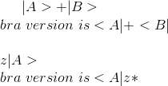
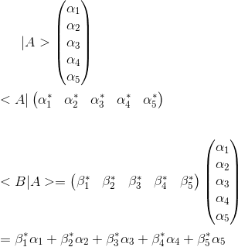
Ket VECTORS
In the same way that complex numbers have a dual version in the form of complex conjugate numbers
The vector space has a dual version that is essentially the complex conjugate vector space.
For every ket-vector |A> there is « bra » vector in the dual space, denoted by <A|

Slide 14

ORTHONORMAL BASIS
Using the inner product, we can define some concepts that are familiar from ordinary 3-vectors
Normalized vector: a vector is said to be normalized if its inner product with itself is 1.
<A|A> =1
Orthogonal vectors: two vectors are said to be orthogonal if their inner product os zero.
|A> and |B> are orthorgonal if
<B|A> = 0
Orthonormal Bases: Begin with any normalized vector and then look for a second one, orthogonal to the first. If you find one, then the space is at least two-dimensional. Then look for a third, a fourth, etc. The maximum number of orthogonal vectors is the dimension of space.
Lets consider an N-dimensional space and a particular othonormal basis of ket vectors |i> (i runs from 1 to N)
The alpha i are called the components of the vector

Slide 15

SPIN STATES
Let’s try to represent spin states using state-vectors.
If A is oriented along the z axis, the two possible states that can be prepared correspond to σ_{z}=+1 or -1. Let’s call them up and down and denote them by |u> and |d>.
When the apparatus is oriented along the z axis and registers +1, the state |u> has been prepared.
On the other hand, if the apparatus is oriented along the x axis and registers -1, the state |l> had been prepared. We call it left
If A is along the y axis, it can prepare the states |i> and |o>
All possible states of the spin can be represented in a two dimensional vector space, and we choose arbitrarily |u> and |d> as the two basis vector

Slide 16
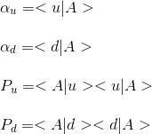

MEASUREMENT PROBALITIES
|A> represent any state of the spin, prepared in any manner.
The components α_{u} and α_{d} are complex numbers
By themselves they have no experimental meaning, but their magnitude do.
Given that the spin has been prepared in the state |A>, and that the apparatus is oriented along z, the quantity P_{u}= α*_{u} α_{u} is the probability that the spin would be measured as σ_{z}=+1
Likewise, P_{d =} α*_{d} α_{d} is the probability that the spin would be measured as σ_{z}=-1
For total probabilities to come out =1
The vector |A> is normalized to a unit vector and this is a very general principle to all quantum systems: the state of a system is represented by a unit (normalized) vector in a vector space of states

Slide 17
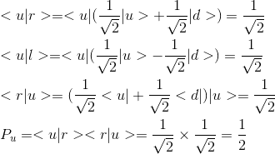
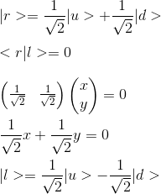
SPIN STATE ALONG x-AXIS
We can represent any spin state as a linear combination of the basis vectors |u> and |d>
Lets try it with |d> and |l>, which represent spins prepared along the x-axis.
If A initially prepares |r>, and is then rotated to to measure σ_{z} there will be equal probabilities for up and down.
Also α*_{u} α_{u +} α*_{d} α_{d} = 1
|u> and |r> are not orthogonal (different from 3-vectors)
We can now calculate the probability to measure |u> when starting from state |r>

Slide 18
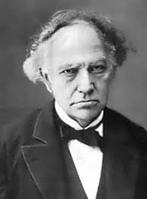
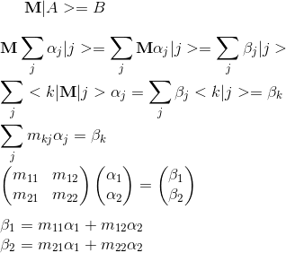
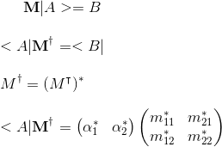
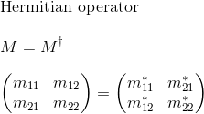

OBSERVABLES AS LINEAR HERMITIAN OPERATORS
States in quantum mechanics are mathematically described as vector in vector space.
Physical observables – the thing that you can measure – are described by linear operators.
We can make direct measurements of the coordinates of a particle; the energy, momentum of a system.
In our case, σ_{z} or σ_{x} would be each an observable and they are represented by linear operators.
Operator must be Hermitian operators (after the french mathematician Charles Hermite), which act on state-vector, such |A>
Charles Hermite
1822 - 1901

Slide 19
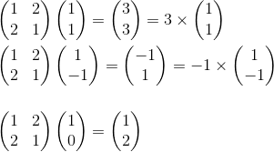
EIGEN VECTORS AND EIGEN VALUES
In general, when a linear operator acts on a vector, it will change the direction of the vector.
But for a particular linear operator, there will be certain vector whose directions are the same when they come out as they were when they went in.
These special vectors are called eigenvectors.
The definition of an eigenvector of M is a vector |λ> such as M|λ> = λ |λ>
The constants that multpily the eigenvectors are called eigenvalues.
In general eigenvalues are complex numbers

Slide 20
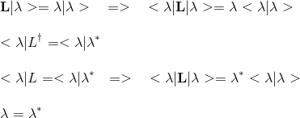
REAL EIGEN VALUES
In general, eigenvalues are complex numbers.
But they are real in case of Hermitian operators
In other words, λ (an therefore any eigenvalue of a Hermitian operator) must be real

Slide 21
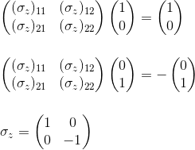
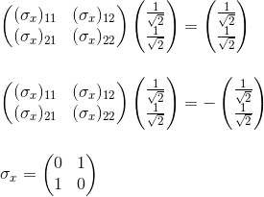
SPIN OPERATORS
Let’s try to construct operators to represent components of spin σ_{x ,} σ_{y} and σ_{z}
The eigenvectors of are |u> and |d> and the corresponding eigenvalues are +1 and -1.

Slide 22
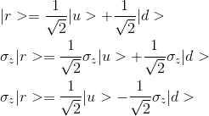
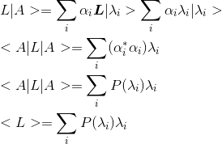
EXPECTATION VALUE
Common misconception: the state resulting from applying σ_{z} to |r> is definitely NOT the state that would result from a measurement of σ_{z.}
That measurement result would be either +1 or -1, leaving the system in state |u> or |d>. Neither of these results would leave the system state-vector in the superpositions below
Rule to compute averages on a observable: just
sandwich the observable between the bra and ket representations of the state-vector

Slide 23
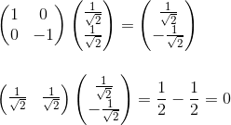
EXPECTATION VALUE with SPIN

Slide 24
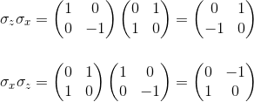
UNCERTAINTY
Uncertainty is one of the hallmarks of quantum mechanics.
Can any pair of spin components by simultaneous mesured?
Only if they commute.
Given two operators or matrices, the combination LM – ML is called the commutator of L with M, and is denoted by a special symbol
LM – ML = [L,M] (=0 only if they commute)
It is easy to see that σ_{x} and σ_{y} don’t commute

Slide 25
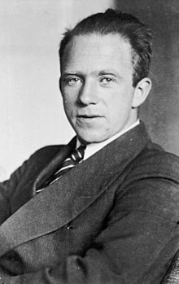

HEISENBERG Uncertainty principle
Uncertainty is one of the hallmarks of quantum mechanics.
The iconic example of this mutual uncertainty is the Heisenberg Uncertainty Principle, which in its original form had to do with the position and momentum of a particle
[X,P] = ih/2π
∆X∆P≥h/4π
Puts a quantitative limite on the simultaneous uncertainties
of the two observables
Werner Heisenberg
(1901-1976)
Nobel Prize 1932

Slide 26
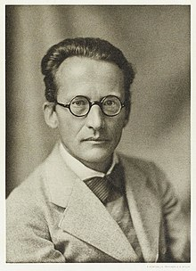

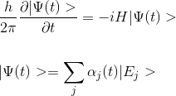

SCHRÖDINGER EQUATION TIME AND CHANGE
Because the Hamiltonian operator H represents the energy, the observable values of energy are just the eigenvalues of H
H|E_{j}> = E_{j}|E_{j}>
The Schrödinger equation is deterministic!
Erwin Schrödinger
1887 – 1961
Nobel Prize 1933 shared with Paul Dirac

Slide 27
COLLAPSE
The Schrödinger equation is deterministic!
Describes how the state-vector evloves between the time that a system is prepared in a given state and the time that is brought into contact with an apparatus and measured.
Between observations, the state of a system evolves in a perfectly definite way, accortding to the time-dependant Schrödinger equation.
If the state-vector were main focus of observational physics, we would say that quantum mechanics is deterministic.
Even if we know the state-vector exactly, we don’t know the result of any given measurement.
An experiment to measure L will have an unpredictable outcome, but after the measurement is made, the system is left in an eigenstate of L. Which eigenstate? The one corresponding to the outcome of the measurement. During an experiment the state of a system jumps unpredictable to an eigenstate of the observable that was measured.
This is called the collapse of the wave function

Slide 28
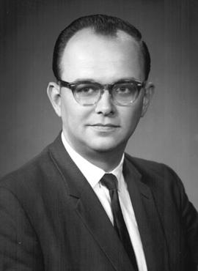
MULTIPLE UNIVERSE
“He was smart in a very broad way. I mean, to go from chemical engineering to mathematics to physics and spending most of the time buried in a science fiction book, I mean, this is talent.”
The wave function does not collapse but gives a different eigenvalue with a corresponding eigenvector in a distinct universe
Hugh Everett III's many-worlds interpretation (MWI) is one of several mainstream interpretations of quantum mechanics.
In brief, one aspect of quantum mechanics is that certain observations cannot be predicted absolutely. Instead, there is a range of possible observations, each with a different probability. According to the MWI, each of these possible observations corresponds to a different universe. Suppose a six-sided die is thrown and that the result of the throw corresponds to a quantum mechanics observable. All six possible ways the die can fall correspond to six different universes.
Hughes Everett III
1930 – 1952
Not yet Nobel Prize

Slide 29
WHAT IS CERTAIN
If a system is prepared in an eigen-vector of a observable, then we are
absolutely certain of the output of the observation: it will be the eigenvalue of the observable corresponding to this eigenvector
The behaviour of a state-vector is perfectly known between instants t0 and t1 (before observation)
The expectation value (statistical average) of the observation given any prepared state is also known in advance.

Slide 30
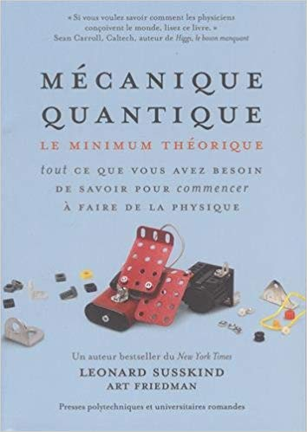
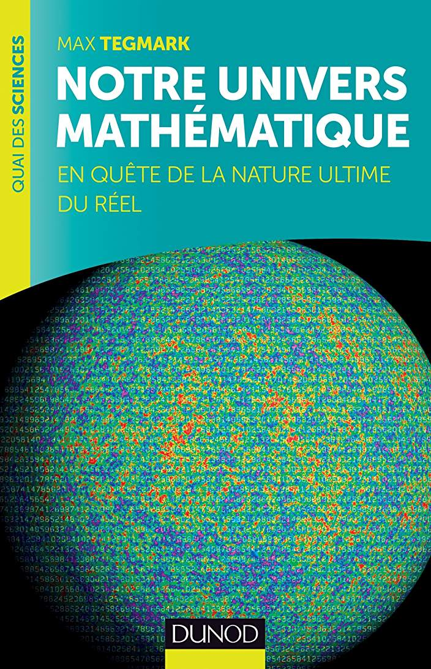
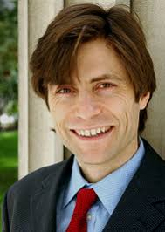

RESOURCES
Lecture 1 | Modern Physics: Quantum Mechanics (Stanford)
https://www.youtube.com/watch?v=2h1E3YJMKfA
Max Tegmark
https://space.mit.edu/home/tegmark/crazy.html
Leonard Susskind is widely regarded as one of the fathers of string theory

