Slide 1
OVERVIEW OF RSA Mathematics

Slide 2

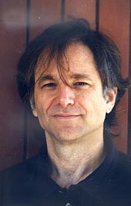

RSA algorithm
RSA algorithm is a public key encryption technique and is considered as the most secure way of encryption.
It was invented by Rivest, Shamir and Adleman in year 1978 (hence the name RSA algorithm)
In a public-key cryptosystem, the encryption key is public (known by everyone)
and distinct from the decryption key, which is kept secret (private) (asymetric cryptography algorithm)
)

Slide 3
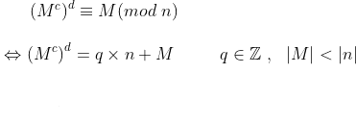
RSA PRINCIPLE
The basic principle behind RSA is the observation that it is possible to find three very large positive integers c,d and n such that:
or (M^{cd} –M) is a multiple of n
or M^{cd} and M have the same rest in the division by n
A famous example is in geometry: two angles are equal if their mesure in radians are congruent modulo 2 Pi: a = b [2Pi] ⬄ a = b + 2kPi k element of Z
Remark: this proposition can be written as well
où a. est l’ensemble des entiers congrus à a modulo n

Slide 4
MODULO OPERATION
Given two positive numbers a and n, a modulo (a mod n) is the remainder of the Euclidean division of a by n, where a is the dividend and n is the divisor.
a mod n = k => a = q x n + k
=> (a –k) = q (is a multiple of n)
Example: 14 mod 10 = 4 as 14 = 1 x 10 + 4
14 – 4 = (1 x 10) is a multiple of 10
a mod n = b mod n
(a –b) is a multiple of n
a and b have the same remainder when divided by n
14 mod 10 = 34 mod 10
(14 -34 ) = - 20 = -2 x 10 (multiple of 10)
14 / 10 = 34/10 = 4

Slide 5
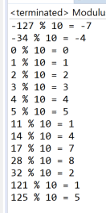
MODULUS OPERATOR in JAVA
In Java Modulus Operator is %
class ModulusOperator {
public static void main(String[] args) {
List<Integer> numbersToTest = Arrays.asList(-127, -34, 0, 1, 2, 3, 4, 5, 11, 14, 17, 28, 32, 121, 125);
int k = 10;
numbersToTest.stream().forEach(number -> System.out.println(number + " % " + k + " = " + number % k));
}
}

Slide 6
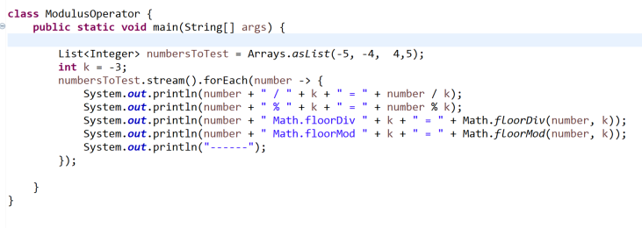
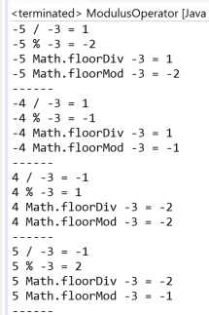
MODULUS OPERATOR in JAVA (2)
<li>If the signs of the arguments are the same, the results of
* {@code floorDiv} and the {@code /} operator are the same. <br>
* For example, {@code floorDiv(4, 3) == 1} and {@code (4 / 3) == 1}.</li>
* <li>If the signs of the arguments are different, the quotient is negative and
* {@code floorDiv} returns the integer less than or equal to the quotient
* and the {@code /} operator returns the integer closest to zero.<br>
* For example, {@code floorDiv(-4, 3) == -2},
* whereas {@code (-4 / 3) == -1}.
<li>If the signs of the arguments are the same, the results
of {@code floorMod} and the {@code %} operator are the same. <br>
The relationship between {@code floorDiv} and {@code floorMod} is such that:
<ul>
<li>x % y == x - (x /y) * y) }
<li>floorMod(x, y) == x - (floorDiv(x, y) * y)
</ul>

Slide 7
RSA Algorithm steps
The RSA algorithm involves four steps
Key generation
Key distribution
Encryption
Decryption

Slide 8
KEY GENERATION JAVA(1)
public class GenerationClesRSA {
/**
* Méthode principale.
* @param args[0] nom du fichier dans lequel sauvegarder la clé privée
* @param args[1] nom du fichier dans lequel sauvegarder la clé publique
*/
public static void main(String[] args) {
// Vérification des arguments
if(args.length != 2) {
System.err.println("Utilisation :");
System.err.println(" java GenerationClesRSA privee publique");
System.err.println(" où :");
System.err.println(" - privee : nom du fichier qui contiendra la clé privée");
System.err.println(" - publique : nom du fichier qui contiendra la clé publique");
System.exit(-1);
}
// Création d'un générateur RSA
KeyPairGenerator generateurCles = null;
try {
generateurCles = KeyPairGenerator.getInstance("RSA");
// the strength parameter may be any length from 512 to 4096. The default key size is 1024 bits.
generateurCles.initialize(2048);
} catch(NoSuchAlgorithmException e) {
System.err.println("Erreur lors de l'initialisation du générateur de clés : " + e);
System.exit(-1);
}
// Génération de la paire de clés
KeyPair paireCles = generateurCles.generateKeyPair();
// Sauvegarde de la clé privée
GestionClesRSA.sauvegardeClePrivee(paireCles.getPrivate(), args[0]);
// Sauvegarde de la clé publique
GestionClesRSA.sauvegardeClePublique(paireCles.getPublic(), args[1]);
System.out.println("Clés sauvegardées.");
}
}
import java.security.KeyPair;
import java.security.KeyPairGenerator;
import java.security.NoSuchAlgorithmException;

Slide 9
PRIVATE KEY GENERATION JAVA
/**
* Sauvegarde de la clé privée dans un fichier.
* @param clePublique la clé privée
* @param nomFichier le nom du fichier dans lequel sauvegarder la clé
*/
public static void sauvegardeClePrivee(PrivateKey clePrivee, String nomFichier) {
RSAPrivateKeySpec specification = null;
try {
KeyFactory usine = KeyFactory.getInstance("RSA");
specification = usine.getKeySpec(clePrivee, RSAPrivateKeySpec.class);
} catch(NoSuchAlgorithmException e) {
System.err.println("Algorithme RSA inconnu : " + e);
System.exit(-1);
} catch(InvalidKeySpecException e) {
System.err.println("Clé incorrecte : " + e);
System.exit(-1);
}
try {
ObjectOutputStream fichier = new ObjectOutputStream(new BufferedOutputStream(new FileOutputStream(nomFichier)));
fichier.writeObject(specification.getModulus());
fichier.writeObject(specification.getPrivateExponent());
fichier.close();
} catch(IOException e) {
System.err.println("Erreur lors de la sauvegarde de la clé : " + e);
System.exit(-1);
}
}

Slide 10
PUBLIC KEY GENERATION JAVA
public static void sauvegardeClePublique(PublicKey clePublique, String nomFichier) {
RSAPublicKeySpec specification = null;
try {
KeyFactory usine = KeyFactory.getInstance("RSA");
specification = usine.getKeySpec(clePublique, RSAPublicKeySpec.class);
} catch(NoSuchAlgorithmException e) {
System.err.println("RSA inconnu : " + e);
System.exit(-1);
} catch(InvalidKeySpecException e) {
System.err.println("Cle incorrecte : " + e);
System.exit(-1);
}
try {
ObjectOutputStream fichier = new ObjectOutputStream(new BufferedOutputStream(new FileOutputStream(nomFichier)));
fichier.writeObject(specification.getModulus());
fichier.writeObject(specification.getPublicExponent());
fichier.close();
} catch(IOException e) {
System.err.println("Erreur lors de la sauvegarde de la clé : " + e);
System.exit(-1);
}
}

Slide 11
KEY GENERATION (1)
Choose two distinct large prime numbers p and q
Compute n = p x q
Compute the Euler’s totient function φ(n)
The totient of a positive integer n is the number of positive integers smaller than n which are coprime to n (they share no factors except 1). It is often written as φ(n)
Exemple: φ(8)=4 because there are four numbers 1,3,5 and 7 which do not share any factors with 8.
By definition, for any prime number p, φ(p) = p-1
In our case, φ(n) = φ(p x q) = φ(p) x φ(q) = (p-1)(q-1) as p,q are prime numbers

Slide 12
KEY GENERATION (2)
Choose an integer c such that 1 < c < φ(n) and c is co-prime to φ(n) (share no factors other than 1)
Compute an integer d to satisfy c x d = 1 (mod φ(n))
Then public key is made of the modulus n and the public exponent c (often chosen to be 2^16+1 = 65537)
The private key is made of of the modulus n and the private exponent d which must be kept secret.
Remark: it is always possible to find d wich satisfies c x d = 1 (mod φ(n))
Bézout’s identity: let a and b be integers with greatest common divisor d. Then there exist integers x and y such that ax + by = d
In our case, as c has been chosen to be co-prime to φ(n), pgcd = 1 and so it is always possible to find two integers a, b such c x a + b x φ(n) = 1 => c x a = 1 (mod φ(n))

Slide 13
KEY GENERATION EXAMPLE
Choose two distinct large prime numbers p and q
p = 7, q = 11
Compute n = p x q
n = p x q = 7 x 11 = 77
Compute the Euler’s totient function φ(n)
φ(n) = (p – 1)x(q-1) = 6 x 10 = 60
Choose an integer c such that 1 < c < φ(n) and c is co-prime to φ(n)
for example c = 13, co-prime to 60
Compute an integer d to satisfy c x d = 1 (mod φ(n))
d x 13 = 1 + (k x60) => d=37 as 37 x 13 = (8 x60) + 1 = 481
The public key is (n=77, c=13) and the private key (n=77 , d=37)

Slide 14
KEY DISTRIBUTION
Suppose that Bob wants to send information to Alice via RSA
Bob must know Alice's public key to encrypt the message and Alice must use her private key to decrypt the message.
To enable Bob to send his encrypted messages, Alice transmits her public key (n, c) to Bob via a reliable, but not necessarily secret, route.
Alice's private key (d) is never distributed.

Slide 15
ENCRYPTION
After Bob obtains Alice's public key, he can send a message M to Alice.
He first turns M_{Bob} (plaintext) into an integer m_{Bob}.
The he computes the ciphertext m’_{bob}, using Alice’s public key c:
m’_{Bob} is the rest of the division of (m_{Bob} to power c) by n.
This operation is called a modular exponentiation

Slide 16
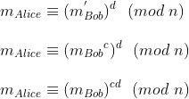
DECRYPTION
Can we show that:
Alice can recover m_{Bob} from m’_{Bob} by using her private key exponent d by computing

Slide 17
FERMAT’s LITTLE THEOREM (1640)
Fermat’s little theorem states that if
p is a prime number,
for any number a not divisible by p, we have:
Example:
a=2 p=7 2⁷⁻¹ = 2⁶ = 64 = 1+ (9 x7)
a=3 p=5 3⁵⁻¹ = 3⁴ = 81 = 1+ (13 x 5)
a=5 p=3 5³⁻¹ = 5² -1 = 25 = 1 + (8 x 3)

Slide 18
EULER’s THEOREM (1736)
Euler’s theorem generalizes Fermat’s little theorem and states that if
p is a prime number,
for any number a not divisible by p, we have:
with φ(p) the totient function exposed before (slide 5)
Example:
a=2 p=7 φ(7)=6 2⁶ = 64 = 1+ (9 x7)
a=3 p=8 φ(8)=4 3⁴ = 81 = 1+ (10 x 8)

Slide 19
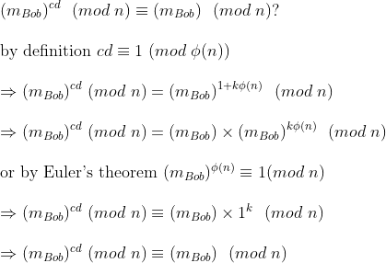
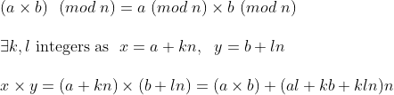
RSA PROOF
Going back to our RSA algorithm, we have to show that:
CQFD

Slide 20
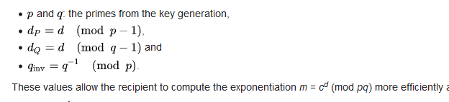
RSA OPTIMISATION WITH THE CHINESE Chinese remainder algorithm
For efficiency many popular crypto libraries (such as OpenSSL, Java and .NET) use the following optimization for decryption and signing based on the Chinese remainder theorem
Not only p,q need to be stored in the private key but also:
d_{P}, d_{Q}, q_{inv}

Slide 21
RSA SIGNATURE
RSA can be used to sign messages
Suppose Alice wishes to send a signed message to Bob.
She produces a hash value of the message, raises it to the power of d mod n (just like when decrypting a message), and attaches it as a "signature" to the message.
When Bob receives the signed message, he raises the signature to the power of c mod n (just like encrypting a message), and compares the resulting hash value with the message's actual hash value.
If the two agree, he knows that the author of the message was in possession of Alice's secret key, and that the message has not been tampered with since.

Slide 22
RSA PROBLEM
The RSA problem is defined as the task of taking eth roots modulo a composite n: recovering a value m such that c ≡ me (mod n), where (n, e) is an RSA public key and c is an RSA ciphertext.
Currently the most promising approach to solving the RSA problem is to factor the modulus n.. To accomplish this, an attacker factors n into p and q, and computes φ(n) = (p − 1) x (q − 1) that allows the determination of d from c.
No polynomial-time method for factoring large integers on a classical computer has yet been found, but it has not been proven that none exists.*
As of 2020, the largest publicly known factored RSA number was 829 bits (250 decimal digits, RSA-250). Its factorization, by a state-of-the-art distributed implementation, took approximately 2700 CPU years.
It is generally presumed that RSA is secure if n is sufficiently large, outside of quantum computing.

Slide 23
HOW TO GENERATE PRIME NUMBERS? FERMAT PRIMALITY TEST
Fermat's little theorem states that if p is prime and a is not divisible by p, then
If one wants to test whether p is prime, then we can pick random integers a not divisible by p and see whether the equality holds.
If the equality does not hold for a value of a, then p is composite (with certainty).
But the opposite is NOT true: if we find many a for which the equality is true, it does not mean that p is prime.
In particular, there are infinitely many Carmichael numbers n, for which all values of a which are coprime to n will satisfy the Fermat test. (those are called Fermat liars)

Slide 24
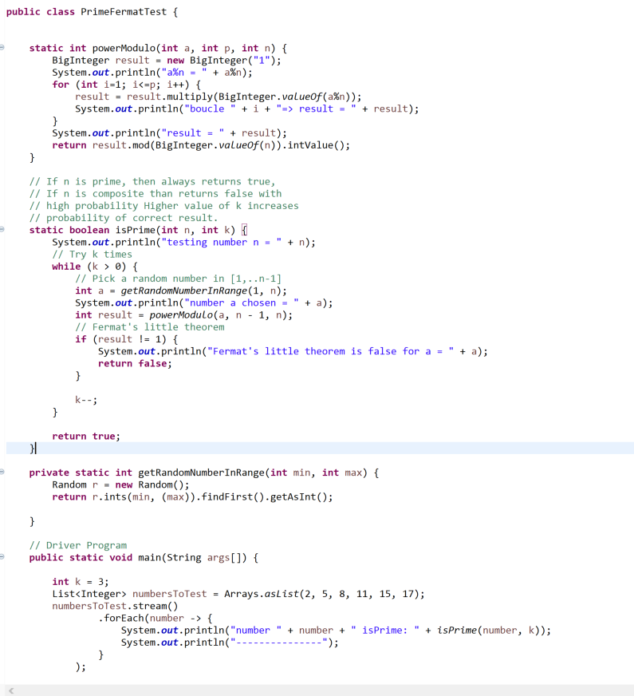
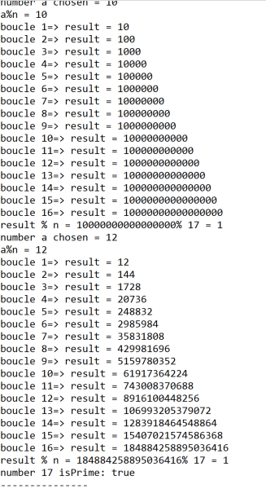
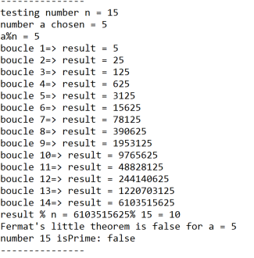
FERMAT PRIMALITY TEST (JAVA)
(axb) (mod n) = [a (mod n) x (b mod n)] (mod n)

Slide 25
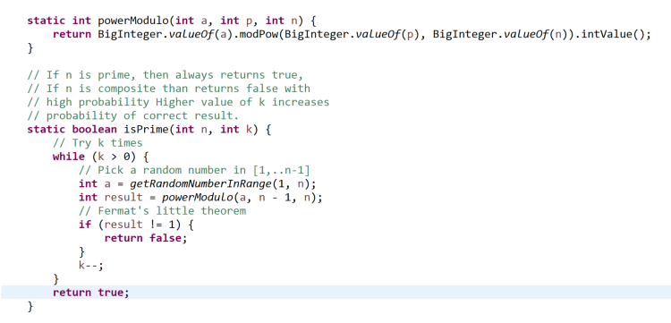
FERMAT PRIMALITY TEST (JAVA)
Use public BigInteger modPow(BigInteger exponent, BigInteger m) {

Slide 26
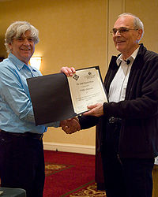
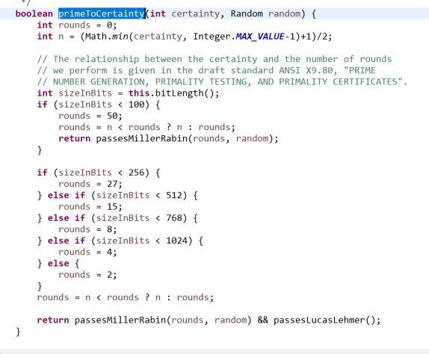
HOW JAVA GENERATES PRIME NUMBERS
The Miller–Rabin primality test or Rabin–Miller primality test is a probabilistic primality test: an algorithm which determines whether a given number is likely to be prime. Miller discovered it in 1976 (Alan Turing price winner)
https://dl.acm.org/doi/10.1145/800116.803773

Slide 27
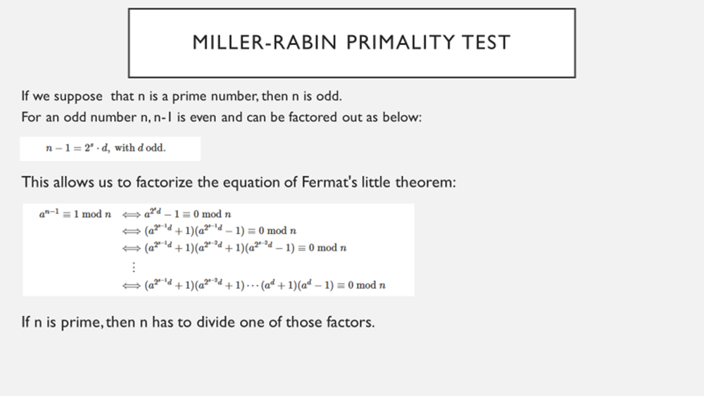
HOW JAVA GENERATES PRIME NUMBERS
The Miller–Rabin primality test or Rabin–Miller primality test is a probabilistic primality test: an algorithm which determines whether a given number is likely to be prime. Miller discovered it in 1976 (Alan Turing price winner)

Slide 28
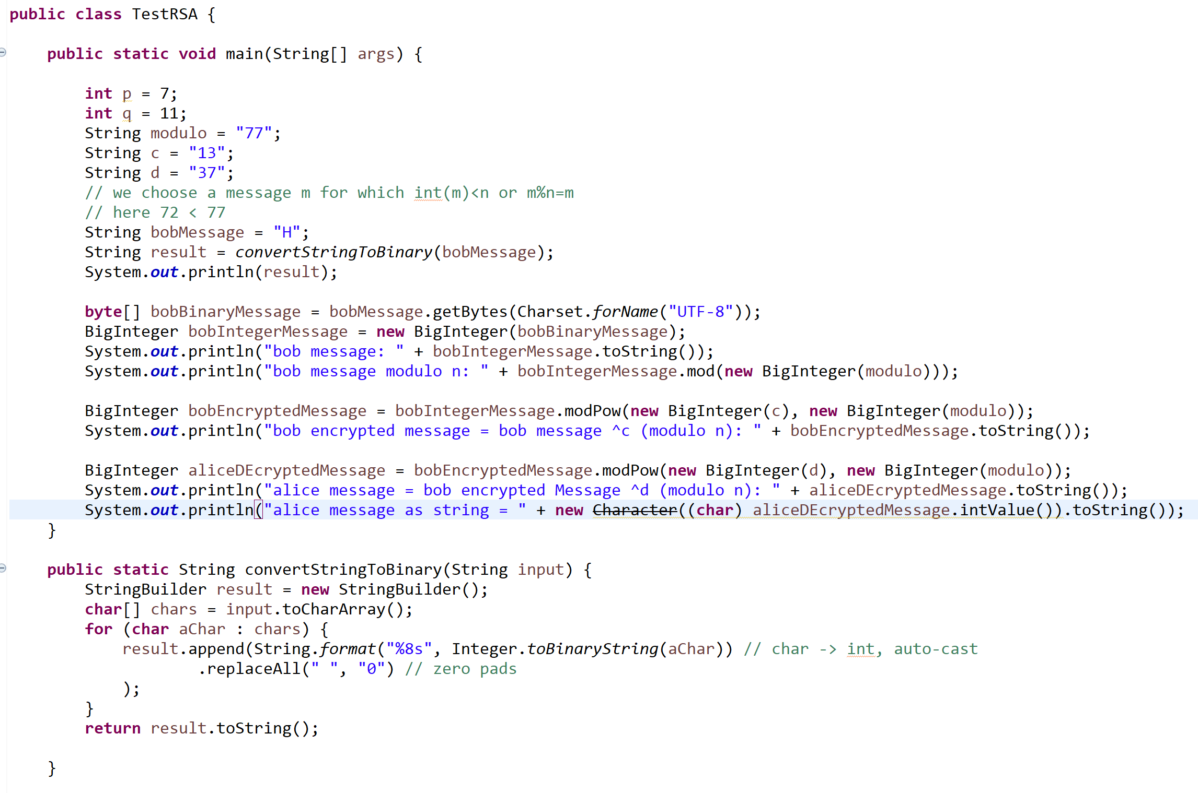
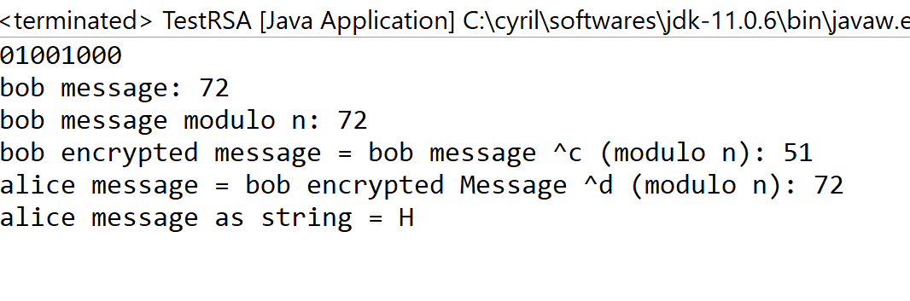
TEST RSA (JAVA)
Let’s write a small java program to show the RSA algorithm effectiveness

Slide 29
THANK YOU

