Slide 1





RTL to GDSII Flow
Activity Based Learning
Session Speaker:
Dr. Cyril Prasanna Raj P.
Professor – Cambridge Institute of Technology
Director – Cambrian Consultancy Center and Industrial Research
cyril@cambridg.edu.in, cyrilyahoo@gmail.com

Slide 2
STEP 1
Foundry Selection

Slide 3

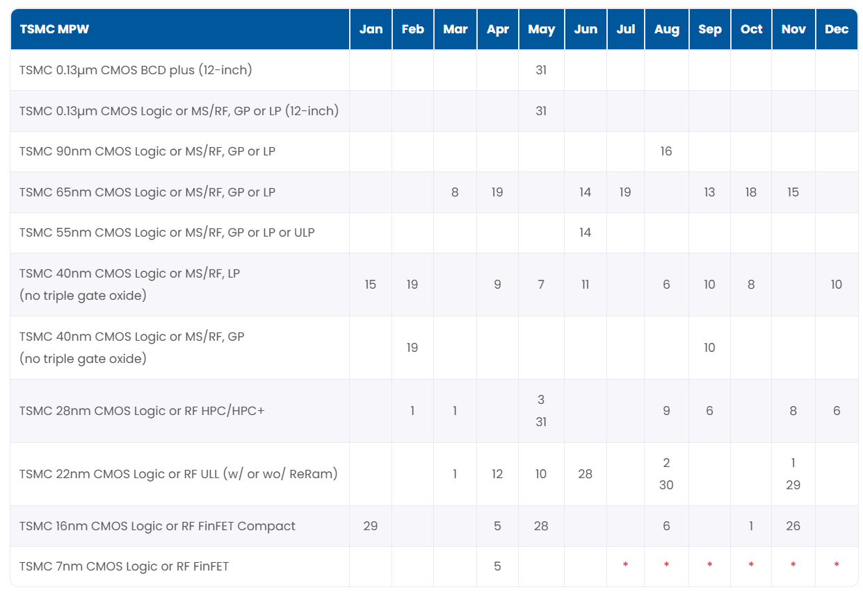
Run Schedule – Euro practice

Slide 4
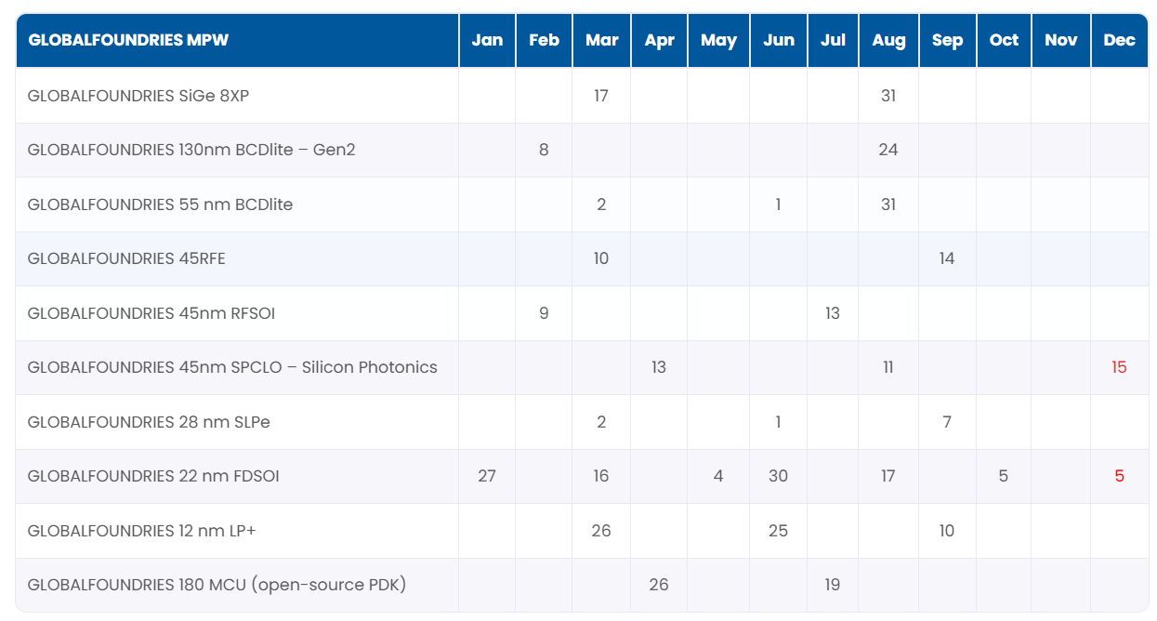
Run Schedule – Euro practice

Slide 5
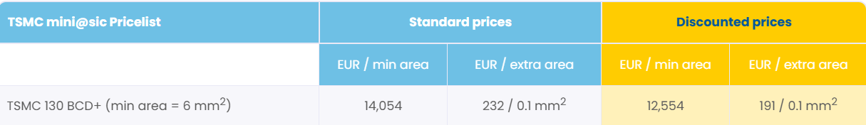
Time Line & Estimated Cost
Total estimated cost: 50-60 Lakhs

Slide 6
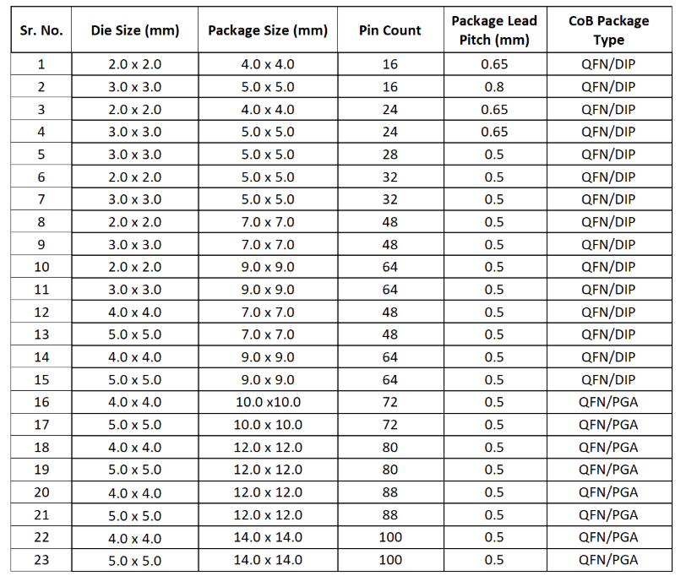
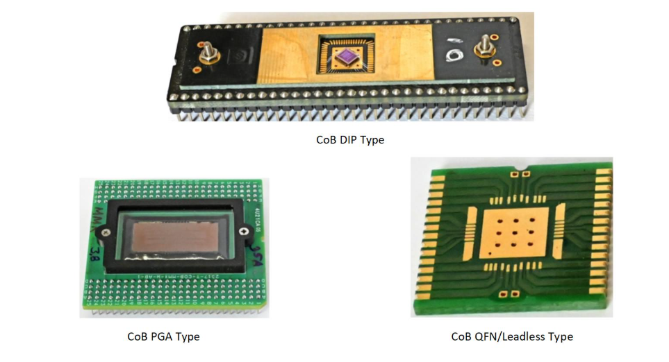
SCL Foundry

Slide 7
Chip Area Selection
20 mm x 20 mm

Slide 8
STEP 2
Import Standard Cell Library
& Technology Files

Slide 9
VLSI DESIGN PROCESS
Design Institute
Book Slots
FOUNDRY
Get Libraries
Physical libraries
  Standard Cell
  IO
Memory Libraries
    RAM / ROM
Special Libraries
  Analog components
    PLL
  Macros
IP Libraries
  DesignWare
Logical Libraries
  Contains logic synthesis relevant information such as area, timing, power, functionality of
    Standard Cells
    IOs
Simulation Libraries
  Contains timing and functional information for post synthesis simulation in different formats such as
    VITAL
    Verilog Model
Symbol Libraries
  Used to view the schematics of generated netlists

Slide 10
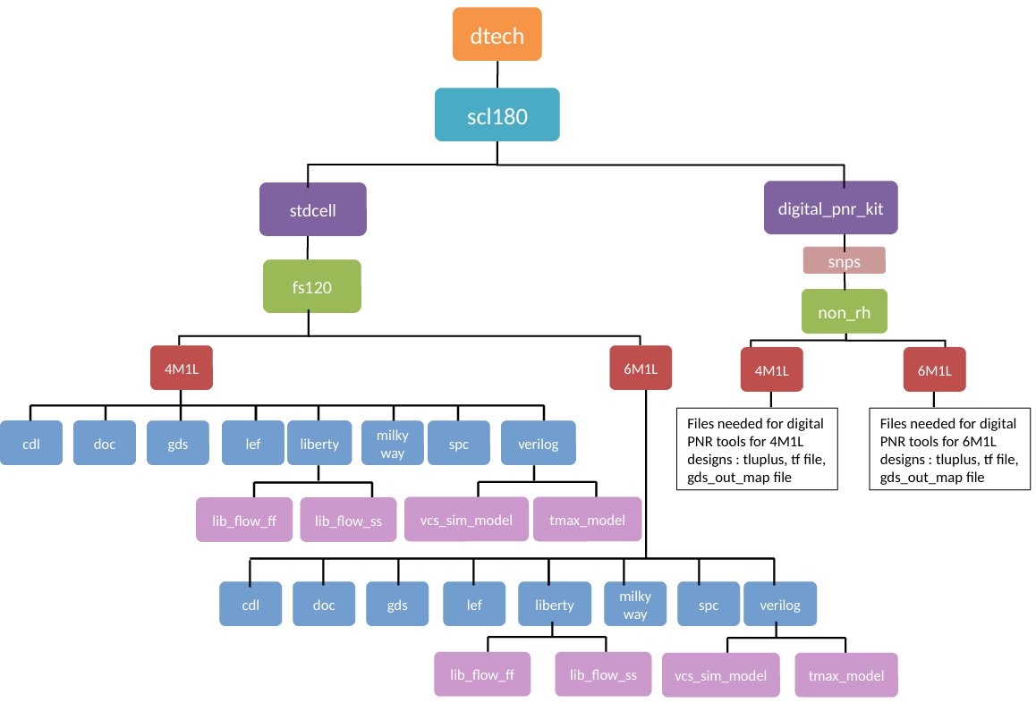
Standard cell library structure

Slide 11
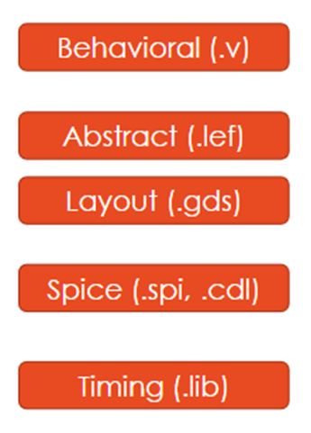
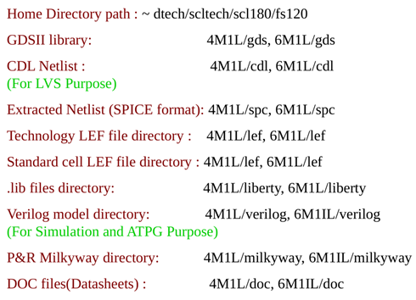
What is Library? FS120 libraries
What files are in a standard cell library
Behavioral Views:
Verilog (or Vital) description used for simulation, logic equivalence.
Physical Views:
Layout of the cells (GDSII format) for DRC, LVS, Custom Layout.
Abstract of the cells (LEF format) for P&R, RC extraction.
Transistor Level:
Spice/ Spectre netlist for LVS, transistor-level simulation
Often provided both with parasitics (post-layout) and without.
Timing/Power:
Liberty files with characterization of timing and power for STA
Power Grid Views:
Needed for IR Drop analysis

Slide 12
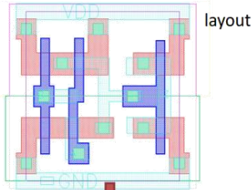
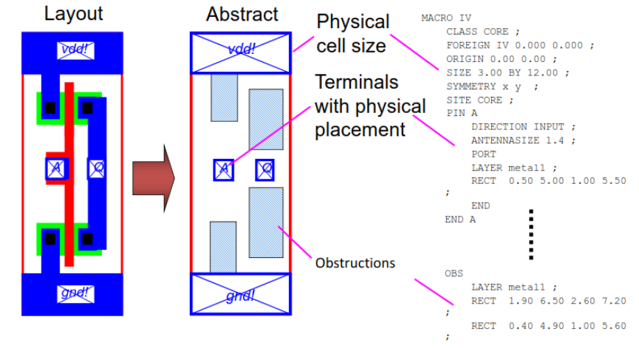
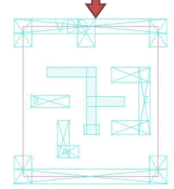
Library Exchange Format (LEF)
Abstract description of the layout for P&R
Readable ASCII Format.
Contains detailed PIN information for connecting.
Does not include front - end of the line (poly, diffusion, etc.) data.
Contains blockages for DRC.

Slide 13
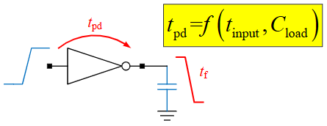
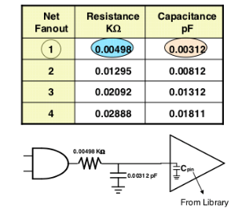
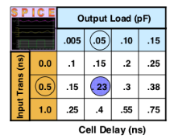
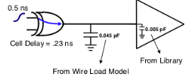
Liberty Timing Models (.lib)
Timing data of standard cells is provided in the Liberty format.
Wire Load Models estimate the parasitics based on the fanout of a net
Non-Linear Delay Model (NLDM)

Slide 14
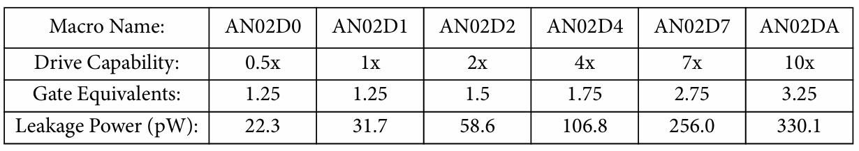
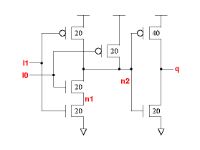
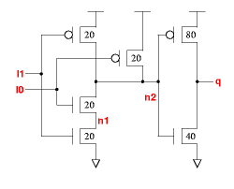
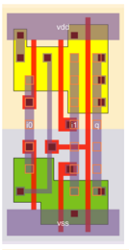
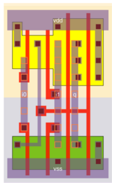
FS120 standard cells
2-Input AND Gate
AN02D1 – 1X
AN02D1 – 2X

Slide 15
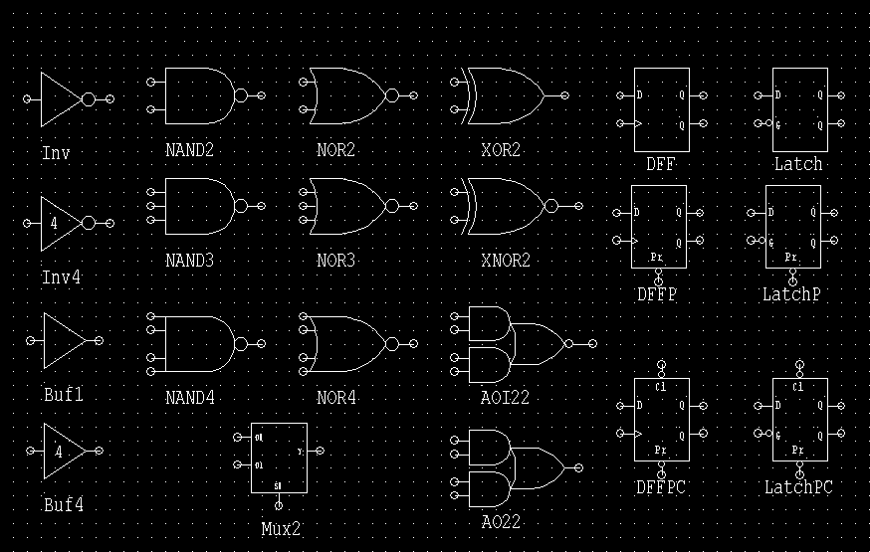
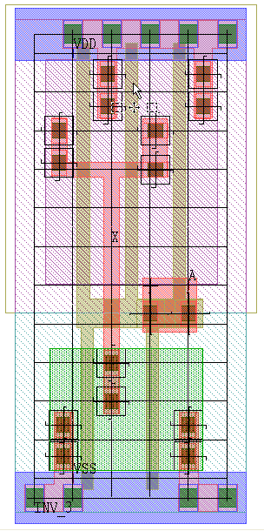
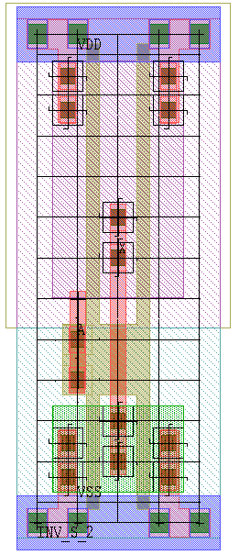
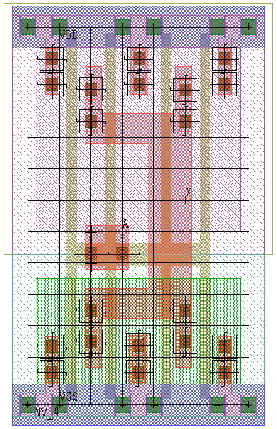
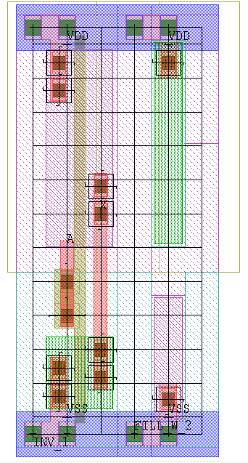
STANDARD CELLS
Standard Cells
INV
NAND
NOR
XOR
AND
OR
AOI
OAI
MUX
BUFFER
FLIP FLOP
HALF ADDER
FULL ADDER
VDD
OUT
IN
VSS
Standard Cell Library Modules

Slide 16
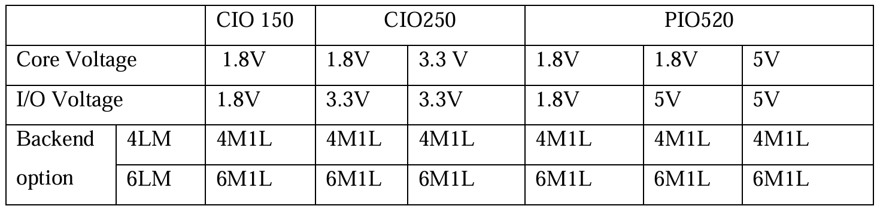
IO PADS in SCL 180nm
There are three types of I/O libraries
  1. CIO 150 (core 1.8V & I/O 1.8V)
  2. CIO250 (core 1.8V & I/O 3.3V or core & I/O 3.3only )
  3. PIO520 ( core & I/O - 5VOnly, 5V/1.8V and 1.8V)

Slide 17
Exercise 3
Open this webpage
https://www.chipestimate.com/Dolphin-Design/Standard-Cell-Library-TSMC-180nm/datasheet/ip/54381
Find out the Ips listed
Open data sheet and find out the format how these IPs are developed

