Slide 1





RTL to GDSII Flow
Activity Based Learning
Session Speaker:
Dr. Cyril Prasanna Raj P.
Professor – Cambridge Institute of Technology
Director – Cambrian Consultancy Center and Industrial Research
cyril@cambridg.edu.in, cyrilyahoo@gmail.com

Slide 2
STEP 3
Design Specifications

Slide 3
Design Specifications
Application – ALU Design (Example)
Specifications:
  Number of ports – 8, 8, 16
  Additional ports – Clock, multiplier enable, start, done
  Data – Integers
  Format – Parallel
  Total Area – 12 mm x 12 mm
  Power dissipation < 1 mW
  Propagation delay < 10 ms
SNx4HC138 3-Line To 8-Line Decoders/Demultiplexers datasheet (Rev. G)

Slide 4
Multiplier Design
Algorithms for multiplier
  Left Shift & Add method
  Right Shift & Add method
  Booths Multiplier
  Modified Booths Multiplier
  Wallace Tree Multiplier
  Dadda Multiplier
  Cannonic Sign Digit Multiplier
  Vedic Multiplier
  Multiplexer Based Multiplier
Or NEW MULTIPLIER

Slide 5
Comparison between LS&A, RS&A
Left Shift and ADD
101 x 111
Right Shift & ADD
101 x 111
Iter. | (5)101 | (7)111
 | ACC | 000
1 | ADD | 101
 |  | 101
 | RS >> 1 | 0101
2 | ADD | 101
 |  | 1111
 | RS >> 1 | 01111
3 | ADD | 101
 |  | 100011
 | RS >> 1 | 0100011
 | Final output | (35)
Iter. | (5)101 | (7)111
 | ACC | 000000
1 | LS << 0 | 101
 | ADD | 000101
2 | LS << 1 | 1010
 | ADD | 001111
3 | LS << 2 | 10100
 | ADD | 100011
 | Final output | (35)

Slide 6
Comparison of LSA and RSA Multiplier Algorithm
 | Multiplicand | Multiplier
Iter. | (5)101 | (7)111
 | ACC | 000000
1 | LS << 0 | 101
 | ADD | 000101
2 | LS << 1 | 1010
 | ADD | 001111
3 | LS << 2 | 10100
 | ADD | 100011
 | Final output | (35)
Multiplicand
Multiplier
Counter
Stop
LSA
ADD
ACC

Slide 7
Comparison of LSA and RSA Multiplier Algorithm
 | Multiplicand | Multiplier
Iter. | (5)101 | (7)111
 | ACC | 000
1 | ADD | 101
 |  | 101
 | RS >> 1 | 0101
2 | ADD | 101
 |  | 1111
 | RS >> 1 | 01111
3 | ADD | 101
 |  | 100011
 | RS >> 1 | 0100011
 | Final output | (35)
Multiplicand
Multiplier
Counter
Stop
ADD
ACC & RS

Slide 8
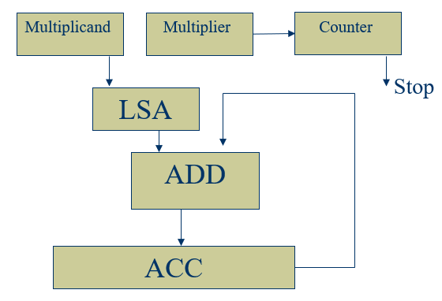
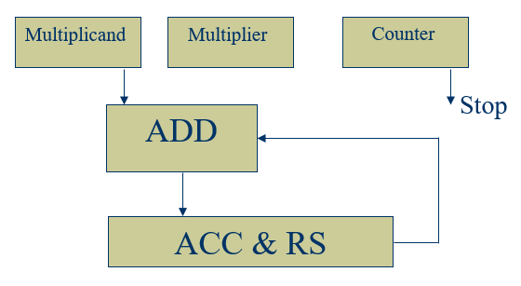
Architecture Selection
Parameter | Left-Shift Algorithm | Right-Shift Algorithm
Iterations | 3 cycles | 3 cycles
Adders | 1 (6-bit adder) | 1 (6-bit adder)
Multiplicand Register | 6-bit (needs shifting left) | 3-bit (no widening required)
Multiplier Register | 3-bit (shift right) | Not separate (embedded in product reg)
Product Register | 6-bit | 6-bit (combined with multiplier)
Shift Registers | 2 (multiplicand + multiplier) | 1 (product register)
Hardware Area | Slightly more (extra shift reg) | Slightly less

Slide 9
STEP 4
Development of HDL Code

Slide 10
VHDL/Verilog Model
Architecture Types
Package
Generic
Ports
Entity
Behavioral
Architect
Structural
Architect
Dataflow
Architect
Mixed Architect

Slide 11
Levels of Modeling - Comparison
module half_adder_behavioral (
input a,
input b,
output reg sum,
output reg carry
);
always @(*) begin
sum = a ^ b;
carry = a & b;
end
endmodule
module half_adder_dataflow (
input a,
input b,
output sum,
output carry
);
assign sum = a ^ b;
assign carry = a & b;
endmodule
module half_adder_structural (
input a,
input b,
output sum,
output carry
);
xor (sum, a, b);
and (carry, a, b);
endmodule

Slide 12
Comparing modelling types
Structural
Behavioral
Gate level

