Slide 1
RTL to GDSII Flow
Activity Based Learning
Session Speaker:
Dr. Cyril Prasanna Raj P.
Professor – Cambridge Institute of Technology
Director – Cambrian Consultancy Center and Industrial Research
cyril@cambridg.edu.in, cyrilyahoo@gmail.com

Slide 2
STEP 9
Placement

Slide 3
Optimal Relative Order:
A
B
C

Slide 4
To spread ...
A
B
C

Slide 5
.. or not to spread
A
B
C

Slide 6
Place to the left
A
B
C

Slide 7
… or to the right
A
B
C

Slide 8
Optimal Relative Order:
A
B
C
Without “free” space, the placement problem is dominated by order

Slide 9
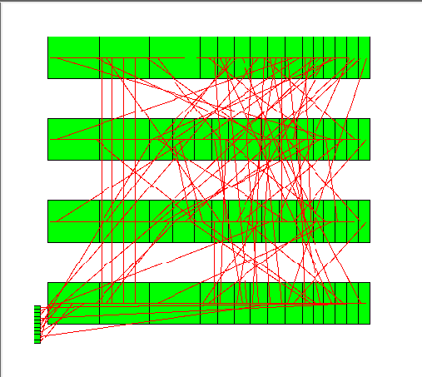
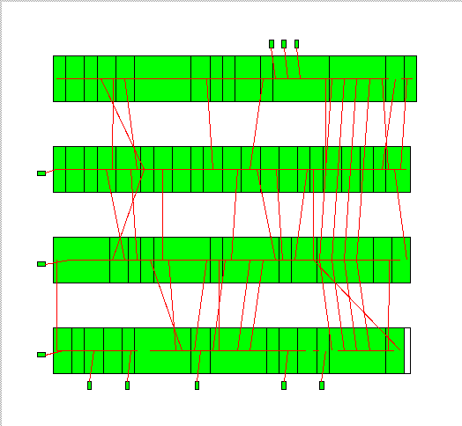
Placement Problem
A bad placement
A good placement

Slide 10
Performing Placement and Optimization:
Partitioning-Based Placement
Global placement
I1
Plan gorup1
1, 3, 5, 6
1
3
I2
2, 4
I3
4
6
O
2
Detailed placement
I4
I2
I1
5
6 5 1 3
2 4
Plan gorup2
I3
I4
Notes:
10

Slide 11
STEP 10
Clock Tree Synthesis

Slide 12
Before CTS
FF
FF
FF
FF
FF
FF
FF
FF
FF
FF
FF
FF
FF
FF
FF
FF
FF
FF
FF
FF
FF
FF
FF
FF
Clock
FF
FF
FF
FF
FF
FF
FF
FF
FF
FF
FF
FF
FF
FF
FF
FF
FF
FF
FF
FF
FF
FF
FF
FF
All clock pins are driven by a single clock source.

Slide 13
Clock Tree Synthesis (CTS) (1/2)
FF
FF
FF
FF
FF
FF
FF
FF
FF
FF
FF
FF
FF
FF
FF
FF
FF
FF
FF
FF
FF
FF
FF
FF
FF
FF
FF
FF
FF
FF
FF
FF
FF
FF
FF
FF
Clock
FF
FF
FF
FF
FF
FF
FF
FF
FF
FF
FF
FF
A buffer tree is built to balance the loads and minimize the skew.

Slide 14
STEP 11
Routing

Slide 15
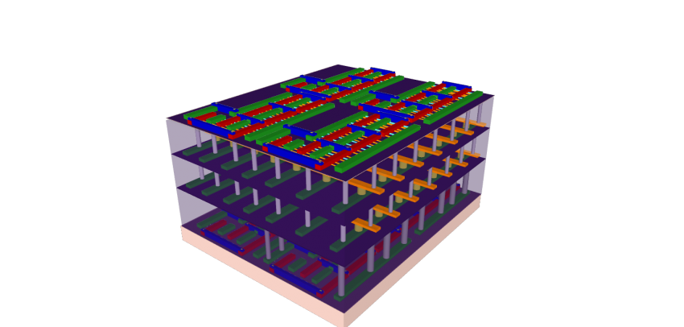
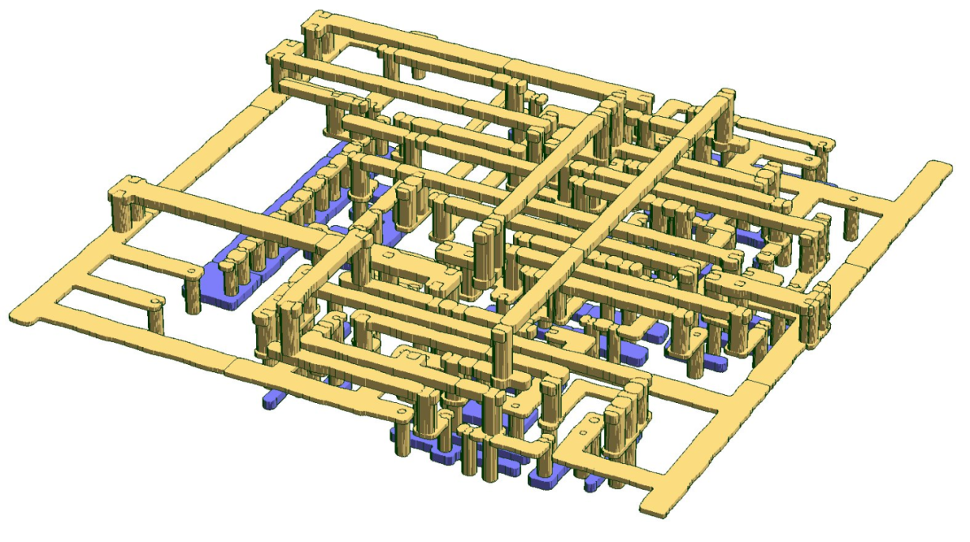
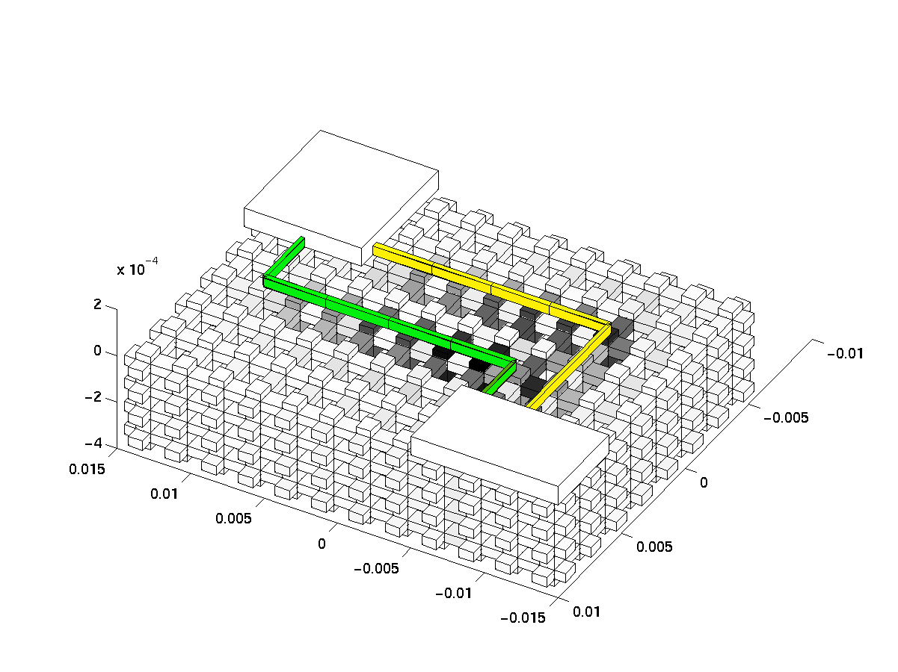
Routing

Slide 16
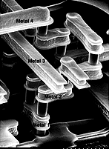
Routing of VLSI Circuits
Slide courtesy L. Daniel
Picture from “Digital Integrated Circuits”,
Rabaey, Chandrakasan, Nikolic

Slide 17
Routing Flow: General Flow for Routing
Placement and CTS
D
B
C
Global Routing
GRoute Optimization
E
A
Track Assignment
Detailed Routing
D
B
C
Optimization
E
A
Design for Manufacturing (DFM)

Slide 18

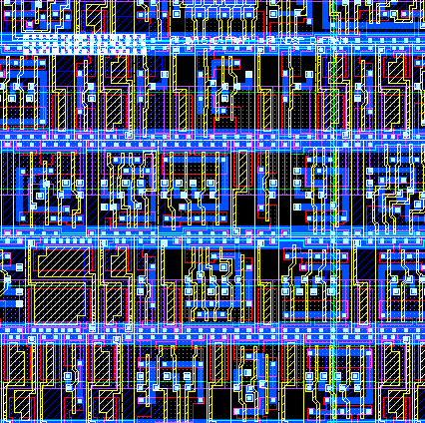
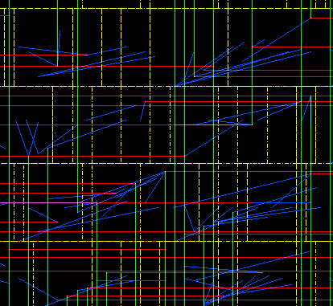
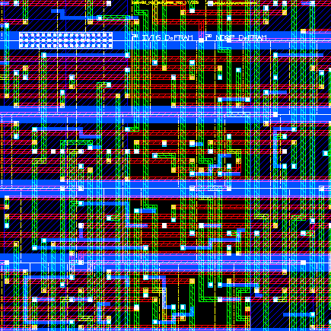
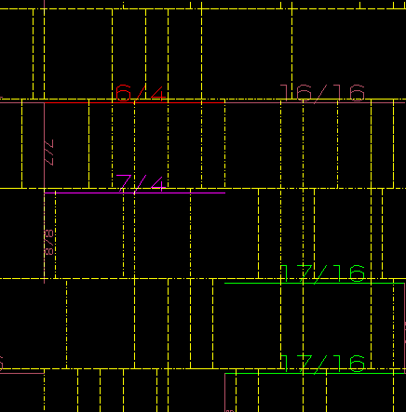
Wire Tracks
Placement
Global Routing
Detailed Routing
Congestion Map

Slide 19
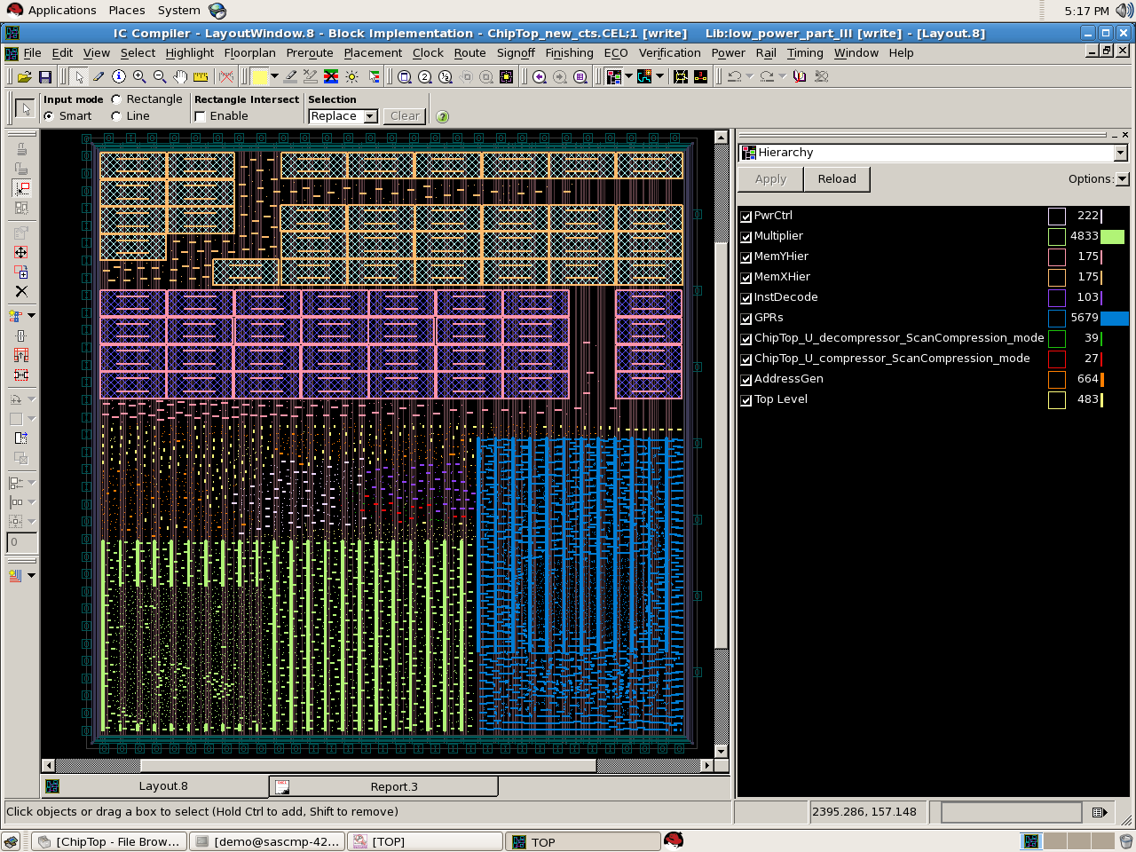
Floorplanning with Placed Macro
MEMX
Pwrctl
MEMY
Multiplier
GPP
GPRs

Slide 20
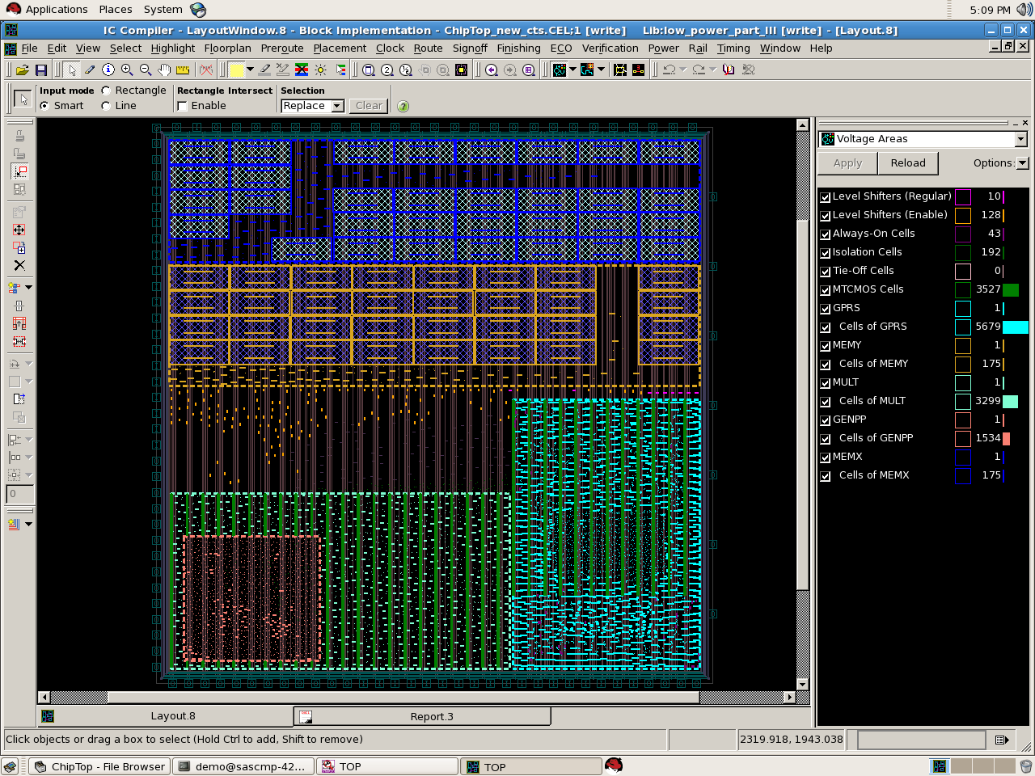
Floorplanning and Voltage Area Defined
MEMX
IO
Pins
MEMY
Multiplier
GPRs
GENPP

Slide 21
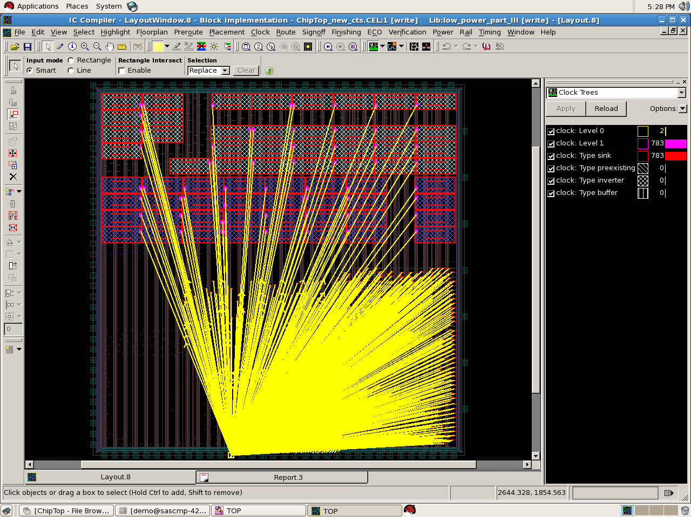
Clock Tree Synthesis

Slide 22
STEP 12
Physical Verification

Slide 23
Physical Verification
Extraction of netlist from P&R design
  Netlist will be extracted with R,C values of interconnects and with delay information of every cell
  Compare the RC netlist with symbolic netlist
  LVS (Layout netlist with Gatelevel netlist)
  STA
  Electrical Rule Check, Design Rule Check
The delay, power at this level will be actual and delay, power information from all other level is only estimated

Slide 24
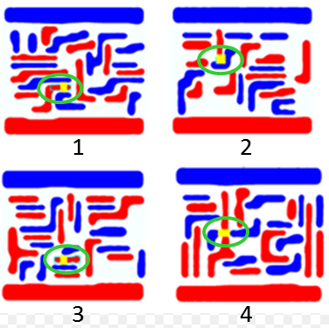
STEP 13
Design for Manufacturability (DFM)

Slide 25
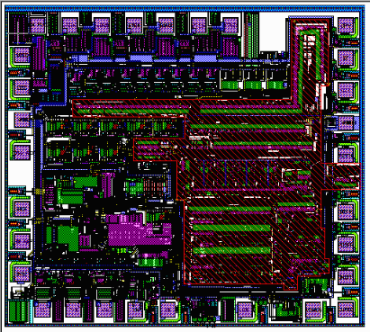
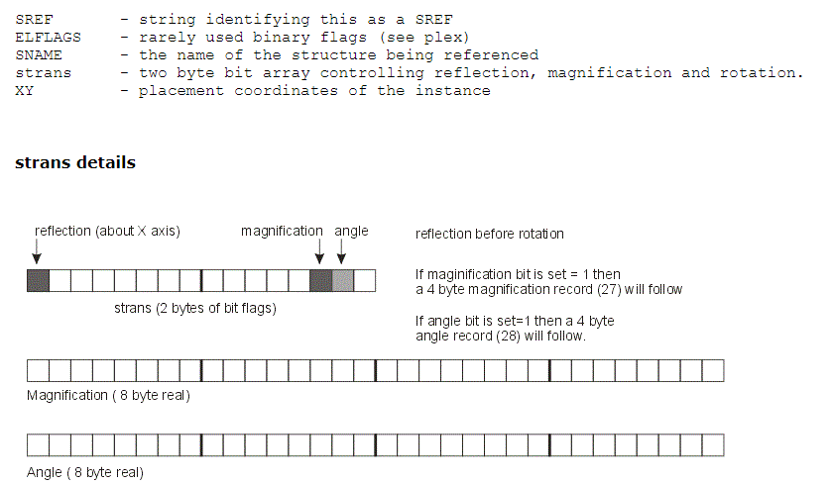
STEP 14
Generate GDSII

Slide 26
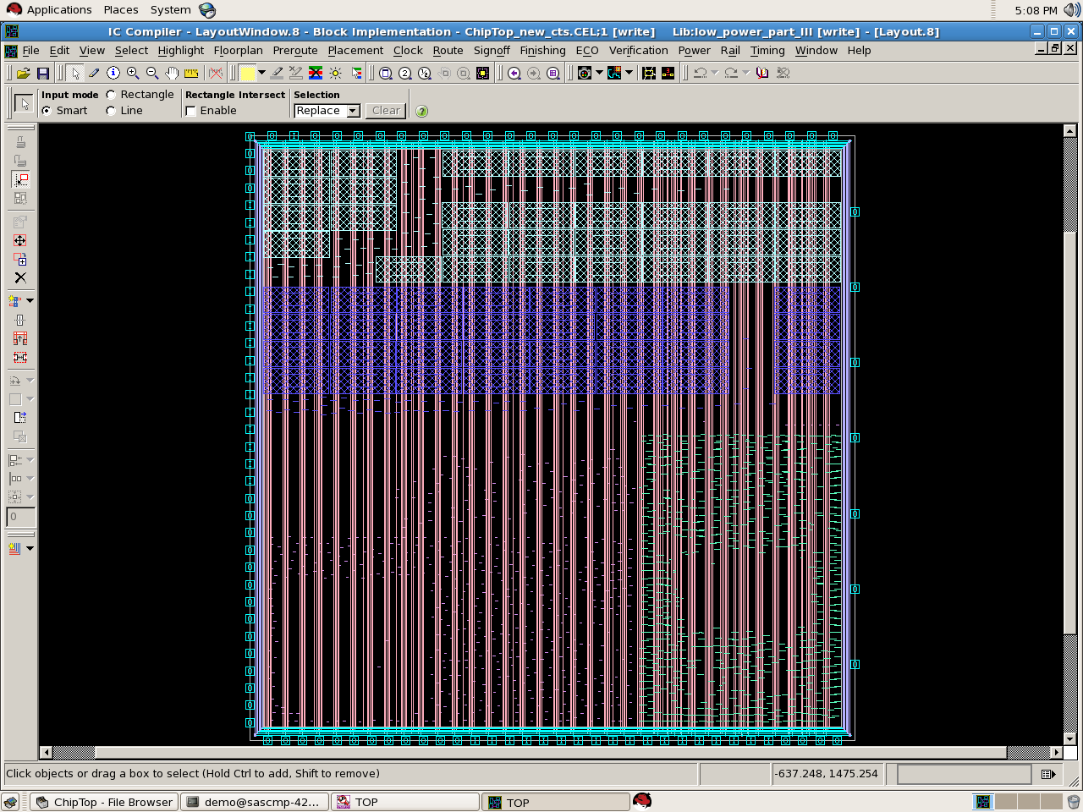
RISC Core Chip

Slide 27
STEP 15
Fabrication & Packaging

Slide 28
VIDEO on Chip Fabrication

