Slide 1
STEPS 6 and 7 are
Formal Verification
DFT
These topics are not discussed here

Slide 2





FloorPlanning
Session Speaker:
Dr. Cyril Prasanna Raj P.
Professor – Cambridge Institute of Technology
Director – Cambrian Consultancy Center and Industrial Research
cyril@cambridg.edu.in, cyrilyahoo@gmail.com

Slide 3
STEP 8
Floor Planning

Slide 4
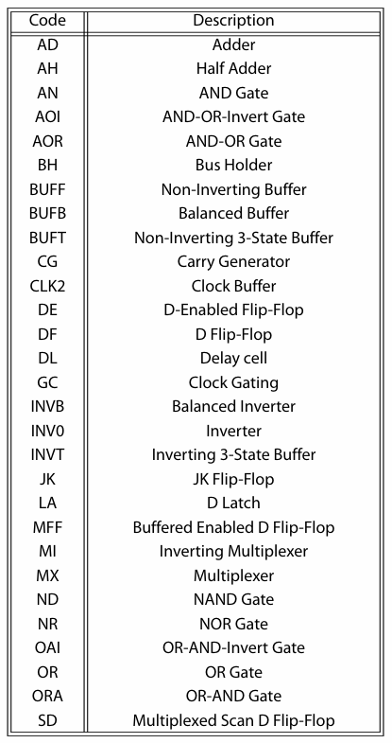
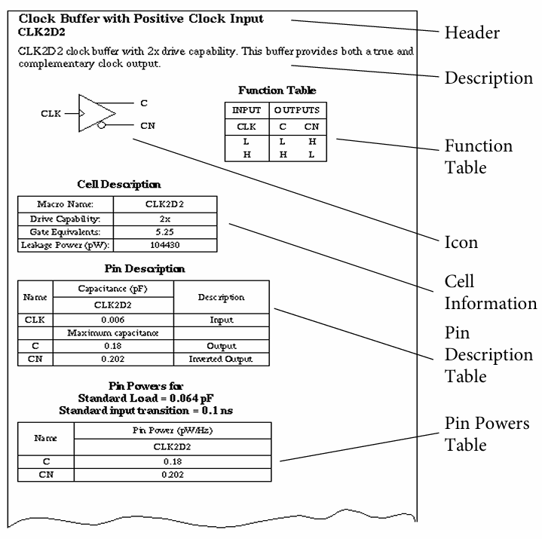
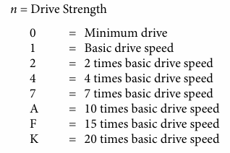
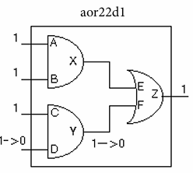
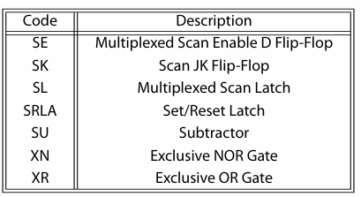
Standard Cell

Slide 5
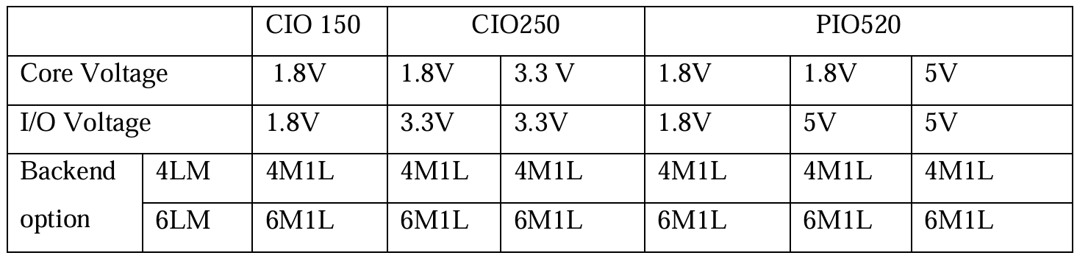
IO PADS in SCL 180nm
There are three types of I/O libraries
  1. CIO 150 (core 1.8V & I/O 1.8V)
  2. CIO250 (core 1.8V & I/O 3.3V or core & I/O 3.3only )
  3. PIO520 ( core & I/O - 5VOnly, 5V/1.8V and 1.8V)

Slide 6
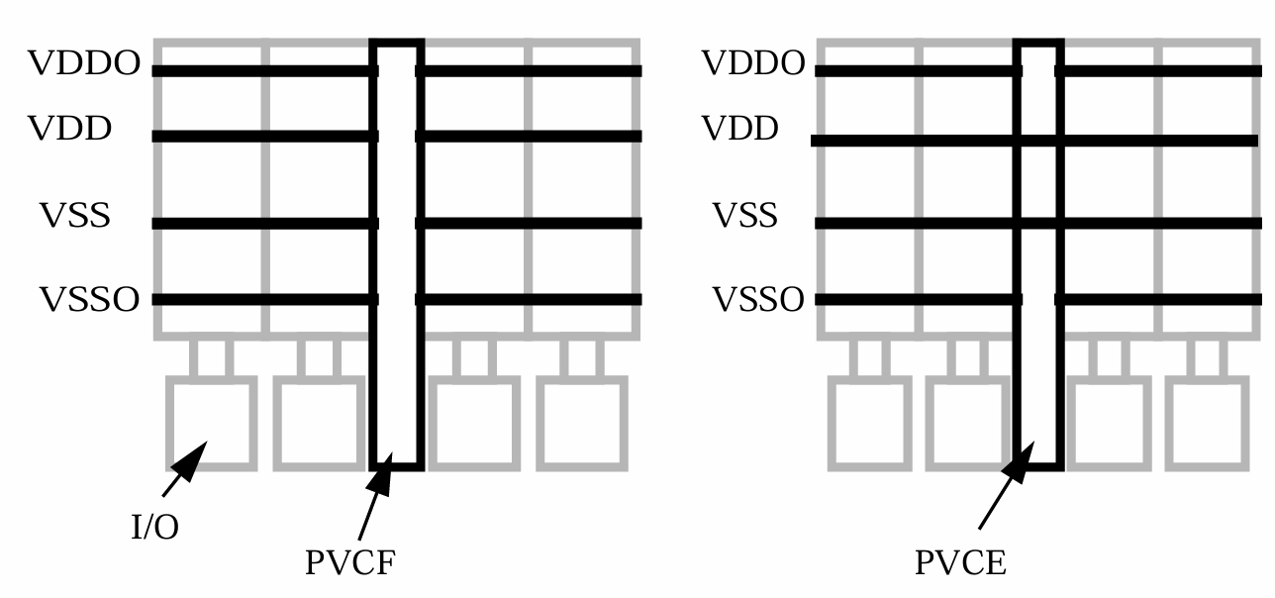
IO Library
 | CIO150 | CIO250
Voltage range | 1.65V to 1.95V | 2.7V to 3.6V
Maximum frequency | 130MHz | 130MHz
Load cap | 40pF | 40pF
Load Inductance | 20nH | 20nH
IO size (W x H) | 65µm x 162µm | 65µm x 162µm
Boding pad | 65µm x 250µm | 65µm x 250µm
Cell | Type | Domain | Connects To
pv0a | GND | Analog IO | VSSO_A
pv0i | GND | Digital IO | VSSO
pv0c | GND | Core | VSS
pvda | VDD | Analog IO | VDDO_A
pvdi | VDD | Digital IO | VDDO
pvdc | VDD | Core | VDD
PVDC/PV0C - core of the chip with separated VDD and VSS
Letter | Domain | Typical Meaning
a | Analog | Analog IO supply
i | IO / Input | Digital IO supply
c | Core | Core supply
PVCF - cuts all power rings and
PVCE - cuts all power rings, except VDD and VSS rings
Power Verification / Connectivity Engine
Physical Verification Connectivity Fix

Slide 7
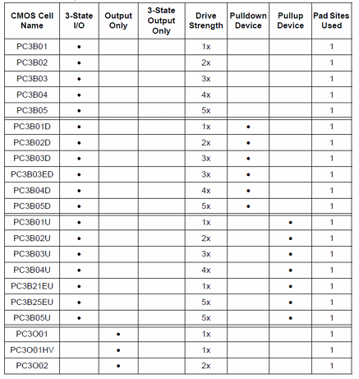
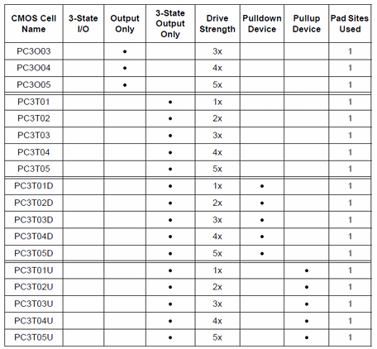
CMOS I/O Pad

Slide 8

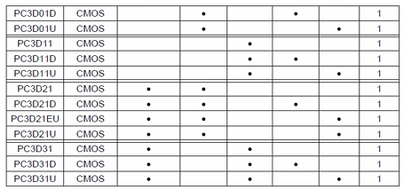
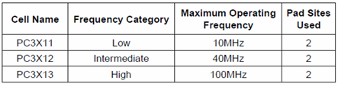
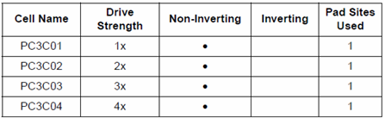
CMOS Input Only Pads
Crystal Oscillator Pads
Core Driven Clock Buffer Pad

Slide 9
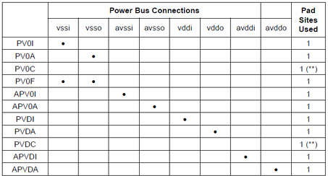
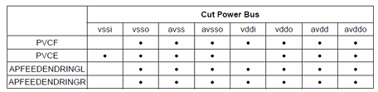
Power Pads
Cut Power Pads

Slide 10
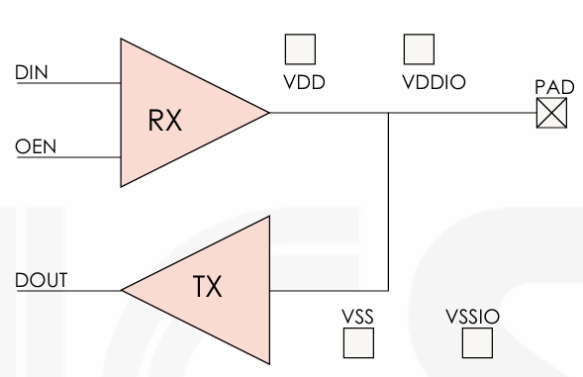
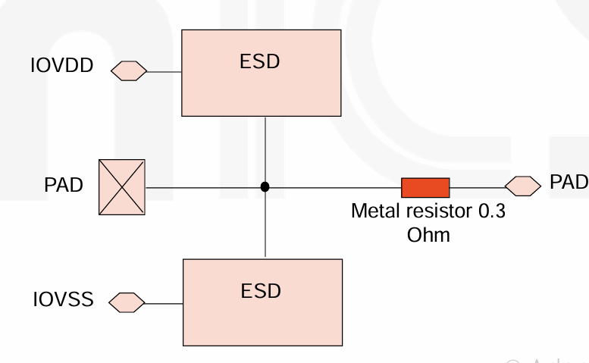
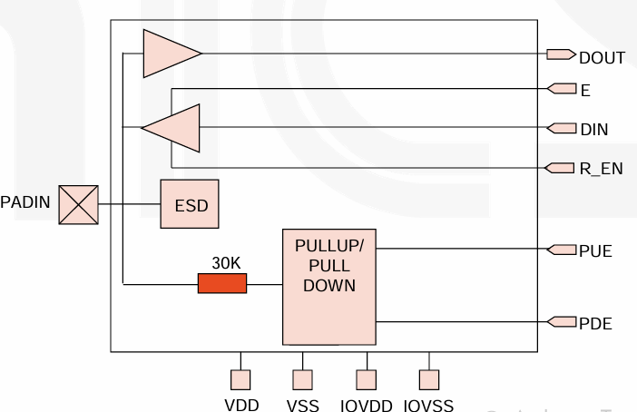
I/O Cells
Digital I/O Buffer
Analog I/O Cell

Slide 11
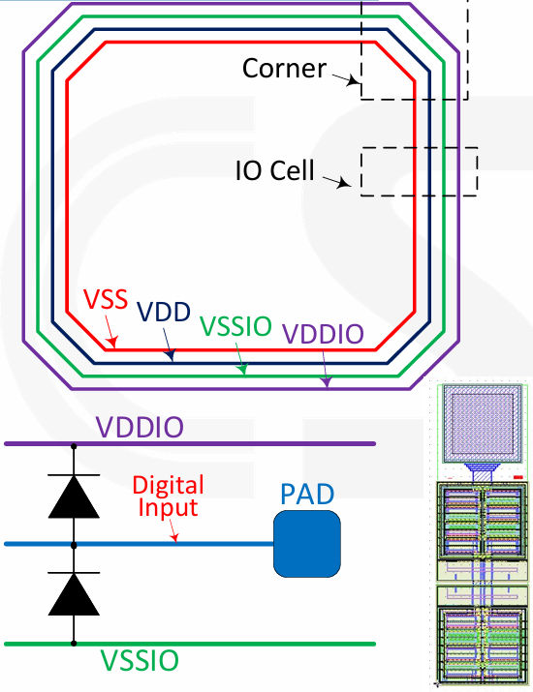
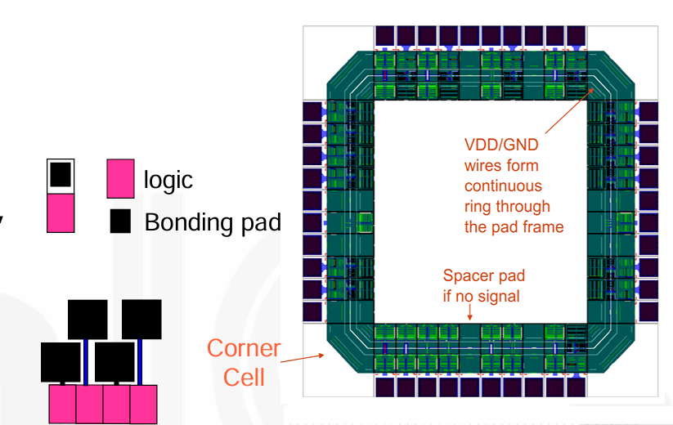
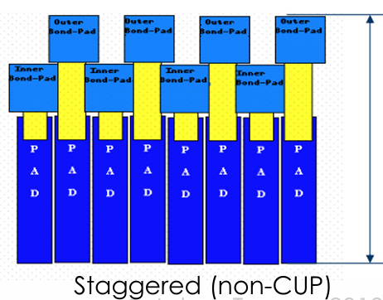
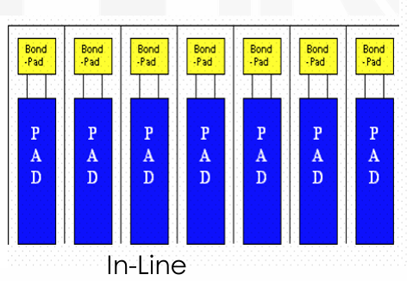
Power Supply Cells and ESD Protection

Slide 12
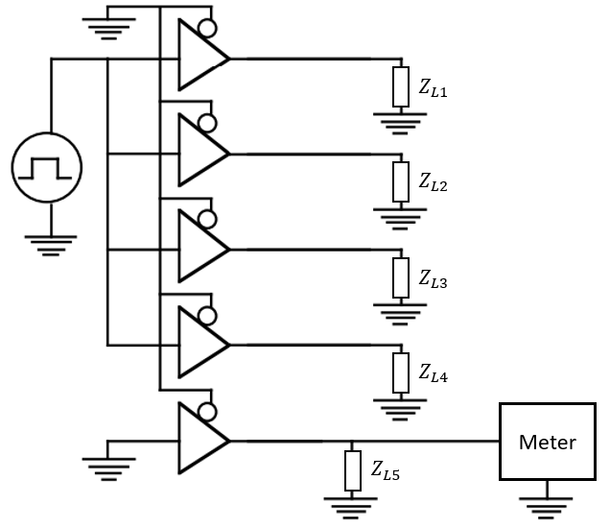


Simultaneous Switching IOs
11111111 → 00000000
Distribute High-Switching IOs Across Banks
Increase Power/Ground Pin Density
S S S S S S → S G S G S G

Slide 13
IO Cell Placements
(iopad
(bottom
(inst name ="pc3c01_2" space = 70 place_status=fixed)
(inst name ="pc3d01_2" space = 70 place_status=fixed )
(inst name ="pvdi_VDD_CORE_1" space = 70 place_status=fixed )
(inst name ="pv0i_VSS_CORE_1" space = 70 place_status=fixed )
(inst name ="pvda_VDDO_CORE_1" space = 70 place_status=fixed )
(inst name ="pv0a_VSSO_CORE_1" space = 70 place_status=fixed )
(inst name ="pc3o05_9" space = 70 place_status=fixed )
(inst name ="pc3o05_10" space = 70 place_status=fixed )
(inst name ="pc3d01_5" space = 70 place_status=fixed )

Slide 14
IO Cell Placements
(topright
(inst name="corner_3"
cell = pfrelr
place_status = fixed
orientation = R90
)
)
(topleft
(inst name="corner_4"
cell = pfrelr
place_status = fixed
orientation = R180
)
)

Slide 15
Power IO placement
pvdi pvdi_VDD_CORE_1 (.VDD(VDD_CORE), .VSS(VSS_CORE), .VDDO(VDDO_CORE), .VSSO(VSSO_CORE));
pv0i pv0i_VSS_CORE_1 (.VDD(VDD_CORE), .VSS(VSS_CORE), .VDDO(VDDO_CORE), .VSSO(VSSO_CORE));
pvda pvda_VDDO_CORE_1 (.VDD(VDD_CORE), .VSS(VSS_CORE), .VDDO(VDDO_CORE), .VSSO(VSSO_CORE));
pv0a pv0a_VSSO_CORE_1 (.VDD(VDD_CORE), .VSS(VSS_CORE), .VDDO(VDDO_CORE), .VSSO(VSSO_CORE));
Cell | Type | Domain | Connects To
pv0a | GND | Analog IO | VSSO_A
pv0i | GND | Digital IO | VSSO
pv0c | GND | Core | VSS
pvda | VDD | Analog IO | VDDO_A
pvdi | VDD | Digital IO | VDDO
pvdc | VDD | Core | VDD
Letter | Domain | Typical Meaning
a | Analog | Analog IO supply
i | IO / Input | Digital IO supply
c | Core | Core supply

Slide 16
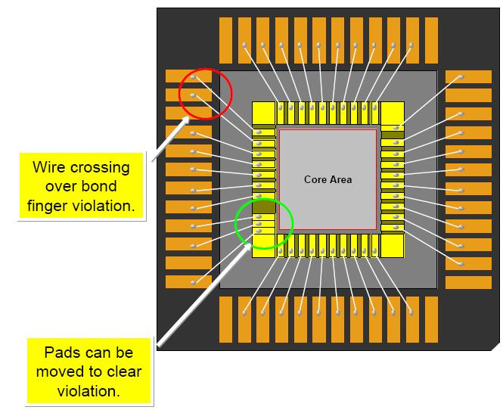

I/O Placement and Chip Package Requirements
Some Bond Wire requirements:
  No Crossing
  Minimum Spacing
  Maximum Angle
  Maximum Length

Slide 17
Inputs for Floor Planning
Synthesized Netlist
  Number of cells
  Number of ports
  Timing information – estimated
  Power dissipation – estimated
  Area – estimated
  Total chip area during foundry selection
    20 mm x 20 mm

Slide 18
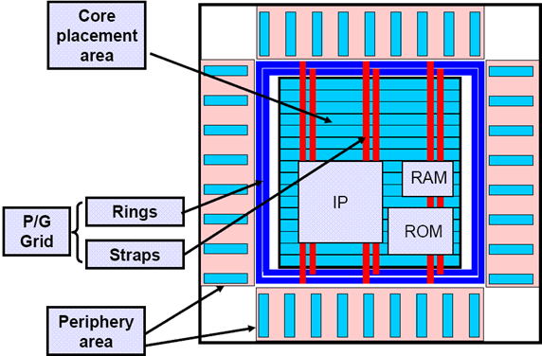
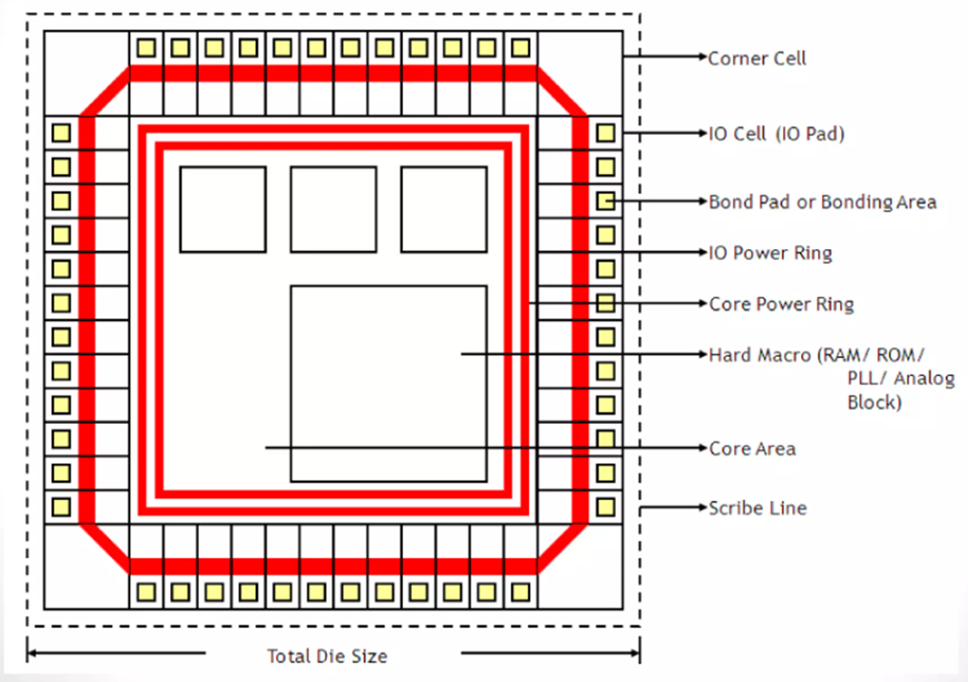
Floorplanning
Floorplanning include
  Defining core area
  Creating and placing power pads
  Placing I/O pads
  Placing Macros
  Power network design
  Defining placement and routing blockage
blocks
RAM
I/O pads
std cell
Routing channels
data path

Slide 19



Floorplanning Guidelines to Reduce DRC Violations
Guideline | DRC Impact
65–75% utilization | Reduces congestion
1:1 aspect ratio | Balanced routing
Clean macro placement | Avoids spacing DRC
Wide routing channels | Prevents shorts
Strong PG grid | Avoids density issues
Aligned IO | Less cross routing
Blockages near macros | Cleaner edges
Rectangular core | No notch violations
Distribute fanout | Less buffering
Uniform density | Pass metal fill DRC

Slide 20
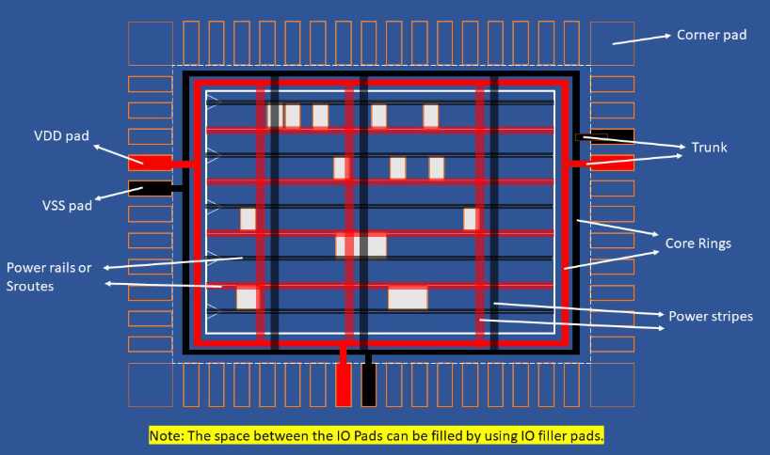
Power planning

Slide 21
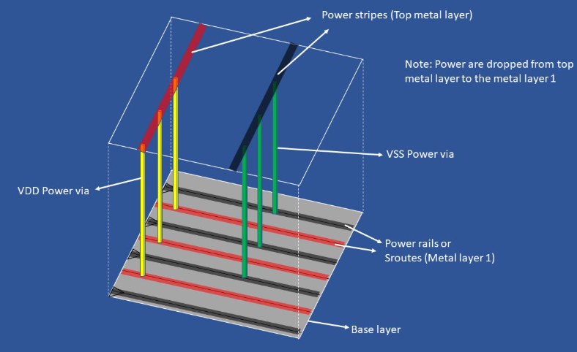
Power planning

Slide 22
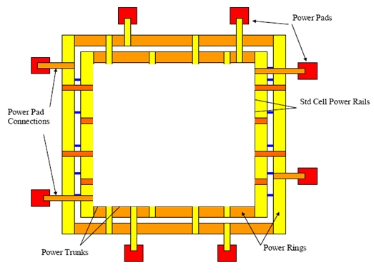
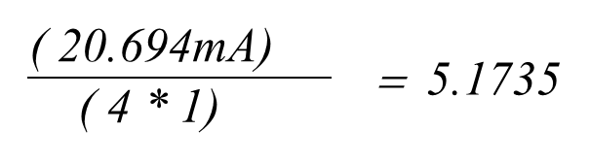

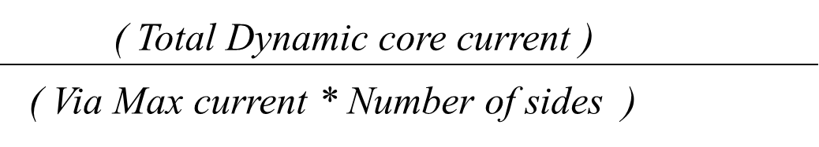
Floor Planning Design
Total Dynamic core current (ma):
( Total Dynamic core power )
( 37.25mW)
= 20.694
( Typical core voltage)
( 1.8V)
PAD to CORE trunk width (um):
( Total Dynamic core current )
( Number of sides * J_{max})
Via count for PAD to CORE trunk
( 20.694mA)
= 12.875
( 0.403 * 4)

Slide 23
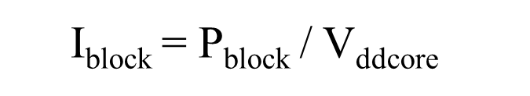
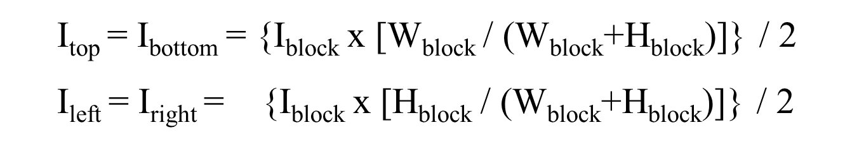
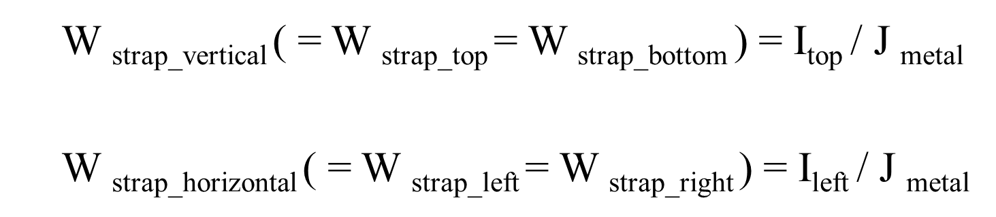
Power planning

Slide 24
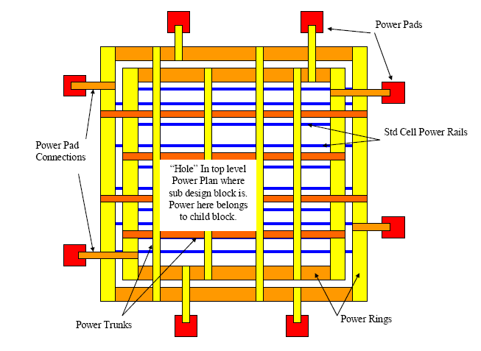
Floorplanning – Power Routing

Slide 25
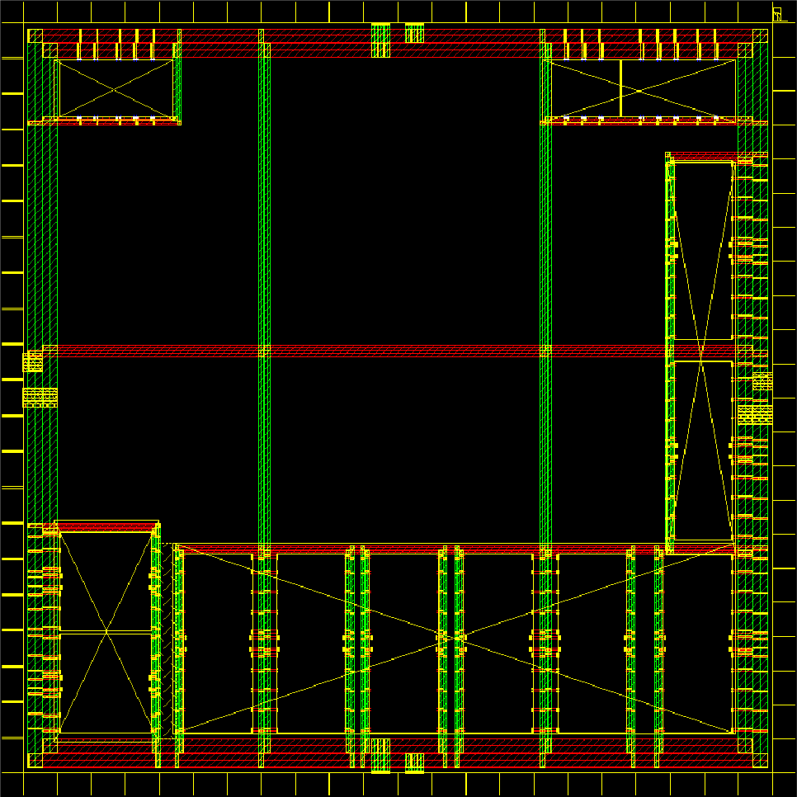
Power planning

Slide 26
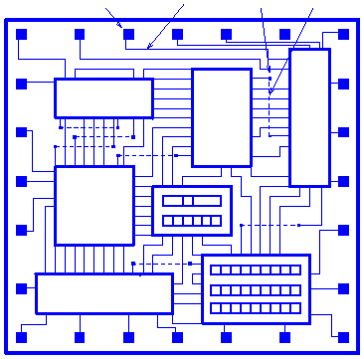
Floorplanning Input - Output
Design netlist
Area requirements
Power requirements
Timing constraints
Die size vs. performance
I/O placement
Macro placement information
Pad
Metal1
Via
Metal2
  Floor Plan Output
    Die/block area
    I/Os placed
    Macros placed
    Power grid designed
    Power pre-routing
    Standard cell placement areas

Slide 27
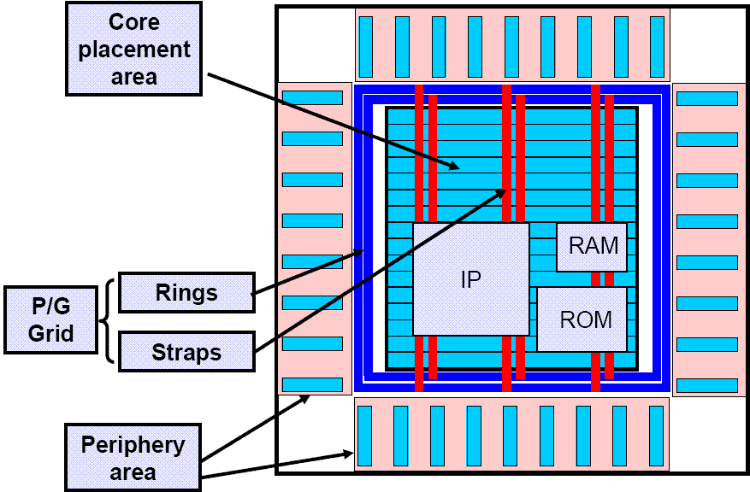
Floor Planning
Floorplan of design:
  Core area defined with large macros placed
  Periphery area defined with I/O macros placed
  Power and Ground Grid (Rings and Straps) established
Utilization:
  The percentage of the core that is used by placed standard cells and macros
  Goal of 100%, typically 80-85%

Slide 28
Hands on Session

