Slide 1





RTL to GDSII Flow
Activity Based Learning
Session Speaker:
Dr. Cyril Prasanna Raj P.
Professor – Cambridge Institute of Technology
Director – Cambrian Consultancy Center and Industrial Research
cyril@cambridg.edu.in, cyrilyahoo@gmail.com

Slide 2
STEP 5
Synthesis
HDL → Gate Level Netlist

Slide 3
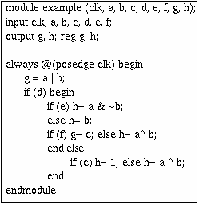
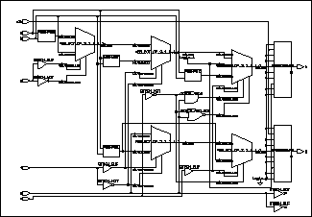
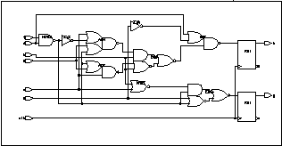
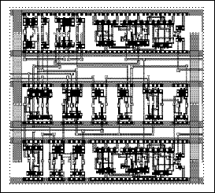


Synthesis Flow
High-Level
Synthesis
Logic
Synthesis
Physical
Design
Fabrication and
Packaging

Slide 4
Synthesis
RTL
Specifications
Library
Synthesis
Netlist
4
Definitions
  “The combining of separate elements or substances to form a coherent whole”
  “Reasoning from the general to the particular - logical deduction ”
Notes:
4

Slide 5
Synthesis Process
Synthesis is a 3 step process
  The first where the code gets translated
  The second where the translated code gets bound by the library
  The third where the netlist is optimized
CONSTRAINTS
LIBRARY
RTL
Map /
Library Binding
Optimize
Translate
NETLIST
5
Notes:
5

Slide 6
Understanding Synthesis with an Example

Slide 7
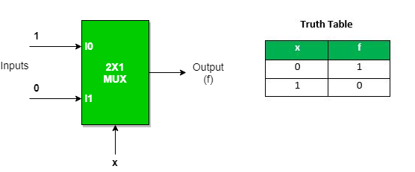
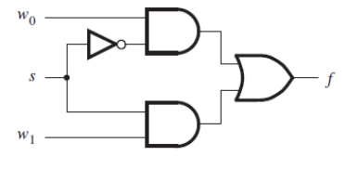
Translation (Step 1 in Synthesis)
module mux2x1_if (
input I1,
input I2,
input S,
output reg Y
);
always @(*) begin
if (S == 0'b0)
Y = I1;
else
Y = I2;
end
endmodule
I1
Y
I2
S
I1
A2
S
A1
Y
A4
A3
I2

Slide 8
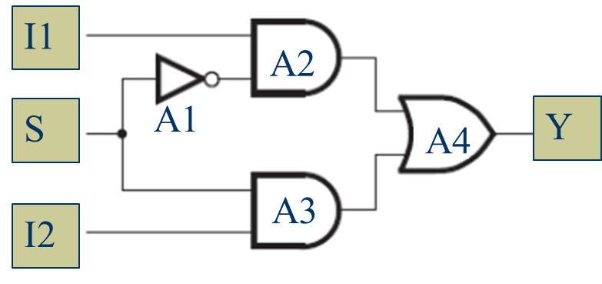
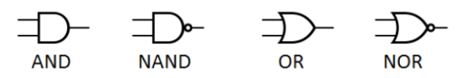
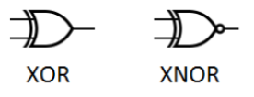
Library Binding (Step 2 in Synthesis)
Translated NL
TM or LB NL
I1
A2
A5
S
A4
Y
A3
I2
1X
STD. Cell Lib.
4X
2X

Slide 9
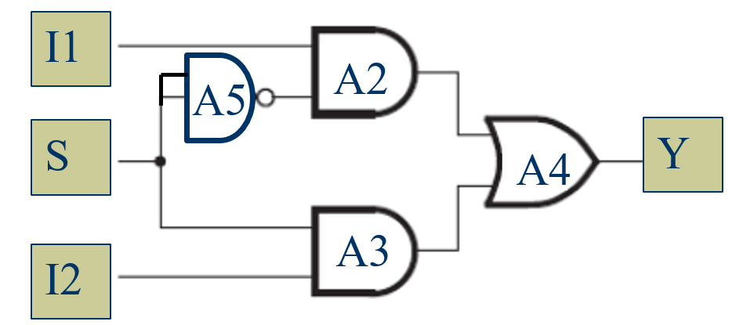
Optimization (Step 3 in Synthesis)
Constraints for the example code are:
  Timing or delay < 10 ns & Area < 8 units
GATE | 1X |  | 2X |  | 4X
 | D (ns) | A | D (ns) | A | D (ns) | A
NAND | 4 | 1 | 3 | 2 | 2 | 4
AND | 4 | 1 | 3 | 2 | 2 | 4
OR | 4 | 1 | 3 | 2 | 2 | 4
1X
DELAY | AREA
8 | 4
12
4
4
2X
DELAY | AREA
6 | 8
9
6
6
4X
DELAY | AREA
4 | 16
6
4
4
PATH | TIMING PATHS
1 | I1 | A2 | A4 | Y
2 | S | A5 | A2 | A4 | Y
3 | S | A3 | A4 | Y
4 | I2 | A3 | A4 | Y

Slide 10

Optimization – meeting timing requirements
GATE | 1X |  | 2X |  | 4X
 | D (ns) | A | D (ns) | A | D (ns) | A
NAND | 4 | 1 | 3 | 2 | 2 | 4
AND | 4 | 1 | 3 | 2 | 2 | 4
OR | 4 | 1 | 3 | 2 | 2 | 4
Timing constraint < 10 ms
AND 2X (3,2)
OR 2X (3,2)
Maximum delay = 9 ns
Maximum area = 8 units
NAND 2X (3,2)
AND 2X (3,2)

Slide 11
Optimization – meeting area requirements
GATE | 1X |  | 2X |  | 4X
 | D (ns) | A | D (ns) | A | D (ns) | A
NAND | 4 | 1 | 3 | 2 | 2 | 4
AND | 4 | 1 | 3 | 2 | 2 | 4
OR | 4 | 1 | 3 | 2 | 2 | 4
Area constraint < 8 units
AND 2X (3,2)
OR 2X (3,2)
Maximum delay = 9 ns
Maximum area = 7 units
NAND 2X (3,2)
AND 2X (4,1)

Slide 12
Exercise 4

Slide 13
Generate Netlist
module timing_example (
input A,
input B,
input C,
input D,
output Y
);
wire n1, n2, n3, n4, n5;
xor U1 (n1, A, B); // 3ns
and U2 (n2, C, D); // 2ns
or U3 (n3, n1, n2); // 2ns
inv U4 (n4, C); // 1ns
and U5 (n5, n3, n4); // 2ns
xor U6 (Y, n5, A); // 3ns
endmodule
Trace All Input-to-Output Paths
Possible paths:
A → U1 → U3 → U5 → U6 → Y
B → U1 → U3 → U5 → U6 → Y
C → U2 → U3 → U5 → U6 → Y
C → U4 → U5 → U6 → Y
D → U2 → U3 → U5 → U6 → Y

Slide 14
Design Objects in Gate Level NL
Ports
Cells
Nets
Pins
A0
a0
O
INV
A1
Reference

