Slide 1
IoT
Chapitre 8
Wireless

Slide 2
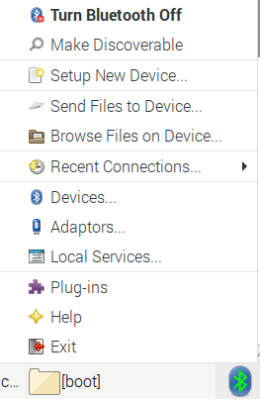
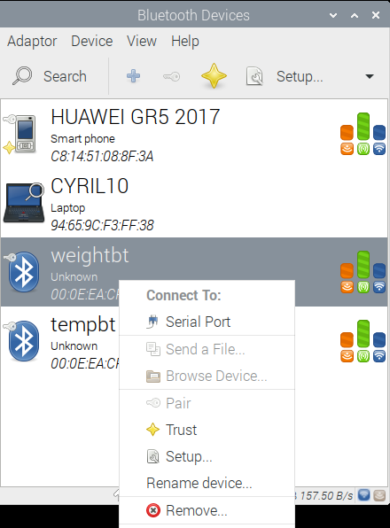
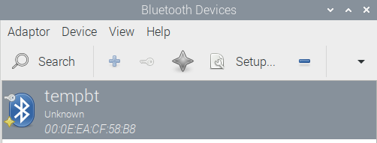
PAN LAN WAN HAN
BT RFCOMM
Arduino BT Maitre Esclave
AT
Les ports BT
PyBluez
Blueman
RPI - Arduino
Arduino - Android
RPI - Android
BLE

