Slide 1
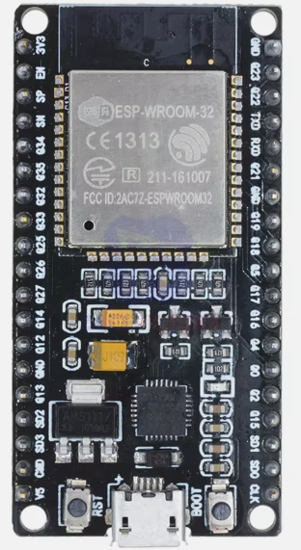
ESP32

Slide 2
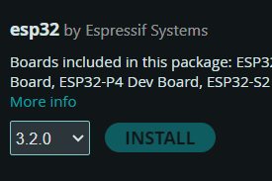

Slide 3
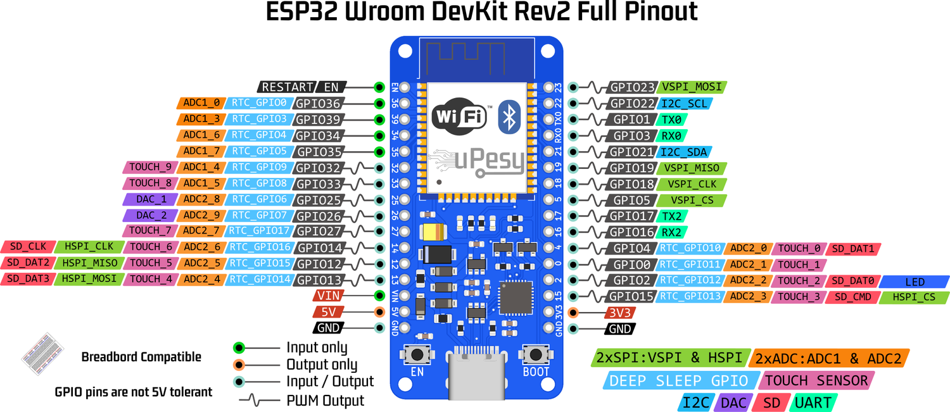
GPIO

Slide 4
https://www.upesy.fr/blogs/tutorials/esp32-pinout-reference-gpio-pins-ultimate-guide#d852f1174e4e9d90592df1b1ad43
https://www.upesy.fr/blogs/tutorials/measure-voltage-on-esp32-with-adc-with-arduino-code#af501f4755b4481c819677dad67db67a

Slide 5
Arduino Nano
Un ESP32 chez Arduino
Arduino Nano ESP32 https://docs.arduino.cc/tutorials/nano-esp32/cheat-sheet/

