Slide 1
Web API
Chapitre 11
Notes:
<*s*o*u*r*c*e*>*9*7*7*b*1*-*9*-*1*<*/*s*o*u*r*c*e*>

Slide 2
ASP.NET Web API
Framework for building Web APIs on top of .NET framework
HTTP is a powerful platform for building APIs to expose services and data
Simple, flexible, ubiquitous
Data transferred using XML, JSON, or other formats by same service
Web API provides support for
Modern HTTP programming model
MVC routing
Content negotiation between client and server
MVC filters; e.g., Authorize
Data services make use of HTTP verbs to indicate action
GET retrieve data
POST insert new data
PUT update data
DELETE remove existing data
Notes:
<*s*o*u*r*c*e*>*9*7*7*f*2*-*9*-*3*5*<*/*s*o*u*r*c*e*>
Jogger text: ASP.NET Web API
Direction: Right
Instructor notes:
Aim of this section is to just provide a very high level overview of what the Web API can do
The new Web course covers this in much more detail.
Feel free to expand on this section of you wish

Slide 3
Step 1: Define Which Operations a Service Will Provide
We will consider a data service for Rainforest
Provides read access to music recording data
Two service operations will be provided
Retrieve individual recording data using recording ID
Retrieve all recording data for a particular category
Both will be accessed using HTTP GET
Will return XML or JSON data based on client content negotiation
Notes:
<*s*o*u*r*c*e*>*9*7*7*f*2*-*9*-*3*7*<*/*s*o*u*r*c*e*>
Jogger text: Step 1: Define Which Operations a Service Will Provide
Direction: Right
Instructor notes:

Slide 4
Step 2: Implémenter ApiController (C#)
Etendre la classe ApiController
Par convention, les méthodes doivent commencer par Get pour le protocole HTTP GET
public class MusicServiceController : ApiController
{
private IMusicRepository musicRepository;
public MusicRecording GetMusicRecording(int id)
{
return musicRepository.GetMusicRecording(id);
}
public Ienumerable<MusicRecording> GetMusicRecordings(string category)
{
return musicRepository.GetMusicRecordings(category);
}
}
Process HTTP Get request
Returns XML or JSON representation of recording based on request header
Notes:
<*s*o*u*r*c*e*>*9*7*7*f*2*-*9*-*3*8*<*/*s*o*u*r*c*e*>
Jogger text: Step 2: Implement Web API Controller (C#)
Direction: Left
Instructor notes:

Slide 5
Step 2: Implémenter ApiController (VB)
Public Class MusicServiceController
Inherits ApiController
Private musicRepository As IMusicRepository
...
Public Function GetMusicRecordings(category As String) _
As Ienumerable(Of MusicRecording)
Return musicRepository.GetMusicRecordings(category)
End Function
Public Function GetMusicRecording(ByVal id As Integer) _
As MusicRecording
Return musicRepository.GetMusicRecording(id)
End Function
End Class
Process HTTP Get request
Returns XML or JSON representation of recording based on request header
Notes:
<*s*o*u*r*c*e*>*9*7*7*f*2*-*9*-*3*9*<*/*s*o*u*r*c*e*>
Jogger text: Step 2: Implement Web API Controller (VB)
Direction: Right
Instructor notes:

Slide 6
Step 3: Définir les routes(C#)
Comme pour MVC
public static void Register(HttpConfiguration config)
{
config.Routes.MapHttpRoute(
name: "Recordings",
routeTemplate: "api/{controller}/{category} ",
defaults: new {category=RouteParameter.Optional},
constraints : new {category = @"w[A-Za-z&=- ]{2,50}
};
config.Routes.MapHttpRoute(
name: "Recording",
routeTemplate: "api/{controller}/{id} ",
defaults: new {id=RouteParameter.Optional},
};
}
Notes:
<*s*o*u*r*c*e*>*9*7*7*f*2*-*9*-*4*0*<*/*s*o*u*r*c*e*>
Jogger text: Step 3: Define Routing Rule for Web API Controller (C#)
Direction: Left
Instructor notes:

Slide 7
Step 3: Définir les routes (VB)
Public Shared Sub Register(ByVal config As HttpConfiguration)
config.Routes.MapHttpRoute( _
name:= "Recordings", _
routeTemplate:= "api/{controller}/{category}", _
defaults:= New With{.category=RouteParameter.Optional}, _
constraints:New With{.category = @"w[A-Za-z&=- ]{2,50}
}
config.Routes.MapHttpRoute(
name:="Recording", _
routeTemplate:= "api/{controller}/{id} ", _
defaults:= New With {.id=RouteParameter.Optional},
}
End Sub
Notes:
<*s*o*u*r*c*e*>*9*7*7*f*2*-*9*-*4*1*<*/*s*o*u*r*c*e*>
Jogger text: Step 3: Define Routing Rule for Web API Controller (VB)
Direction: Right
Instructor notes:

Slide 8
Structure des requêtes
Voici les exemples de requêtes
HTTP GET
/api/MusicService/Jazz
Invoque GetMusicRecordings(Jazz)
HTTP GET
/api/MusicService/2000
Invoque GetMusicRecording(2000)
Notes:
<*s*o*u*r*c*e*>*9*7*7*f*2*-*9*-*4*2*<*/*s*o*u*r*c*e*>
Jogger text: Request Structure
Direction: Left
Instructor notes:

Slide 9

Exemple Get
Par convention, si Get sans paramètre n'est pas utilisé, il document l'API

Slide 10
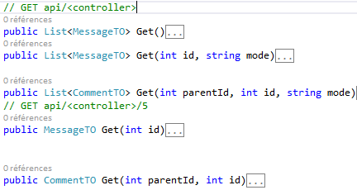
Les méthodes Get peuvent être surchargées
Discrimination par le nom des paramètres

Slide 11
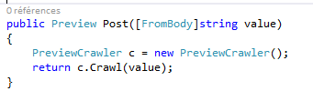
Requêtes POST
FromBody récupère les données du corps de la requêtes
Limitation : une seule valeur

Slide 12
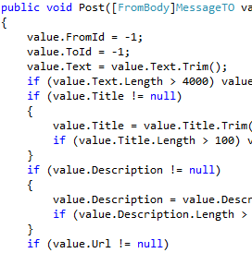
Discrimination POST
Comme il n'y a qu'un seul paramètre en POST, la discrimination se fait par une ou plusieurs propriété du ViewModel

Slide 13
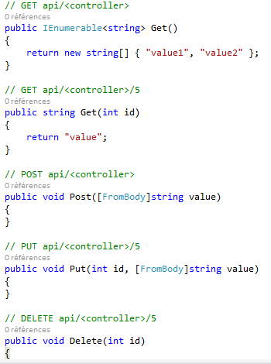
Exemple multi-protocoles
Il est possible de mixer GET et POST
Le FromBody doit être le dernier paramètre
Get = Request
Post = Create
Put = Update
Delete = Delete

Slide 14
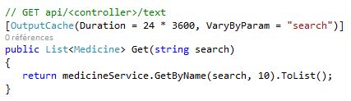
OutputCache
Permet de rajouter un cache

Slide 15
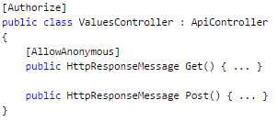
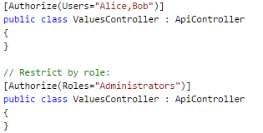
Authorisation
Authorize marche comme en MVC

Slide 16


Surcharger les protocoles
Depuis Web API 2 il est possible de ne pas utiliser la convention par défaut
Liste des annotation :
HttpDelete
HttpGet
HttpHead
HttpOptions
HttpPatch
HttpPost
HttpPut
Accept Verb autorise de nouveaux protocoles non normalisés

Slide 17
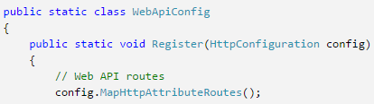
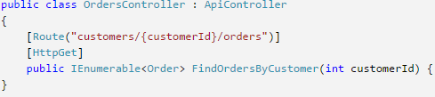
Surcharge des routes
Il est possible de surcharger les routes par action
Nécessite une configuration

Slide 18
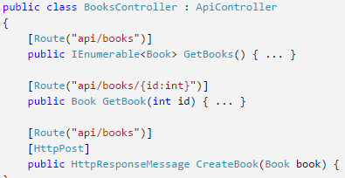
Paramètres
Pour les routes avec un préfixe identique, il est possible de discriminer les méthodes avec paramètre et un verbe

Slide 19
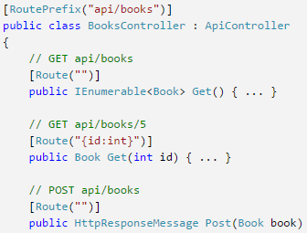
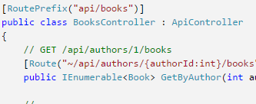
RoutePrefix
Il est possible de simplifier l'écriture des routes
~permet de redéfinir la route

Slide 20
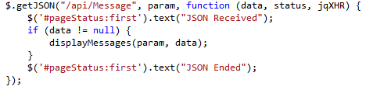
Exemples jQuery getJSON

