Slide 1
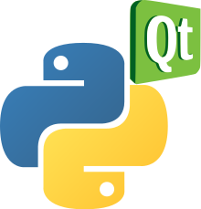
Chapitre 6
MVC

Slide 2
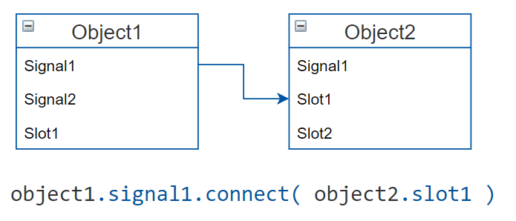
Adding the logic
Signals and Slots are used for communication between objects
Signal = is emitted by a Qt Object when a particular event is fired
Slot = a Python callable (function) that is called in response to a particular signal
button.clicked.connect(self.slot_method)
Notes:
Moving on to the next section, adding the logic To do that we use signals and slots Drawing: --Signal doesn’t care if anyone is listening
--Connect one to many….. --Typesafe: the signal type must match the slot type Widgets have some predefined signals, we can add our own Next: How to organize code when making these connections…..

Slide 3
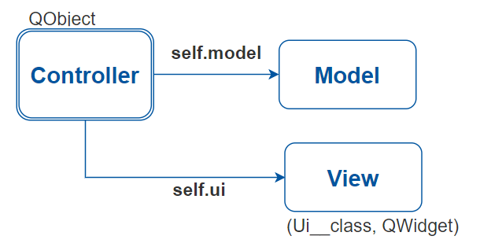
MVC Architecture
The Controller is a separate QObject:
Inside the Controller we have the Model and the View
We are obliged to use multiple inheritance for the View Class
To add the widget to a larger application we need to access the view class
Notes:
--Closer to the Java way we have seen before Create a controller which handles connecting the signals to the slots from the ui to the model (and vise versa)
--Multiple Inheritance(not Single) for easier accessing of elements(widgets) in the Ui_class form
Positive→ separate the logic from the view
Note(Issue): Doesn’t follow the philosophy of PyQt where every object is a view widget which includes its own logic --When we add a widget to a tree we need to access the view class, and ensure that the controller and the model are also part of the tree

Slide 4
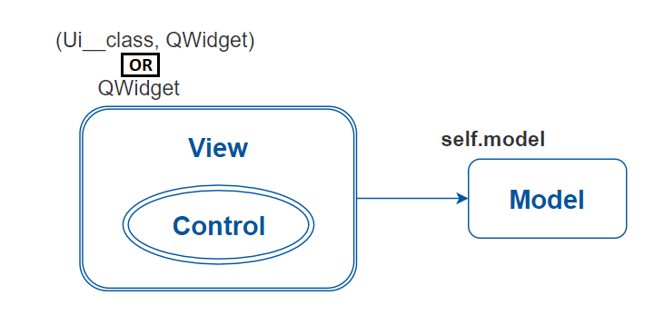
MV Architecture – The Qt Way
The logic is part of the View
Connections of signals to slots happen inside the View Class
Can be used with single or multiple inheritance
Can be used directly to compose larger UIs

Slide 5
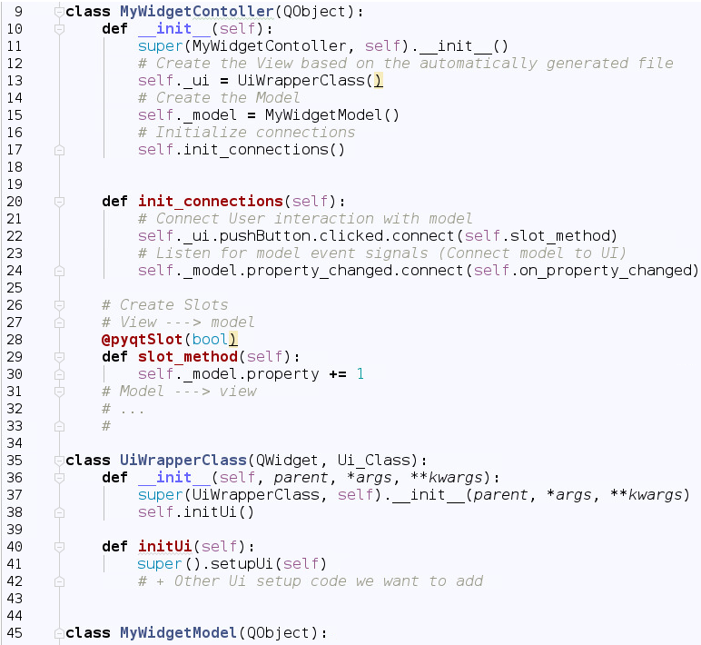
MV
MVC
Notes:
Comparing the code of the two approaches (MV and MVC) side by side

Slide 6
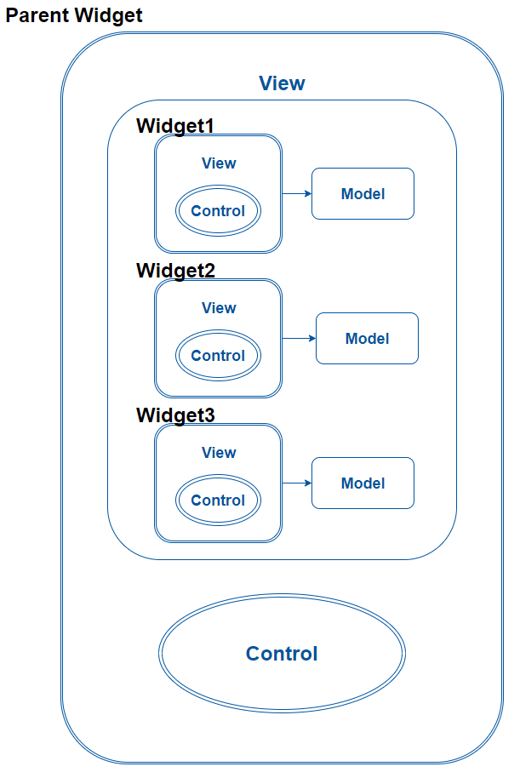
Using our custom Widgets
Parent Widget
Widget2
Widget3
Widget1
Logic to combine data from smaller widgets
Notes:
Scematic representation of how a larger UI of many widgets would be composed This tree structure should be respected from the lowest to the highest levels

Slide 7
Summing Up
MVC vs MV?
Single vs Multiple Inheritance?
Notes:
Although both MV and MVC widgets can be harmonically combined into to one application, it would be nice to follow a standard solution Which of the two approaches is better for designing our GUIs (MV vs MVC) MVC: Provides an already known and structured way of organizing code (everything is separate)
MV: The new more minimalistic solution that Qt proposes

Slide 8
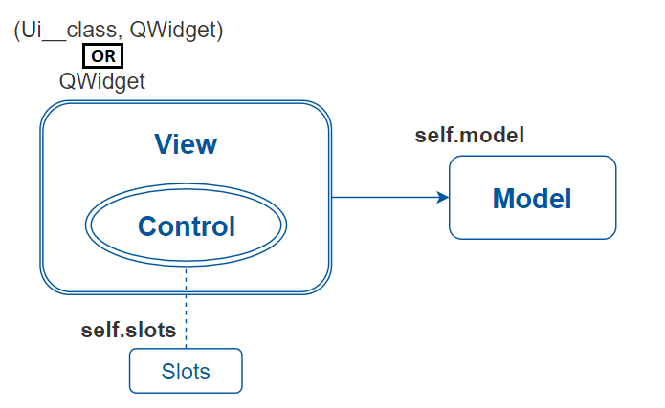
MV Architecture – Another Idea
The logic is part of the View, but the slot methods that handle the signals are defined in a separate class
Organizes the code in MVC style, while maintaining the PyQt philosophy

