Slide 1

Chapitre 5
QtDesigner

Slide 2
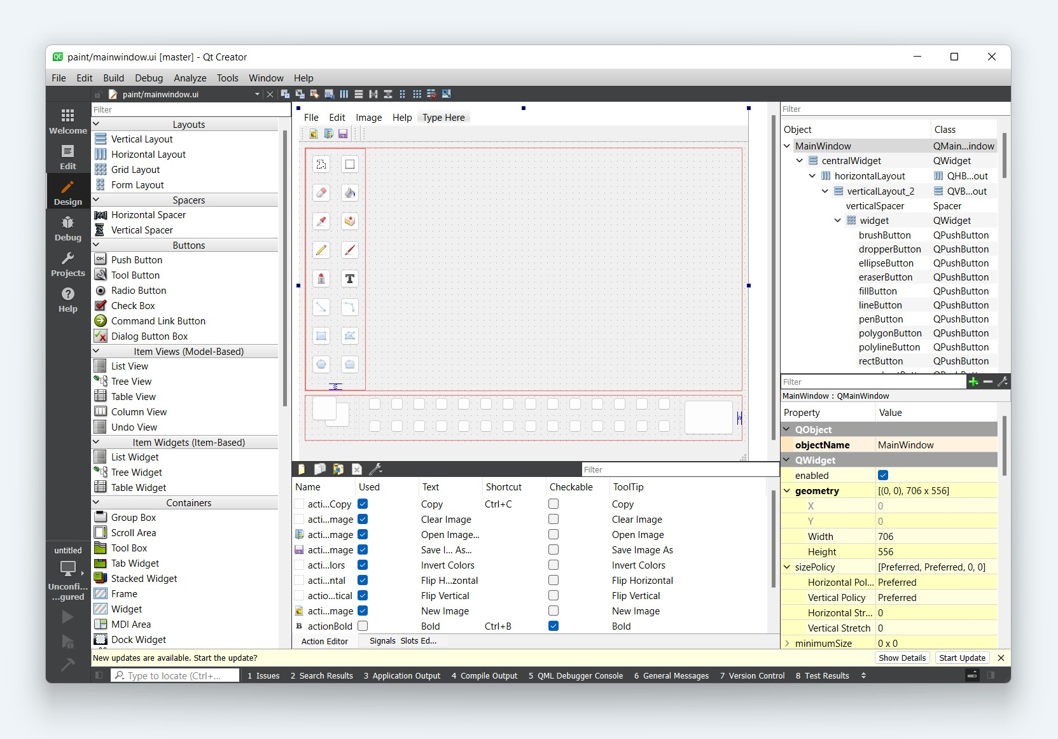
Qt Designer

Slide 3
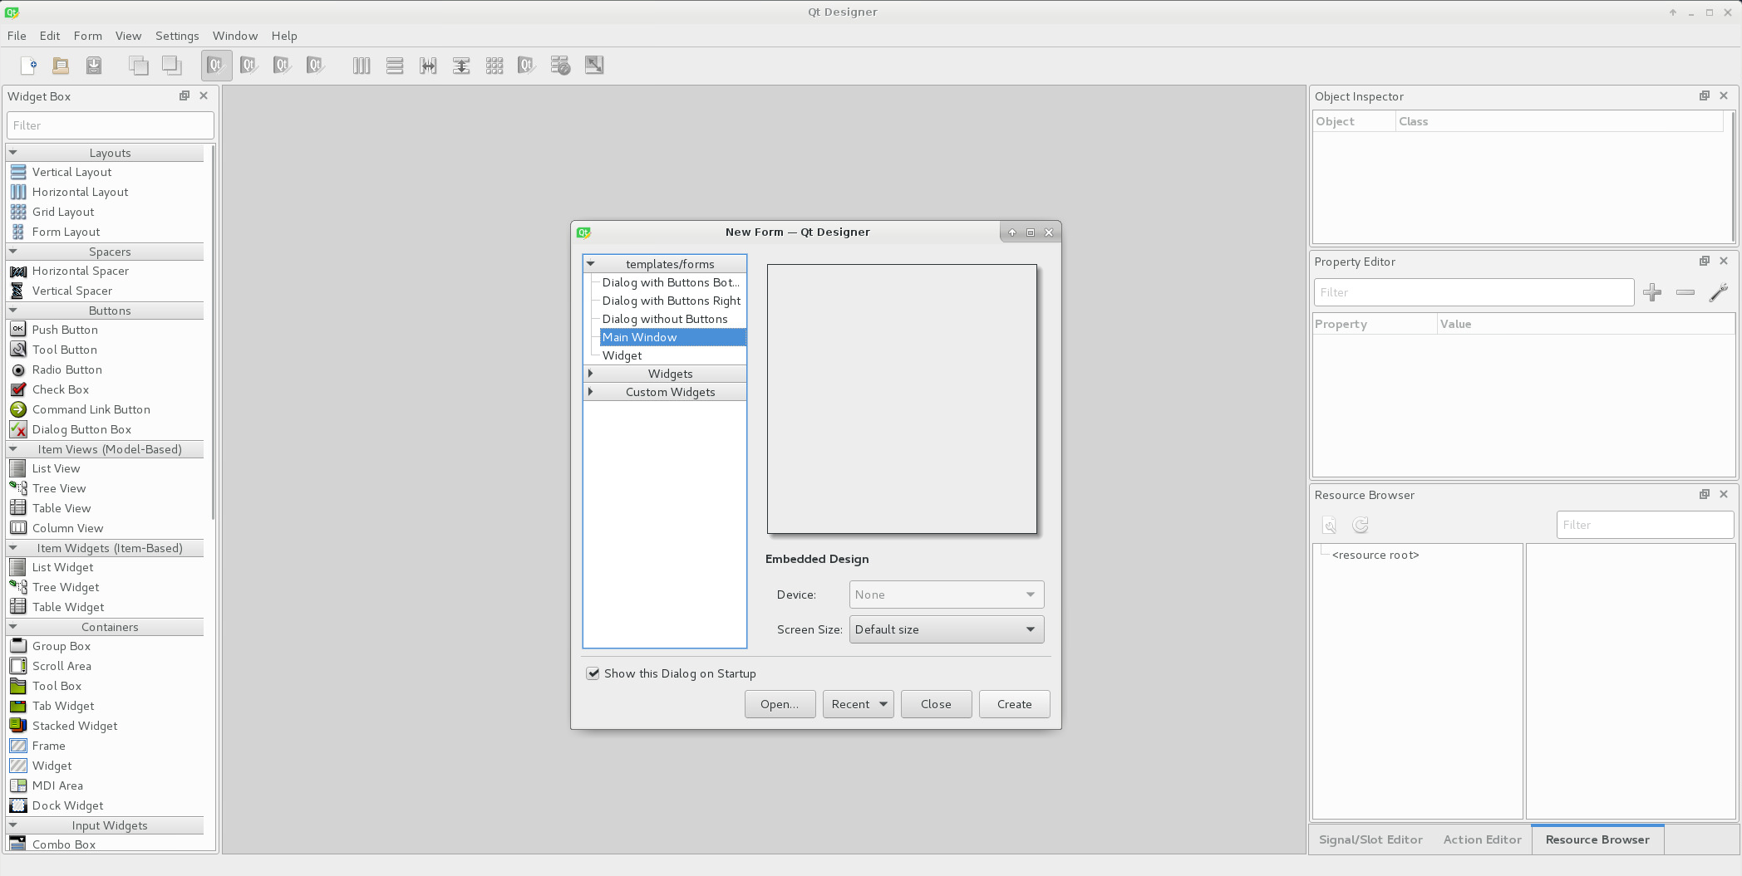
Qt Designer
Design the look of the GUI and automatically generate the Python code. Qt Designer can be extended by writing plugins (in C++ or Python)
A plugin is used to expose a custom widget to Designer so that it appears in Designer’s widget box just like any other widget.
Notes:
Screenshot of what we see on startup:
-Open or Create a new “Form” (Main Window, Dialog, Widget)
-from the left sidebar → simple drag and drop elements(widgets) to our design space
-On the right side → edit properties for our Widgets (Margin, Spacing…..) Useful for us: extension (example: wheel switch)

Slide 4
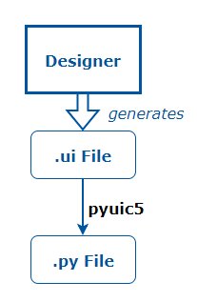

Using the Qt Designer
Designing small, reusable UI widgets
Use the Qt Designer to design the visual part of the widget (without logic).
Using the “pyuic5” command transform the generated XML .ui file into python code.
Extend generated code to add logic to the widget using signals and slots mechanism.
Notes:
First steps for using the designer

Slide 5
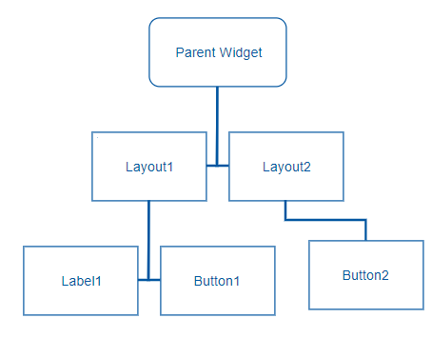
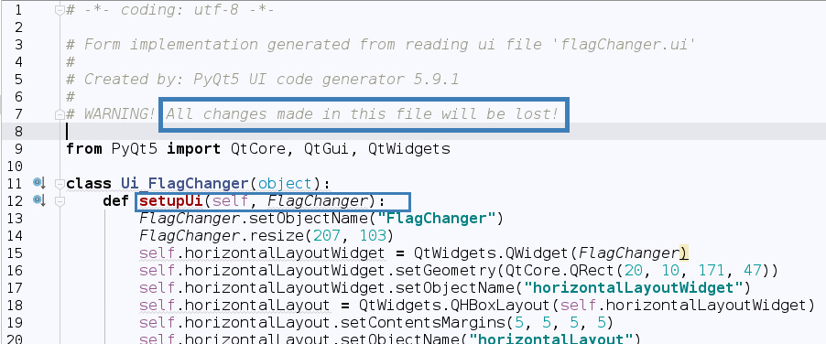
Automatically Generated Ui.py Code Structure
The code is structured as a single class that is derived from the Python object type.
The class contains a method called: setupUi(self, parentWidget) which builds the widget tree from the parent widget.
This file should only be imported, never edited.
Notes:
1) The name of the class is the name of the toplevel object set in Designer with Ui_ prepended.
2) This takes a single argument which is the widget in which the user interface is created.
---The type of this argument (typically QDialog, QWidget or QMainWindow) is set in Designer. We refer to this type as the Qt base class. Qt uses a tree structure for memory management (A “Ui Form” is this tree) 3)Never edit this flie --Change something in the design → delete and regenerate this file

Slide 6
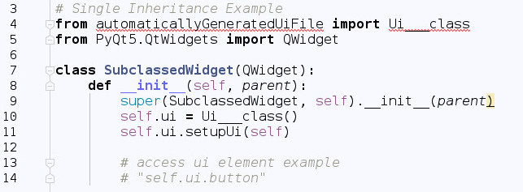
Single Inheritance Approach
Subclass a Qt widget, and set up the User Interface from within the constructor.
Expose the widgets and layouts used in the form to the Qt widget subclass, providing a standard system for making signal and slot connections between the user interface and other objects in your application
Encapsulation of the user interface widget variables within the “ui” data member
Notes:
simple use of inheritance to provide a QWidget-based interface
-
-
We can use this method to define a number of UIs within the same widget and overlay them.
(This approach can be used to create individual tabs from existing forms, for example.)

Slide 7
GridLayout
Le Layout en grille sont les plus pratiques
Utilisation de QtDesigner quasi-obligatoire

Slide 8
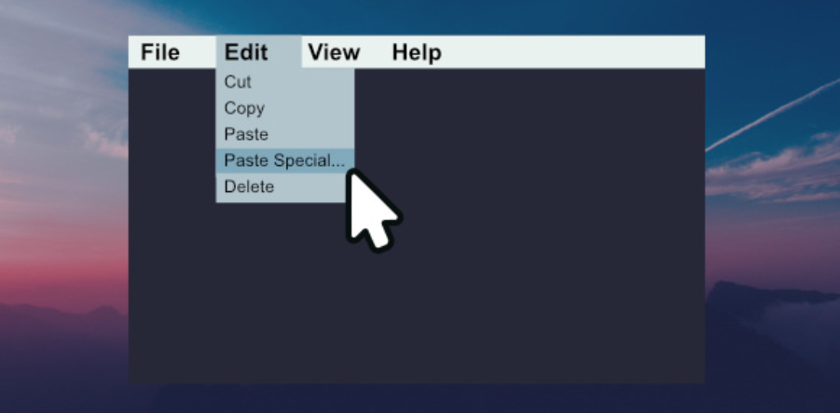
Menu & Toolsbar
Widgets containers
S’utilise comme les autres widgets

Slide 9
Conversion
Il peut être utile de pouvoir convertir le .ui en .py
Pour le modifier
Préférer l’héritage
Permet d’avoir l’intellisense
Attention : non réversible
pyuic6 mainwindow.ui -o MainWindow.py
Python –m pyuic6 …

