Slide 1
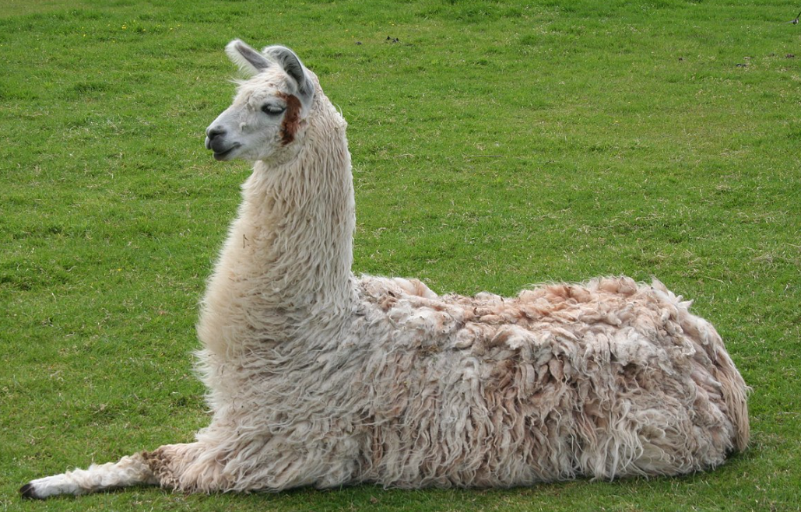
Large Language Model
Embedding
Introduction

