Slide 1
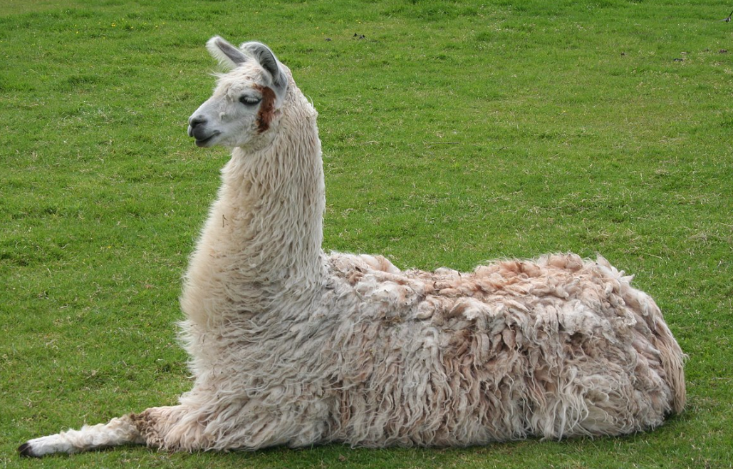

Large Language Model
RAG

Slide 2
Commencer par textsplitter
https://python.langchain.com/docs/concepts/text_splitters/
Puis les loaders
https://python.langchain.com/docs/integrations/document_loaders/
Puis tuto1 RAG

Slide 3
https://python.langchain.com/docs/integrations/text_embedding/

Slide 4
retrieval
https://python.langchain.com/docs/integrations/retrievers/

Slide 5
Chainage
QA
Graph

