Slide 1
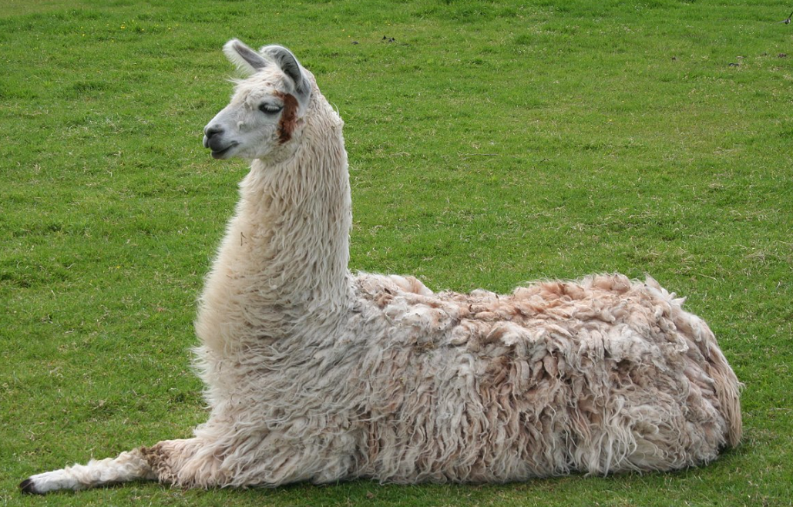
Large Language Model
RAG
Chaînage

Slide 2
Chainage
QA
Graph

Slide 3
Graph

