Slide 1

Forecasting the intermittent solar resource
Cyril Voyant, Research Director — Mines Paris – PSL, Centre O.I.E., Sophia Antipolis
UE14 — Mines Paris engineering curriculum (English version of the 2026 course)
Applied research project: modelling and forecasting global solar irradiance
MINES PARIS – PSL
CENTRE O.I.E.
SOPHIA ANTIPOLIS
Cite as: Voyant, C. (2026). Forecasting the intermittent solar resource (UE14 course, English version). Mines Paris – PSL. Licence CC BY 4.0.
Web companion with the worked example: cyrilvoyant.github.io/teaching/solar-forecasting-basics.html

Slide 2
Course outline
01
02
03
Why forecast solar power?
Solar radiation
Time series and forecasting
Grid issues, units, the Ajaccio data
Direct, diffuse, atmosphere, Sun position
Components, horizon, a first AR(1) model
04
05
06
Clear sky and clear-sky index
AR model and least squares
Evaluation, ELM and online learning
Solis model, CSI, stationarity
Building X and y, least squares, choosing p
Persistence, metrics, ELM, sliding window, frugality
Appendices: wide-sense stationarity, conditional expectation, AIC/BIC criteria. Glossary and references at the end.
Cyril Voyant · Mines Paris – PSL · Solar forecasting basics · CC BY 4.0
2

Slide 3
Project objectives
Context
By the end, you will be able to
Solar irradiance is intermittent (clouds).
The power grid must anticipate photovoltaic production.
Need: reliable short-term forecasts (here 1 h).
compute a clear-sky index (CSI);
build and estimate an AR(p) model by least squares;
build an ELM and measure its variability;
compare models with persistence (MAE, RMSE, skill score);
update a model online and judge its frugality.
The full chain we will build
1
2
3
4
5
6
7
8
9
GHI
measurements
Clear sky
GHI^{cs}
CSI index
(difference)
Centring
y = CSI − μ
Chronological
split
Model
P · AR · ELM
Forecast
ŷ_{t+h}
Forecast GHI
ŷ + μ + GHI^{cs}
Evaluation
day · day+night
This chain comes back in every chapter; the current step is highlighted.
Cyril Voyant · Mines Paris – PSL · Solar forecasting basics · CC BY 4.0
3

Slide 4
Notation (used throughout the course)
Symbol | Meaning
GHI_{t} | global horizontal irradiance measured at hour t (Wh/m²)
GHI^{cs}_{t} | clear-sky GHI (Solis model)
CSI_{t} | clear-sky index: GHI_{t} − GHI^{cs}_{t} (Wh/m²)
y_{t} | centred CSI, the modelled series: y_{t} = CSI_{t} − μ
ŷ_{t+h} | forecast of y made at t for t + h
h | horizon, in number of steps (1 step = 1 h)
p | number of lags (past values used)
GHI^{fc}_{t+h} | ŷ_{t+h} + μ + GHI^{cs}_{t+h}; 0 at night or if negative
e_{t} | forecast error: GHI^{fc}_{t} − GHI_{t}
μ | mean CSI (training period)
Symbol | Meaning
X, y | input matrix, target vector
w | AR model coefficients
ε_{t} | error (unpredictable part)
W_{in}, b | random ELM weights and biases
H, β, L | hidden outputs, output weights, number of neurons
θ_{z}, δ, ω, φ | zenith angle, declination, hour angle, latitude
α; W | ridge regularization; sliding-window length
N | number of examples (rows of X)
Δt | time step (here 1 h)
Convention: bold lower case = vector, bold upper case = matrix, plain = number. Time is always a subscript: y_{t}, y_{t−1}, CSI_{t+h}.
Cyril Voyant · Mines Paris – PSL · Solar forecasting basics · CC BY 4.0
4

Slide 5
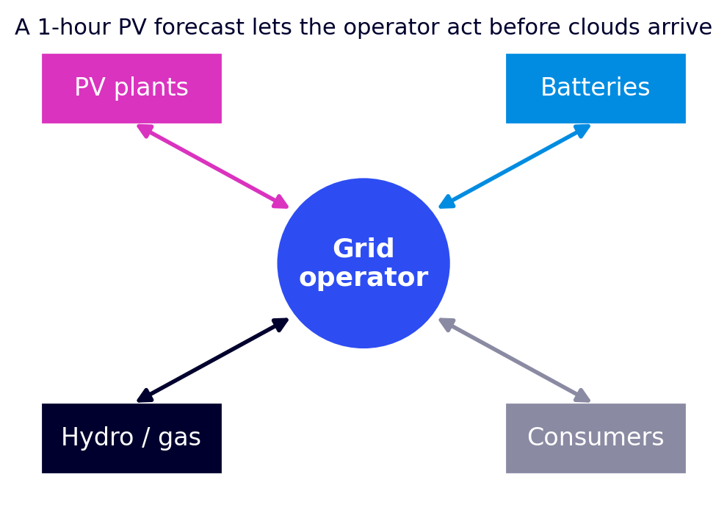
1 · Why forecast solar power?
Why forecast? Grid and solar production
Solar output varies with clouds. To integrate it into the grid, it must be anticipated.
Grid stability
Storage
Anticipate production drops to keep the frequency stable.
Charge or discharge batteries at the right time.
Supply / demand balance
Economic value
The grid operator balances PV, storage, other plants and consumers.
Adjust the other plants (hydro, pumped storage*, gas…).
Sell production at the best price and cut operating costs.
* Pumped-storage hydropower: a reversible dam that stores energy by pumping water uphill.
Cyril Voyant · Mines Paris – PSL · Solar forecasting basics · CC BY 4.0
5

Slide 6
1 · Why forecast solar power?
Irradiance, irradiation and photovoltaic output
Irradiance (W/m²)
Irradiation (Wh/m²)
Our data
Power received per m² at a given instant. Example: 1,000 W/m² in full sun at noon.
Energy received per m² over a duration. Over one hour: hourly irradiation in Wh/m² = mean irradiance in W/m².
Hourly GHI in Wh/m². Météo-France files are in J/cm²: 1 J/cm² = 2.78 Wh/m², so Wh/m² = J/cm² / 0.36.
From irradiance to electrical power
P ≈ η · S · G
η: module efficiency (≈ 20 %), S: area (m²), G: irradiance on the module (W/m²).
Example: 10 m² under 800 W/m² → P ≈ 0.20 × 10 × 800 = 1.6 kW.
Output is proportional to irradiance: forecasting GHI is forecasting production.
Cyril Voyant · Mines Paris – PSL · Solar forecasting basics · CC BY 4.0
6

Slide 7
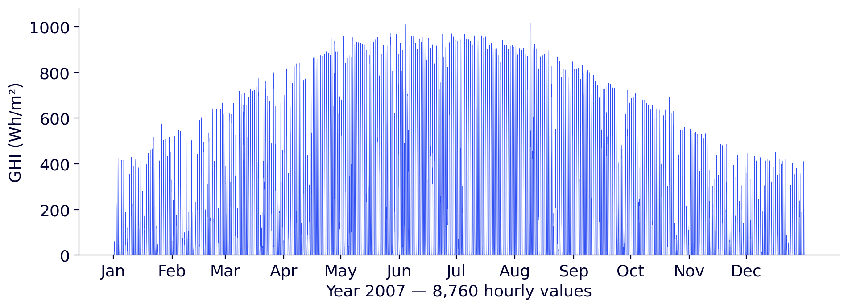
1 · Why forecast solar power?
The dataset: Ajaccio, 1998–2007
Site: Ajaccio (Corsica), 41.9° N, 8.8° E, 4 m.
Variable: hourly GHI (Wh/m²).
Period: 1998–2007, i.e. 87,600 hours.
Maximum: 1,025 Wh/m².
Daytime mean: 368 Wh/m².
Hourly GHI measured at Ajaccio in 2007 (Météo-France).
Ten years of measurements: 8 years to learn, 1 year to tune the model, 1 year to test it (chapter 5).
Cyril Voyant · Mines Paris – PSL · Solar forecasting basics · CC BY 4.0
7

Slide 8
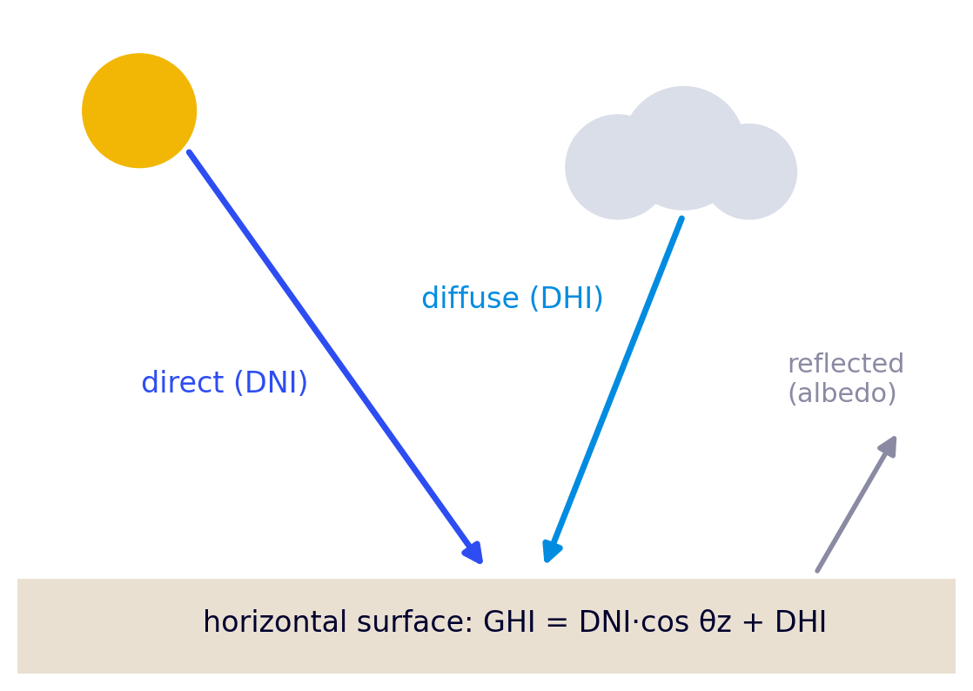
2 · Solar radiation
Components of global radiation
Direct (DNI)
Received straight from the Sun, measured on a surface perpendicular to the rays (direct normal). Dominant under clear sky.
Diffuse (DHI)
Scattered by air, aerosols and clouds. Dominant under overcast sky.
Reflected (albedo)
Sent back by the ground. Counts only for a tilted surface, not for GHI.
θ_{z}: zenith angle (between the Sun and the vertical). GHI = Global Horizontal Irradiance.
Cyril Voyant · Mines Paris – PSL · Solar forecasting basics · CC BY 4.0
8

Slide 9
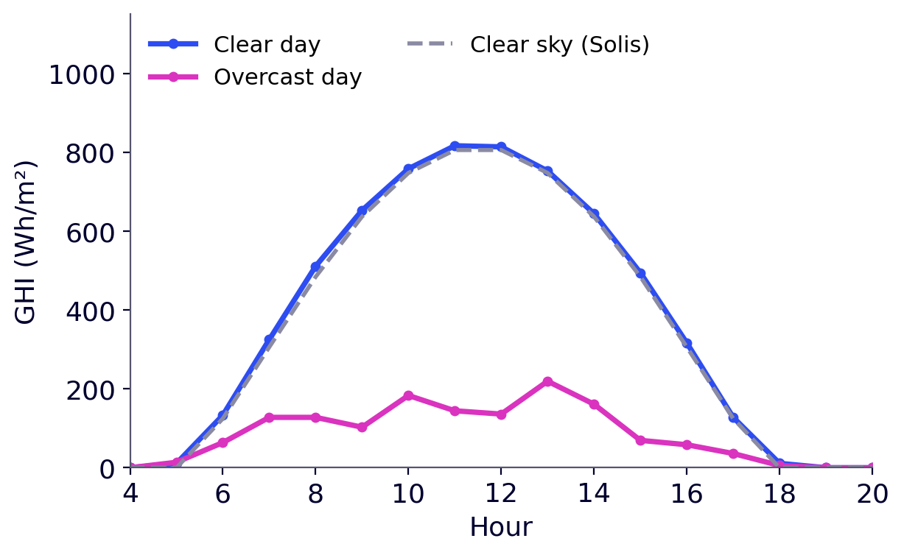
2 · Solar radiation
Crossing the atmosphere
Through the atmosphere, radiation is attenuated by four mechanisms.
Absorption
Rayleigh scattering
Water vapour, ozone, CO₂: part of the energy is absorbed.
By air molecules: it makes the sky blue.
Mie scattering
Clouds
By aerosols (dust, sea salt, pollution): depends on turbidity.
Reflection, scattering and absorption: main cause of intermittency.
Ajaccio, 2007: a clear day and an overcast day.
Under overcast sky, GHI drops here to about 20 % of its clear-sky value.
Cyril Voyant · Mines Paris – PSL · Solar forecasting basics · CC BY 4.0
9

Slide 10
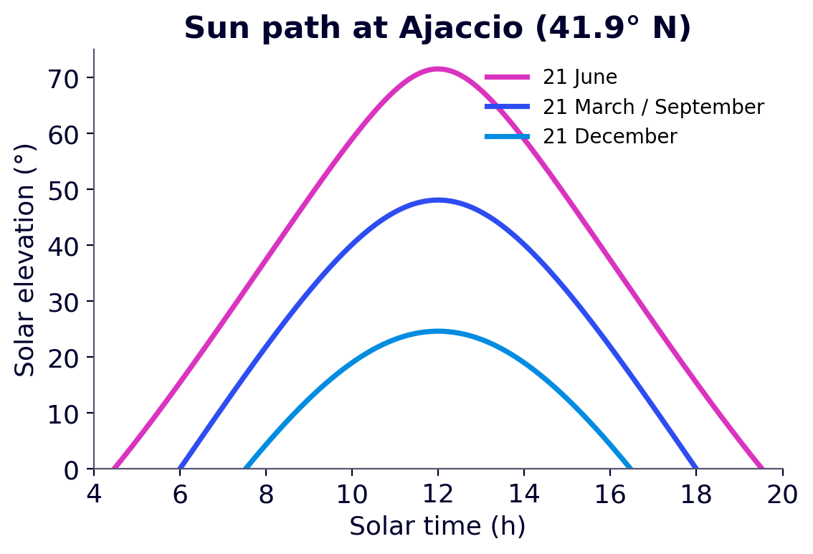
2 · Solar radiation
The position of the Sun
Zenith angle θ_{z}: between the Sun and the vertical. The larger it is, the thicker the atmosphere crossed.
Declination δ: angle between the Sun's direction and the equatorial plane; from −23.45° to +23.45° over the year.
Hour angle ω: 15° per hour, zero at solar noon. Latitude φ: 41.9° at Ajaccio.
cos θ_{z} = sin φ · sin δ + cos φ · cos δ · cos ω
Solar elevation over the day at Ajaccio, by season.
G₀ = I₀ · (d₀/d)² · cos θ_{z}
G₀: extraterrestrial radiation; I₀ ≈ 1361 W/m² (solar constant; 1367 in older codes).
The Earth–Sun distance d varies by ±1.7 %, so (d₀/d)² varies by ±3.3 %.
Cyril Voyant · Mines Paris – PSL · Solar forecasting basics · CC BY 4.0
10

Slide 11
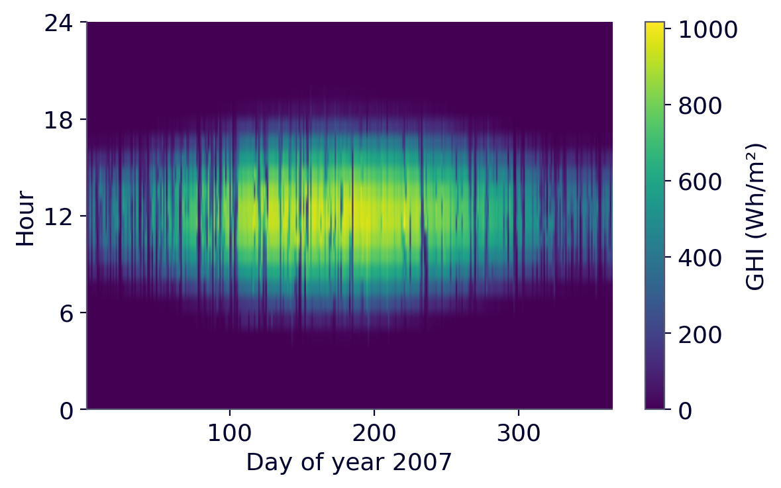
2 · Solar radiation
The double seasonality of GHI
Daily seasonality
Zero at night, maximum around solar noon: a 24-h cycle well described by the clear-sky model.
Annual seasonality
The amplitude of the daily cycle changes with the season (declination, day length): a 365-day cycle.
Raw GHI is not stationary: its mean depends on the hour and the month. Both cycles must be removed before modelling.
Hourly GHI in 2007: hours of the day × days of the year (Ajaccio).
Cyril Voyant · Mines Paris – PSL · Solar forecasting basics · CC BY 4.0
11

Slide 12
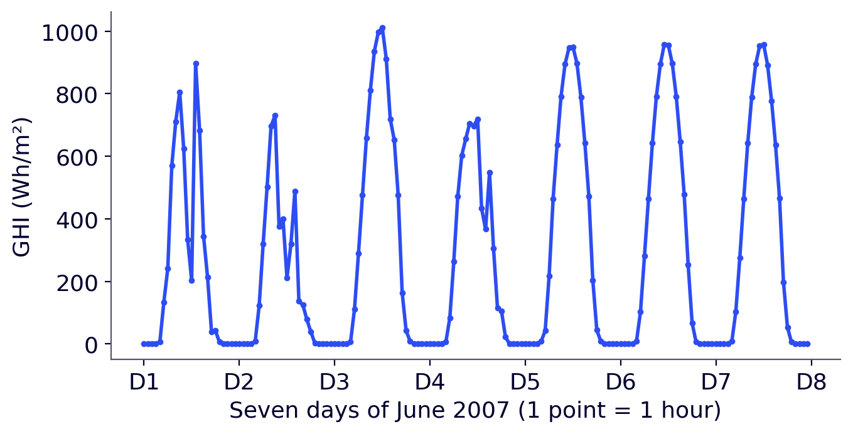
3 · Time series and forecasting
What is a time series?
A sequence of measurements y₁, y₂, …, y_{N} of one quantity, taken at a constant time step Δt. Here Δt = 1 h.
Three properties
Regularity: measurements are equally spaced.
Dependence: the past informs the future.
Randomness: each value has an unpredictable part.
What we want for modelling
Ajaccio: one week of hourly GHI.
Stationarity: stable mean and variance over time.
Complete series: no missing values.
Raw GHI is not stationary (day/night and seasonal cycles): that is the whole point of chapter 4.
Cyril Voyant · Mines Paris – PSL · Solar forecasting basics · CC BY 4.0
12

Slide 13
3 · Time series and forecasting
Components of a time series
Trend T_{t}
Seasonality S_{t}
Slow long-term change: increasing, decreasing or none.
Regular, repeatable cycles (day, year). Very strong for GHI.
Cycle C_{t}
Residual R_{t}
Long, not strictly periodic oscillations (climate phenomena).
Unexplained random part. Ideally white noise (independent values, zero mean).
For GHI: seasonality dominates, with two cycles (daily and annual).
Cyril Voyant · Mines Paris – PSL · Solar forecasting basics · CC BY 4.0
13

Slide 14
3 · Time series and forecasting
Decomposing a time series
Additive model
Why decompose?
y_{t} = T_{t} + S_{t} + C_{t} + R_{t}
Remove trend and seasonality (the part predictable without effort);
keep a residual that is easier to model;
check that this residual looks like white noise.
When the amplitude of fluctuations stays constant.
Multiplicative model
y_{t} = T_{t} × S_{t} × C_{t} × R_{t}
Link with what follows: subtracting clear-sky GHI, CSI_{t} = GHI_{t} − GHI^{cs}_{t}, applies the additive model: both cycles go at once. The ratio (multiplicative model) also exists: chapter 4.
When the amplitude grows with the level (GHI: small in winter, large in summer).
Cyril Voyant · Mines Paris – PSL · Solar forecasting basics · CC BY 4.0
14

Slide 15
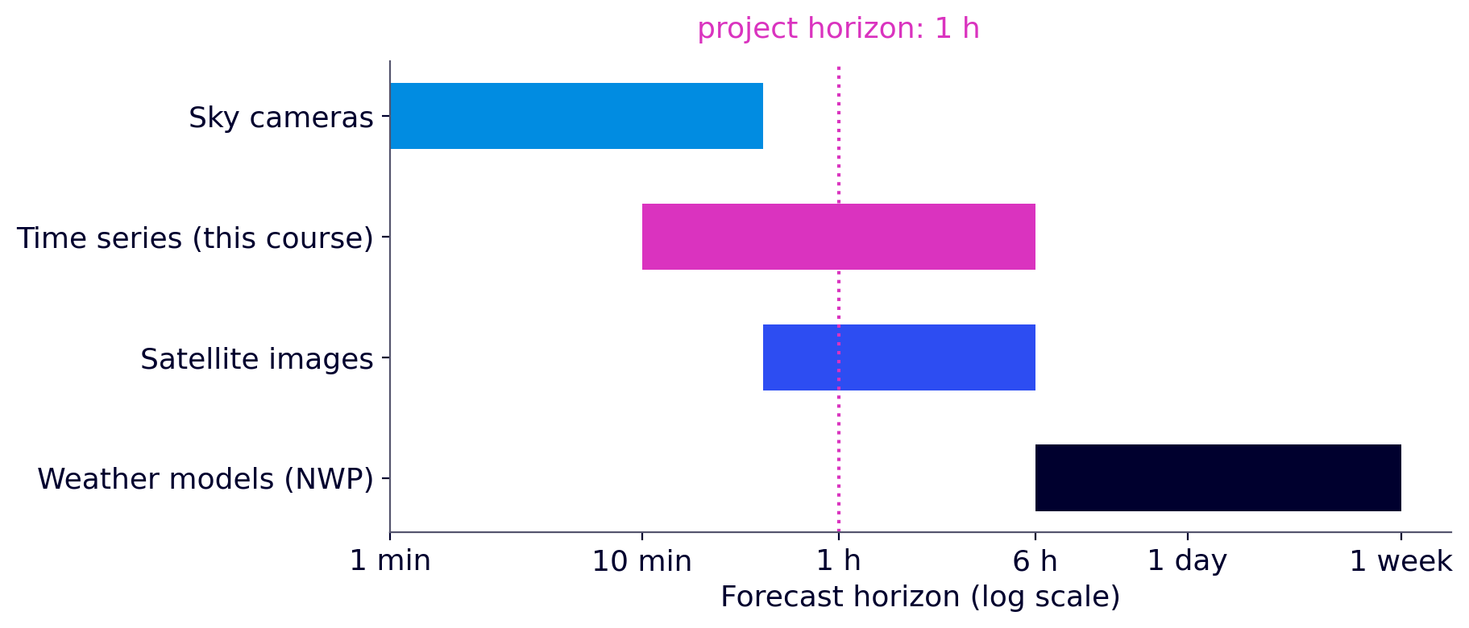
3 · Time series and forecasting
Horizon, time step and types of forecast
Time step Δt = 1 h; horizon h in steps: h = 1 → 1 h, h = 3 → 3 h.
Direct forecast: one model trained for each horizon h.
Recursive forecast: forecast t + 1, then feed that forecast back to forecast t + 2, and so on.
Usual methods by horizon (orders of magnitude).
In this course: 1-h horizon, direct forecast.
Cyril Voyant · Mines Paris – PSL · Solar forecasting basics · CC BY 4.0
15

Slide 16
3 · Time series and forecasting
Forecasting: a predictable part and an error
y_{t+1} = f(y_{t}, y_{t−1}, …, y_{t−p+1}) + ε_{t+1}
The predictable part
The error
The goal
f sums up what the past tells us about the future. The forecast is ŷ_{t+1} = f(y_{t}, …, y_{t−p+1}).
ε_{t+1} = y_{t+1} − ŷ_{t+1} is the unpredictable part. If the model is good, ε looks like white noise.
Choose f so that errors are as small as possible in mean square.
The framework suits GHI: regular measurements and strong hour-to-hour dependence (cloud inertia). Further reading: appendix B.
Cyril Voyant · Mines Paris – PSL · Solar forecasting basics · CC BY 4.0
16

Slide 17
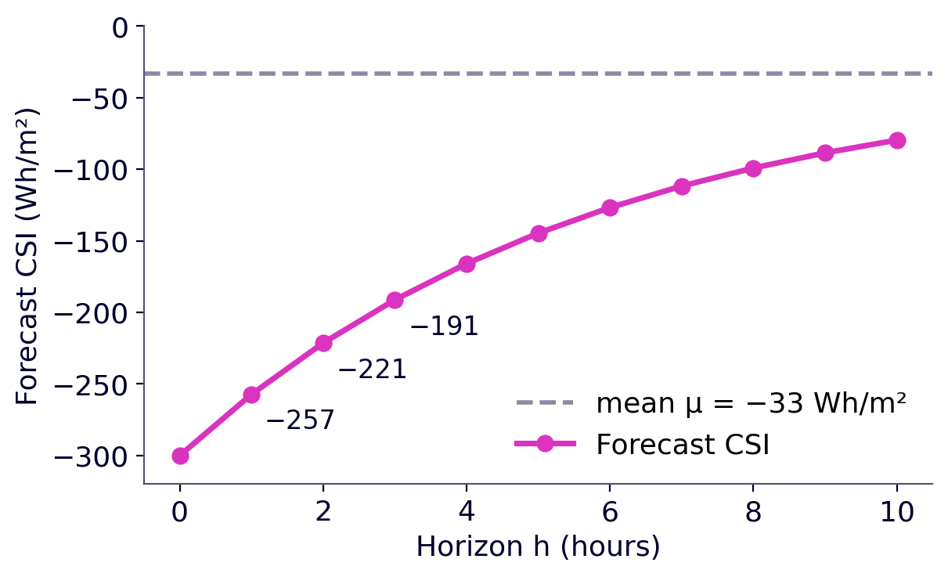
3 · Time series and forecasting
A first example: the AR(1) model, with numbers
y_{t+1} = w · y_{t} + ε_{t+1}
y_{t} = CSI_{t} − μ: gap of the CSI to its mean; w: weight of the last gap.
|w| < 1: the series always returns to its mean.
ŷ_{t+h} = w^{h} · y_{t}
Ajaccio: μ ≈ −33 Wh/m² and w ≈ 0.84. A cloud: CSI_{t} = −300 Wh/m², so y_{t} = −267.
ŷ_{t+1} = 0.84 × (−267) = −224: forecast CSI = −257 Wh/m²; then −221 and −191 at 2 h and 3 h.
The forecast CSI returns to its mean as h grows.
Cyril Voyant · Mines Paris – PSL · Solar forecasting basics · CC BY 4.0
17

Slide 18
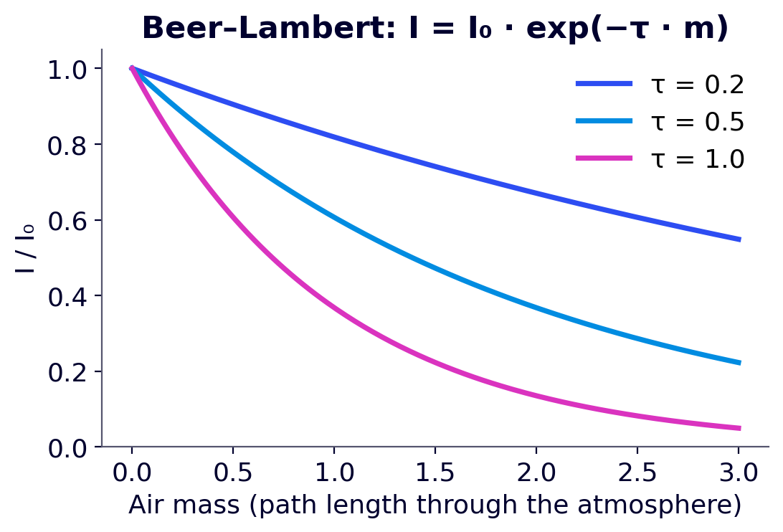
4 · Clear sky and clear-sky index
The clear-sky model
What is it?
The GHI one would measure without clouds, given the Sun's position and a clear atmosphere.
Inputs
site position (latitude, longitude, altitude);
Sun position (θ_{z});
water vapour and aerosols (AOD: aerosol optical depth).
Role: GHI^{cs}_{t} is the reference used to remove the day/night and seasonal cycles.
Beer–Lambert law: intensity decays exponentially with the path length crossed.
Cyril Voyant · Mines Paris – PSL · Solar forecasting basics · CC BY 4.0
18

Slide 19
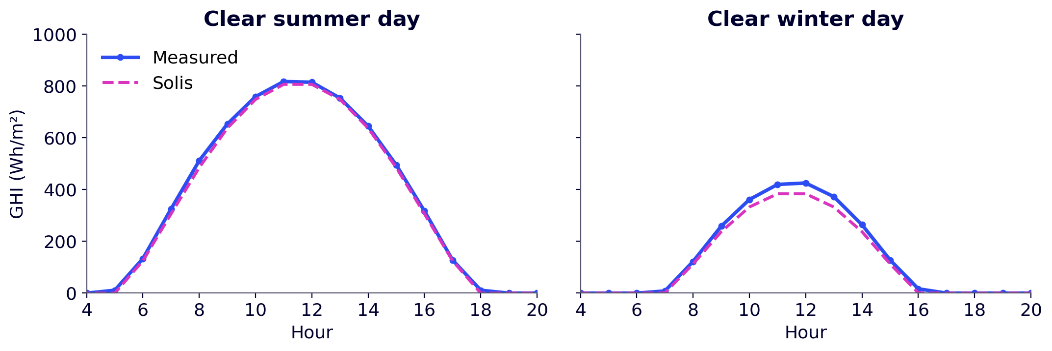
4 · Clear sky and clear-sky index
The Solis model
Solis (Ineichen, 2008) is a simplified version of a radiative-transfer model. It starts from the Beer–Lambert law:
GHI^{cs} ≈ I₀ · exp(−τ / cos θ_{z}) · cos θ_{z}
τ: optical depth (air, water vapour, aerosols);
Solis adjusts τ and the exponent for water vapour, aerosols and altitude.
Ajaccio, 2007: Solis and measurement under clear sky.
Settings: rural zone, water column 3.79 cm, AOD 0.16, I₀ = 1367 W/m².
The hourly value is the mean of the past hour: the Sun is computed at mid-hour, ω = (i − 12.5) × 15°.
Mean clear-sky error at Ajaccio: ≈ 32 Wh/m².
Cyril Voyant · Mines Paris – PSL · Solar forecasting basics · CC BY 4.0
19

Slide 20
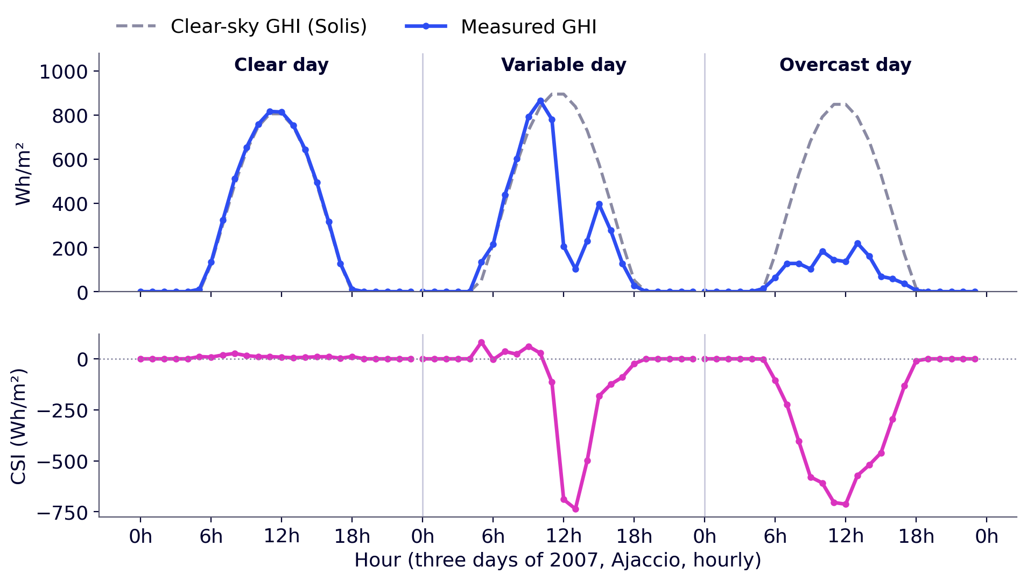
4 · Clear sky and clear-sky index
Stationarizing: the clear-sky index (CSI)
CSI_{t} = GHI_{t} − GHI^{cs}_{t}
≈ 0 under clear sky, and 0 at night;
negative under clouds (down to −GHI^{cs});
mean μ ≈ −33 Wh/m²: we centre it, y_{t} = CSI_{t} − μ.
The procedure
1. compute GHI^{cs}, then the CSI;
2. centre: y_{t} = CSI_{t} − μ;
3. forecast ŷ_{t+h};
4. rebuild GHI^{fc}_{t+h} = ŷ_{t+h} + μ + GHI^{cs}_{t+h} (0 at night, never negative).
Ajaccio, 2007: top, GHI; bottom, CSI. The daily cycle has gone from the CSI.
Cyril Voyant · Mines Paris – PSL · Solar forecasting basics · CC BY 4.0
20

Slide 21
4 · Clear sky and clear-sky index
Two ways to stationarize
The Solis model removes the cycles in two ways:
Difference (additive model) — this course
Ratio (multiplicative model)
CSI_{t} = GHI_{t} − GHI^{cs}_{t}, in Wh/m²;
no division: valid day and night (at night, 0 − 0 = 0);
all hours are kept, no filtering.
k_{t} = GHI_{t} / GHI^{cs}_{t}, unitless (≈ 1 under clear sky); widely used in the literature;
at night: 0 / 0, undefined; at sunrise and sunset, GHI^{cs} ≈ 0: values explode;
requires filtering on solar elevation (for instance keep h > 10°).
For hourly data with nights, the ratio is poorly suited: we use the difference. The ratio is also very sensitive to small timestamp offsets and to the filtering thresholds chosen (Voyant et al., 2025a; 2026).
Cyril Voyant · Mines Paris – PSL · Solar forecasting basics · CC BY 4.0
21

Slide 22
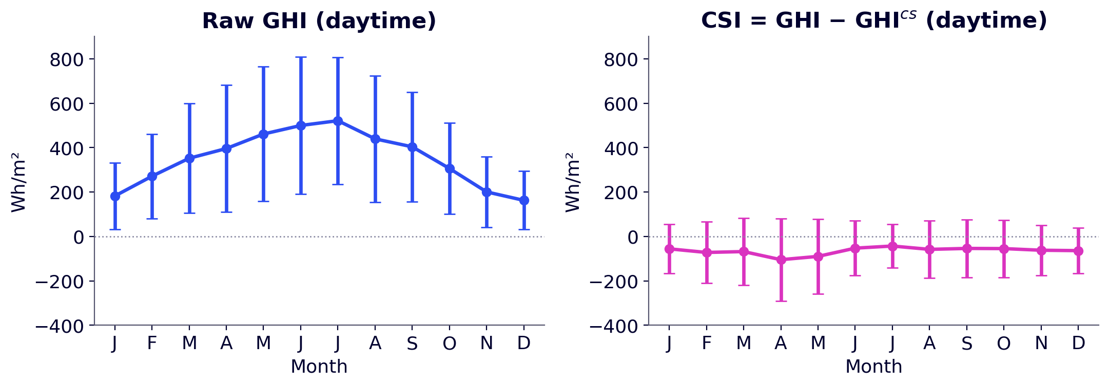
4 · Clear sky and clear-sky index
Is the CSI stationary?
GHI: the mean ranges from 163 to 521 Wh/m² depending on the month.
CSI: the mean stays between −105 and −43 Wh/m², close to 0.
The CSI standard deviation still varies (97 to 185 Wh/m²): more clouds in spring.
Mean ± standard deviation by month, daytime hours, Ajaccio 1998–2007.
The CSI is approximately stationary: much more than GHI, though not perfectly. Formal definition: appendix A.
Cyril Voyant · Mines Paris – PSL · Solar forecasting basics · CC BY 4.0
22

Slide 23
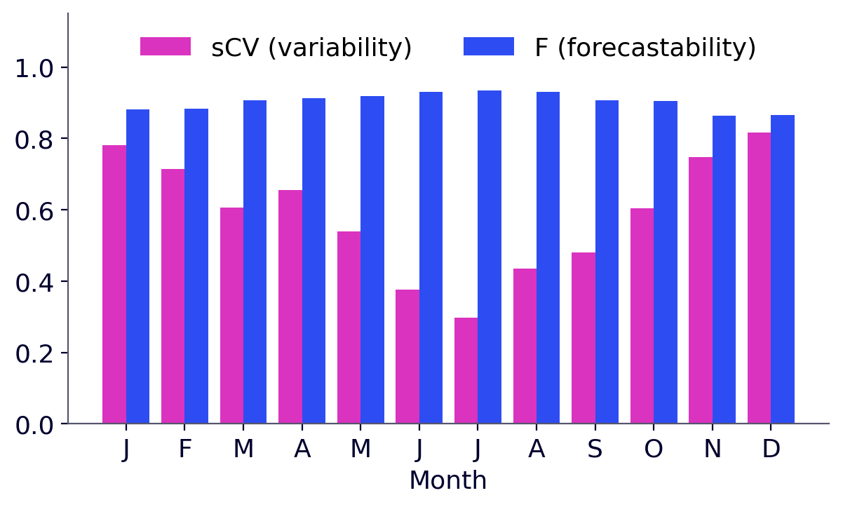
4 · Clear sky and clear-sky index
Site variability: the sCV
How far does GHI depart, on average, from clear sky? We measure the gap ε_{t} = GHI_{t} − GHI^{cs}_{t} (the CSI):
sCV = (√2 / (1 − d)) · √[ Σ_{t} (GHI_{t} − GHI^{cs}_{t})² / Σ_{t} (GHI^{cs}_{t})² ]
Numerator: typical size of the gaps to clear sky (the clouds).
Denominator: typical size of clear-sky GHI.
√2 / (1 − d) scales the worst case to 1: clear sky, then very overcast, every other hour (d = 0.2: even under overcast sky, at least 20 % of clear sky remains).
Ajaccio 1998–2007: sCV and F at 1 h, month by month (Voyant et al., 2026).
Ajaccio: sCV = 0.52 over 1998–2007.
Winter: 0.8 (changeable sky); July: 0.3 (often clear sky).
sCV = 0: always clear; sCV = 1: maximum variability. It does not depend on the horizon: it is a property of the site.
Cyril Voyant · Mines Paris – PSL · Solar forecasting basics · CC BY 4.0
23

Slide 24
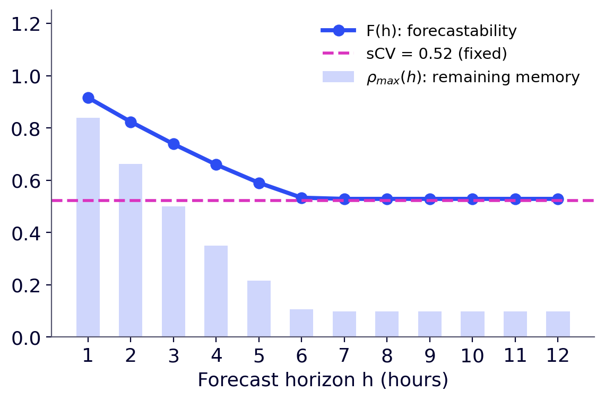
4 · Clear sky and clear-sky index
Forecastability: F depends on the horizon
A variable series is not necessarily unpredictable: if the gaps to clear sky last, they can be anticipated.
ρ(k): correlation between the clear-sky gap now, ε_{t}, and k hours later, ε_{t+k} (the memory of clouds).
ρ_{max}(h): the strongest of these correlations for k between h and 12 h: the memory left when forecasting at horizon h.
F(h) = 1 − sCV · (1 − ρ_{max}(h))
Ajaccio 1998–2007: F and remaining memory by horizon (Voyant et al., 2026).
perfect memory (ρ_{max} = 1): F = 1, everything is predictable;
no memory (ρ_{max} = 0): F = 1 − sCV.
F = 0.92 at 1 h, 0.74 at 3 h, 0.53 at 6 h.
The atmosphere is chaotic: cloud memory fades within a few hours. sCV does not move.
Cyril Voyant · Mines Paris – PSL · Solar forecasting basics · CC BY 4.0
24

Slide 25
4 · Clear sky and clear-sky index
Pre-processing step by step
1
2
3
4
5
6
7
8
9
GHI
measurements
Clear sky
GHI^{cs}
CSI index
(difference)
Centring
y = CSI − μ
Chronological
split
Model
P · AR · ELM
Forecast
ŷ_{t+h}
Forecast GHI
ŷ + μ + GHI^{cs}
Evaluation
day · day+night
1 · Measurements
2 · Clear sky
3 · CSI
4 · Centring
Hourly GHI, converted from J/cm² to Wh/m² (÷ 0.36).
GHI^{cs} by Solis, Sun at mid-hour, over a typical year.
CSI_{t} = GHI_{t} − GHI^{cs}_{t}, every hour.
y_{t} = CSI_{t} − μ with μ ≈ −33 Wh/m²: series ready for AR and ELM.
With the difference, nights cause no problem (0 − 0 = 0): no filtering on solar elevation, unlike the ratio.
Cyril Voyant · Mines Paris – PSL · Solar forecasting basics · CC BY 4.0
25

Slide 26
5 · AR model and least squares
From the AR model to linear regression
An AR(p) model forecasts the next value from the last p values:
y_{t+1} = w₁ y_{t} + w₂ y_{t−1} + … + w_{p} y_{t−p+1} + ε_{t+1}
Matrix form
y (N × 1): the values to forecast;
X (N × p): one row per example, with the p lags;
w (p × 1): the coefficients to estimate;
ε (N × 1): the errors.
y = X w + ε
It is a multiple linear regression. Since y is centred, no intercept is needed.
Cyril Voyant · Mines Paris – PSL · Solar forecasting basics · CC BY 4.0
26

Slide 27
5 · AR model and least squares
Building X and y: a worked example
Five centred CSI values (Wh/m²): y₁ = −10; y₂ = −25; y₃ = −240; y₄ = −180; y₅ = −30. Take p = 2.
Row | y_{t} | y_{t−1} | Target y_{t+1}
t = 2 | −25 | −10 | −240
t = 3 | −240 | −25 | −180
t = 4 | −180 | −240 | −30
In practice: all hours are kept, nights included (at night, y = −μ ≈ 33). At Ajaccio: 8 years, about 70,000 rows for training.
The two middle columns form X (3 × 2), the last one forms y (3 × 1).
Each row shifts the previous one by one step.
Cyril Voyant · Mines Paris – PSL · Solar forecasting basics · CC BY 4.0
27

Slide 28
5 · AR model and least squares
Ordinary least squares (OLS)
We look for the w that minimizes the sum of squared errors:
ŵ = (X^{T}X)⁻¹ X^{T}y
J(w) = ‖y − Xw‖² = Σ_{i} (y_{i} − x_{i}^{T} w)²
At the minimum, the derivative is zero:
−2 X^{T}(y − Xw) = 0 ⟹ X^{T}X w = X^{T}y
Exact solution, in one step: no iteration, a single minimum.
Ajaccio, AR(2): ŵ = (0.97; −0.15), computed in 5 ms.
The last gap y_{t} weighs by far the most.
Conditions: many more examples than coefficients (N ≫ p);
columns of X not proportional to each other.
Cyril Voyant · Mines Paris – PSL · Solar forecasting basics · CC BY 4.0
28

Slide 29
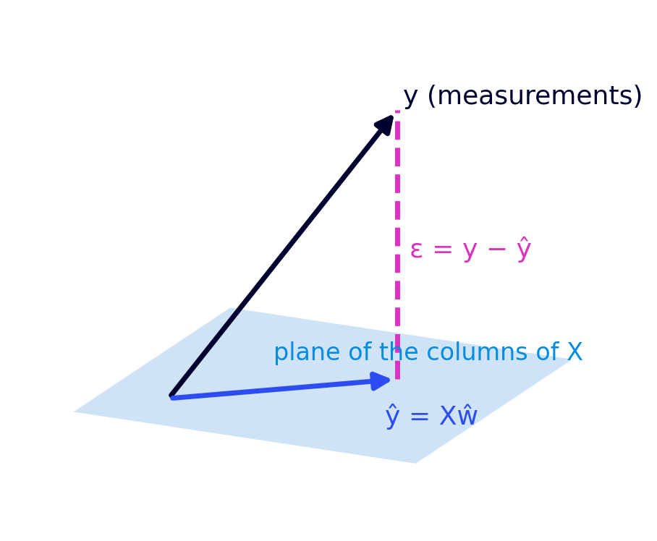
5 · AR model and least squares
Geometric interpretation
Xŵ is the point of the “plane of the columns of X” closest to y: its orthogonal projection.
The error ε = y − Xŵ is perpendicular to this plane.
Pythagoras: ‖y‖² = ‖ŷ‖² + ‖ε‖². This is the basis of the R² coefficient.
OLS does not “guess” anything: it projects the measurements onto what the inputs can explain.
Cyril Voyant · Mines Paris – PSL · Solar forecasting basics · CC BY 4.0
29

Slide 30
5 · AR model and least squares
Training, validation, test
Training
1998 – 2005
Validation
2006
Test
2007
time
Training
Validation
Test
Coefficients are estimated (w, β).
Hyperparameters (p, L) are chosen without touching the test.
Performance is measured once, on data never seen.
Chronological split, never shuffled: the past is not forecast with the future. After validation, re-estimate on training + validation.
Cyril Voyant · Mines Paris – PSL · Solar forecasting basics · CC BY 4.0
30

Slide 31
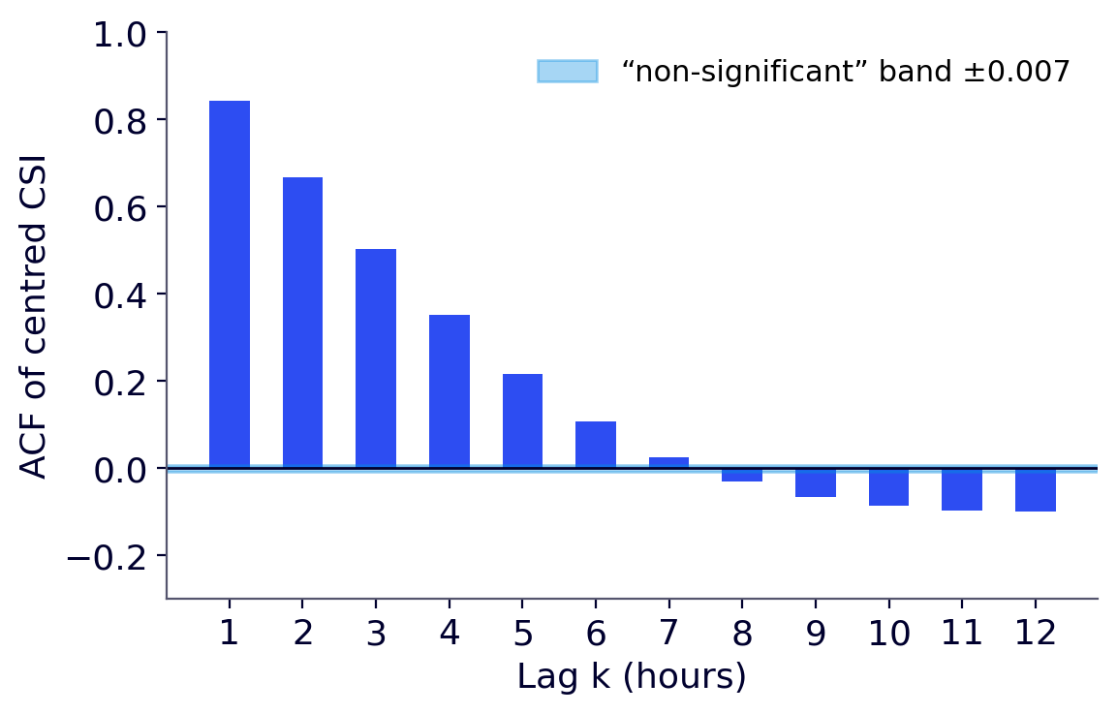
5 · AR model and least squares
Choosing p (1/3): autocorrelation (ACF)
ACF(k): correlation between y_{t} and y_{t−k}, the value k hours earlier.
Here ACF(1) = 0.84, ACF(2) = 0.67, ACF(3) = 0.50: it decays slowly.
But this correlation propagates step by step: if y_{t} depends on y_{t−1}, which depends on y_{t−2}, then y_{t} and y_{t−2} are correlated even without a direct link.
The ACF therefore does not tell how many lags are really useful. The PACF is needed.
ACF of the centred CSI, Ajaccio 1998–2005, all hours.
Cyril Voyant · Mines Paris – PSL · Solar forecasting basics · CC BY 4.0
31

Slide 32
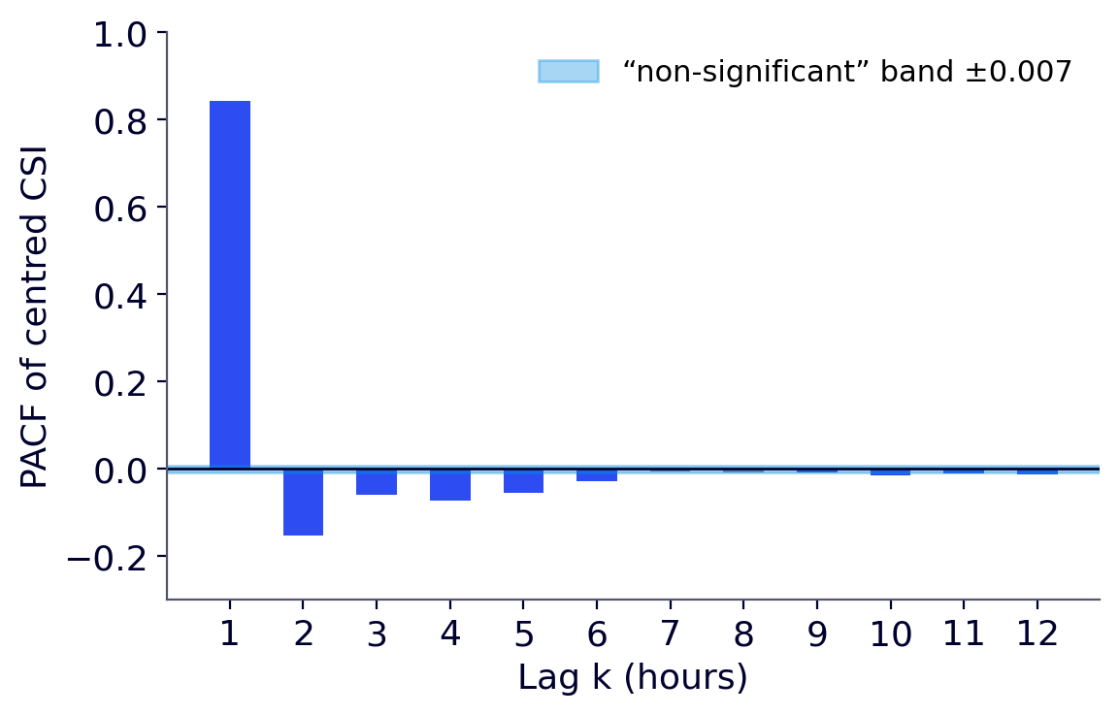
5 · AR model and least squares
Choosing p (2/3): partial autocorrelation (PACF)
PACF(k): once y_{t−1}, …, y_{t−k+1} are known, what does y_{t−k} add? It is the last coefficient w_{k} of an AR(k).
A bar outside the blue band: this lag brings direct information.
For a true AR(p), the PACF vanishes after lag p.
Here PACF(1) = 0.84, PACF(2) = −0.15, then values below 0.08: the PACF suggests p ≈ 2.
But with N ≈ 70,000 points, the ±0.007 threshold is tiny: almost everything is “significant”. Significant ≠ useful.
PACF of the centred CSI, Ajaccio 1998–2005, all hours.
Cyril Voyant · Mines Paris – PSL · Solar forecasting basics · CC BY 4.0
32

Slide 33
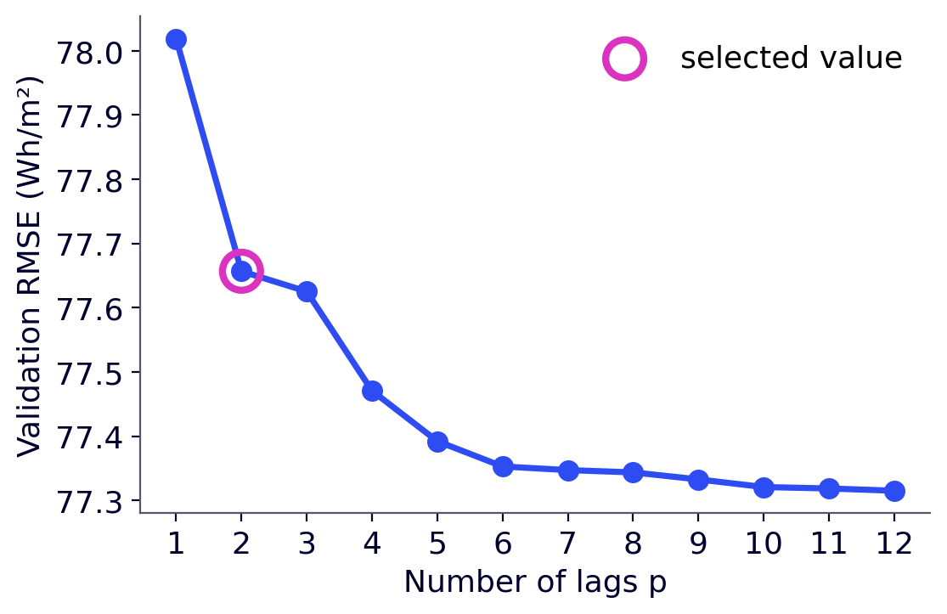
5 · AR model and least squares
Choosing p (3/3): filter or wrapper approach
Filter
look at the data alone, before any model: PACF, AIC / BIC criteria (appendix C);
fast, but indirect.
Wrapper
train an AR(p) for p = 1 to 12 on 1998–2005;
measure the forecast error on validation (2006);
driven by the real objective, but more costly.
Wrapper approach: validation RMSE (2006, daytime hours) versus p.
p = 1: 78.0; p = 2: 77.7; p = 12: 77.3 Wh/m². Parsimony: the smallest p within 0.5 % of the best, i.e. p = 2.
Cyril Voyant · Mines Paris – PSL · Solar forecasting basics · CC BY 4.0
33

Slide 34
5 · AR model and least squares
Summary: forecasting GHI with an AR(p)
1
2
3
4
5
6
7
8
9
GHI
measurements
Clear sky
GHI^{cs}
CSI index
(difference)
Centring
y = CSI − μ
Chronological
split
Model
P · AR · ELM
Forecast
ŷ_{t+h}
Forecast GHI
ŷ + μ + GHI^{cs}
Evaluation
day · day+night
1. Compute GHI^{cs} (Solis), then CSI_{t} = GHI_{t} − GHI^{cs}_{t}; centre it: y_{t} = CSI_{t} − μ.
2. Split: training / validation / test.
3. Choose p on validation.
4. Build X and y; estimate ŵ = (X^{T}X)⁻¹X^{T}y.
5. Forecast ŷ_{t+1} = ŵ^{T} x_{t} with x_{t} = (y_{t}, …, y_{t−p+1}).
6. Rebuild GHI^{fc}_{t+1} = ŷ_{t+1} + μ + GHI^{cs}_{t+1}; set 0 at night (Sun below the horizon) and 0 if the forecast is negative.
7. Evaluate on 2007: daytime, then day + night.
Simple, fast, interpretable: it is the linear reference to beat.
Cyril Voyant · Mines Paris – PSL · Solar forecasting basics · CC BY 4.0
34

Slide 35
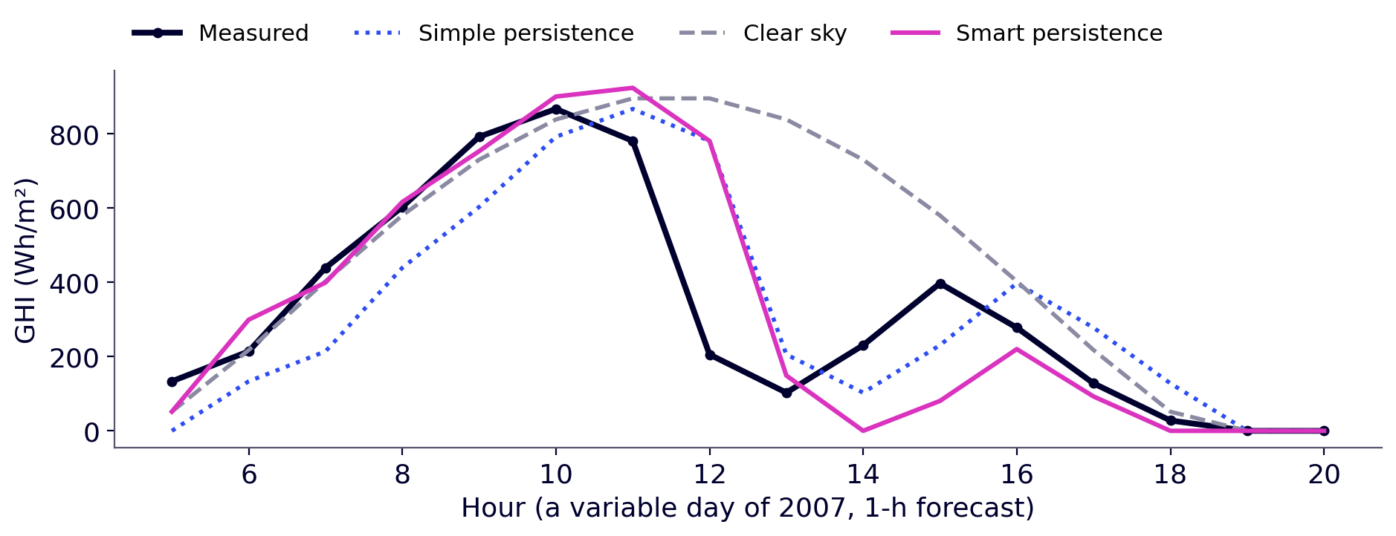
6 · Evaluation, ELM and online learning
Reference models
Every model must be compared with a simple reference. If it does not do better, it adds nothing.
Simple persistence
Clear sky
Smart persistence
“It will be as it is now.”
GHI^{fc}_{t+1} = GHI_{t}
“It will be sunny.”
GHI^{fc}_{t+1} = GHI^{cs}_{t+1}
“The sky will stay the same.”
GHI^{fc}_{t+1} = GHI_{t} − GHI^{cs}_{t} + GHI^{cs}_{t+1}
Ignores the Sun's course.
Ignores clouds.
Keeps the same gap to clear sky.
Smart persistence = AR(1) with w = 1: the reference of the skill score SS.
Two rules, for every model: 1) at night (Sun below the horizon, θ_{z} > 90°), forecast = 0; 2) a negative forecast is replaced by 0.
Cyril Voyant · Mines Paris – PSL · Solar forecasting basics · CC BY 4.0
35

Slide 36
6 · Evaluation, ELM and online learning
Measuring the error
e_{t} = GHI^{fc}_{t} − GHI_{t} (forecast error)
nMBE (bias): > 0 if the model over-estimates on average, < 0 if it under-estimates. Errors of opposite sign cancel: it is not a score for ranking models.
MAE: mean error, in Wh/m², easy to interpret.
RMSE: penalizes large errors more (sudden cloud). Always ≥ MAE.
nRMSE: RMSE as % of mean GHI, to compare sites.
nMBE = [(1/N) Σ e_{t}] / mean(GHI_{t})
MAE = (1/N) Σ |e_{t}|
RMSE = √[(1/N) Σ e_{t}²] ; nRMSE = RMSE / mean(GHI_{t})
Essential check: if |nMBE| > 1 %, there is probably a problem, or a very poor model. The bias can be removed, provided this is tested; we do not do it here.
Errors are computed on the rebuilt GHI, over the test year (2007): first on daytime hours, then day + night. Always say which!
Cyril Voyant · Mines Paris – PSL · Solar forecasting basics · CC BY 4.0
36

Slide 37
6 · Evaluation, ELM and online learning
Comparing with persistence: SS and NICEΣ
SS = 1 − RMSE_{model} / RMSE_{smart persistence}
NICE^{k} = L^{k}(model) / L^{k}(simple persistence)
Skill score: > 0 if smart persistence is beaten, < 0 otherwise.
Looks only at the RMSE.
L^{k} = ((1/N) Σ |e_{t}|^{k})^{1/k} ; NICE^{Σ} = (NICE¹ + NICE² + NICE³) / 3
e_{t} = GHI^{fc}_{t} − GHI_{t}: the forecast error (previous slide).
k = 1: average errors (MAE); k = 2: RMSE; k = 3: large errors;
NICE^{Σ} < 1: the model beats simple persistence on all three norms at once.
Two different references: SS compares with smart persistence, NICE^{Σ} with simple persistence (Voyant et al., 2025b).
Cyril Voyant · Mines Paris – PSL · Solar forecasting basics · CC BY 4.0
37

Slide 38
6 · Evaluation, ELM and online learning
Results at Ajaccio: 1-hour forecast
Model | RMSE day | nRMSE day | nRMSE day + night | nMBE day | SS | NICE^{Σ}
Simple persistence | 135 | 36.4 % | 51.5 % | −0.9 % | −0.66 | 1.00
Clear sky | 148 | 39.9 % | 56.4 % | +16.4 % | −0.82 | 1.06
Smart persistence | 82 | 22.0 % | 31.0 % | +1.3 % | 0.00 | 0.59
AR(2) | 79 | 21.3 % | 30.1 % | +2.0 % | +0.03 | 0.58
ELM (L = 50, best draw) | 76 | 20.5 % | 28.9 % | +1.1 % | +0.07 | 0.55
Test 2007. Daytime: 4380 hours, mean GHI 372 Wh/m². Day + night: 8759 hours, mean GHI 186 Wh/m². RMSE in Wh/m²; SS and NICE computed on daytime hours.
Smart persistence divides the RMSE of simple persistence by 1.7. AR gains 3 % over it, ELM 7 %.
Cyril Voyant · Mines Paris – PSL · Solar forecasting basics · CC BY 4.0
38

Slide 39
6 · Evaluation, ELM and online learning
Daytime only, or day + night?
79 → 56
372 → 186
21 → 30 %
AR RMSE (Wh/m²)
Mean GHI (Wh/m²)
AR nRMSE
At night (Sun below the horizon), every model forecasts 0 by construction and is right: adding these hours lowers the RMSE (≈ ÷ √2).
But the mean GHI is halved: the nRMSE increases.
The ranking of models does not change.
An error figure without the list of hours used means nothing: always state daytime or day + night.
Cyril Voyant · Mines Paris – PSL · Solar forecasting basics · CC BY 4.0
39

Slide 40
6 · Evaluation, ELM and online learning
The bias (nMBE): effect of the two rules
Rule 1 (night): when the Sun is below the horizon (θ_{z} > 90°), the forecast is 0. Rule 2: a negative forecast is replaced by 0.
nMBE: mean bias, as % of mean GHI (see “Measuring the error”). Test 2007.
Model | nMBE no rules, day | nMBE no rules, day + night | nMBE with rules, day | nMBE with rules, day + night
Simple persistence | −0.88 % | 0.00 % | −0.88 % | −1.02 %
Clear sky | +16.44 % | +16.28 % | +16.44 % | +16.28 %
Smart persistence | +0.35 % | 0.00 % | +1.25 % | +1.11 %
AR(2) | +1.49 % | −0.24 % | +2.02 % | +1.87 %
ELM | +0.69 % | −0.38 % | +1.13 % | +0.99 %
How to read this table
No rules, day + night: both persistences have an nMBE of exactly zero.
Rule 2: setting negative forecasts to 0 raises the mean (smart persistence: +0.35 % → +1.25 % in daytime).
Rule 1: the nMBE of simple persistence goes from 0 to −1.02 % over day + night (next slide).
Clear sky: +16 %: it always forecasts sunshine.
An nMBE depends on how it is computed: always state daytime or day + night, with or without rules.
Cyril Voyant · Mines Paris – PSL · Solar forecasting basics · CC BY 4.0
40

Slide 41
6 · Evaluation, ELM and online learning
Why does persistence go from 0 to −1 %?
second-to-last
daytime hour
last
daytime hour
first
night hour
No rules: persistence copies the previous hour's measurement. Over the year, each measurement is used once as measurement and once as forecast: the two sums are equal, nMBE = 0.
With rule 1 (night): at the first night hour the Sun is below the horizon, so the forecast 43 is replaced by 0. Every day, a forecast of about 43 Wh/m² disappears.
Over the year: 365 × 43 ≈ 15,642 Wh/m², plus 1,008 Wh/m² of small values measured at night: 16,650 Wh/m² are missing.
Relative to the GHI measured over the year (1,630,161 Wh/m²): 1.02 %, hence a day + night nMBE of −1.02 %.
Measurement
150
43
0
Persistence, no rules
…
150
43
With rule 1 (night)
…
150
0
Values in Wh/m²; 43 Wh/m² = 2007 mean of the last daytime hour.
A single hour per day, but it weighs heavily: the day + night mean is only 186 Wh/m², because night hours count as zero.
The rule is physically right (no Sun at night), but it changes the bias.
Cyril Voyant · Mines Paris – PSL · Solar forecasting basics · CC BY 4.0
41

Slide 42
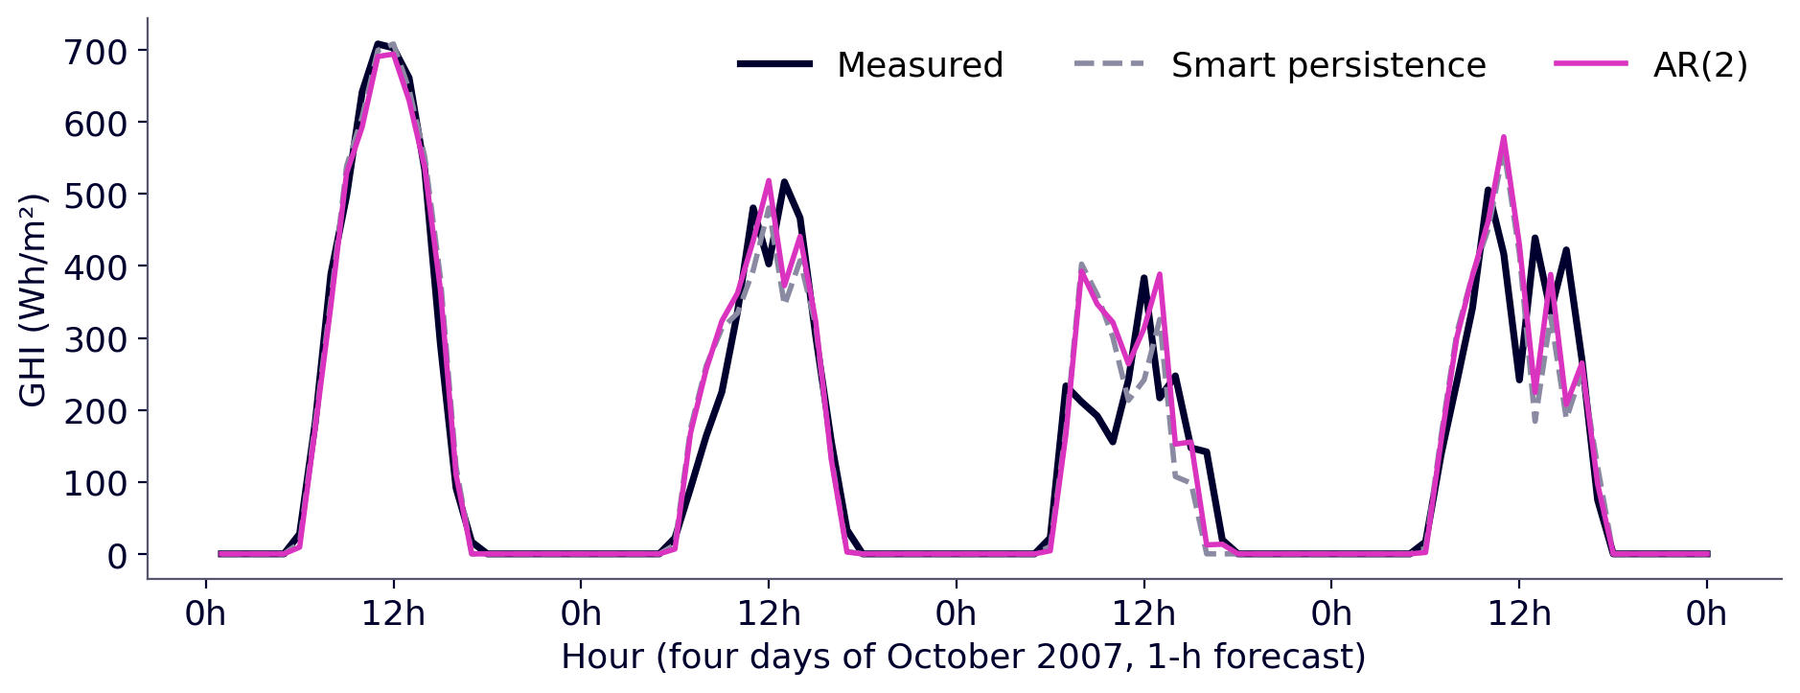
6 · Evaluation, ELM and online learning
Forecast and measurement, hour by hour
Ajaccio, October 2007: 1-h forecast.
Both models follow regular days and miss sudden changes: an arriving cloud cannot be seen in the past.
Cyril Voyant · Mines Paris – PSL · Solar forecasting basics · CC BY 4.0
42

Slide 43
6 · Evaluation, ELM and online learning
Limits of the AR model
AR(p) assumes a linear relation between the CSI and its lags. Often enough at short horizons, but not always.
Under-fitting
A linear model cannot capture a curved relation, even with many lags.
Difficult situations
fast clear / overcast transitions (cloud fronts);
cloud-edge effects (GHI > GHI^{cs});
very variable sky (cumulus);
nonlinear links between lags.
Saturation
Beyond some p, adding lags no longer improves anything (slide “Choosing p”).
Idea: transform the inputs nonlinearly, then keep least squares. That is the ELM.
Cyril Voyant · Mines Paris – PSL · Solar forecasting basics · CC BY 4.0
43

Slide 44
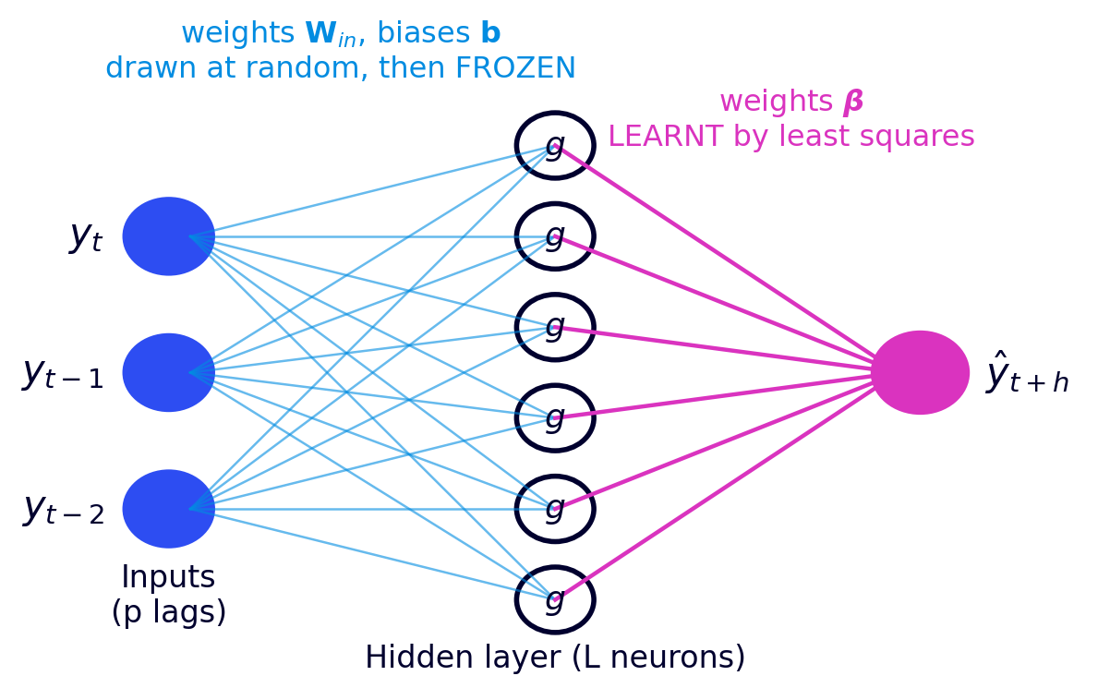
6 · Evaluation, ELM and online learning
Extreme Learning Machine (ELM): the principle
A neural network with a single hidden layer.
Input weights W_{in} and biases b are drawn at random, then frozen.
Each neuron applies a nonlinear function g (tanh, sigmoid…).
Only the output weights β are learnt, by least squares.
No gradient back-propagation: training is done in a single solve.
One-hidden-layer ELM (Huang et al., 2006).
Cyril Voyant · Mines Paris – PSL · Solar forecasting basics · CC BY 4.0
44

Slide 45
6 · Evaluation, ELM and online learning
ELM: the formulation
The p lags of each row go through the hidden layer:
H = g(X W_{in} + b) (N × L)
 | Model | Least-squares solution | Columns used
AR | y = Xw + ε | ŵ = (X^{T}X)⁻¹X^{T}y | lags of the centred CSI
ELM | y = Hβ + ε | β̂ = (H^{T}H + αI)⁻¹H^{T}y | outputs of the L neurons
Same equation, only the columns change. The small term αI (ridge regression) stabilizes the solve when L is large; at Ajaccio, α = 10⁻³.
Cyril Voyant · Mines Paris – PSL · Solar forecasting basics · CC BY 4.0
45

Slide 46
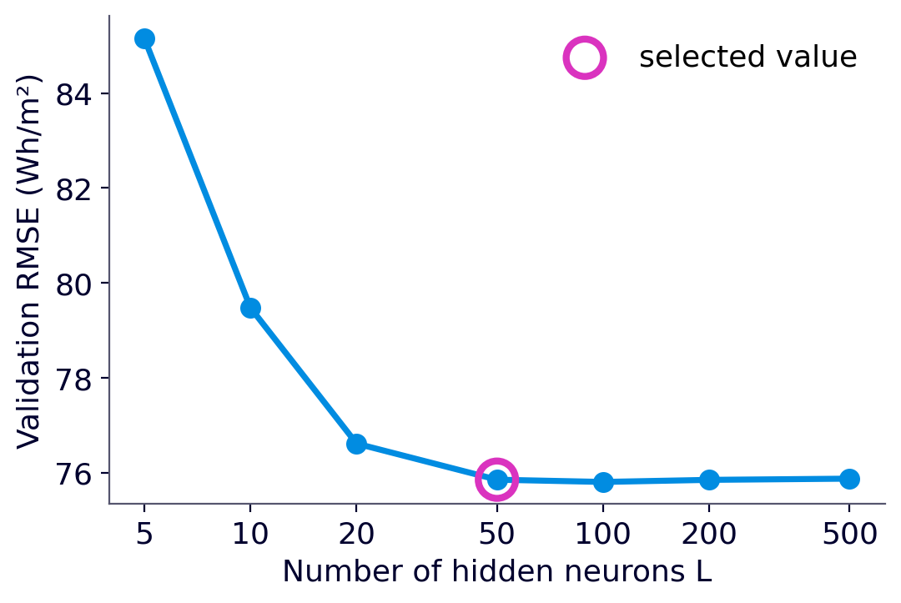
6 · Evaluation, ELM and online learning
ELM: choosing the number of neurons L
L = 5: 85.2 Wh/m² → under-fitting.
L = 50: 75.9 Wh/m².
Beyond, no further gain: 75.8 at L = 200, 75.9 at L = 500 (risk of over-fitting).
As for p: test a few values (5 to 500) on validation and keep the smallest near-optimal one. Here L = 50.
Validation RMSE (2006, daytime hours) versus L, for p = 2.
Cyril Voyant · Mines Paris – PSL · Solar forecasting basics · CC BY 4.0
46

Slide 47
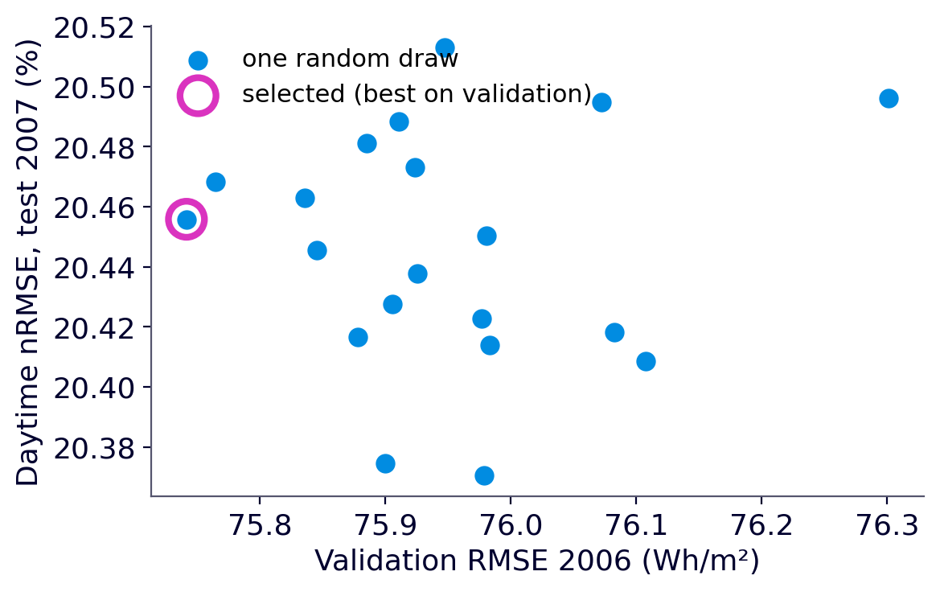
6 · Evaluation, ELM and online learning
ELM: a result that depends on the draw
Input weights are random: two trainings give two different models.
Candidate search: make 20 draws and keep the one with the smallest validation error (2006).
The test (2007) is used only at the end, for the selected draw.
Selected draw: test nRMSE 20.46 %.
The 20 draws: from 20.37 to 20.51 % (mean 20.45 %).
The best on validation is not necessarily the best on test: the gap is small here, but it must be checked.
Each point: one draw. Validation 2006 (horizontal), test 2007 (vertical).
Cyril Voyant · Mines Paris – PSL · Solar forecasting basics · CC BY 4.0
47

Slide 48
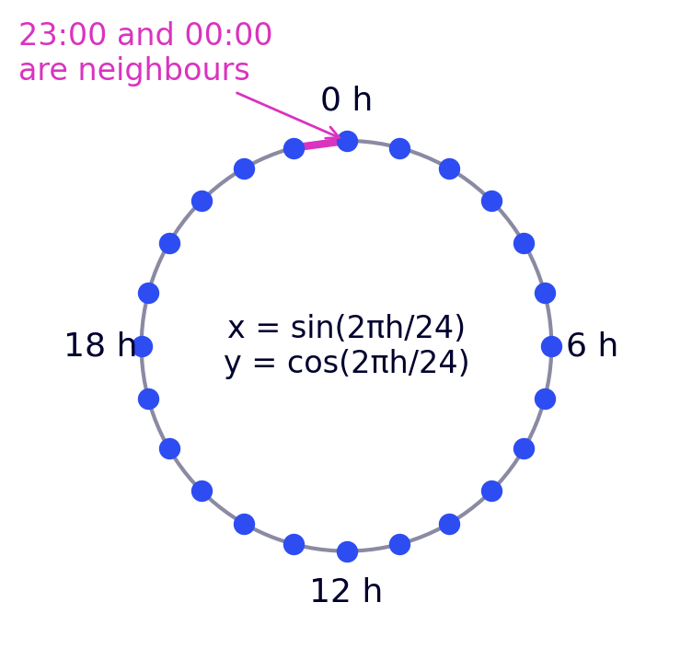
6 · Evaluation, ELM and online learning
Giving the model the time: sin / cos encoding
Idea: add calendar variables known in advance to the lags: the hour h and the day of year j.
Problem: coded as a number, 23:00 is “far” from 00:00, although they are neighbouring hours.
Solution: place the hour on a circle, with two variables:
(sin(2π h / 24); cos(2π h / 24)) and (sin(2π j / 365); cos(2π j / 365))
4 more columns in X. The model then “knows” the hour and the season (Voyant et al., 2025a).
Cyril Voyant · Mines Paris – PSL · Solar forecasting basics · CC BY 4.0
48

Slide 49
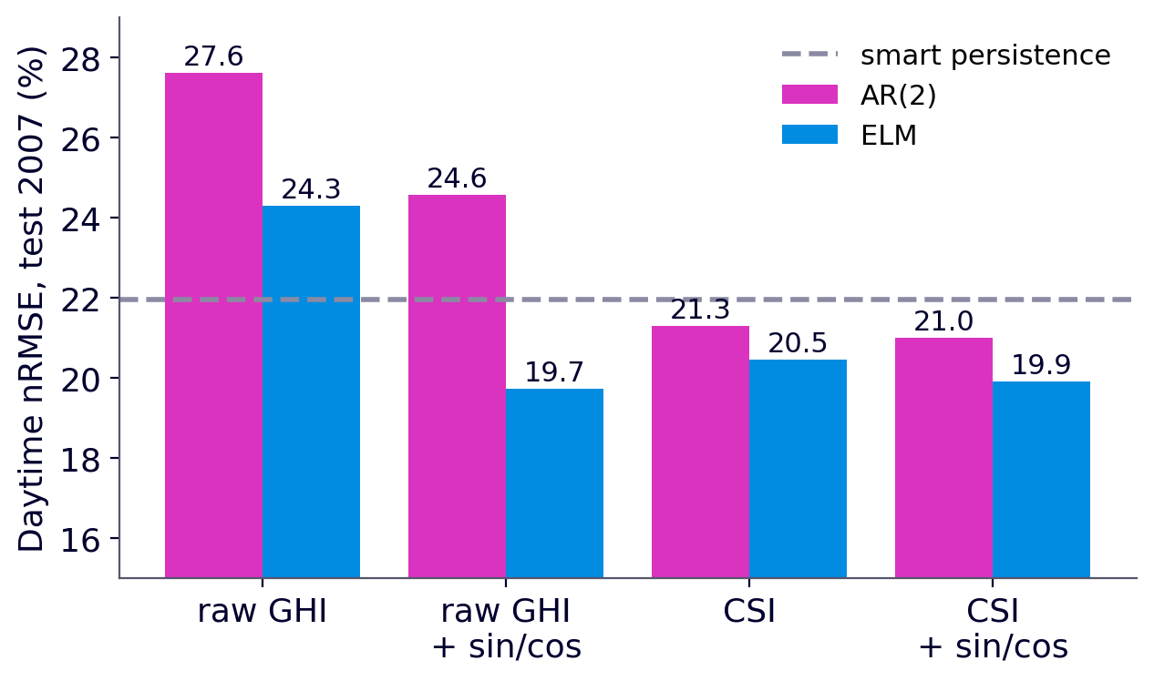
6 · Evaluation, ELM and online learning
Stationarize or give the time? AR and ELM
Inputs | AR(2) nRMSE | AR NICE^{Σ} | ELM nRMSE | ELM NICE^{Σ}
raw GHI | 27.6 % | 0.76 | 24.3 % | 0.66
GHI + sin/cos | 24.6 % | 0.68 | 19.7 % | 0.54
CSI | 21.3 % | 0.58 | 20.5 % | 0.55
CSI + sin/cos | 21.0 % | 0.57 | 19.9 % | 0.54
AR (linear): needs the CSI. On raw GHI, even with sin/cos, it does worse than smart persistence.
ELM (nonlinear): with sin/cos, it learns the Sun's cycle by itself, from raw GHI.
nRMSE and NICE^{Σ} give the same ranking.
Daytime nRMSE, test 2007, same protocol for the 8 variants. “No clear-sky” approach: Voyant et al., 2025a.
Cyril Voyant · Mines Paris – PSL · Solar forecasting basics · CC BY 4.0
49

Slide 50
6 · Evaluation, ELM and online learning
AR or ELM? The verdict
ELM strengths
ELM limits
At Ajaccio, 1 h ahead
fast training, a single solve;
captures nonlinear relations;
same method (OLS) as AR.
L must be chosen;
result varies with the draw;
less interpretable than AR;
over-fits if L grows large;
needs a lot of data.
AR(2): 2 coefficients; nRMSE 21.3 %.
ELM: 51 learnt + 150 random; nRMSE 20.5 %.
Skill score SS: +0.03 (AR) versus +0.07 (ELM).
About 100 times more coefficients (learnt + random) for 4 more points of skill score. Is the gain worth the complexity?
Cyril Voyant · Mines Paris – PSL · Solar forecasting basics · CC BY 4.0
50

Slide 51
6 · Evaluation, ELM and online learning
Online learning (1/2): the sliding window
Forecast
Observe
Update
Trick: no need to recompute everything. X^{T}X ← X^{T}X + x_{new}x_{new}^{T} − x_{old}x_{old}^{T}.
Same for the ELM, with H instead of X.
hour t
hour t + 1
Update: 11 µs for AR, 38 µs for the ELM, per hour.
Useful when the system changes (drifting sensor, soiled panel, new site): the model forgets the distant past.
blue: the W training hours; pink: the hour to forecast
Matrix X always keeps W rows: the last W hours.
Every hour, the newest row is added and the oldest removed, then ridge is re-estimated:
ŵ = (X^{T}X + αI)⁻¹X^{T}y
Cyril Voyant · Mines Paris – PSL · Solar forecasting basics · CC BY 4.0
51

Slide 52
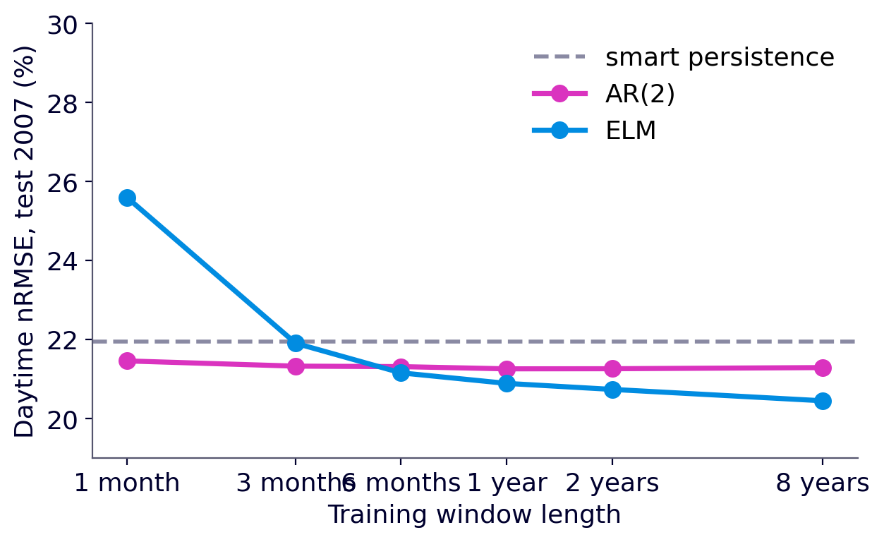
6 · Evaluation, ELM and online learning
Online learning (2/2): which window length?
Test 2007: every hour, ridge re-estimated on the last W hours, from 1 month to 2 years.
Short window: follows recent changes… but learns from little data.
Window W | AR(2) | ELM (L = 50)
1 month | 21.5 % | 25.6 %
3 months | 21.3 % | 21.9 %
6 months | 21.3 % | 21.2 %
1 year | 21.3 % | 20.9 %
2 years | 21.3 % | 20.7 %
8 years (fixed) | 21.3 % | 20.5 %
Daytime nRMSE over 2007 versus window length.
AR (2 coefficients) works even with 1 month. The ELM (51 coefficients) degrades clearly with a short window: the more parameters a model has, the more data it needs.
Cyril Voyant · Mines Paris – PSL · Solar forecasting basics · CC BY 4.0
52

Slide 53
6 · Evaluation, ELM and online learning
Frugality
A frugal model reaches good accuracy with little computation, little data and little maintenance.
Model | Learnt coefficients | Training cost | Data needed | nRMSE day (test)
Smart persistence | 0 | none | 1 hour | 22.0 %
AR(2) | 2 | 5 ms | 1 month is enough | 21.3 %
ELM (L = 50) | 51 (+ 150 random) | 68 ms per draw | several years | 20.5 %
AR, 1-month sliding window | 2 | 11 µs per hour | 720 hours | 21.5 %
Timings measured on a laptop: only the orders of magnitude matter.
The right question is not “which model is best?” but “does the gain justify the cost?” (computation, data, maintenance, monitoring).
Cyril Voyant · Mines Paris – PSL · Solar forecasting basics · CC BY 4.0
53

Slide 54
Thank you — your turn: the project
Grid and units
Radiation
Time series
Forecasting GHI is forecasting production.
Direct, diffuse; Sun position; clouds.
Components, horizon, AR(1).
Clear sky and CSI
AR and OLS
Evaluation, ELM, online
Solis; CSI = GHI − GHI^{cs}, centred.
ŵ = (X^{T}X)⁻¹X^{T}y, choice of p.
Day / day + night, sliding window, frugality.
Cyril Voyant — cyril.voyant@minesparis.psl.eu — Mines Paris – PSL, Centre O.I.E.
Worked example on the web: cyrilvoyant.github.io/teaching/solar-forecasting-basics.html
Cyril Voyant · Mines Paris – PSL · Solar forecasting basics · CC BY 4.0
54

Slide 55
Glossary
Acronym | Meaning
AR(p) | autoregressive model of order p
ACF / PACF | autocorrelation / partial autocorrelation
AIC / BIC | Akaike / Bayesian information criteria
AOD | aerosol optical depth
CSI | clear-sky index
DHI | diffuse horizontal irradiance
DNI | direct normal irradiance
ELM | Extreme Learning Machine
GHI | global horizontal irradiance
MAE | mean absolute error
OLS | ordinary least squares
Acronym | Meaning
NWP | numerical weather prediction
nRMSE | RMSE normalized by mean GHI
RMSE | root mean square error
MBE | mean bias error
sCV | stochastic coefficient of variation
F | forecastability
NICE | score relative to simple persistence
sin / cos | circular encoding of hour and day
SS | skill score
PHS | pumped-storage hydropower
Cyril Voyant · Mines Paris – PSL · Solar forecasting basics · CC BY 4.0
55

Slide 56
References
Huang G.-B., Zhu Q.-Y., Siew C.-K. (2006). Extreme learning machine: theory and applications. Neurocomputing, 70, 489–501. doi:10.1016/j.neucom.2005.12.126
Ineichen P. (2008). A broadband simplified version of the Solis clear sky model. Solar Energy, 82(8), 758–762. doi:10.1016/j.solener.2008.02.009
Voyant C. et al. (2017). Machine learning methods for solar radiation forecasting: a review. Renewable Energy, 105, 569–582. doi:10.1016/j.renene.2016.12.095
Voyant C. et al. (2022). Benchmarks for solar radiation time series forecasting. Renewable Energy, 191, 747–762. doi:10.1016/j.renene.2022.04.065
Voyant C. et al. (2026). Stochastic coefficient of variation: assessing the variability and forecastability of solar irradiance. Renewable Energy, 256, 123913. doi:10.1016/j.renene.2025.123913
Voyant C., Despotovic M., Notton G., Saint-Drenan Y.-M., Asloune M., Garcia-Gutierrez L. (2025a). On the importance of clearsky model in short-term solar radiation forecasting. Solar Energy, 289, 113490. doi:10.1016/j.solener.2025.113490
Voyant C. et al. (2025b). NICEk metrics: unified and multidimensional framework for evaluating deterministic solar forecasting accuracy. Sustainable Energy Technologies and Assessments, 81, 104588. doi:10.1016/j.seta.2025.104588
Hyndman R. J., Athanasopoulos G. (2021). Forecasting: Principles and Practice, 3rd ed. OTexts. otexts.com/fpp3
Box G. E. P., Jenkins G. M., Reinsel G. C., Ljung G. M. (2015). Time Series Analysis: Forecasting and Control, 5th ed. Wiley.
Data: Météo-France, Ajaccio station. All figures and schematics drawn by the author.
Cyril Voyant · Mines Paris – PSL · Solar forecasting basics · CC BY 4.0
56

Slide 57
Appendices
Appendix A — Wide-sense stationarity
A process (z_{t}) is wide-sense stationary if:
E[z_{t}] = μ (constant) and Cov(z_{t}, z_{t+k}) = γ(k) (depends only on the lag k)
In practice
Simple check: plot the mean and standard deviation month by month (slide “Is the CSI stationary?”). Statistical tests exist but are not needed here.
the mean is constant over time;
the variance is finite and constant;
the dependence between two instants depends only on their gap.
Cyril Voyant · Mines Paris – PSL · Solar forecasting basics · CC BY 4.0
57

Slide 58
Appendices
Appendix B — The best possible forecast
ŷ_{t+h} = E[y_{t+h} | y_{t}, y_{t−1}, …, y_{t−p+1}]
Among all forecasts built from the past, the one that minimizes the mean squared error is the conditional expectation: the mean of possible futures, given the past.
We then write y_{t+h} = ŷ_{t+h} + ε_{t+h}: predictable part + error, with a zero-mean error.
An AR(p) model is a linear approximation of this expectation; the ELM, a nonlinear one.
If the model errors form white noise (non-significant error ACF), no usable information is left in the past.
Cyril Voyant · Mines Paris – PSL · Solar forecasting basics · CC BY 4.0
58

Slide 59
Appendices
Appendix C — Choosing p with AIC or BIC
AIC ≈ N · ln(σ̂²) + 2(p+1)
The first term falls as the model fits better; the second penalizes each added coefficient.
BIC penalizes more than AIC: it picks smaller models.
Advantage: no validation period needed. Drawback: assumes Gaussian errors.
BIC ≈ N · ln(σ̂²) + (p+1) · ln N
σ̂²: variance of the training errors;
keep the p that gives the smallest criterion.
Cyril Voyant · Mines Paris – PSL · Solar forecasting basics · CC BY 4.0
59

