Slide 1
Kestrel Financial Summary
Revenue grew steadily across all four quarters of the fiscal year.
Notes:
Speaker note: mention the Q4 uptick was driven by the Nightjar rollout.

Slide 2
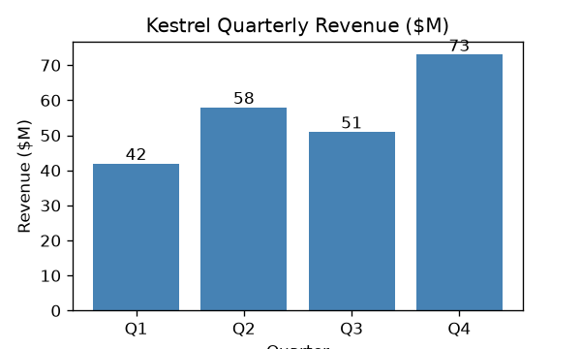
Revenue Chart (image)

Slide 3
Revenue Chart (native)

