Slide 1
Usability Criteria for Class-Directed Interactive Code Completion
Friday 4 Mar 2011
Cyrus Omar (cyrus@cmu.edu)
YoungSeok Yoon (youngseok@cs.cmu.edu)

Slide 2
Outline
Survey
Method
Statistics
Design Principles
System Design Constraints
Palette Design Considerations
Suggestions

Slide 3
Survey Method
SurveyMonkey
Target: professional developers
Participants recruited from
“reddit.com” /r/programming page
Collaborative filtering (upvotes/downvotes)
~340,000 registered readers
cs-students mailing list (22)
696 people started the survey (~20 minutes long)
475 people completed the survey, we only analyzed these responses

Slide 4
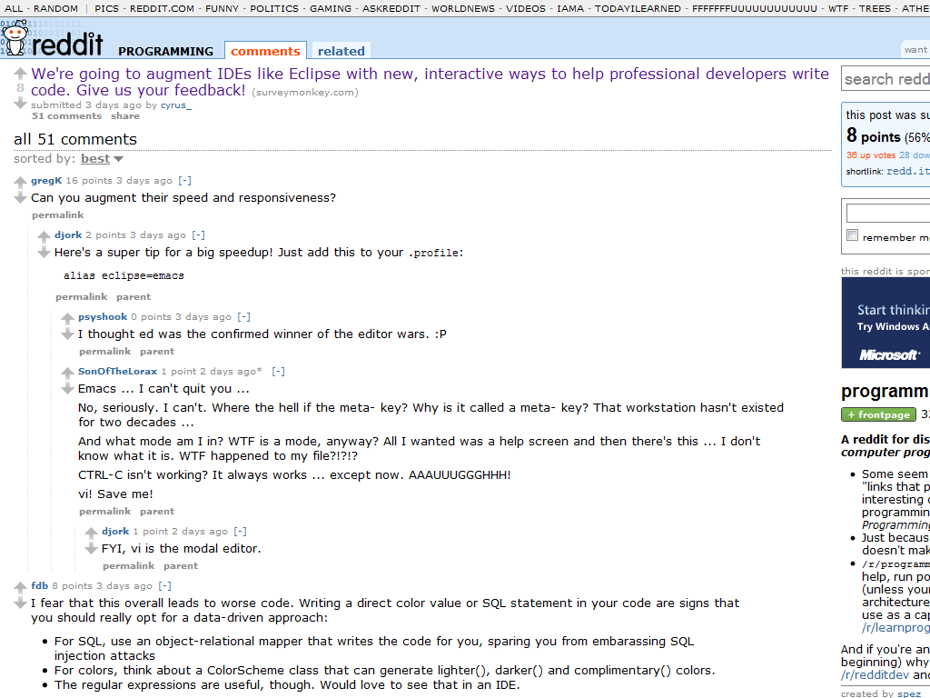
Survey Method

Slide 5
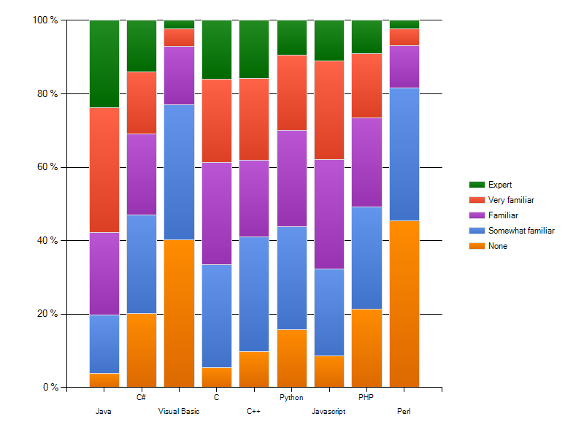
Participant Experience
Q1) Familiarity with various programming languages

Slide 6
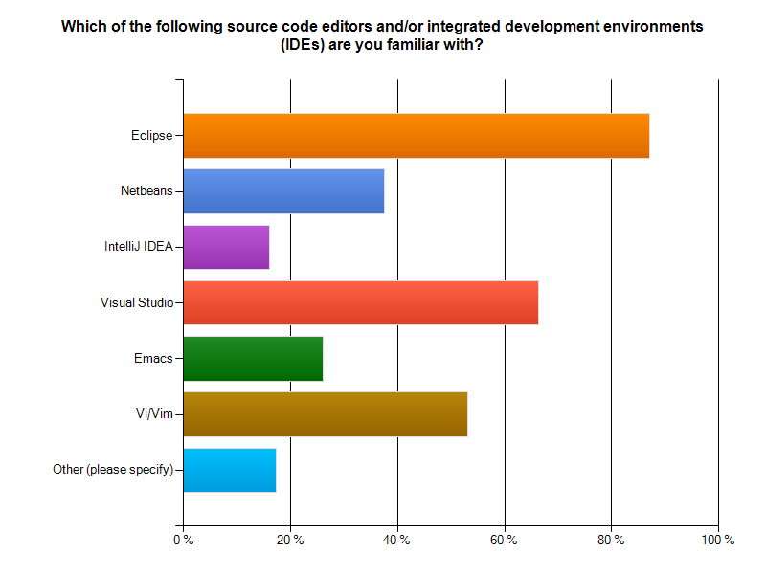
Participant Experience
Q2) Familiarity with code editors and IDEs

Slide 7
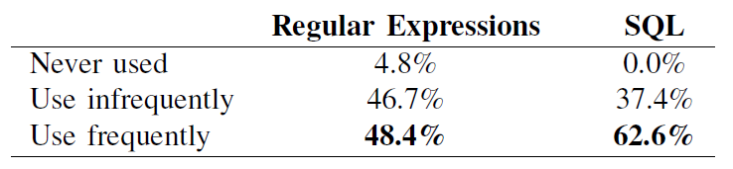
Participant Experience
Participant’s experience with regular expressions and SQL
Along with experience with programming languages, implies that most participants are professional programmers

Slide 8
I. Mockups
For each of three classes (Color, Regular Expressions, SQL query)
Ask which strategy they would naturally use to instantiate the given class
Show them mockup screenshots of our tool
Ask how often they would use the tool if they wanted to instantiate the class
Ask them to qualify the answer or make suggestions (open-ended)

Slide 9
II. Suggestions
Ask what other classes could benefit from these kind of interactive palettes (open-ended)

Slide 10
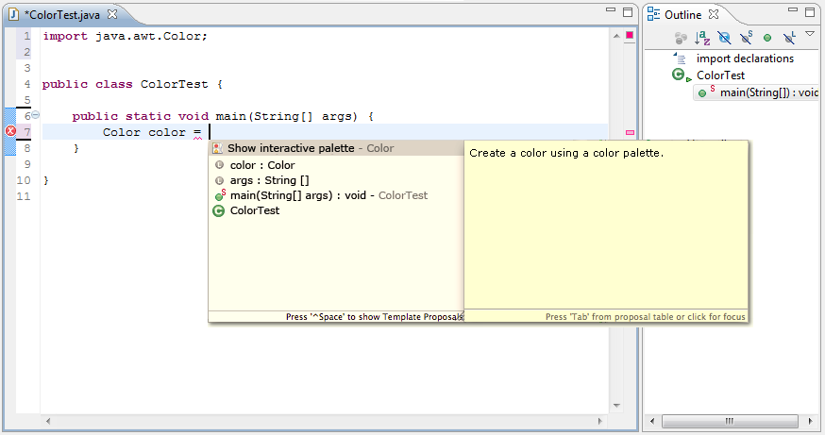
Mockup – Color

Slide 11
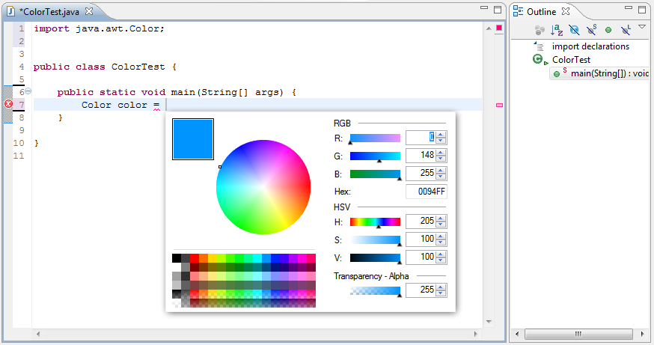
Mockup – Color

Slide 12
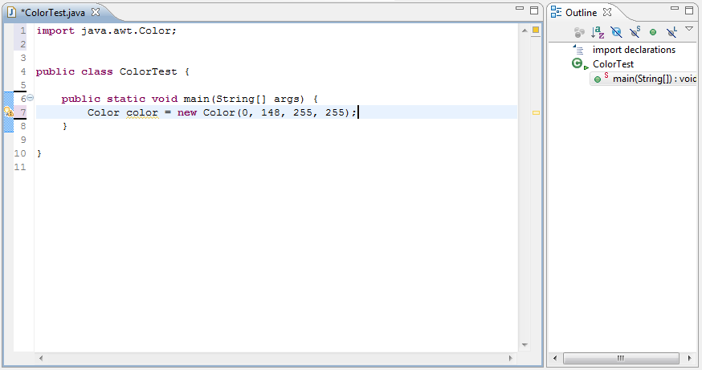
Mockup – Color

Slide 13
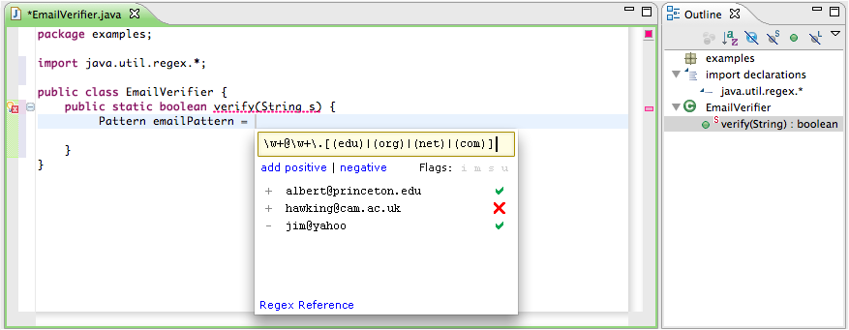
Mockup – Regular Expressions

Slide 14
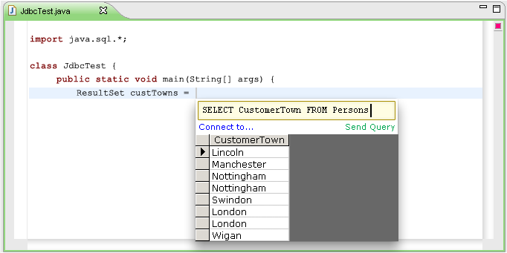
Mockup – SQL queries

Slide 15
Mockups
For each of three classes (Color, Regular Expressions, SQL query)
Ask which strategy they would naturally use to instantiate the given class
Show them mockup screenshots of our tool
Ask how often they would use the tool if they wanted to instantiate the class
Ask them to qualify the answer or make suggestions (open-ended)

Slide 16
Default Strategy – Color

Slide 17
Default Strategy – Regex, SQL

Slide 18
Default Strategy – Regex, SQL

Slide 19
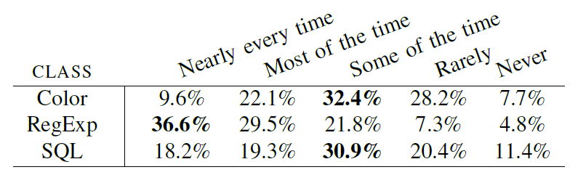
Usefulness of Mockups
“Consider situations where you need to instantiate the [specified] class. What portion of the time, in these situations, do you think you would use this feature?”

Slide 20
Outline
Survey
Method
Statistics
Design Principles
System Design Constraints
Palette Design Considerations
Suggestions

Slide 21
System Design Constraints
Handling Separation of Concerns
Professional developers are very wary of mixing code and data
Many responses (54 of 193) expressed general sentiment or specific preference for project-wide color theme or external resource file
33 of 193 expressed that color picking is the ‘designer’s job’
17 of 193 said they would only use to define named constants
Database connection strings also considered configuration. Saved queries in DB also mentioned often.

Slide 22
System Design Constraints
Handling Separation of Concerns
Professional developers are very wary of mixing code and data
Tool encourages bad practice. Hard-coding color choices in code is a bad practice. Most developers are not good graphical designers.
Dude, that is _super_ nasty. I can't imagine a situation where this would be a good idea. Magic numbers don't belong in the middle of code like that.

Slide 23
System Design Constraints
Handling Separation of Concerns
Some expressed that they would use palettes for prototyping, but not production (14)
A few said or implied that tool would be useful for configuration file editors, stylesheet editors, etc.
Suggests a need for typed configuration files
Others suggested that it would be useful if it could be integrated into IDE resource managers

Slide 24
System Design Constraints
Handling Separation of Concerns
Regular expressions were considered part of the program logic, not data

Slide 25
System Design Constraints
Handling Separation of Concerns
But the comments containing test cases were viewed with skepticism.
Professional developers wanted these to automatically become unit tests (35 of 143)
This is effectively unit testing -- why not output a function with these unit tests, instead of a comment block?

Slide 26
System Design Constraints
Reversibility (19 across classes)
Bring palette back up from data
Palette settings and state
Wanted recent regexes + control over comments (12)
Persistent database connection information (9)
Recent colors (20)
Interaction with code context
SQL queries are complex, dynamic, use variables (13)

Slide 27
System Design Constraints
Performance
Developers wary of slow IDEs
Mentioned several times in survey, most popular comment on reddit
IDE/language independence
Several expressed a desire for IDE or even language independence of this feature

Slide 28
Outline
Survey
Method
Statistics
Design Principles
System Design Constraints
Palette Design Considerations
Suggestions

Slide 29
Palette Design Considerations
Simplicity vs. Complexity
Developers are split
Our color palette was considered too complex by many (26), would be satisfied with seeing colors next to a list a color names (26)
The regex and SQL palettes were considered too simple (12, 15)
Developers wanted syntax highlighting, match highlighting
Developers wanted to be able to browse SQL database
Several suggested using tabbed palettes to make different views available

Slide 30
Palette Design Considerations
Keyboard Navigability
Strong antipathy toward the mouse (12)
Mostly directed at Color palette
If everything is keyboard controlled, then perhaps I'd consider using it more frequently.

Slide 31
Outline
Survey
Method
Statistics
Design Principles
System Design Constraints
Palette Design Considerations
Suggestions

Slide 32
Suggestions
Alternatives / Tricky / Literal Syntax (16)
Example classes
string, vector, dictionary, matrix, embedded languages
URLs, paths
What people wanted
syntax highlighting
auto-completion
escaping properly

Slide 33
Suggestions
Unclear Parameter Implications (11)
What people wanted
modify the parameters more easily
seeing the modification results directly without running the application
Example classes
audio tweaks
3D transformation matrices
number/string/date formatting

Slide 34
Suggestions
Query Languages (17)
What people wanted
testing the query result directly without running the application
Example classes
regular expression
SQL query
XPath / XQuery

Slide 35
Suggestions
Graphical Elements (27)
What people wanted
checking the graphical property directly
manipulating the layout of GUI elements
Example classes
color, font, shape, thickness, etc.
JFrame, layouts, any swing components, etc.

Slide 36
Suggestions
Complex Instantiation Procedures (5)
Examples
BufferedReader reader = new BufferedReader( new FileReader(path));
BufferedImage image = ImageIO.read( new File(path));
any classes where factory pattern is used
connection string builder

Slide 37
Suggestions
Describe by Example (2)
Example classes
keyboard keys (e.g., shortcut)
regular expression
Integrating with Documentation, Tutorial (7)

Slide 38
Summary
Professional developers would be willing to use these for a number of use cases, but have stiff requirements from the architecture.
Prefer help with program logic, not data

