Slide 1
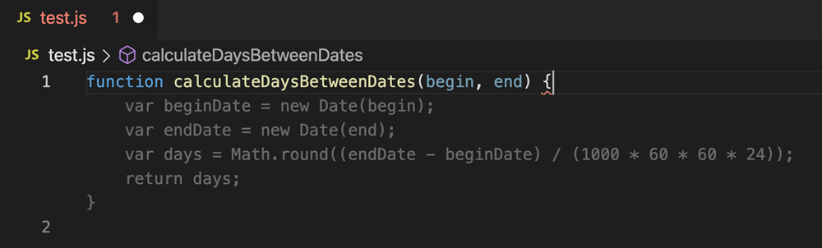

Neurosymbolic Program Synthesis: From Enumerative Search to LLM-Guided Methods
Vanshika Singla
4/13/2026
20 Years of Research
Notes:
Program synthesis = computer writes code for you automatically
Left side: function with holes, right side: completed by computer
Arrow: 20 years of research connects them
Covering 6 papers today, DreamCoder is the deep dive
Hi everyone, I'm Vanshika and today I'm talking about program synthesis. If you look at this slide, the left side shows a function with question marks where the hard parts should go. The right side shows the same function but completed automatically by a computer. That arrow in the middle says 20 years of research, and that's literally what this talk is about. How did we go from a computer filling in blanks in 2006 to GitHub Copilot writing entire functions from a sentence in 2021. Let's get into it

Slide 2
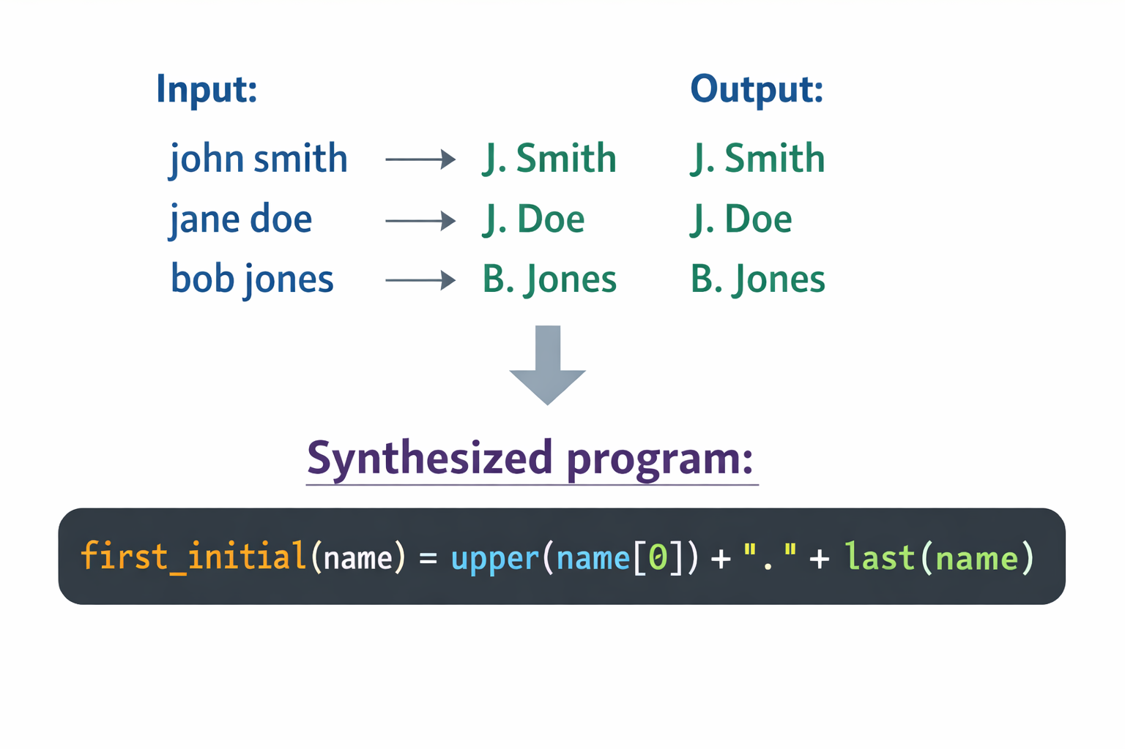
What is Program Synthesis?
Automatically generating a program from a description of what it should do
Notes:
So what actually is program synthesis? At its core it's this: you show a computer some examples of what you want, and it automatically figures out the program.
Look at the visual here. Someone gives three examples — john smith should become J. Smith, jane doe should become J. Doe, bob jones should become B. Jones.
The computer looks at those examples and synthesizes a function that does that transformation. That function at the bottom — the user never wrote that. They just showed examples and the computer figured out the rule. That's program synthesis. Automatically generating a program from a description of what it should do. In this case the description is input-output examples, pairs of inputs and their expected outputs.
The description can be examples like this, or natural language, or a formal specification.
Now this sounds simple but it's actually really hard and I'll show you why on the next slide.

Slide 3
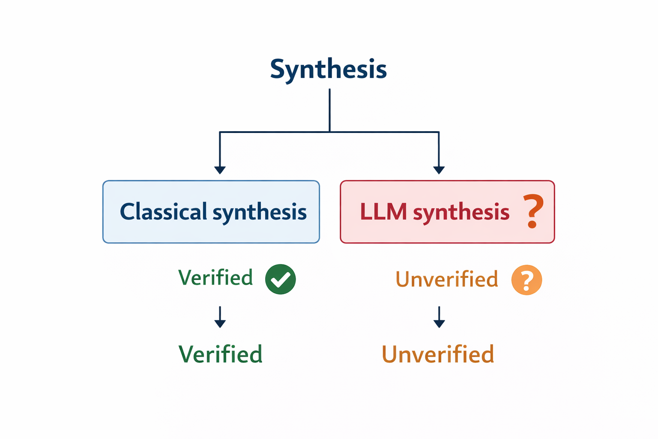
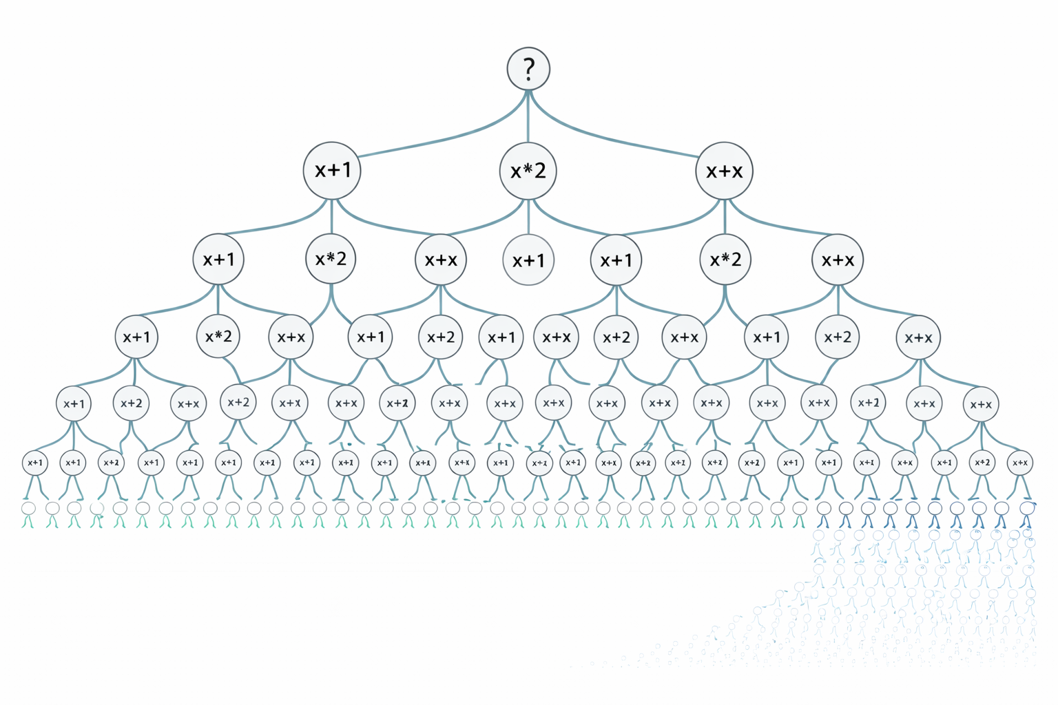
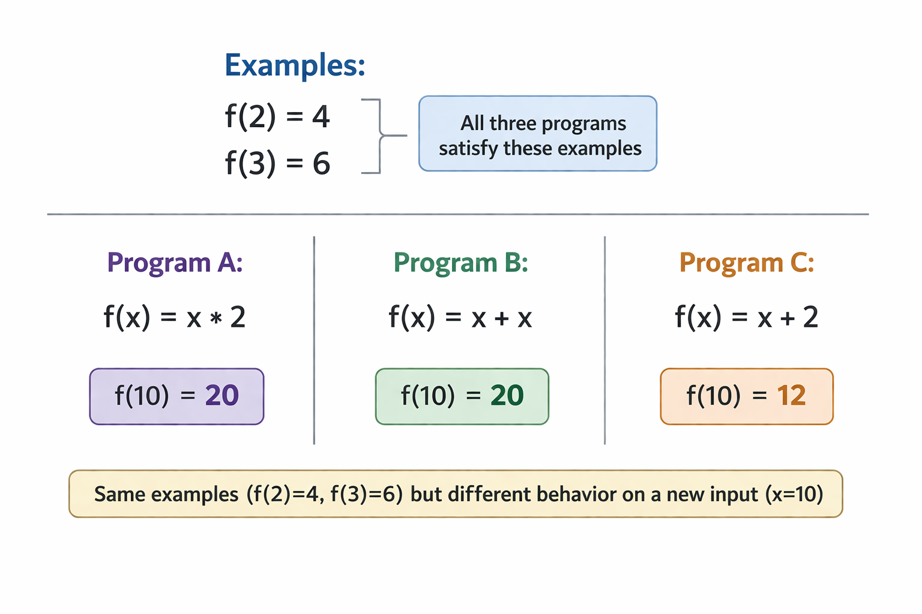
Why Is It Hard?
1. The search space is enormous
Even simple examples are consistent with infinitely many programs
2. User intent is ambiguous
Which one did the user actually want?
3. Correctness is hard to guarantee
Neural methods are powerful but offer no formal guarantees
Notes:
So why is this hard? Three reasons.
First, the search space is enormous. Look at this tree on the left. Even for simple examples like f of 2 equals 4 and f of 3 equals 6, there are infinitely many programs that satisfy those examples. x times 2 works. x plus x works. Some weird polynomial works. The computer has to search through all of these candidates and the space grows exponentially.
Second, user intent is ambiguous. Look at the middle column. Three programs all satisfy the same two examples. Program A gives 20 for input 10. Program B also gives 20. But Program C gives 12. If you only gave f of 2 equals 4 and f of 3 equals 6 as examples, the computer cannot tell which one you wanted. All three are valid.
Third, correctness is hard to guarantee. Classical synthesis on the right gives you a mathematical proof that the program is correct on all possible inputs, not just the ones you tested. But neural methods like Copilot just predict likely code. There's no guarantee it's actually right. It might look correct and still be wrong on some input you didn't think to test.
These three problems are what the whole field is wrestling with and every paper we cover today is trying to solve one of them and This is why it took roughly two decades to go from theory to practice

Slide 4
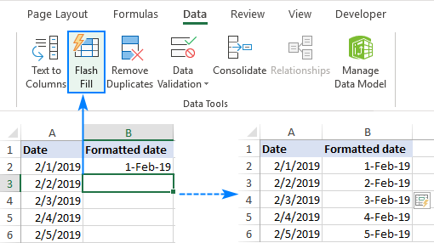
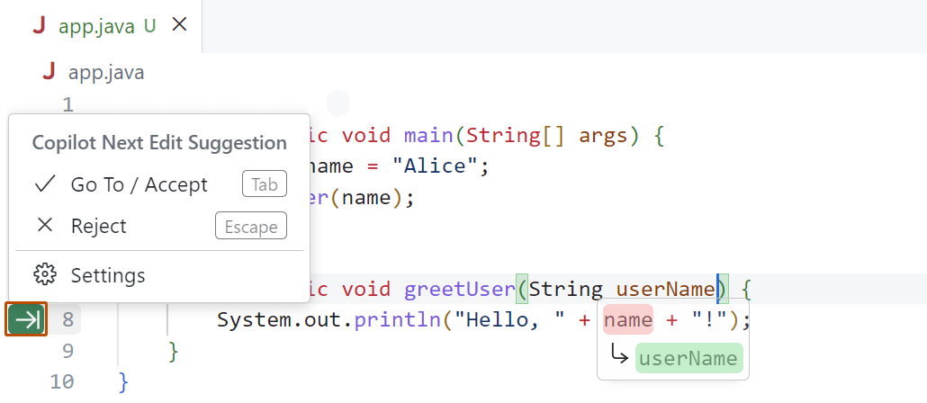
Why Does It Matter?
Excel FlashFill
ships to 1 billion+ Office users
GitHub Copilot
used by 1.3 million developers
Program synthesis is not just a research idea. It is already in tools you use every day.
Notes:
Now you might be wondering, why does any of this matter? Why did anyone spend twenty years trying to solve these hard problems? Because look at what came out of it.
On the left is Excel FlashFill. When you type a couple of examples in Excel and it automatically fills in the rest of the column, that is a synthesis system. It is literally built on one of the papers we are covering today, Gulwani's 2011 paper. It ships to over a billion Office users.
On the right is GitHub Copilot. When a developer types a comment saying what they want and Copilot suggests the code, that is a language model doing synthesis. Also built directly on a paper we are covering today, the Codex paper from 2021. Over a million developers use it daily.
Program synthesis is not just a research idea. It is already running on your laptop, in tools you probably use. The papers I’ll be covering today are the reason those tools exist. That is why this matters.

Slide 5
Roadmap
Introduction: what is synthesis and why does it matter
Solar-Lezama et al. (2006) — SKETCH: correctness-guaranteed synthesis without domain rules
Gulwani (2011) — FlashFill: synthesis that reached hundreds of millions of users
Gulwani, Polozov, Singh (2017) — Survey: mapping the landscape
Ellis et al. (2021) — DreamCoder: synthesis that learns over time ⭐
Chen et al. (2021) — Codex: LLMs enter the picture
Grand et al. (2024) — LILO: combining classical and neural
Open problems and conclusion
Notes:
Alright so here's the plan for today. We've got six papers, all in chronological order from 2006 to 2024, and each one builds directly on what came before it.
I’ll start with SKETCH in 2006, then FlashFill in 2011, a survey in 2017 that mapped the entire field, then two papers from 2021 that pulled in completely different directions, and finally LILO in 2024 which tries to bring everything together.
One thing to flag — I’ll be covering DreamCoder in depth so will spend significantly more time there.
By the end of this talk you'll see exactly how we got from a research idea in 2006 to GitHub Copilot in your code editor today.
Let's start with the paper that started it all

Slide 6
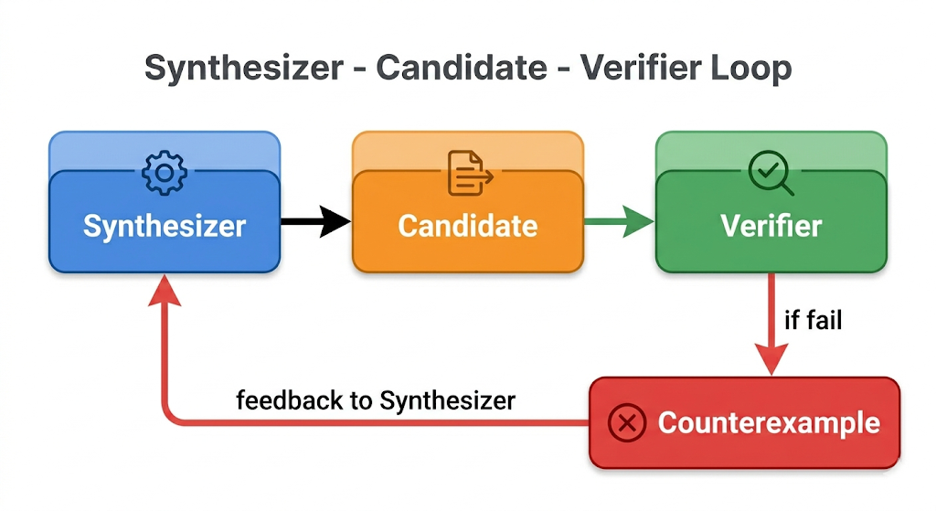
SKETCH (2006): Synthesis Without Domain Rules
Problem:
Every synthesis tool before SKETCH needed hand-coded domain rules
No general approach existed
Solution:
Programmer writes partial program with holes
SAT-based search fills the holes
Correctness guaranteed by construction
Introduced CEGIS (Counterexample Guided Inductive Synthesis):
generate candidate → test → counterexample → refine
Notes:
SKETCH was published at ASPLOS 2006 by Solar-Lezama and colleagues.
Before SKETCH every synthesis tool needed hand-coded domain-specific rules. Like if you wanted a tool that synthesizes string programs you'd have to manually program all the rules about strings. If you wanted a tool for math programs you'd have to manually program all the rules about math. Every new domain meant building everything from scratch. Nothing transferred
SKETCH changed this completely. The idea is simple: the programmer writes a partial program with holes where the hard parts go, and a SAT solver fills those holes in. A SAT solver, by the way, is just a program that solves logical equations — you give it constraints and it finds values that satisfy them.
The diagram on the right shows the key mechanism SKETCH introduced called CEGIS, which stands for Counterexample Guided Inductive Synthesis. Here's how it works: the synthesizer proposes a candidate program to fill the holes. The verifier tests it against the specification. If the candidate is wrong, the verifier produces a counterexample — a specific input where it failed. That counterexample goes back to the synthesizer to rule out similar wrong answers next time. This loop repeats until a correct program is found.
The really important thing about SKETCH is that any program it produces is provably correct, not just probably correct. That correctness guarantee is what separates it from everything before it.

Slide 7
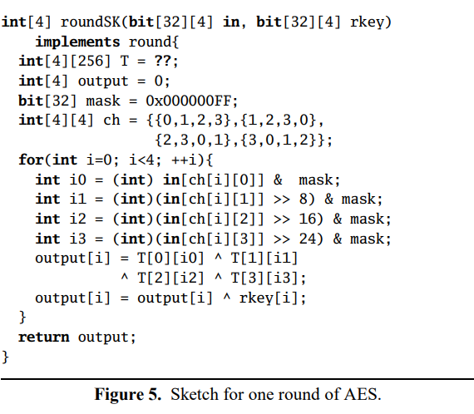
SKETCH: Evaluation + Limitations
took 665 iterations to fill in
Evaluation:
Synthesized complete AES encryption implementation
SKETCH: 21.3ms vs OpenSSL: 19.6ms: less than 10% difference
Original spec: 19,936ms: SKETCH was 1000x faster
MultiGrid kernel: completed in under 5 minutes
Limitations:
Programmer must understand algorithm to write a meaningful sketch
Only works for finite programs: unbounded loops out of scope
More holes = longer synthesis time
SKETCH proved correctness-guaranteed synthesis was possible.
Next question: can it work without the programmer writing the sketch at all?
Notes:
So how was SKETCH evaluated? The main result is AES, the encryption algorithm that secures basically every website and app you use. SKETCH synthesized a complete AES implementation and if you look at the numbers — SKETCH ran in 21.3 milliseconds, hand-optimized OpenSSL ran in 19.6 milliseconds. To give you a sense of how impressive that is — OpenSSL is written by expert cryptographers who spend years optimizing it. Less than 10% difference. The original specification ran in 19936 milliseconds, over 1000 times slower. So SKETCH was competitive with expert-optimized code, automatically.
Now the limitations. The programmer still has to write a meaningful sketch, so you need to understand the algorithm well enough to write the structure. That limits who can actually use it.
It also only works for finite programs, anything with unbounded loops is out of scope.
And synthesis time grows with the number and complexity of holes. That one line with the question marks took 655 CEGIS iterations to fill in.
SKETCH proved correctness-guaranteed synthesis was possible at realistic scale. But the next question was: can synthesis work without any sketch at all? Just give examples and get a program back. That's exactly what FlashFill answered

Slide 8

FlashFill: Synthesis for Real Users
Problem + Solution:
Non-programmers reformatting spreadsheets constantly
DSL for strings + version space algebras
Runs in under one second while you type
Example: "John Smith" → "J. Smith", "Jane Doe" → "J. Doe“
Evaluation:
175 benchmarks, 74% correct from single example
Shipped in Excel 2013, hundreds of millions of users
Most influential POPL paper award 2021
Limitations:
Strings only, version space does not transfer to other domains
Ambiguous examples can silently produce wrong program
FlashFill proved synthesis could reach real users. But it only worked in one narrow domain. The field needed a map of what existed and where to go next.
Notes:
FlashFill was published at POPL 2011 by Gulwani and it's probably the most famous paper in program synthesis.
The problem is simple — non-programmers in Excel constantly need to reformat columns, splitting names, extracting dates, and most people find formulas too hard. FlashFill lets you type a couple of examples and synthesizes the transformation automatically.
The solution has two key parts. First a DSL (domain specific language), which is just a small restricted programming language designed specifically for strings — that restriction keeps the search space manageable. Second, version space algebras, which instead of trying programs one by one, represent all programs consistent with your examples simultaneously as one compact structure and find the best one in under a second.
The screenshot on the right is FlashFill actually running in Excel right now. 175 benchmarks, 74% correct from a single example, under one second every time. Shipped in Excel 2013 with hundreds of millions of users, most influential POPL paper award in 2021.
The limitation is it only works for strings, and ambiguous examples can silently produce the wrong program with no warning.
But it proved synthesis could reach real users but only in one narrow domain.

Slide 9
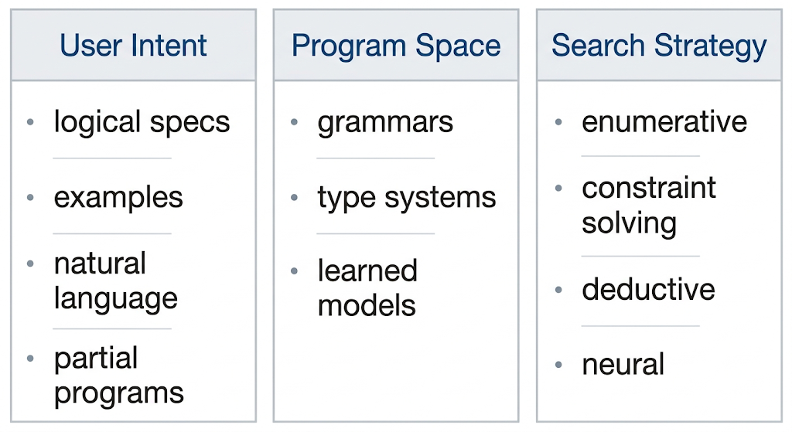
Survey (2017): Mapping the Landscape
Problem:
Field fragmented across PL, ML, HCI with no shared vocabulary
Researchers talking past each other
Three-axes framework:
Intent: how does the user say what they want?
Program space: what programs are possible?
Search: how do you find the right one?
Coverage:
Manna and Waldinger 1970s through early neural methods
Four decades, three research communities
Limitations:
Written just as neural methods got serious, coverage thin
Flags neurosymbolic combination as the major open direction
The survey identified the gap. DreamCoder filled it.
Notes:
By 2017 synthesis research had exploded but in a messy way. People in programming languages, machine learning, and HCI were all working on synthesis problems but using different terminology and largely unaware of each other.
So the authors of this paper wrote this survey to give the field a shared vocabulary. They organized everything around three questions. How does the user express what they want — that's intent, could be examples like FlashFill, partial programs like SKETCH, or natural language. What is the space of programs being searched — that's the program space. And how does the system search through it — that's the search strategy, which includes things like enumerative search which just tries programs one by one from smallest to largest, constraint solving like the SAT solver in SKETCH, or neural prediction.
The table on the right summarizes it. Every synthesis system ever built fits somewhere in this framework. It covers everything from Manna and Waldinger's work in the 1970s through early neural methods.
The limitation is timing — it was written just as neural methods were getting serious so that coverage is thin.
But the authors explicitly flag combining neural and symbolic methods as the major open direction. DreamCoder and LILO are direct responses to exactly that.

Slide 10
DreamCoder (2021): Synthesis That Learns
Problem:
Classical synthesis starts from scratch every time, does not accumulate knowledge
Neural synthesis generalizes but lacks correctness guarantees
Can a system get better at synthesis the more it synthesizes?
Key idea:
Library learning: build up reusable abstractions over time instead of searching from scratch
Neural policy guides search, gets smarter each iteration
Wake-sleep algorithm: alternates between solving tasks and reflecting on what was learned
Notes:
DreamCoder was published at PLDI 2021 by Ellis and colleagues at MIT.
Think about how a programmer gets better over time. You start by solving every problem from scratch but after years of experience you build up patterns and functions you can reuse.
Classical synthesis systems have none of that. SKETCH starts from scratch every time. FlashFill starts from scratch every time. They don't get better.
Neural systems can generalize across tasks but give no correctness guarantees.
DreamCoder asks whether a synthesis system can actually accumulate expertise the way a programmer does.
The answer is library learning — instead of searching from scratch each time, the system builds up a library of reusable abstractions alongside a neural policy that guides search, and both get better together over time.
The mechanism is a wake-sleep algorithm, and I'm going to walk through exactly how that works on the next slide.

Slide 11
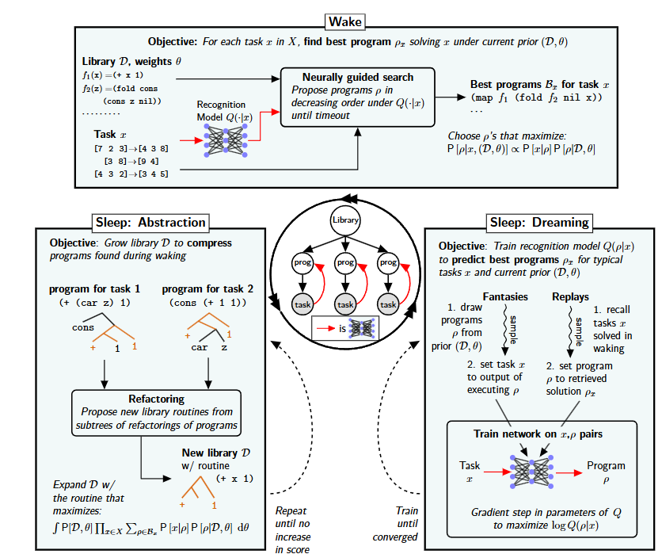
DreamCoder: The Wake-Sleep Algorithm
Wake Phase:
Solve batch of tasks using neurally-guided enumerative search
Recognition network scores which programs to explore first
Sleep Phase:
Compress solutions, find shared substructures
Add common patterns to library as named primitives
Retrain neural policy on updated vocabulary
Each iteration starts from a richer language and a smarter guide
Notes:
So how does DreamCoder actually work? The algorithm has two phases that alternate.
During the wake phase — that's the top box in the diagram — the system takes a batch of synthesis tasks and searches for programs using neurally-guided enumerative search. Enumerative search means trying programs one by one, but instead of random order a recognition network scores candidates and prioritizes the more promising ones. So it's smarter than brute force.
Then during the sleep phase the system reflects on what it just learned. The bottom left box is sleep abstraction — it takes all the programs it just found, runs a compression algorithm to find shared patterns across them, and adds those patterns to the library as named functions. The bottom right box is sleep dreaming — it retrains the neural policy on the updated library.
The key insight is that the next iteration starts from a richer library and a smarter guide. The system compounds its knowledge over time. Starting from nothing but basic recursion, after enough iterations DreamCoder rediscovered higher-order functions like map, filter, and fold entirely on its own. It never knew what map was. It induced the concept from patterns across programs. So this is a qualitatively different kind of result.

Slide 12
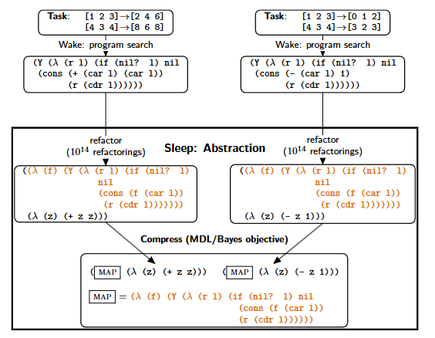
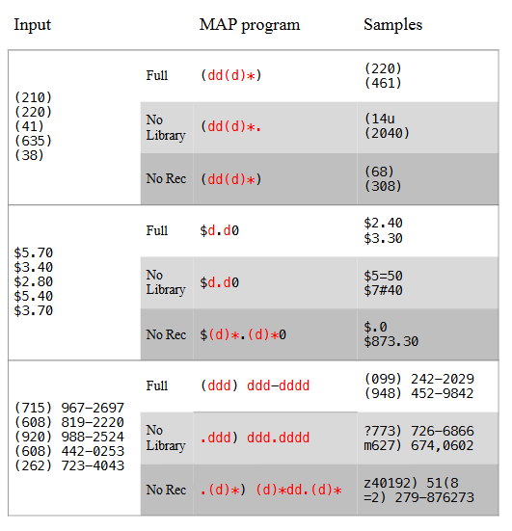
DreamCoder: Results
Rediscovered map, filter, fold from basic recursion alone
Discovered Newton's and Coulomb's laws from physics data
Outperformed pure enumeration, pure neural, prior library learning across all 8 domains
This is not a benchmark improvement. This is a qualitatively different kind of result.
Notes:
So here are the results.
Look at the diagram on the left — two different programs go through the sleep phase, the system finds they share a common pattern, and MAP just pops out as a new primitive. The system literally invented map on its own. Nobody told it what map was.
The table on the right backs this up — with the full library, the system produces clean readable patterns, without it, things get messy.
Now the three big results.
Starting from basic recursion DreamCoder rediscovered map, filter, and fold on its own. Starting from basic arithmetic it discovered Newton's and Coulomb's laws from physics data. And it beat every baseline across all eight domains the authors specified.
This is not just better numbers on a benchmark. The system is genuinely learning structure that humans invented over decades.

Slide 13
DreamCoder: Limitations and What Comes Next
Limitations:
Enumerative search is expensive across 8 domains over many iterations
Needs many training tasks to bootstrap library learning effectively
Distribution shift between training and test hurts library transfer
Cannot start from scratch in a new domain without significant setup
Notes:
So DreamCoder is great but it has some real problems.
Even with the neural network guiding the search you're still trying programs one by one across eight domains over many iterations and that gets really expensive computationally.
It also needs a lot of training tasks before it starts finding useful patterns — if you only give it a few examples there's not enough to learn from.
And if the tasks you train on look different from the tasks you test on, the library it learned isn't really useful anymore.

Slide 14
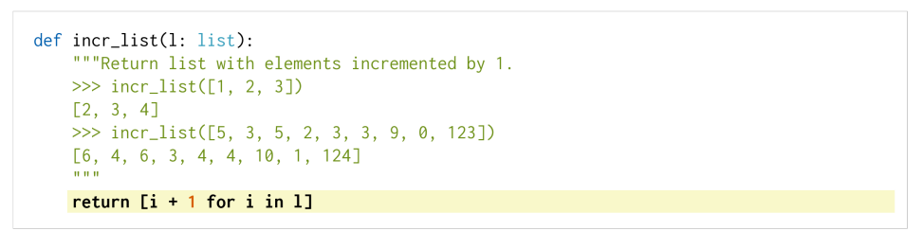
Codex (2021): When LLMs Entered the Picture
The question: Do you even need classical synthesis machinery with a large enough LLM?
Solution:
GPT-3 fine-tuned on publicly available GitHub code
Natural language prompt or docstring → token prediction → candidate program
No search, no DSL, no specification language
Became foundation for GitHub Copilot
White = prompt given by user.
Yellow = code generated by Codex.
Notes:
Codex was published by Chen et al. at OpenAI in 2021.
The question driving it is— do you even need any of the classical synthesis machinery if your model is big enough?
Codex is basically GPT-3, which is a large language model fine-tuned on publicly available GitHub code. You give it a function description or a docstring and it predicts the code that probably comes next. No search, no DSL, nothing classical at all.
If you look at the figure, the white background is the prompt the user gave and the yellow line is what Codex generated.
In the example — user wrote that incr_list should return a list with elements incremented by 1, Codex generated the correct one-liner.
This became GitHub Copilot.

Slide 15
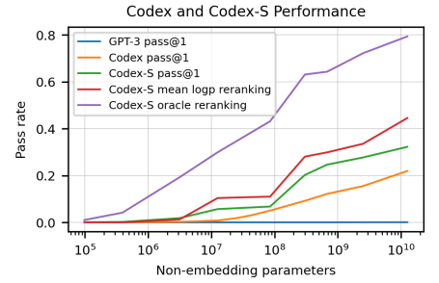
Codex: Evaluation + Limitations
Evaluation:
HumanEval: 164 hand-written Python problems with unit tests
28.8% pass@1: correct on first try
70.2% pass@100: correct within 100 samples
Significantly exceeded all prior language models on code tasks
Reset practical expectations across the entire field
Limitations:
No notion of specification, no correctness guarantee
LLMs predict likely tokens, synthesis requires provably correct programs: structurally different problems
Fails on novel algorithms, edge cases, precise reasoning
Code looks plausible but can fail silently on untested inputs
Fast and flexible but no formal guarantees. LILO asks: what if you keep the LLM speed but add back the classical structure?
Notes:
To test it, they made a benchmark called HumanEval in which there were 164 Python problems each with unit tests. The metric is pass@k which just means how many problems does it get right if you give it k tries. Codex got 28.8% correct on the first try and 70.2% when you let it generate 100 options and pick the best. The graph shows the bigger the model the better it does, and GPT-3 with no code training is basically zero.
If we talk about limitations, Codex is just predicting what code probably comes next. That's completely different from actually proving a program is correct.
It produces code that looks right and passes your examples but can silently fail on inputs you didn't test. There's no way for it to know when it's wrong.
And you can't fix this by making the model bigger, it's just a fundamental mismatch between what language models do and what synthesis actually requires.
LILO tries to fix exactly that

Slide 16
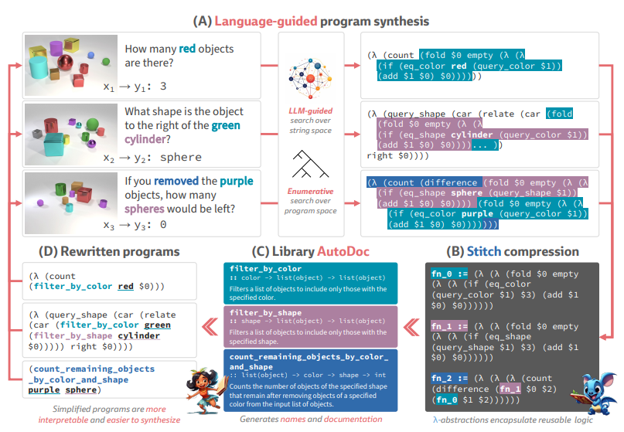
LILO (2024): The Best of Both Worlds
Problem:
DreamCoder: powerful library learning but enumerative search is slow
Codex: fast generation but no accumulated knowledge, no correctness
Can we get LLM speed without giving up classical structure?
Solution:
Replaces enumerative search in wake phase with LLM-guided synthesis
Sleep phase keeps DreamCoder's compression and abstraction unchanged
LLM generates candidates fast, classical machinery verifies and compresses
Novel addition: auto-documentation generates readable names for learned functions
Notes:
LILO was published by Grand et al. at ICLR 2024 and it basically tries to fix everything we just talked about.
DreamCoder was powerful but enumerative search was slow.
Codex was fast but no correctness guarantees and no accumulated knowledge.
LILO takes DreamCoder's wake-sleep framework and makes one key change — instead of enumerating programs one by one in the wake phase, the LLM generates candidates directly. Way faster. The sleep phase stays exactly the same as DreamCoder with same compression, same library learning.
If you look at the diagram, section A is the LLM generating candidates from natural language descriptions, section B is Stitch which is the compression algorithm finding shared patterns, section C is AutoDoc which generates readable names for discovered functions, and section D shows the simplified programs that come out.
The genuinely new contribution is that auto-documentation piece and I'll show you exactly why it matters on the next slide

Slide 17
LILO (2024): The Best of Both Worlds
Problem:
DreamCoder: powerful library learning but enumerative search is slow
Codex: fast generation but no accumulated knowledge, no correctness
Can we get LLM speed without giving up classical structure?
Solution:
Replaces enumerative search in wake phase with LLM-guided synthesis
Sleep phase keeps DreamCoder's compression and abstraction unchanged
LLM generates candidates fast, classical machinery verifies and compresses
Novel addition: auto-documentation generates readable names for learned functions
Notes:
LILO was published by Grand et al. at ICLR 2024 and it basically tries to fix everything we just talked about.
DreamCoder was powerful but enumerative search was slow.
Codex was fast but no correctness guarantees and no accumulated knowledge.
LILO takes DreamCoder's wake-sleep framework and makes one key change — instead of enumerating programs one by one in the wake phase, the LLM generates candidates directly. Way faster. The sleep phase stays exactly the same as DreamCoder with same compression, same library learning.
If you look at the diagram, section A is the LLM generating candidates from natural language descriptions, section B is Stitch which is the compression algorithm finding shared patterns, section C is AutoDoc which generates readable names for discovered functions, and section D shows the simplified programs that come out.
The genuinely new contribution is that auto-documentation piece and I'll show you exactly why it matters on the next slide

Slide 18
LILO (2024): The Best of Both Worlds
Problem:
DreamCoder: powerful library learning but enumerative search is slow
Codex: fast generation but no accumulated knowledge, no correctness
Can we get LLM speed without giving up classical structure?
Solution:
Replaces enumerative search in wake phase with LLM-guided synthesis
Sleep phase keeps DreamCoder's compression and abstraction unchanged
LLM generates candidates fast, classical machinery verifies and compresses
Novel addition: auto-documentation generates readable names for learned functions
Notes:
LILO was published by Grand et al. at ICLR 2024 and it basically tries to fix everything we just talked about.
DreamCoder was powerful but enumerative search was slow.
Codex was fast but no correctness guarantees and no accumulated knowledge.
LILO takes DreamCoder's wake-sleep framework and makes one key change — instead of enumerating programs one by one in the wake phase, the LLM generates candidates directly. Way faster. The sleep phase stays exactly the same as DreamCoder with same compression, same library learning.
If you look at the diagram, section A is the LLM generating candidates from natural language descriptions, section B is Stitch which is the compression algorithm finding shared patterns, section C is AutoDoc which generates readable names for discovered functions, and section D shows the simplified programs that come out.
The genuinely new contribution is that auto-documentation piece and I'll show you exactly why it matters on the next slide

Slide 19
LILO (2024): The Best of Both Worlds
Problem:
DreamCoder: powerful library learning but enumerative search is slow
Codex: fast generation but no accumulated knowledge, no correctness
Can we get LLM speed without giving up classical structure?
Solution:
Replaces enumerative search in wake phase with LLM-guided synthesis
Sleep phase keeps DreamCoder's compression and abstraction unchanged
LLM generates candidates fast, classical machinery verifies and compresses
Novel addition: auto-documentation generates readable names for learned functions
Notes:
LILO was published by Grand et al. at ICLR 2024 and it basically tries to fix everything we just talked about.
DreamCoder was powerful but enumerative search was slow.
Codex was fast but no correctness guarantees and no accumulated knowledge.
LILO takes DreamCoder's wake-sleep framework and makes one key change — instead of enumerating programs one by one in the wake phase, the LLM generates candidates directly. Way faster. The sleep phase stays exactly the same as DreamCoder with same compression, same library learning.
If you look at the diagram, section A is the LLM generating candidates from natural language descriptions, section B is Stitch which is the compression algorithm finding shared patterns, section C is AutoDoc which generates readable names for discovered functions, and section D shows the simplified programs that come out.
The genuinely new contribution is that auto-documentation piece and I'll show you exactly why it matters on the next slide

Slide 20
LILO (2024): The Best of Both Worlds
Problem:
DreamCoder: powerful library learning but enumerative search is slow
Codex: fast generation but no accumulated knowledge, no correctness
Can we get LLM speed without giving up classical structure?
Solution:
Replaces enumerative search in wake phase with LLM-guided synthesis
Sleep phase keeps DreamCoder's compression and abstraction unchanged
LLM generates candidates fast, classical machinery verifies and compresses
Novel addition: auto-documentation generates readable names for learned functions
Notes:
LILO was published by Grand et al. at ICLR 2024 and it basically tries to fix everything we just talked about.
DreamCoder was powerful but enumerative search was slow.
Codex was fast but no correctness guarantees and no accumulated knowledge.
LILO takes DreamCoder's wake-sleep framework and makes one key change — instead of enumerating programs one by one in the wake phase, the LLM generates candidates directly. Way faster. The sleep phase stays exactly the same as DreamCoder with same compression, same library learning.
If you look at the diagram, section A is the LLM generating candidates from natural language descriptions, section B is Stitch which is the compression algorithm finding shared patterns, section C is AutoDoc which generates readable names for discovered functions, and section D shows the simplified programs that come out.
The genuinely new contribution is that auto-documentation piece and I'll show you exactly why it matters on the next slide

Slide 21
LILO: The Auto-Documentation Insight
The surprising finding:
Giving LLM unnamed compressed abstractions actually hurt performance
Without auto-documentation: solve rates dropped 30+ points on REGEX domain
With auto-documentation: LLM generates readable names and docstrings for learned functions
LLM reuses functions it can understand semantically, ignores ones it cannot
Example:
Without doc: fn_42 = (λ f. (λ z. (+ z z)))
With doc: double = (λ f. (λ z. (+ z z))) : "Returns twice the input"
Notes:
So here's the most surprising finding in the paper. When they first gave the LLM the compressed abstractions from DreamCoder, performance actually got worse. On the REGEX domain solve rates dropped over 30 points. Why? Because DreamCoder's compression produces anonymous functions like fn_42 with no meaningful name. The LLM has no idea what fn_42 does so it just ignores it. The fix was auto-documentation. After each compression step the LLM generates a readable name and description for each new function. So instead of fn_42 you get double with the description returns twice the input. Now the LLM actually understands what it can use. And that's it

Slide 22
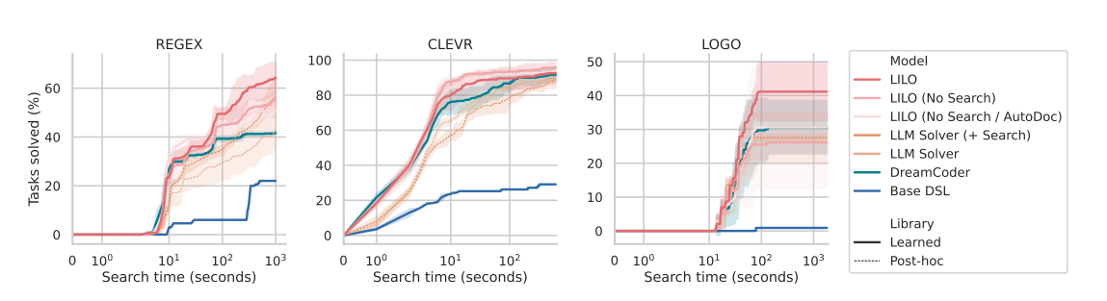
LILO: Results + Limitations
Results:
Outperformed DreamCoder by 33.14 points on REGEX
Outperformed DreamCoder by 20.42 points on LOGO
Outperformed DreamCoder by 2.26 points on CLEVR (where DreamCoder was already at 94.5%)
Improved over LLM-only baselines by up to 16.82 points on LOGO
Limitations:
Still requires hand-designed domain primitives to initialize library
Cannot bootstrap from scratch in a genuinely new domain
Depends on capable LLM, introduces cost and latency at scale
Notes:
Here are the results. The three graphs show tasks solved over search time across REGEX, CLEVR, and LOGO. Red line is LILO, green is DreamCoder, blue is the base DSL with no learning.
LILO is clearly on top in REGEX and LOGO — 33 points over DreamCoder on REGEX, 20 points on LOGO. CLEVR is a smaller improvement but DreamCoder was already at 94.5% there so there wasn't much room anyway.
Also notice the lighter red lines — those are ablations removing parts of LILO. Removing AutoDoc hurts performance, which directly shows its contribution.
Now the limitations. LILO still needs hand-designed primitives to initialize the library so you can't start from nothing in a brand new domain. It also depends on a capable LLM which costs money and adds latency. And it's only been tested on three domains so how well it generalizes beyond those is an open question.

Slide 23
Open Problems: Where Does the Field Go Next?
Classical synthesis: correct but only works in narrow domains with hand-designed DSLs
Neural synthesis: flexible and fast but fails silently with no formal guarantees
Neurosymbolic synthesis: promising but expensive and only tested on three domains
How do you handle genuinely ambiguous intent?
How do you build tools non-experts can actually trust?
Can formal guarantees survive as systems get more neural?
Can we build a general synthesizer without a hand-designed DSL?
Recent work: hybrid LLM plus formal synthesis approaches now solving 80% of benchmarks — but a truly general solution is still out of reach
Notes:
So where does the field stand right now?
Classical methods are correct but only work in narrow domains and you need to hand-design a DSL every single time.
Neural methods are fast and flexible but they fail silently and there are no guarantees.
Neurosymbolic systems like LILO are the most promising direction but they're expensive and have only been tested on three domains.
And there are bigger questions nobody has really answered yet — what do you do when user intent is genuinely ambiguous, how do you build tools that non-experts can actually trust, can formal guarantees even survive as systems get more neural, and can we ever build a synthesizer that works anywhere without hand-engineering a DSL first.
The field is moving though — in 2024 hybrid approaches combining LLMs with formal synthesis are already solving 80% of benchmarks. But a truly general solution still doesn't exist. That's what the next decade is probably about.

Slide 24
Conclusion
Classical methods: solved correctness, not generality
Neural methods: solved generality, not correctness
Neurosymbolic methods: the attempt to solve both
SKETCH made synthesis domain-agnostic
FlashFill made it practical for real users
Survey mapped the landscape and identified the gap
DreamCoder made it cumulative
Codex made it fast but unverified
LILO combined both, best results so far
Progress: from synthesizing AES in an hour (2006) to GitHub Copilot (2021) in twenty years
What remains: a general synthesis system that works anywhere without hand-engineering does not exist yet
Can computers write programs for us? The field is closer than ever. But it is not there yet.
Notes:
So to wrap up. The whole field has been wrestling with one tension — correctness versus flexibility.
Classical methods solved correctness but not generality.
Neural methods solved generality but not correctness. Neurosymbolic methods are trying to solve both and LILO is the best answer so far.
Each paper we covered today solved something its predecessors couldn’t.
SKETCH made synthesis domain-agnostic, FlashFill made it practical, the survey mapped everything, DreamCoder made it cumulative, Codex made it fast, LILO combined both.
We went from synthesizing AES in an hour in 2006 to GitHub Copilot in 2021 in twenty years.
But a general synthesis system that works anywhere without hand-engineering still doesn't exist. Can computers write programs for us? The field is closer than ever. But it's not there yet.

Slide 25
References
[1] M. Chen et al. "Evaluating Large Language Models Trained on Code." arXiv:2107.03374, 2021.
[2] K. Ellis et al. "DreamCoder: Bootstrapping Inductive Program Synthesis with Wake-Sleep Library Learning." PLDI, 2021.
[3] G. Grand et al. "LILO: Learning Interpretable Libraries by Compressing and Documenting Code." ICLR, 2024.
[4] S. Gulwani. "Automating String Processing in Spreadsheets Using Input-Output Examples." POPL, 2011.
[5] S. Gulwani, O. Polozov, R. Singh. "Program Synthesis." Foundations and Trends in Programming Languages, 2017.
[6] A. Solar-Lezama et al. "Combinatorial Sketching for Finite Programs." ASPLOS, 2006.

Slide 26
Thank You! Questions?

