Slide 1
OP Mainnet: Who Makes Money, What We Keep, How to Grow It
Sequencer revenue review for the last 12 months (Sep 16 2025 to Sep 15 2026) and a 12-month plan
Apps make the money. OP kept $1.22M, mostly from bots, as blockspace prices fell 76%. A staged fee floor, L1 fix and payments lift next year to $1.19M, not $0.90M.
Business Intelligence Lead take-home · data through 2026-09-15 · code & SQL in the accompanying git repo

Slide 2
EXECUTIVE SUMMARY
Apps make the money; OP keeps ~$1.2M, mostly from bots. Pricing blockspace grows our take.
Net sequencer revenue, last 12m
Fees apps earned, last 12m
Share of fees paid by bots
Next 12m, Base case with levers
$1.22M
$41M
66%
$1.19M
97% margin after L1 costs
≈33× OP's gross take
87% of transactions
vs $0.90M with no action
Finding & evidence
So what
▪ OP's take is small and shrinking because the price of blockspace (the transaction capacity OP sells) collapsed, not the volume. OP kept $1.216M net in the last 12 months, while apps on OP Mainnet collected $41.3M in fees.
▪ Gross fees per day fell 70% ($11.6k to $3.4k) while transactions per day rose 71%. The price per unit of gas (compute) fell 76%.
▪ Bots pay about two-thirds of fees (57% unnamed automated contracts plus 9% labelled MEV bots). Named apps pay 18%. The top 10 customers pay 50%.
▪ Revenue is event-driven. The Oct 10 2025 crash day alone earned $250k, 20% of the year, and the 10 busiest days earned 32%.
With no action, net revenue for the next 12 months falls to $0.90M (-26%). Demand barely responded when blockspace got cheaper (+0.38% transactions per 1% price drop), so we should work on price, not volume.
Recommended action
Phase in a minimum base fee toward 2.5 mwei/gas, re-tune the L1 data fee scalars, sign payments issuers and pursue chains as OP Enterprise customers. Base case: $1.19M, +32% versus no action.
OP Mainnet revenue · BI Lead case study
2

Slide 3
APPROACH
We define our share as user fees minus Ethereum posting costs.
▪ Our share = sequencer revenue: fees paid to OP's block producer (the sequencer), minus the L1 data cost of posting to Ethereum.
▪ Window: the last 12 months (Sep 16 2025 to Sep 15 2026) against the prior 258 days, compared per day.
▪ Fee change split into four drivers: transactions, gas (compute units) per transaction, price per unit of gas, and ETH/USD.
▪ Fees assigned to the contract each transaction calls: 724 paying customers, grouped into apps, bots and the long tail.
Data checks run on every build: 13/13 pass
▪ 06 fees reconcile to 01 (max daily deviation): 0.01215%
▪ 06 txs reconcile to 01 (max daily deviation): 0.00000%
▪ 01 USD = ETH x price: 0.000000%
▪ 01 price matches 02: 0.000000%
▪ 01 execution + L1 data = total (ETH): 3.55e-15 ETH
▪ 06 unique (date, to_address): 0
▪ 01 one row per day, no gaps: 623 days 2025-01-01..2026-09-15
▪ last-12-month window = 365 days: 365
▪ 07 labels: one row per tracked address: 1082 labels / 1082 addresses
OP Mainnet revenue · BI Lead case study
3

Slide 4
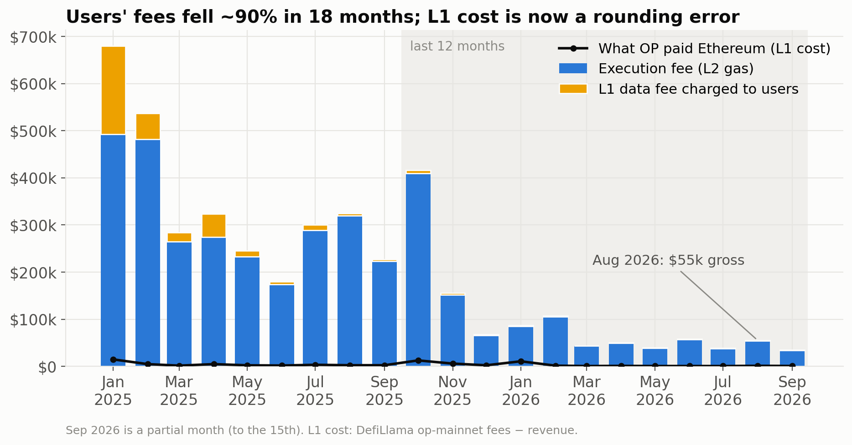
1 · DIAGNOSE THE REVENUE
We kept $1.22M net last year; the run-rate is now $49.7k/month.
▪ Last-12-month gross user fees were $1.256M (430 ETH). L1 cost was $40k, so net sequencer revenue was $1.216M, a 96.8% margin.
▪ Gross fees per day fell 70%, from $11.6k in the prior period to $3.4k.
▪ Jun to Aug 2026 averaged $50.5k/month gross, against $680k in Jan 2025 alone.
▪ The margin holds on either cost source: L1 cost is 5.6% of gross (growthepie) or 2.1% (DefiLlama). Net stays at about 95-97%.
OP Mainnet revenue · BI Lead case study
4

Slide 5
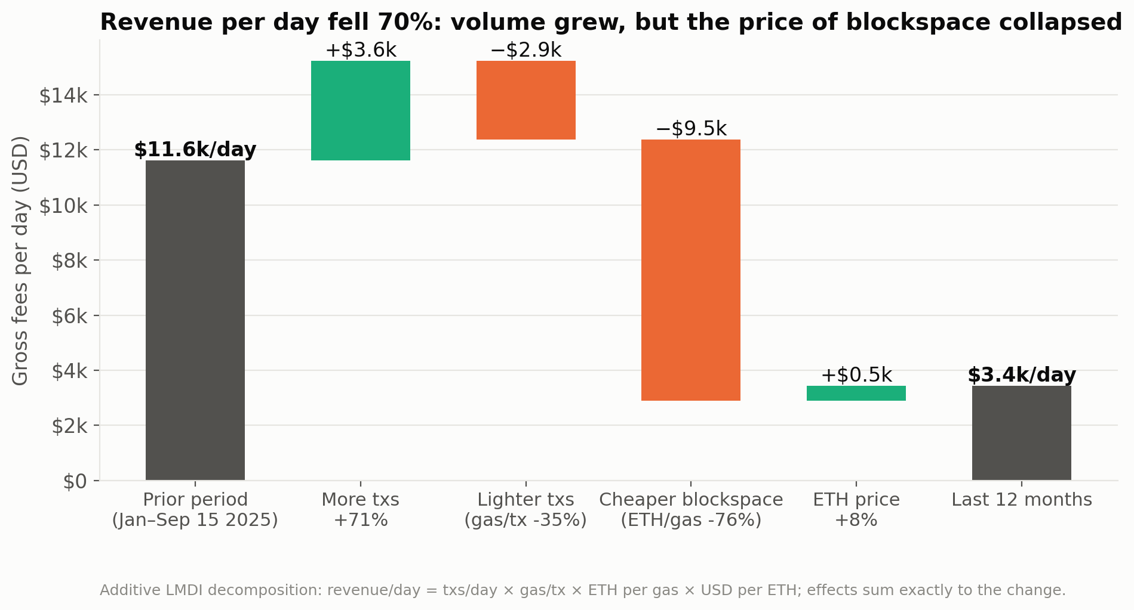
1 · DIAGNOSE THE REVENUE
Volume grew, but blockspace prices collapsed 76% and drove the decline.
▪ Transactions per day rose 71% (1.03M to 1.76M), adding $3.6k/day of fees.
▪ Gas (compute units) per transaction fell 35%, removing $2.9k/day.
▪ The price paid per unit of gas fell 76%, removing $9.5k/day: the main driver of the -$8.2k/day change.
▪ Daily active addresses fell from ~81k to ~21k while transactions doubled, so the volume is automated.
OP Mainnet revenue · BI Lead case study
5

Slide 6
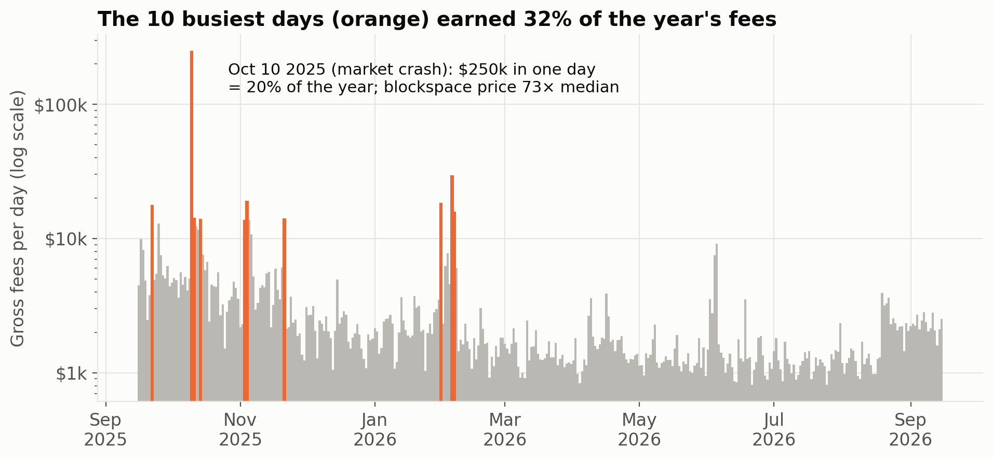
1 · DIAGNOSE THE REVENUE
Revenue is event-driven: one crash day earned 20% of the year.
▪ The Oct 10 2025 market crash earned $250k, at 73x the median day's price of 1.28 mwei/gas.
▪ The 10 busiest days delivered 32% of last-12-month fees.
▪ About 40% of fees (173 of 430 ETH) was a congestion premium paid above the median price.
▪ Budget off the base load and treat spikes as upside we cannot schedule.
OP Mainnet revenue · BI Lead case study
6

Slide 7
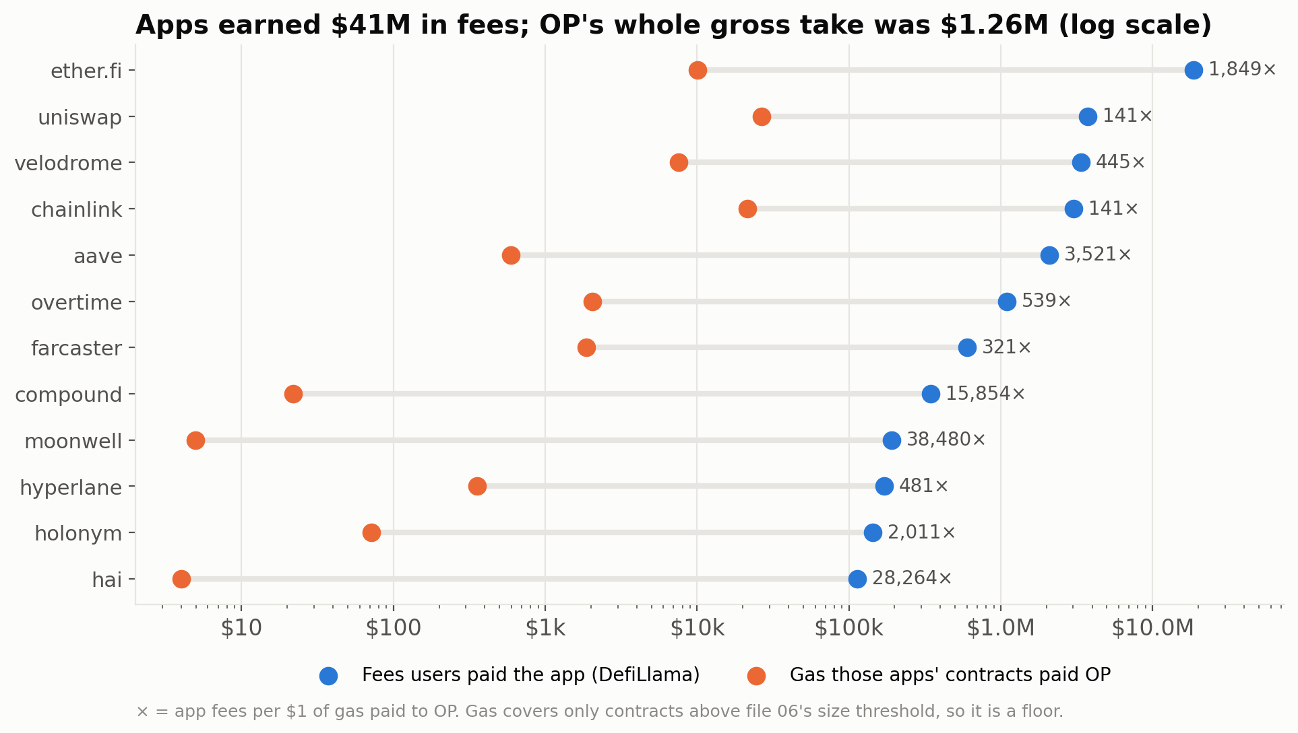
1 · WHO IS MAKING MONEY
Apps collected $41.3M in fees; OP's gross take was $1.26M.
▪ Apps on OP Mainnet earned $41.3M in fees and kept $17.4M as revenue (DefiLlama).
▪ OP's gross take of $1.26M is about 3% of what apps collect.
▪ ether.fi earned $18.5M in app fees and $7.1M revenue, but its contracts paid OP only $10k in gas.
▪ Uniswap $3.75M fees / $27k gas; Velodrome $3.36M / $7.6k; Chainlink $3.0M / $21k; Aave $2.1M / $0.6k.
OP Mainnet revenue · BI Lead case study
7

Slide 8
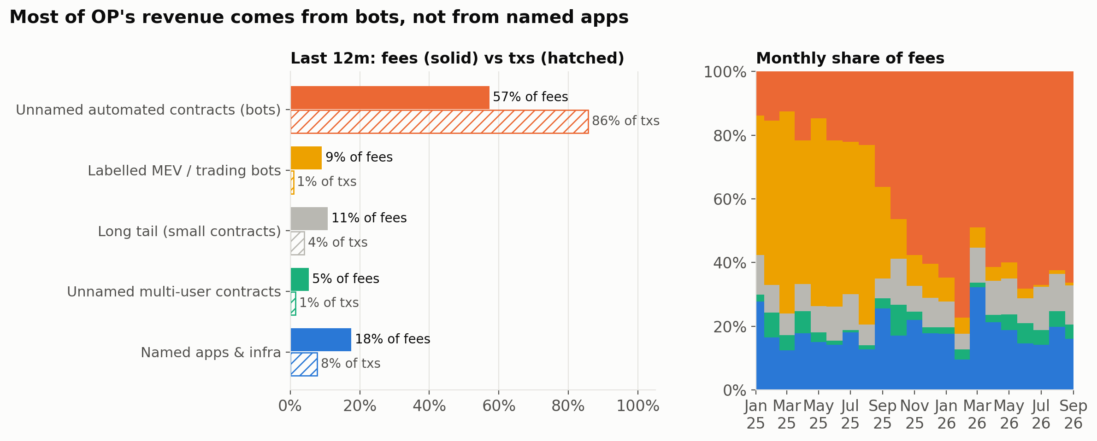
2 · IDENTIFY THE CUSTOMERS
Bots pay about two-thirds of our revenue; named apps pay 18%.
▪ Unnamed automated contracts (bots) pay 57% of fees and send 86% of transactions.
▪ Labelled MEV bots, which profit from the order of trades, pay 9% of fees with 1% of transactions.
▪ Named apps and infrastructure pay 18% of fees with 8% of transactions.
▪ The long tail of small contracts pays 11%; unnamed multi-user contracts pay 5%.
OP Mainnet revenue · BI Lead case study
8

Slide 9
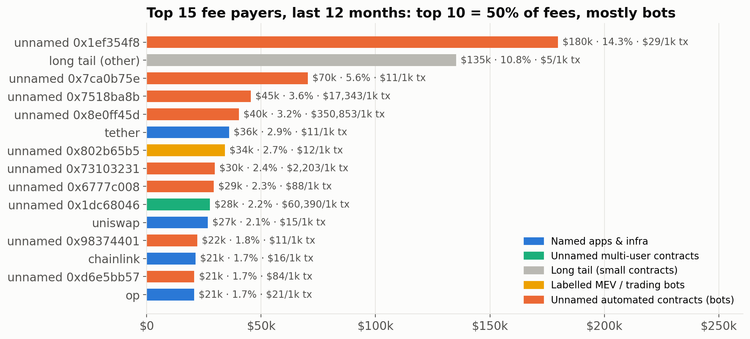
2 · IDENTIFY THE CUSTOMERS
Revenue is concentrated: ten customers pay half, and seven are bots.
▪ Of 724 paying customers, the top 10 pay 50% of fees and the top 50 pay 81%.
▪ Seven of the top 10 are bots or MEV searchers, not named consumer apps.
▪ The HHI concentration index is 443, low overall, but key-account exposure at the top is real.
▪ Some searchers pay up to $350 per transaction on spike days through priority-fee auctions.
OP Mainnet revenue · BI Lead case study
9

Slide 10
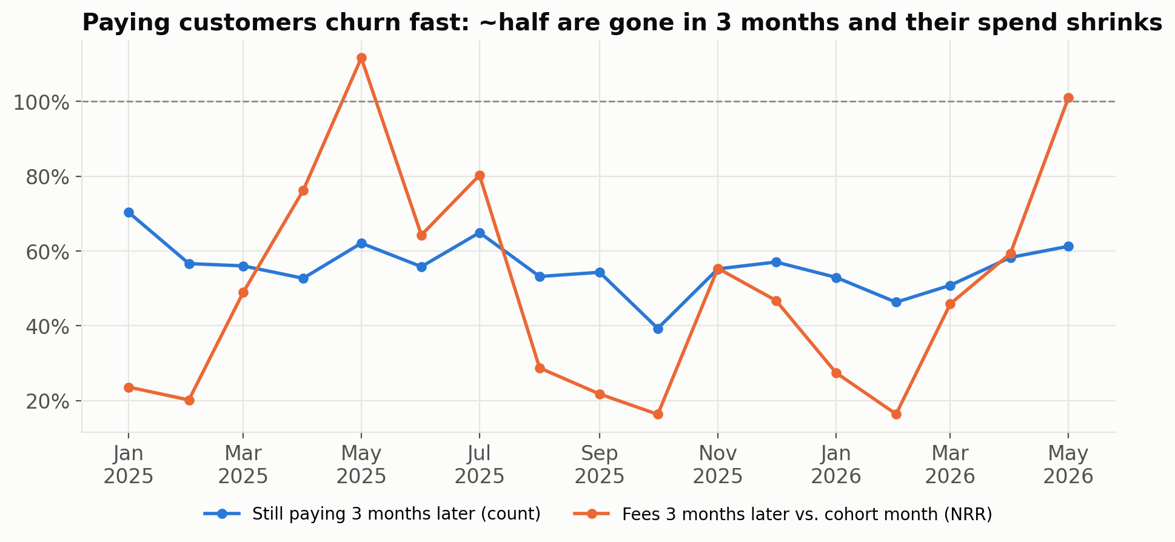
2 · IDENTIFY THE CUSTOMERS
Paying customers churn fast: only ~53% still pay three months later.
▪ Of addresses paying at least $10/month, only ~53% are still paying three months later.
▪ Three-month net revenue retention averages 43%, so a cohort's spend shrinks by more than half.
▪ The revenue base turns over constantly. Growth needs a steady pipeline of new flow, not just existing payers.
OP Mainnet revenue · BI Lead case study
10

Slide 11
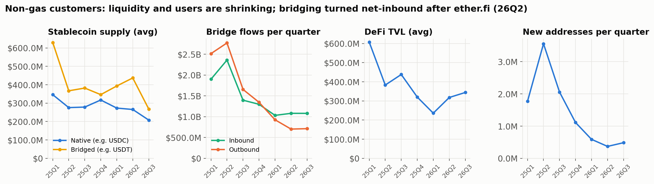
2 · OTHER CUSTOMER TARGETS
Payments flow is the growth signal; most other ecosystem metrics shrank.
▪ Adjusted stablecoin transfer volume rose 67%, from $1.08B to $1.81B per quarter (Q3 2025 to Q3 2026).
▪ But stablecoin supply fell: native from $279M to $208M, bridged from $382M to $268M.
▪ Bridges now bring in more than they send out ($1.08B in versus $0.71B out per quarter).
▪ Base left the Superchain revenue share in Feb 2026. It had been ~90% of Collective inflows in Jan 2026.
OP Mainnet revenue · BI Lead case study
11

Slide 12
3 · RECOMMENDATION
Price blockspace with a staged minimum base fee
Finding
Evidence
The 76% fall in blockspace price drove the decline, and demand barely responded to cheaper prices.
Price effect -$9.5k/day. Observed elasticity: 0.38% more transactions and 0.08% more gas per 1% price drop. Median price 1.28 mwei/gas.
Business implication
Recommended action
A floor recovers price on base-load blockspace, mostly paid by bots, at negligible cost to users ($0.0014 per typical transaction).
Check the current minBaseFee setting, then raise the floor 1.5 -> 2.0 -> 2.5 mwei/gas. Each step goes ahead only if guardrails hold.
Owner
Product-Protocol (accountable), with Data monitoring and Finance signing off each stage
Timeline
Month 1: verify the setting and the governance path. Month 2: 1.5 mwei. Month 4: 2.0 mwei. Month 6: 2.5 mwei, then hold and review.
Expected impact
+$215k a year at 2.5 mwei in the base case. The floor range 1.5-4.0 mwei gives a total of $0.98M-$1.44M.
Track
Net revenue per day versus the no-action line ($0.90M/yr pace) · Bot gas decline no worse than the modelled -31% at 2.5 mwei · User gas decline no worse than the modelled -6% · Typical user transaction cost around $0.0014 at 2.5 mwei
OP Mainnet revenue · BI Lead case study
12

Slide 13
3 · RECOMMENDATION
Fix L1 fee hygiene
Finding
Evidence
Since Oct 2025, users have paid less L1 data fee than OP's actual Ethereum posting cost, because the fee scalars are stale.
The data leg runs at about -$20k/yr. L1 cost is $40k against $20k of L1 data fee collected in the last 12 months.
Business implication
Recommended action
We subsidise Ethereum posting costs for free. It is small, but it is a pure leak that is easy to fix.
Re-tune the L1 data fee scalars so the data leg breaks even. Reconcile the L1 cost source (2.1% DefiLlama vs 5.6% growthepie) with an on-chain batcher rebuild.
Owner
Product-Protocol (scalars) and Data (cost reconciliation)
Timeline
Months 1-2
Expected impact
+$20k a year in the base case.
Track
L1 data fee collected minus L1 cost >= 0 each month · L1 cost ratio reconciled to one agreed source
OP Mainnet revenue · BI Lead case study
13

Slide 14
3 · RECOMMENDATION
Grow payments and stablecoin flow
Finding
Evidence
Stablecoin payments are the one clear growth line, and payments apps create far more value than they pay OP.
Adjusted stablecoin transfer volume +67% to $1.81B/qtr. ether.fi: $18.5M app fees against $10k of gas paid to OP.
Business implication
Recommended action
Each issuer adds little direct fee revenue but brings recurring, non-bot flow, plus deposits and stablecoin balances that strengthen the ecosystem.
Target 2 more card or payments issuers of ether.fi's scale, with co-marketing and launch support.
Owner
Business Development
Timeline
Pipeline by month 3, first signing by month 6, both live by month 12
Expected impact
+$51k a year of direct sequencer revenue in the base case (0-4 wins: $1.14M-$1.24M total). The main value is ecosystem fees, stablecoin volume and TVL.
Track
Issuers signed (target: 2) · Adjusted stablecoin transfer volume above $1.81B/qtr · Native stablecoin supply recovering from $208M
OP Mainnet revenue · BI Lead case study
14

Slide 15
3 · RECOMMENDATION
Sell to chains as customers (OP Enterprise)
Finding
Evidence
Base's exit from the Superchain revenue share removed the largest source of Collective inflows.
Base announced its exit on 2026-02-19. It had been ~90% of Collective inflows in Jan 2026.
Business implication
Recommended action
OP needs paying chain customers to replace that inflow, on top of OP Mainnet's own margin.
Package OP Enterprise (OP Stack plus services for chains) with clear pricing, and build a pipeline of target chains.
Owner
Business Development (pipeline) and Finance (pricing and contract terms)
Timeline
Offer and pricing by month 3, pipeline review by month 6, first contracts by month 12
Expected impact
Not modelled. This is upside outside the $1.19M base case and should be sized once pricing is set.
Track
Chains in qualified pipeline · Signed chain contracts · Contracted annual revenue
OP Mainnet revenue · BI Lead case study
15

Slide 16
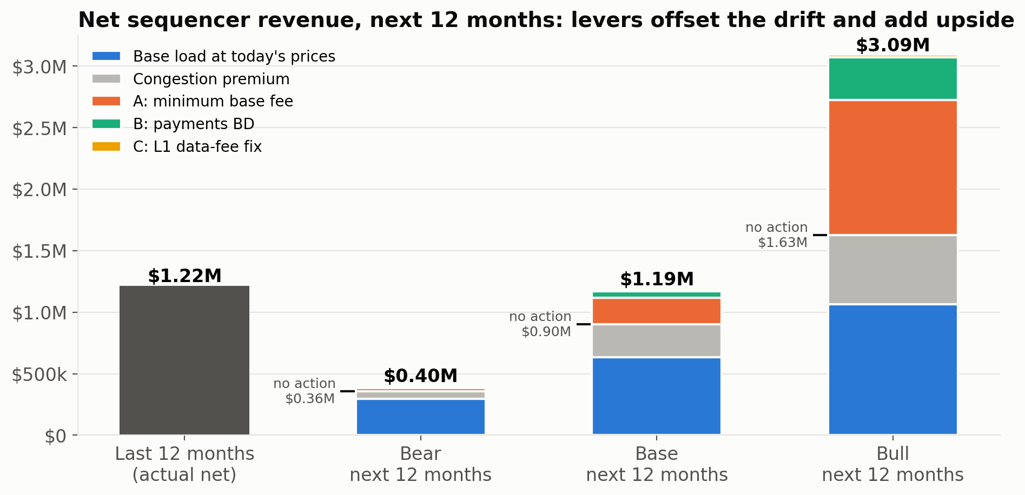
3 · BUSINESS CASE
Doing nothing yields $0.90M; three levers lift next year to $1.19M.
▪ No action: $0.90M net (-26% vs last 12 months), with ETH at $2,388, no crash like Oct 10, flat gas.
▪ Lever A, a 2.5 mwei/gas fee floor: +$215k. Lever B, payments BD: +$51k. Lever C, L1 fee fix: +$20k.
▪ Base case with levers: $1.19M, +32% versus no action and about flat versus the last 12 months.
▪ Range: Bear case $0.40M, Bull case $3.09M (Bull assumes a 4.0 mwei floor).
OP Mainnet revenue · BI Lead case study
16

Slide 17
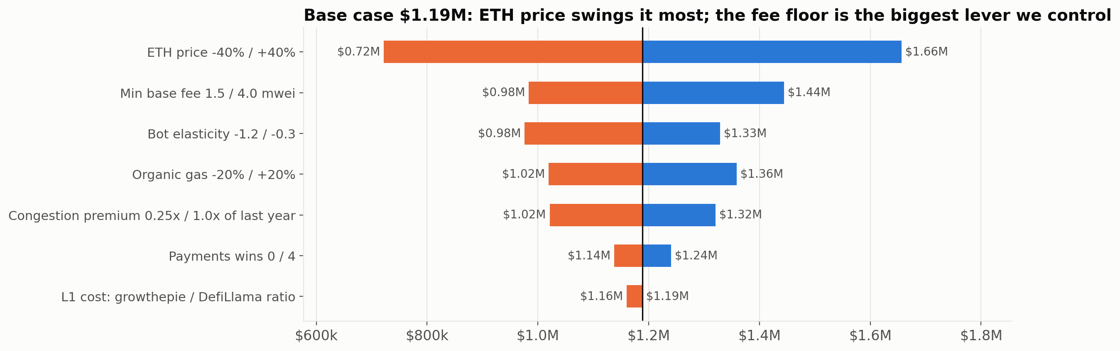
3 · BUSINESS CASE
ETH price drives the range most; bot reaction is the biggest controllable unknown.
▪ ETH price at -40% or +40% gives $0.72M to $1.66M around the $1.19M base case.
▪ A 1.5 to 4.0 mwei floor gives $0.98M to $1.44M. Bot elasticity of -1.2 to -0.3 gives $0.98M to $1.33M.
▪ Organic gas at -20% or +20% gives $1.02M to $1.36M. A congestion premium of 0.25x to 1.0x gives $1.02M to $1.32M.
▪ Payments wins of 0 to 4 give $1.14M to $1.24M. The L1 cost source gives $1.16M to $1.19M.
OP Mainnet revenue · BI Lead case study
17

Slide 18
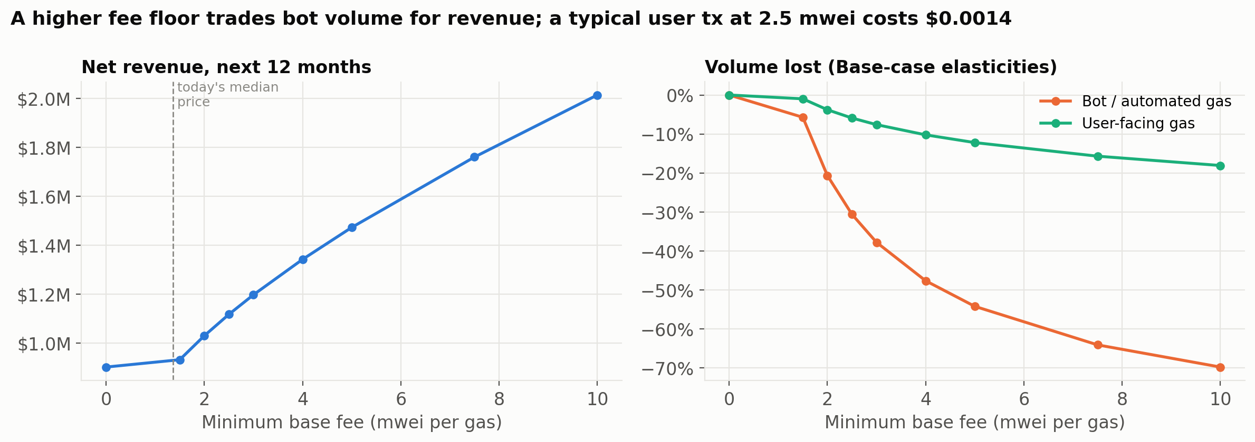
3 · BUSINESS CASE
A higher fee floor earns more but risks pushing flow to Base.
▪ Fee floor alone: 1.5 mwei $0.93M, 2.0 $1.03M, 2.5 $1.12M, 3.0 $1.20M, 4.0 $1.34M, 5.0 $1.47M.
▪ At 2.5 mwei a typical user transaction costs $0.0014. Modelled user gas falls 6% and bot gas falls 31%.
▪ Base, our closest competitor, sets its minimum base fee at 0.5 mwei. If the gap gets too wide, flow may move.
▪ We recommend 2.5 mwei, about 1.8x today's 90-day median of 1.36, reached in stages.
OP Mainnet revenue · BI Lead case study
18

Slide 19
3 · BUSINESS CASE
Every assumption is explicit, and the observed data anchors the key ones
Assumption | Bear | Base | Bull
ETH price (avg, USD) | $1,433 | $2,388 | $3,343
Organic gas change | -20% | +0% | +20%
Congestion premium vs last 12m | 0.25× | 0.67× | 1.00×
L1 cost, % of gross | 5.6% | 3.2% | 3.2%
Lever A: minimum base fee (mwei/gas) | 2.5 | 2.5 | 4.0
Lever A: bot price elasticity | -1.0 | -0.6 | -0.4
Lever A: user price elasticity | -0.2 | -0.1 | -0.05
Lever B: ether.fi-scale payment wins | 0 | 2 | 4
Lever B: induced-activity multiple | 1× | 2× | 3×
Lever C: re-tune L1 data-fee scalars | Yes | Yes | Yes
→ Net revenue, no action | $0.36M | $0.90M | $1.63M
→ Net revenue, with levers | $0.40M | $1.19M | $3.09M
▪ Elasticities: when blockspace got 76% cheaper, txs rose only 0.38% and gas 0.08% per 1% price cut. A bot elasticity of −0.6 is conservative.
▪ Congestion premium: last 12m excluding the Oct-10 crash day = 0.67× of the full year.
▪ Base-load price: 90-day median 1.36 mwei per gas; ETH $2,388 (30-day average).
▪ L1 cost: DefiLlama 3.2% of gross; growthepie 5.6% (Bear).
▪ Lever B uses ether.fi's observed 90-day gas run-rate on OP Mainnet.
OP Mainnet revenue · BI Lead case study
19

Slide 20
3 · MEASURING SUCCESS
How we'll know it's working: one north-star metric, four drivers, three guardrails
Metric | Definition | Target / guardrail | Owner
Net sequencer revenue | Gross user fees minus L1 data cost (Ethereum posting) | Target $1.19M for the next 12 months. Guardrail: stay above the $0.90M no-action line | Finance
Effective blockspace price | Median ETH paid per unit of gas, in mwei/gas | From a 90-day median of 1.36 to a 2.5 mwei floor, in stages | Product-Protocol
Base-load gas by segment (bots vs users) | Gas used per day, excluding spike days, split by customer segment | Bot gas no worse than -31%, user gas no worse than -6% at 2.5 mwei | Data
Typical user transaction cost | USD cost of a 234k-gas user transaction | Around $0.0014 at 2.5 mwei | Product-Protocol
Congestion premium share | Share of fees paid above the median price on volatile days | Track separately. Base case assumes 0.67x last year; last year it was ~40% of fees | Finance
L1 data leg balance | L1 data fees collected minus OP's Ethereum posting cost | At or above break-even, from about -$20k/yr today | Product-Protocol
Paying-customer retention | Share of $10+/month payers still paying after 3 months, and their net revenue retention | Improve on the ~53% (customers) and 43% (revenue) baselines | Business Development
Payments flow | Adjusted stablecoin transfer volume per quarter, plus native stablecoin supply | Above $1.81B/qtr volume; supply recovering from $208M; 2 issuers signed | Business Development
Competitive price gap and flow share | OP's minimum base fee versus Base's 0.5 mwei, and the share of top bots still active | Pause the next floor stage if top-payer activity drops beyond the modelled bot response | Data
OP Mainnet revenue · BI Lead case study
20

Slide 21
3 · RISKS & NEXT STEPS
What could go wrong, and what happens in the first 90 days
Risk | Mitigation
Bots react more strongly to a floor than assumed. Bot elasticity is the biggest unknown. | Stage the rollout 1.5 -> 2.0 -> 2.5 mwei and measure at each step. Even at -1.2 the base case is $0.98M, above the $0.90M no-action line.
Flow moves to Base, Arbitrum or other chains. Base's floor is 0.5 mwei. | Track top-payer activity weekly. Pause or roll back a stage if the bot response exceeds the modelled -31%.
ETH price swings dominate the result: -40%/+40% gives $0.72M-$1.66M. | Finance plans in both ETH and USD and reports the levers' effect separately from ETH moves.
Spike dependence: one day (Oct 10 2025) was 20% of the year, and a calm year undershoots. | Budget on base load. The base case already assumes no crash on that scale (0.67x last year's congestion premium).
Concentration: the top 10 customers pay 50%, and 7 of them are bots. | Monitor the top payers individually as key accounts, and diversify through payments and OP Enterprise.
Measurement gaps: bot labels are heuristic (~340 of 1,082 addresses labelled), the L1 cost source is uncertain, and the current minBaseFee is unverified. | Data checks the on-chain configuration, rebuilds L1 cost from batcher transactions and improves address labels before stage one.
By day 30
▪ Product-Protocol: verify OP Mainnet's current minBaseFee and the governance path for changing it
▪ Product-Protocol: re-tune the L1 data fee scalars to break even
▪ Data: build the KPI dashboard (price, base-load gas by segment, top-payer activity, L1 data leg)
▪ Finance: re-base the 12-month budget to the $0.90M no-action line and the $1.19M plan
By day 60
▪ Product-Protocol: ship floor stage one at 1.5 mwei/gas
▪ Data: measure the bot and user response against the modelled elasticities
▪ BD: build a target list of payments issuers and an OP Enterprise offer with pricing (with Finance)
By day 90
▪ Leadership: go/no-go on 2.0 mwei based on the stage-one guardrails
▪ BD: have the first issuer and chain conversations in qualified pipeline
▪ Finance and Data: re-forecast with the measured elasticity and replace the assumed -0.6
OP Mainnet revenue · BI Lead case study
21

Slide 22
APPENDIX
Appendix A: definitions, data sources and how AI was used
▪ Our share = sequencer revenue = user fees on OP Mainnet (execution + L1 data fee, file 01) − what OP pays Ethereum to post data.
▪ L1 cost is not in the files provided. Primary source: DefiLlama op-mainnet (fees − revenue), daily; its last-12m gross differs from file 01 by -3.37%. Cross-check: growthepie (last ~90 days). An on-chain rebuild via Blockscout was coded (external/fetch_l1_costs.py) but rate-limited.
▪ Customers: fees are assigned to the destination contract (file 06). Contracts are grouped into apps by label precedence: Allium entity → Dune namespace → display name → Dune owner. Bot = no name AND (≤5 senders/day OR ≥50 txs per sender-day).
▪ App earnings: DefiLlama fees/revenue (file 08), mapped to the same app names. Gas paid by apps is a floor (small contracts sit in 'other').
▪ Window: last 12 months = 2025-09-16 → 2026-09-15 (365 days); the prior period is compared per day because data starts 2025-01-01.
▪ AI use: Claude Code wrote the SQL/Python and ran it. Every number is produced by code, never typed in. Checks: 13 automated integrity tests (06 reconciles to 01 within 0.012%/day), cross-source L1/gross checks, and a manual read of every chart. A performance-optimizer agent had to prove its changes were output-identical, and a business-translation agent drafted copy that was checked figure-by-figure against the outputs (src/verify_copy.py).
OP Mainnet revenue · BI Lead case study
22

Slide 23
APPENDIX
Appendix B: reproducible pipeline (one command rebuilds every number and this deck)
Step | What it produces
sql/01_revenue_monthly | Gross, L1 cost, net by month
sql/02_revenue_decomposition | LMDI: volume × gas/tx × price × ETH
sql/03_address_dim | Address → app + segment
sql/04_app_ranking | Customer ranking, concentration, spikiness
sql/05_segments_monthly | Fees by segment over time
sql/06_retention | 3-month logo retention + NRR
sql/07_apps_vs_op | App fees vs gas paid to OP
sql/08_ecosystem_quarterly | Stablecoins, bridges, CEX, TVL, users
sql/09_fee_concentration_by_day | Revenue concentration by day
src/growth_model.py | Scenarios, tornado, floor sweep
src/checks.py | 13 integrity checks (build fails on any FAIL)
run_all.sh | checks → SQL → model → charts → deck
OP Mainnet revenue · BI Lead case study
23

Slide 24
APPENDIX
Appendix C: public sources
▪ DefiLlama chain fees, OP Mainnet: api.llama.fi/summary/fees/op-mainnet?dataType=dailyFees | dailyRevenue
▪ growthepie fundamentals (OP Mainnet costs_total_usd, fees_paid_usd): api.growthepie.com/v1/fundamentals.json
▪ Jovian hardfork, configurable minimum base fee: docs.optimism.io/notices/upgrade-17 ; specs.optimism.io/protocol/jovian/exec-engine.html
▪ Base leaving the Superchain (announced 2026-02-19), ether.fi moving ~70k cards to OP Mainnet, Collective buyback: dlnews.com/articles/defi/optimism-token-price-plunges-as-base-leaves-superchain/
▪ Superchain revenue share (greater of 2.5% of revenue or 15% of profit): optimism.io/blog/how-(and-why)-the-superchain-drives-fees-to-the-optimism-collective
▪ Optimism buyback (50% of Superchain revenue): cointelegraph.com/news/optimism-passes-buyback-proposal-to-bolster-op-token
▪ Base min base fee / gas configuration change (Dec 2025): reported by Base network notices; used only as a competitive reference point
OP Mainnet revenue · BI Lead case study
24

