Slide 1


Statistical Software Metrics Analysis
Cyrus Kalantarpour

Slide 2
Preparation
We separated the class log and class log at test for Apache and free chart
We concatenated ‘HT Effort’ column along with class test logs for Apache and Free chart
Therefore, we have 4 excel sheets as follows:
1: Apache class logs.xlsx
2: Apache class logs at test.xlsx
3: Free chart class logs at test.xlsx
4: Free chart class logs.xlsx
Then, we read the data (excel sheets) with Pandas (a python framework).
Next step we use ‘dropna’ method to remove Nan data cells.

Slide 3
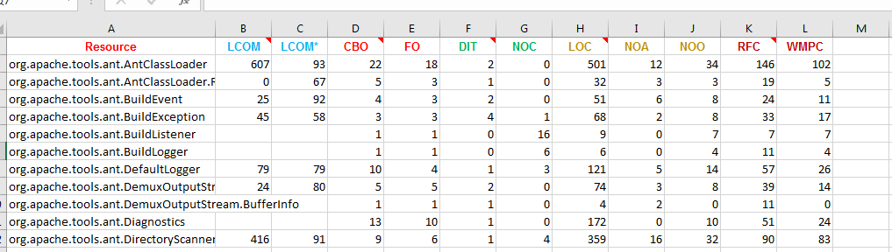
Prepared Excel sheets preview
1: Apache class logs.xlsx

Slide 4
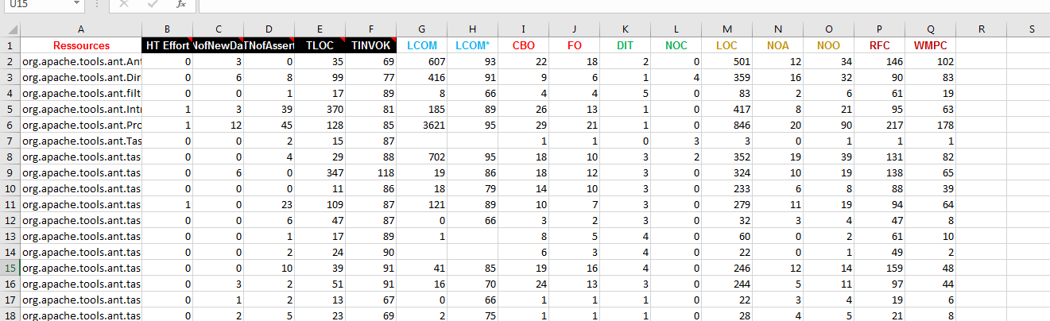
Prepared Excel sheets preview
2: Apache class logs at test.xlsx

Slide 5
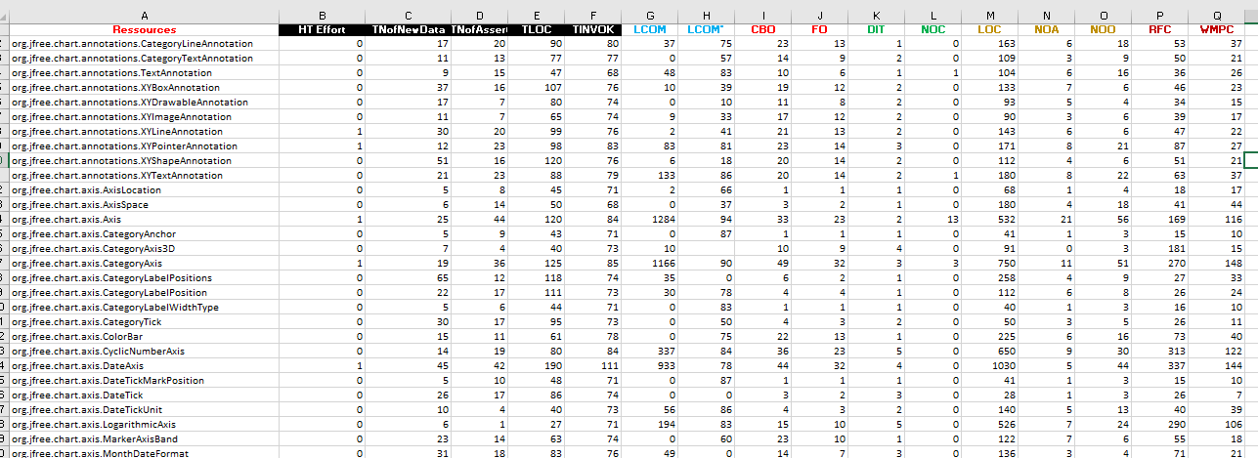
Prepared Excel sheets preview
Free chart class logs at test.xlsx

Slide 6
Prepared Excel sheets preview
Free chart class logs.xlsx

