Slide 1
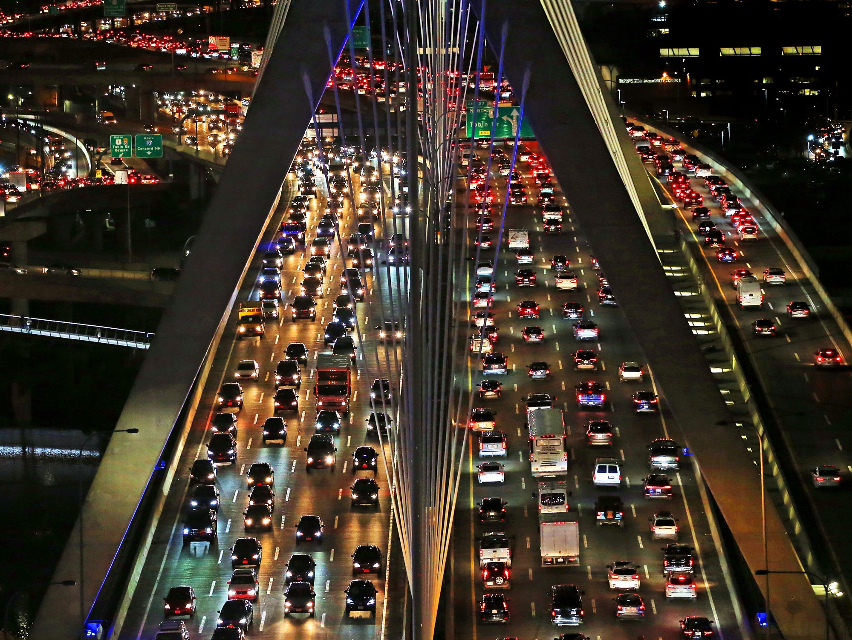
Road Safety
By:
Parastoo Razavi
Cyrus Au Yeung
John Bingley
Seranica Williamson

Slide 2
EXECUTIVE SUMMARY
Decreasing the risk of accident on the road and improving the quality of roads is one of the signs of progress in a country.
Based on WHO report on 2018, Deaths from road traffic crashes have increased to 1.35 million a year which is 8th leading cause of death for people of all ages and number one cause of death for children and young adults 5-29 years of age. Millions of people are injured or disabled every year. The meaning of this data is the cost of emergency response, health care and government support increase as well. So, we can understand the importance of road safety.

Slide 3

_{#1}
cause of death for children and young adults 5-29 years of age
1.35 million people
die each year
as a result of road traffic crashes.
8th
leading cause of death for people of all ages
88%
of pedestrian
travel occurs on roads that are unsafe

Slide 4
Questions
Based on the importance of the cause study in this area and by information collected by the group, it was decided to direct the project to answer the following questions:
Does higher income make you safer on the road?
Does differences in the types of road users affected on the rates of deaths?
How many countries reducing distracted driving by banned mobile phone while driving?
How much mobile phone laws improve safety in roads?
By knowing that children are very vulnerable, does child restraints laws protect them in accident?
How much wearing seatbelt reduce the risk of death among drivers?
How seatbelt can protect other occupants?
How many countries control death rate by driving by using motorcycle helmet?
Does drink–driving laws have an effect on road safety?
Countries try to increase their road safety by managing speed, which speed limits were successful?
What’s the highest proportion of age group that are killed in road accidents?
Which gender has the most fatality rate?
Does speed limits have a relationship with the mortality rate?
Does number of fatality increase or decrease over the year?

Slide 5


Data
The data is collected from following websites:
https://www.who.int/data/gho
https://stats.oecd.org/
"Road injury accidents : Road casualties (under Transport > Transport Safety > Road Injury Accidents"
"Road injury accidents : Passenger Transport Showing the Passenger KM, millions (under Transport > Transport Measurement > Passenger Transport > Overview> Select ""Road Passenger Transport"" on the header ""Variable"""
https://apps.who.int/gho/data/node.main.A989?lang=en
WHO global road safety datasets
https://data.gov.au/data/dataset/australian-road-deaths-database/resource/fd646fdc-7788-4bea-a736-e4aeb0dd09a8
ARDD Fatalities September 2020

Slide 6
Data Cleanup & Exploration
Problems we encountered at this stage:
Lots of missing data (mostly the countries with low income).
Information collected at different times.
Unknown symbols.
By given a lot of effort we couldn't get the incomplete information, it was decided that focus on countries with full information.
We decided to work the recent year in datasets however the year was mismatch ( e.g. joining 2016 and 2017 data)
For some unknown symbols we used “Notepad” to correct data and then import in Panda and correct the rest in Jupiter notebook.

Slide 7

Data Analysis
This analysis could have been more comprehensive
if we had full information from All countries.

Slide 8
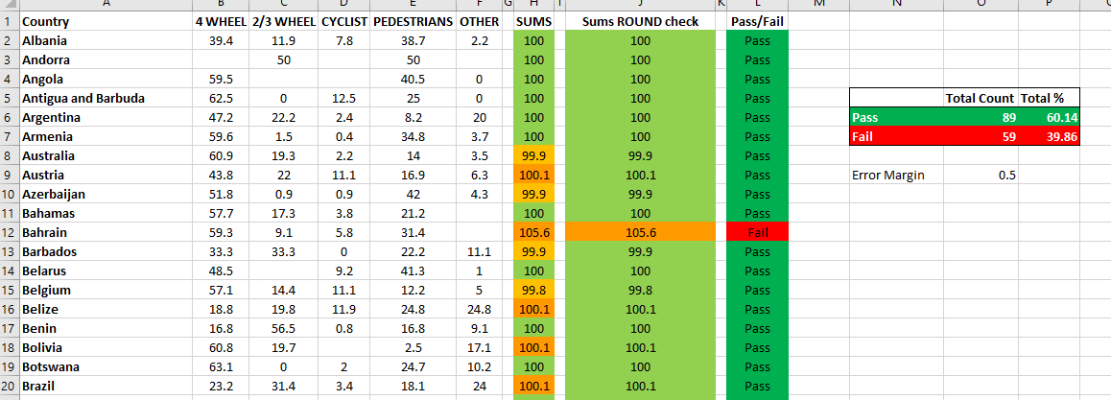
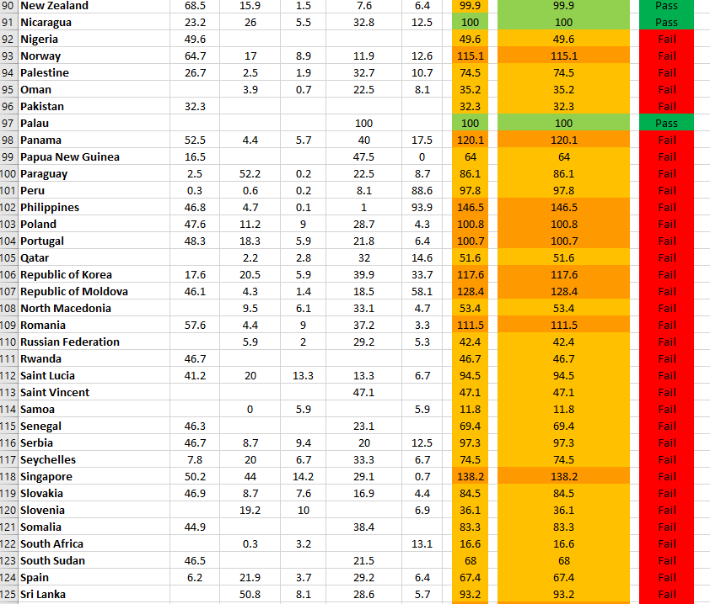

Slide 9
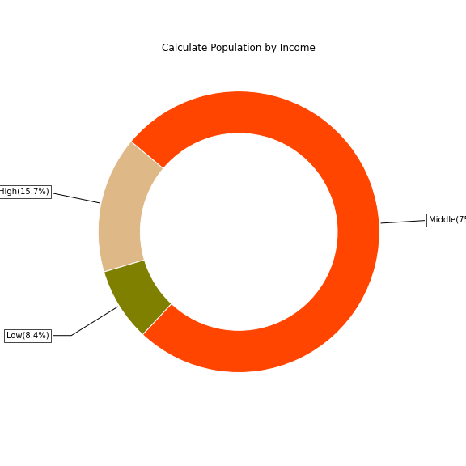
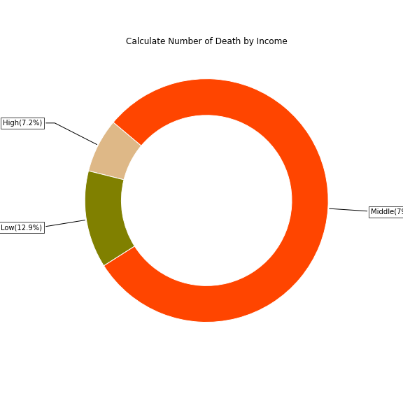
Proportion of population and road traffic deaths by countries income
Population, income level, education and laws are very effective in reducing the rate of road traffic deaths. Wealthy countries have this opportunity to invest in this area by providing enough information and education to their own people, and enforcing the law more efficiently. This is also assisted by using better technology and equipment to reach a high standard in car safety.
* Income levels are based on 2017 WORLD BANK classifiers.

Slide 10
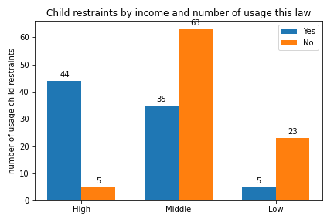
Influence of child restraints laws on road traffic deaths
Although children are very vulnerable and based on WHO reports the first cause of death between them is driving accidents but only 84 countries of 175 countries used child restraints laws which is just 48% in all around the world.
We can see in this bar chart, 90% of countries with high income level are using this law. This percentage for middle income countries is 36% and just 17% of low income countries are protecting children in this area.

Slide 11
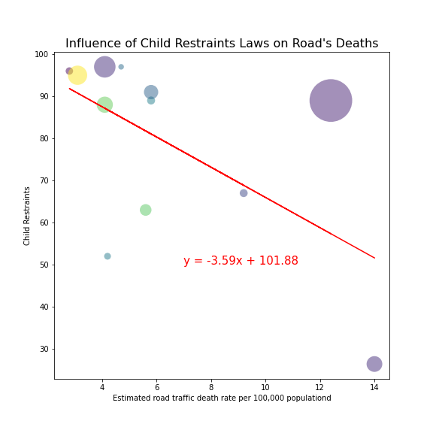
Influence of child restraints laws on road traffic deaths
Child restraints are highly effective in reducing injury and death to children.
In this scatter plot, x axis is rate of road traffic per 100,000 people, y axis is child restraints and the size of each circles representative population.
What is clear on this chart, there is a negative relationship between using child restraints laws and the number of road traffic deaths. In other words, as the usage of child restraints laws goes up, the number of deaths on the road decreases.
By calculating the r-squared which is 0.34, we can see there is a weak correlation between these

Slide 12
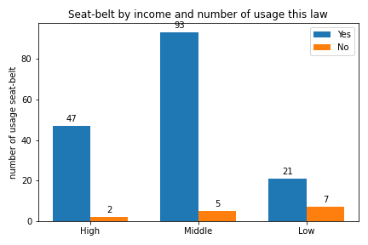
Seat-belt laws
Seat belts dramatically reduce risk of death and serious injury. Seat belt use is on the rise. Laws, education, and technology have increased seat belt use all around the world.
161 countries of 175 countries used seat-belt laws which is 92% in all around the world.
As we see in the bar chart, 96% of countries with high income level are using this law. This percentage for middle income countries is 95% and 75% of low income countries are protecting people in this area.
This statistic shows that almost everyone is aware of the need to use seat-belt.

Slide 13
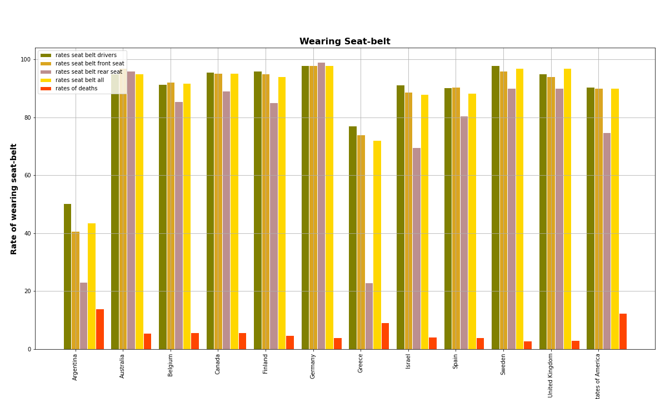
Seat-belt laws
105 countries of 175 countries currently have laws on seat-belt use.
This chart presents the rates of wearing seat-belt for drivers, front seat occupants, rear seats occupants, all occupants and rate on deaths on traffic road.
We could better investigate this if we had the similar data for before enforcement of this law in each county.

Slide 14
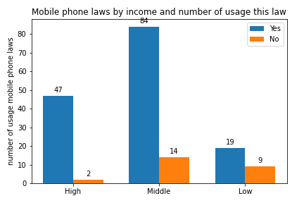
Mobile phone Laws
Using mobile devices such as smartphones and/or other in-vehicle devices is a major source of distraction while driving. Some behavioral studies show that using mobile phone while driving has the same effect as drink-driving. Evidence suggests that if there is no enforcement, this behavior will increase in society because of human nature.
150 countries of 175 countries (86% ) have banned using mobile phone while driving.
In this chart, we can see 96% of high-income countries used this law, this number is 86% for middle-income countries and 68% of low-income countries banned mobile phone while driving.
It can be inferred from the above information that most countries understand the importance of this laws.

Slide 15
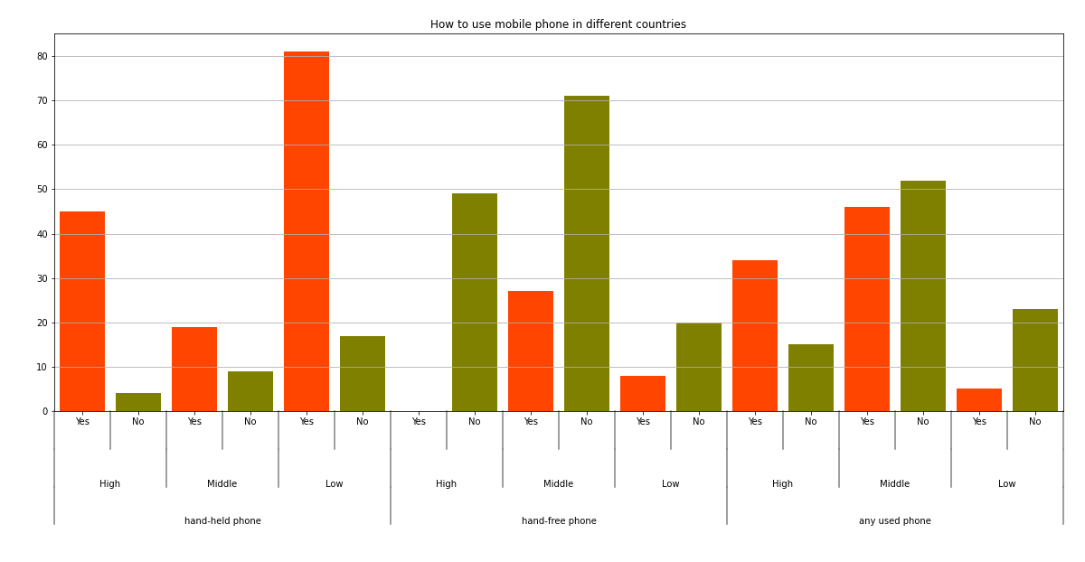
Mobile phone Laws
The extent to which mobile phone use while driving is restricted in different countries is demonstrated in below chart by income level categories.

Slide 16
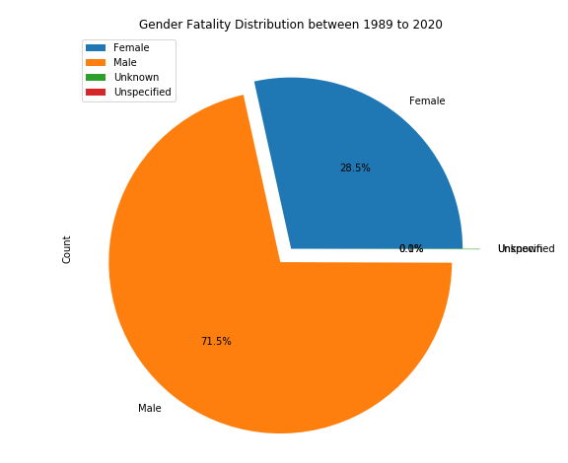
Gender distribution in Australia From accidents since 1989
Gender | Count
Female | 14706
Male | 36948
Unknown | 26
Unspecified | 1

Slide 17
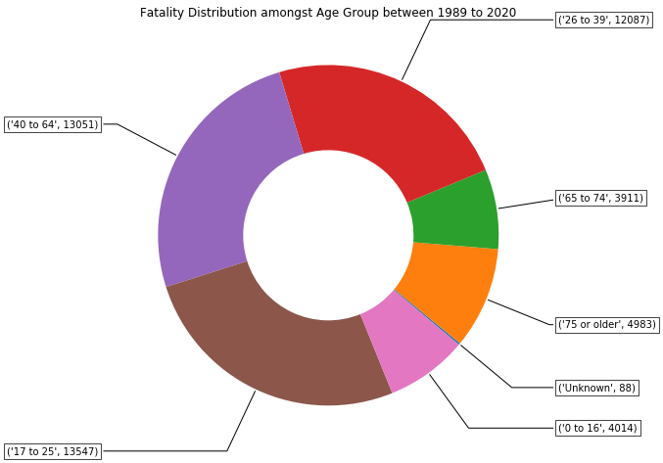
Age group
Vs.
fatality in Australia

Slide 18
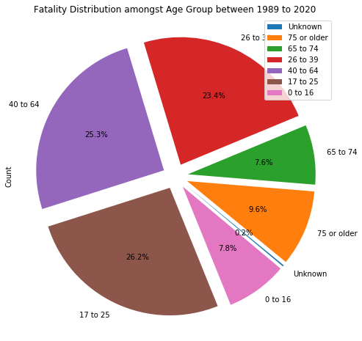
Age group
Vs.
fatality in Australia
(Cont)

Slide 19
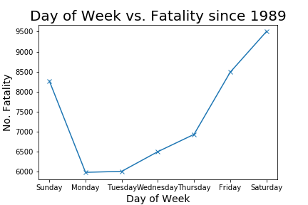
Which day is safer to Drive?
A trend is seen when it is approaching the weekend
Rising from Thursday to Sunday
Monday and Tuesday have the lowest fatalities

Slide 20
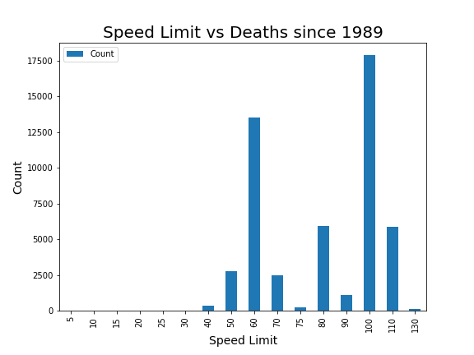
Do speed limits help save lives?
We are seeing more deaths on roads with 60km/h and 100km/h
There is a larger proportion of road designed with these speed limit
This does not convey the relative safety of the speeds in isolation from other variables

Slide 21
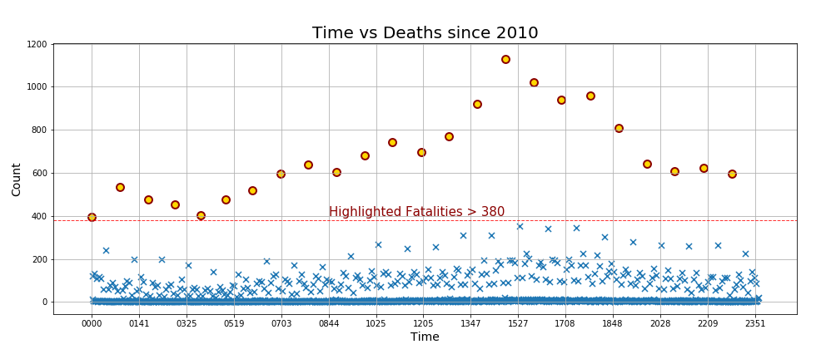
What time is the safest to go?
Most accidents are recorded at O’clock
Believed it’s easier for memory
Fatality rate starts increasing by 4am
Reaches the highest at around 3pm and a small surge at 6pm

Slide 22
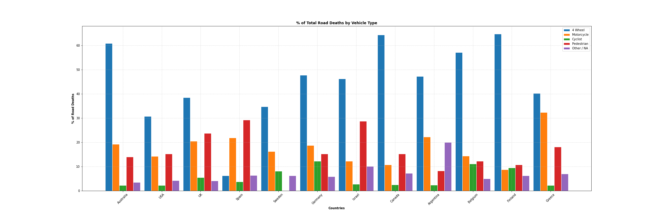
Death by vehicle type

Slide 23
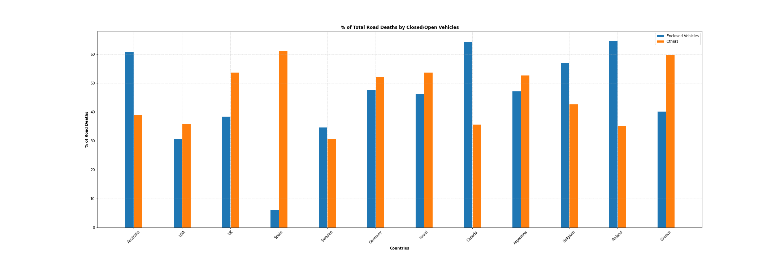
DEATHS IN OPEN/NO VEHICLE VS CLOSED

Slide 24
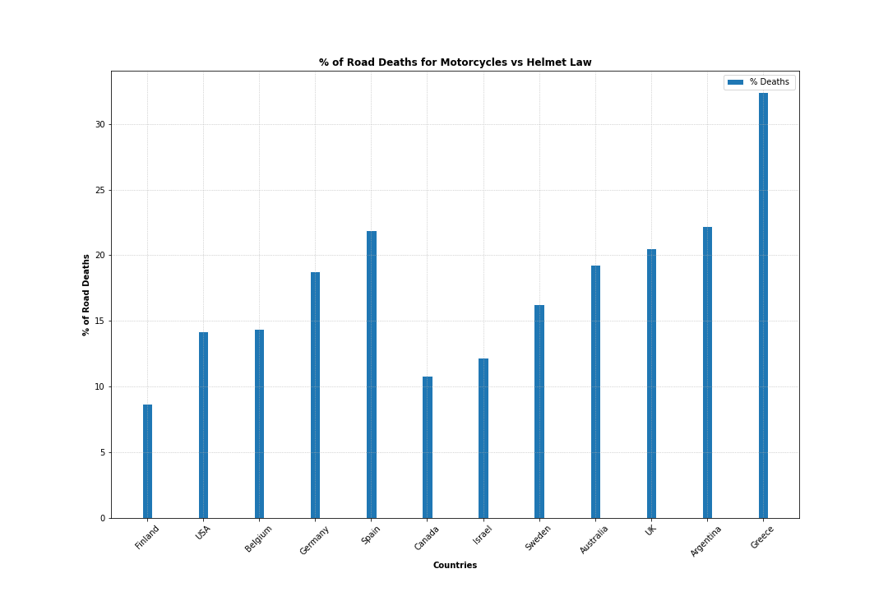
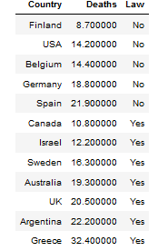

DO HELMET LAWS HELP?

Slide 25
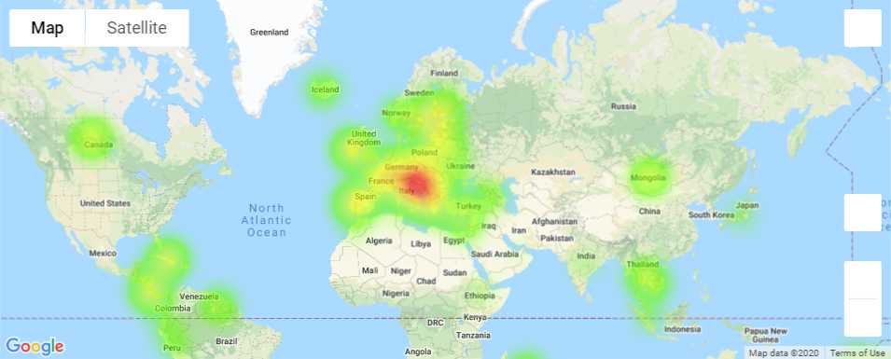
Drink driving laws and influence on road fatalities

Slide 26
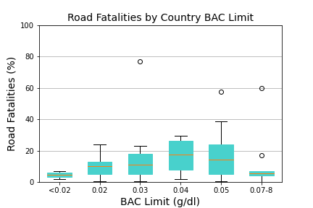
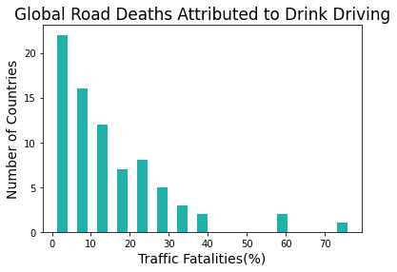
Drink driving laws and influence on road fatalities
Majority of countries surveyed attributed <15% of traffic fatalities to incidents involving alcohol
Notwithstanding, some countries had a very high prevalence of fatalities related to DUI offences
The correlation between BAC limit and percentage of fatalities was found to be weak (r² = 4%), therefore likely that correlation ≠ causation.

Slide 27
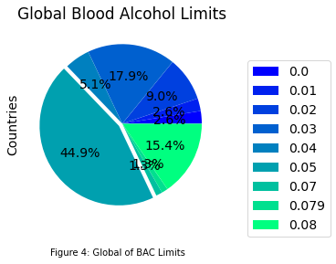
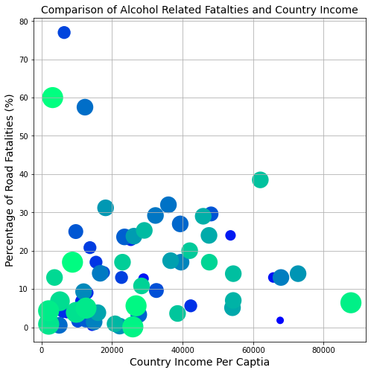
Drink driving laws and influence on road fatalities
Limited correlation between GNIPC and limits
Hypothesis: countries’ penalties may influence behaviour
68% of countries had BAC limits between 0.03 and 0.05g/dl
Limits above 0.07g/l accounted for 19% of counties

Slide 28

In your opinion, what changes should be made to the traffic structure to reduce the number of deaths in this area?

Slide 29

References
https://www.optalert.com/the-evolution-of-road-safety/
https://commons.wikimedia.org/wiki/File:World_Health_Organization_Logo.svg
https://knowinjury.org.au/2016/12/funding-for-road-trauma-data-another-step-towards-safer-australian-roads/
https://www.who.int/violence_injury_prevention/road_safety_status/2018/en/

