Slide 1
DemoAssist : automating slides and demos
Semicolons 2023
Team Gladiators
January 2023

Slide 2


Problem Statement:
“ Help users deliver quality presentations and demos more easily and efficiently using ChatGPT , NLP , voice synthesis, automated slides and video generation.”
These features aim to help users personalize their presentations, test them for errors, and turn them into professional-quality videos that can be shared with clients.
The tool is meant to save users time and effort, while still delivering high-quality presentations and demos.
“
2
Confidential © 2023 Persistent Systems

Slide 3





Flow
Scan Application context and tests scenarios
Meeting notes / audio
Script and content
Generate slides
Generate demo Video
Notes
Scan
Summary
Presentation
Final Output

Slide 4
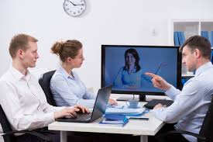
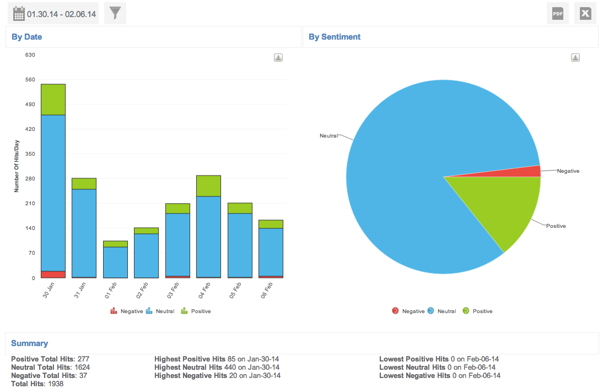
Architecture
Generate slides
API s
DemoAssist Service
Dalle API : Text to Image
ChatGPT API
Meeting audio
Generate Demo Script and Video
Testcases
ChatGPT API
Speech APIs
Client Sentiment Analysis
Meeting notes, Ticket
Speech to text API
NLP
Voice synthesis API
4

Slide 5



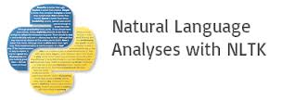


Technology Stack
Speech To Text
Web/ UI
ChatGPT, DALL·E
Natural Language Processing
Voice Synthesis
Devops
Services

Slide 6
The end
Team Gladiators

