Slide 1
U.S FLIGHT DELAYS ANALYSIS
Cyrus

Slide 2
Content
Aims/Questions
Findings
Methodology
Challenges/Issues
Conclusion

Slide 3
Aims
Data Engineering and EDA project into causes of flight delays
Scope of analysis is early 2019 in the U.S.
6 csv files: 2019_1, 2019_2, 2019_3, airports, carriers, plane_data
Processing and queries: Spark, Spark SQL
All visualisation with Python

Slide 4
Questions
Reasons for delays?
Which days see the longest delays?
Do departure delays cause problems for future flights?
Best time to book a flight for?
Best carrier to fly with?
Most efficient airports?

Slide 5
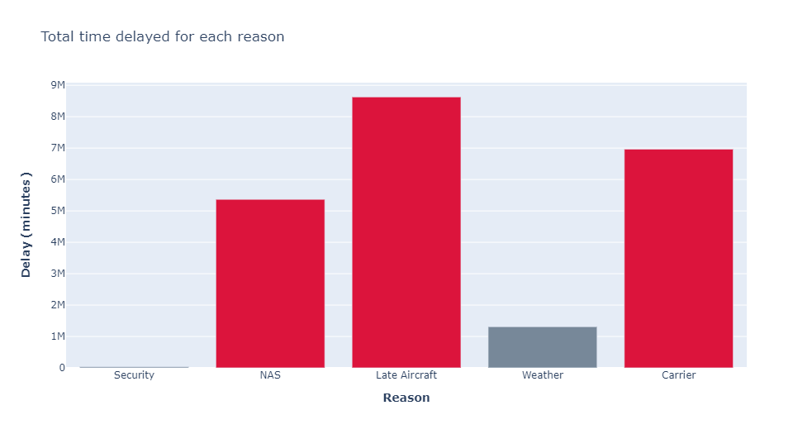
Biggest reason for delays
NAS and Carrier delays are the biggest reasons
They are the major contributors to the Late Aircraft delay reason

Slide 6
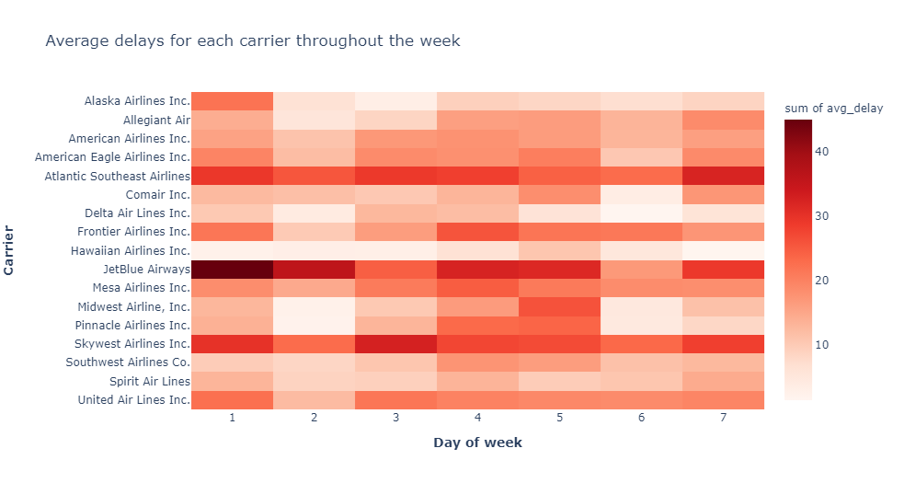
Days in the week with longest delay times?
Monday, Thursday and Friday have long delays across most carriers
JetBlue Airways long delays across all days
Day of month might give us more information

Slide 7
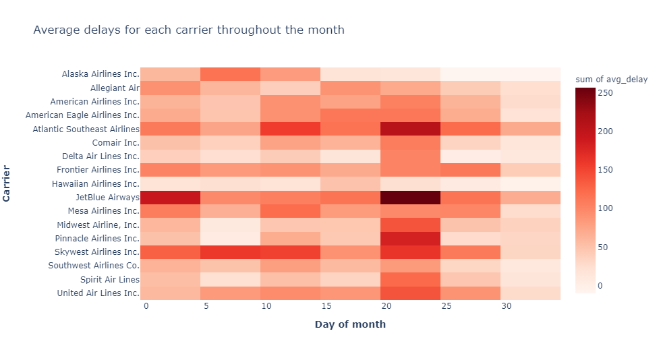
Days in the month with the longest delays?
Bin size 10
Beginning of month sees above average delay times
Flights between 20th-25th are delayed the longest in the whole month

Slide 8
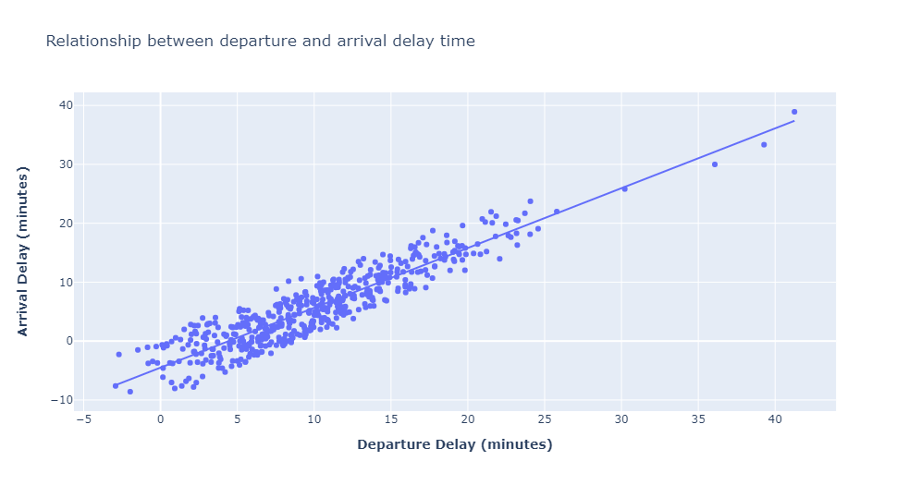
Does departure delay affect arrival delay?
High correlation
R² = 0.85
Can see how a knock-on effect could happen

Slide 9
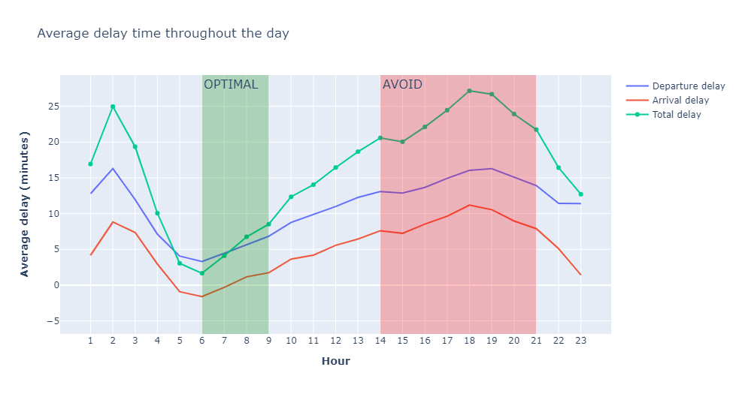
What time should I book my flight for?
Delays are lowest early morning, lowest at 6am
Delay time increases steadily until 6pm
Try avoid flights after lunch to 9pm

Slide 10
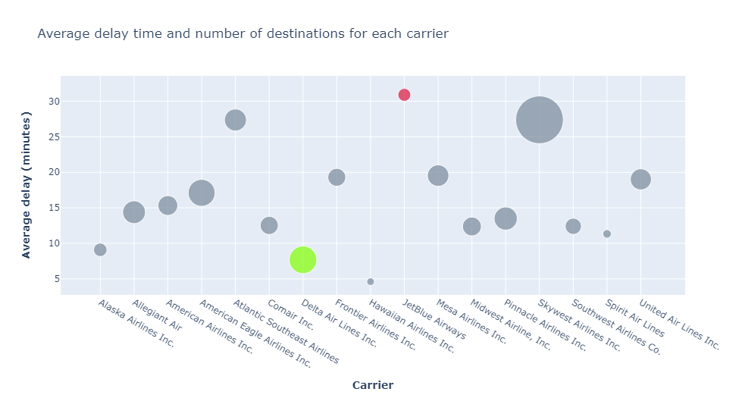
Which carrier should I fly with?
Hawaiian Airlines seem to be the obvious choice
But has only 18 destinations.
Best choice goes to Delta Air Lines
146 destinations
Sub 10 min delay
Avoid JetBlue Airways
68 destinations only
30 min average delay time

Slide 11
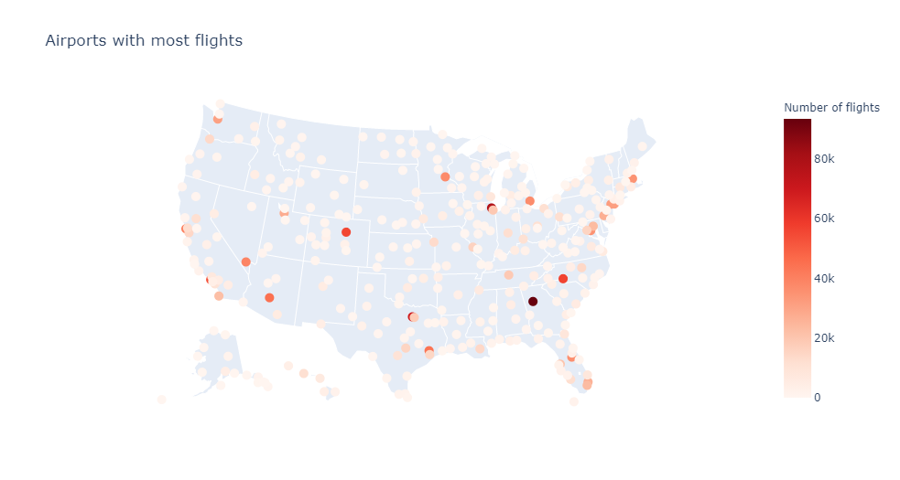
Where are the airports with most traffic?
East and West coast see a lot of traffic along with the connection hubs
Connection hubs in Chicago, Dallas and Denver all handle more traffic than the coastal cities

Slide 12
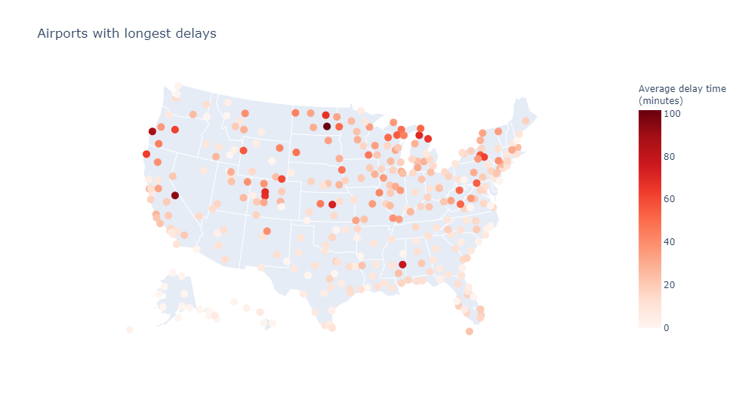
What about delays?
Long delays for low volume airports
Major airports in the coasts and connection hubs have much lower times

Slide 13
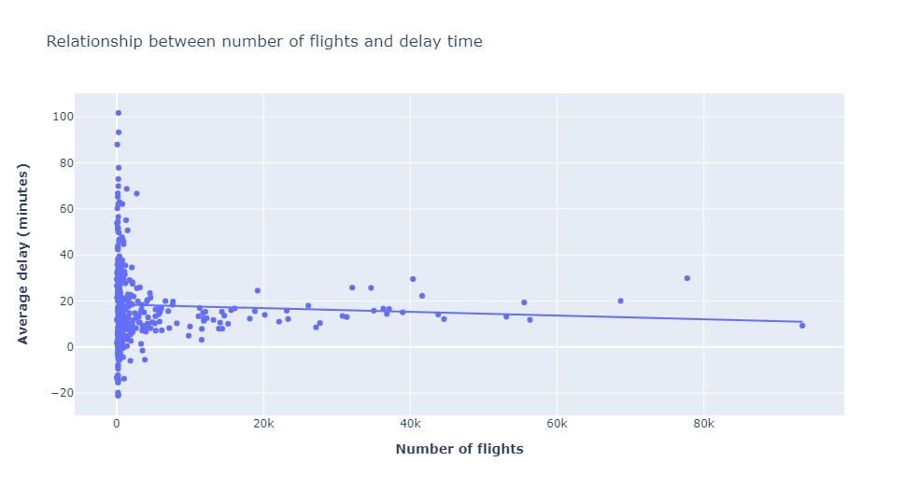
Relationship between flight volume and delay time?
No correlation
R² = 0.003
Many other factors affecting delay time. i.e., staff, infrastructure

Slide 14
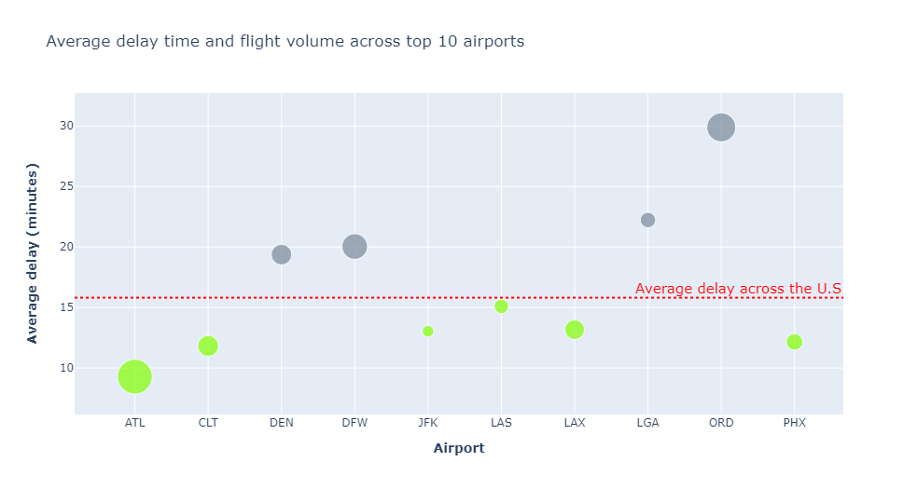
Efficiency of the top 10 airports
More than half have delay times below the country average
Most impressive: Atlanta Intl’
6-digit flight volume
Sub 10 min delay

Slide 15
Methodology
Create DataFrames with raw csv files
Union the 3 flight detail DataFrames
Write Parquet files with DataFrames and read the new files into new DF
Add relevant new columns in flight DF
Create temporary table for each DF
Cache tables and analyse for query optimiser and best execution
Check join columns for nulls (data skew), decide to salt or not

Slide 16

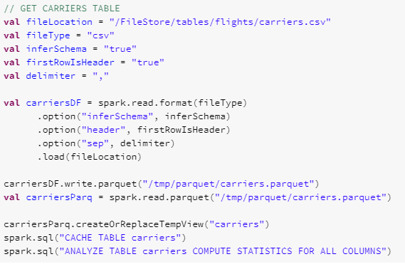
Creating new columns for hour, total delay and flight route
Loading csv data into query-able table

Slide 17
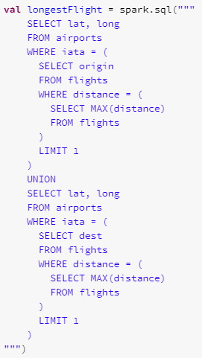
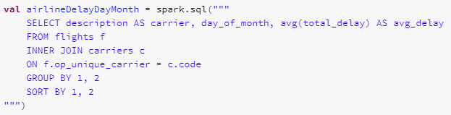
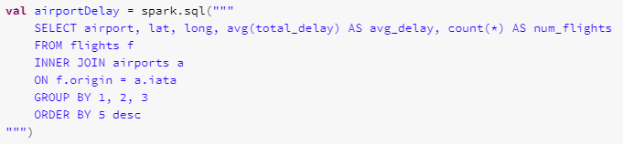
Airport coordinates for the longest flight
Delay times for each carrier throughout each month
Delay times, flight count and location for each airport

Slide 18
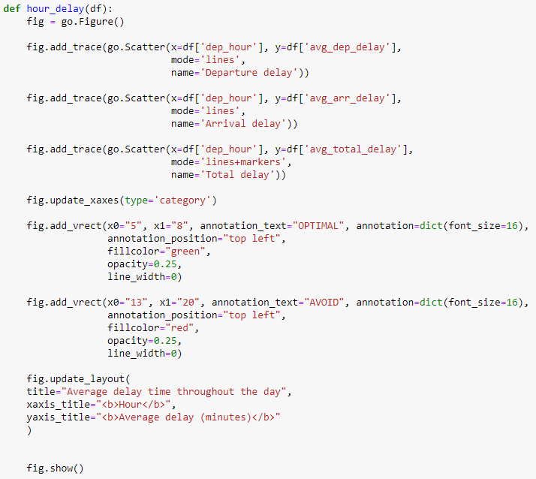
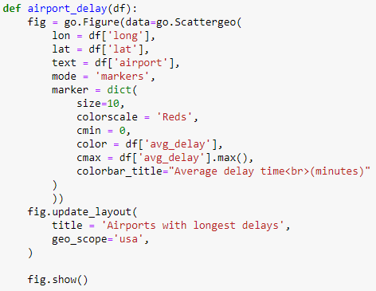
Visualising delay times for each hour
Visualising airport delay times for map

Slide 19
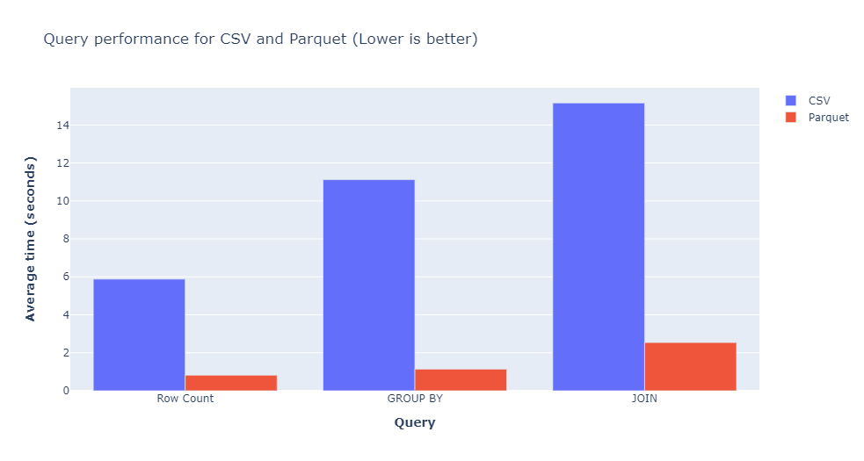
Benchmarking Parquet: Speed
Row counting is 7x faster with Parquet
GROUP BY operations go 10x faster
JOIN operations go 6x faster
Go even faster with partitionBy()
Why?

Slide 20
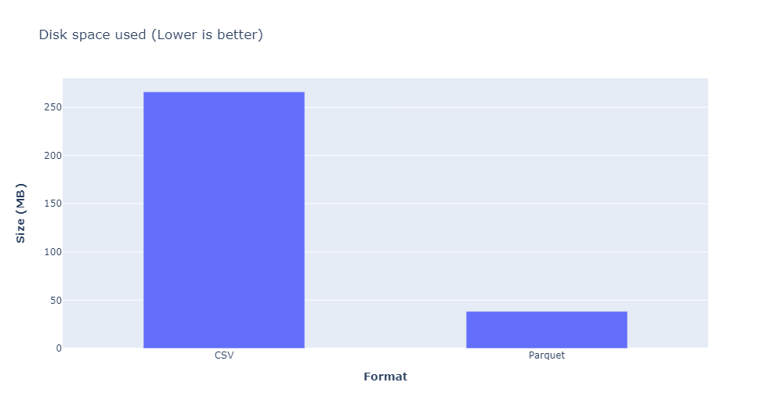
Benchmarking Parquet: File Size
Compression Ratio: 85.6%
Spark reads 6.9x less data for Parquet than CSV

Slide 21
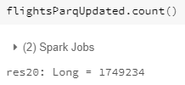

Challenges/Issues
Forgot about duplicate rows
Found 1873 duplicate rows in flights table

Slide 22
Conclusion
Avoid flying at the start of the month and between the 20th-25th
Departure delays do affect arrival delays
Best time to fly would be 6am-9am
Delta Air Lines is a safe bet, avoid JetBlue
More flights does not mean longer delays
Atlanta Intl’ airport is speediest
USE PARQUET

