Slide 1
BATPING
Bidirectional Acoustics Traveltime Pulser for INdex Gradients
Cyrus Urheim · Stubbs Group · Harvard · July 2026

Slide 2
Introduction
Statement of Purpose
  • LSST/Rubin dome and mirror seeing remains uncharacterized (Urbach et al. 2026)
  • Temperature fluctuations → refractive index gradients → PSF broadening
  • BATPING measures the line integral of temperature along the optical path via acoustic TOF
Precision Goal
  • Target: σ_T < 0.1 °C per ping
  • Equivalent to σ_TOF < 1.02 μs (for 2m round-trip path at 20 °C)
  • Best achieved so far: σ(Δτ) = 0.076 μs → 0.007 °C/ping (Stubbs pipeline, a0.8_sm_2ms)
Anticipated Final Implementation
  • Winfield Hill transponder PCB: retransmits received burst after known delay → optimal adaptive matched filter
  • Array of piezo transducers (hexagonal, ~40 kHz) + Dodotronic UltraMic 384k
  • Rubin dome crossing paths; continuous monitoring during observations

Slide 3
Progress Since Last Meeting
[Cyrus to fill in]
□
□
□
□
□
□

Slide 4
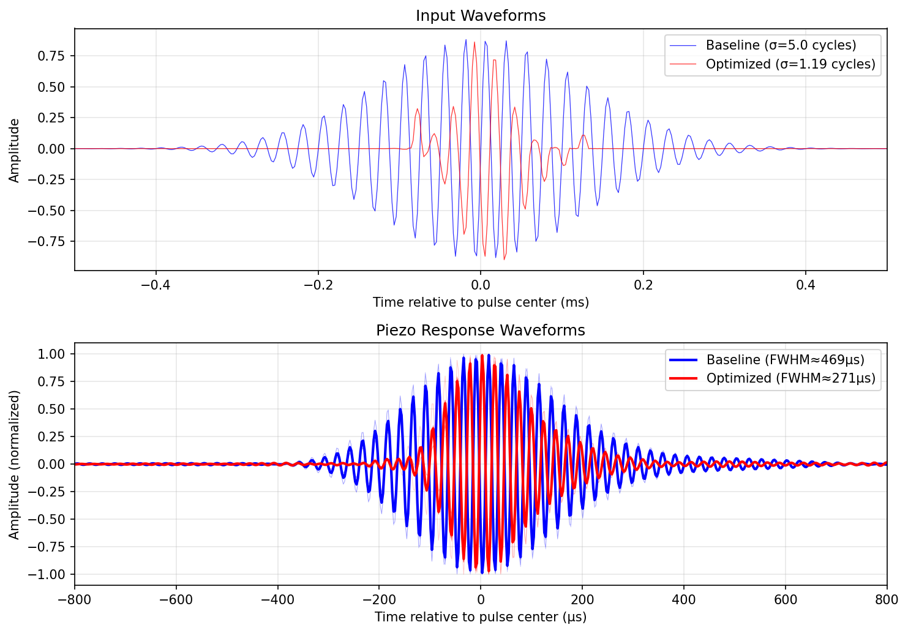
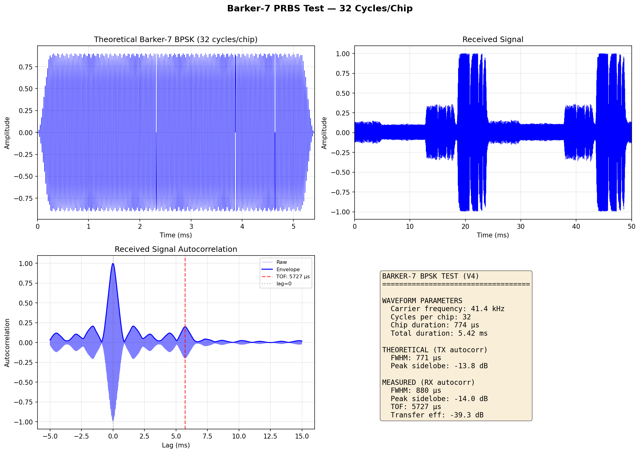
Waveform Design Rationale (I): Early Approaches
Modified Gaussian + Bayesian Optimization (v1–v3)
  • Parametrized waveform: Gaussian envelope × 40 kHz carrier + K sinusoidal compensation bursts
  • Objective: minimize FWHM of ACF peak (then per-period σ_TOF)
  • v3 (N=1000 iter): 38% FWHM improvement (443 → 275 μs) but marginal gains beyond v2 — parametrization bottleneck
Barker-7 Code (BPSK modulated onto 40 kHz carrier)
  • Sidelobe level: −12 to −14 dB (theoretical −16.9 dB)
  • FWHM ∝ T_chip = N_cyc / f_carrier — scales linearly, no improvement over Gaussian at matched chip size
  • Both approaches hit a ~250 μs FWHM floor set by the piezo ring-down (τ_ring ≈ Q/πf₀ ≈ 180 μs)

Slide 5
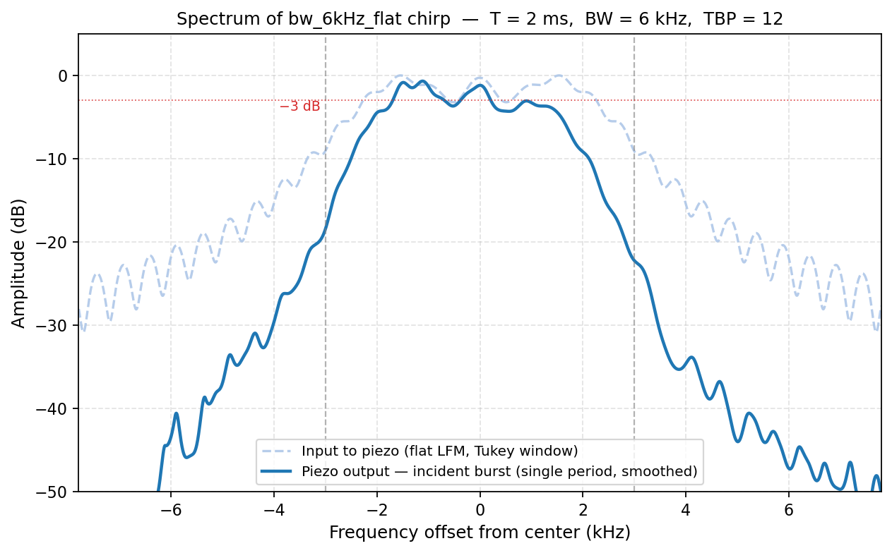
Waveform Design Rationale (II): LFM Chirped Waveforms
Why a chirp?
  • Sweeps f_start → f_stop over duration T: band-limited approximation to a delta function's spectrum
  • Prof. Stubbs: "a delta function spread out in time"
Expected autocorrelation peak shape (Wiener-Khinchin):
|S(f)|² ≈ rect((f − f₀)/B) → y(τ) = IFT(|S(f)|²) = B · sinc(Bτ)
Expected FWHM:
sinc²(Bτ) = 0.5 → Bτ ≈ 0.443 → FWHM = 0.886 / B
Amplitude compensation:
  • Flat: constant amplitude — simple, surprisingly competitive
  • comp (1/H(f), 10% floor): flattens acoustic output spectrum
  • comp_light (20% floor): less aggressive, less ring-down
  • α-parametrization: H(f)^{−α}, α ∈ [0,1] — continuous flat→full-inversion
Key caveat:
σ_TOF ≈ FWHM / (3.33 × SNR)
Aggressive compensation amplifies off-resonance noise as much as signal
→ wider σ_TOF despite narrower FWHM if SNR degrades

Slide 6
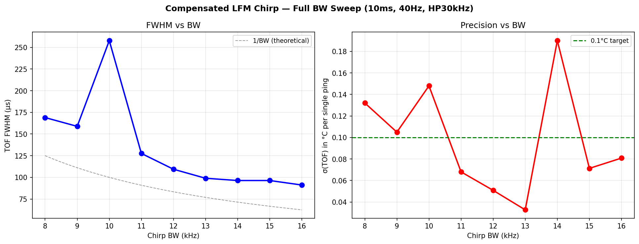
LFM Chirp: FWHM and σ_TOF vs Bandwidth
FWHM saturates at ~95 μs for BW ≥ 13 kHz — multipath/noise floor, not a piezo limit. σ_TOF first crosses 0.1°C target at BW = 12 kHz. FWHM tracks 1/BW as predicted; σ_TOF does not — SNR matters.

Slide 7
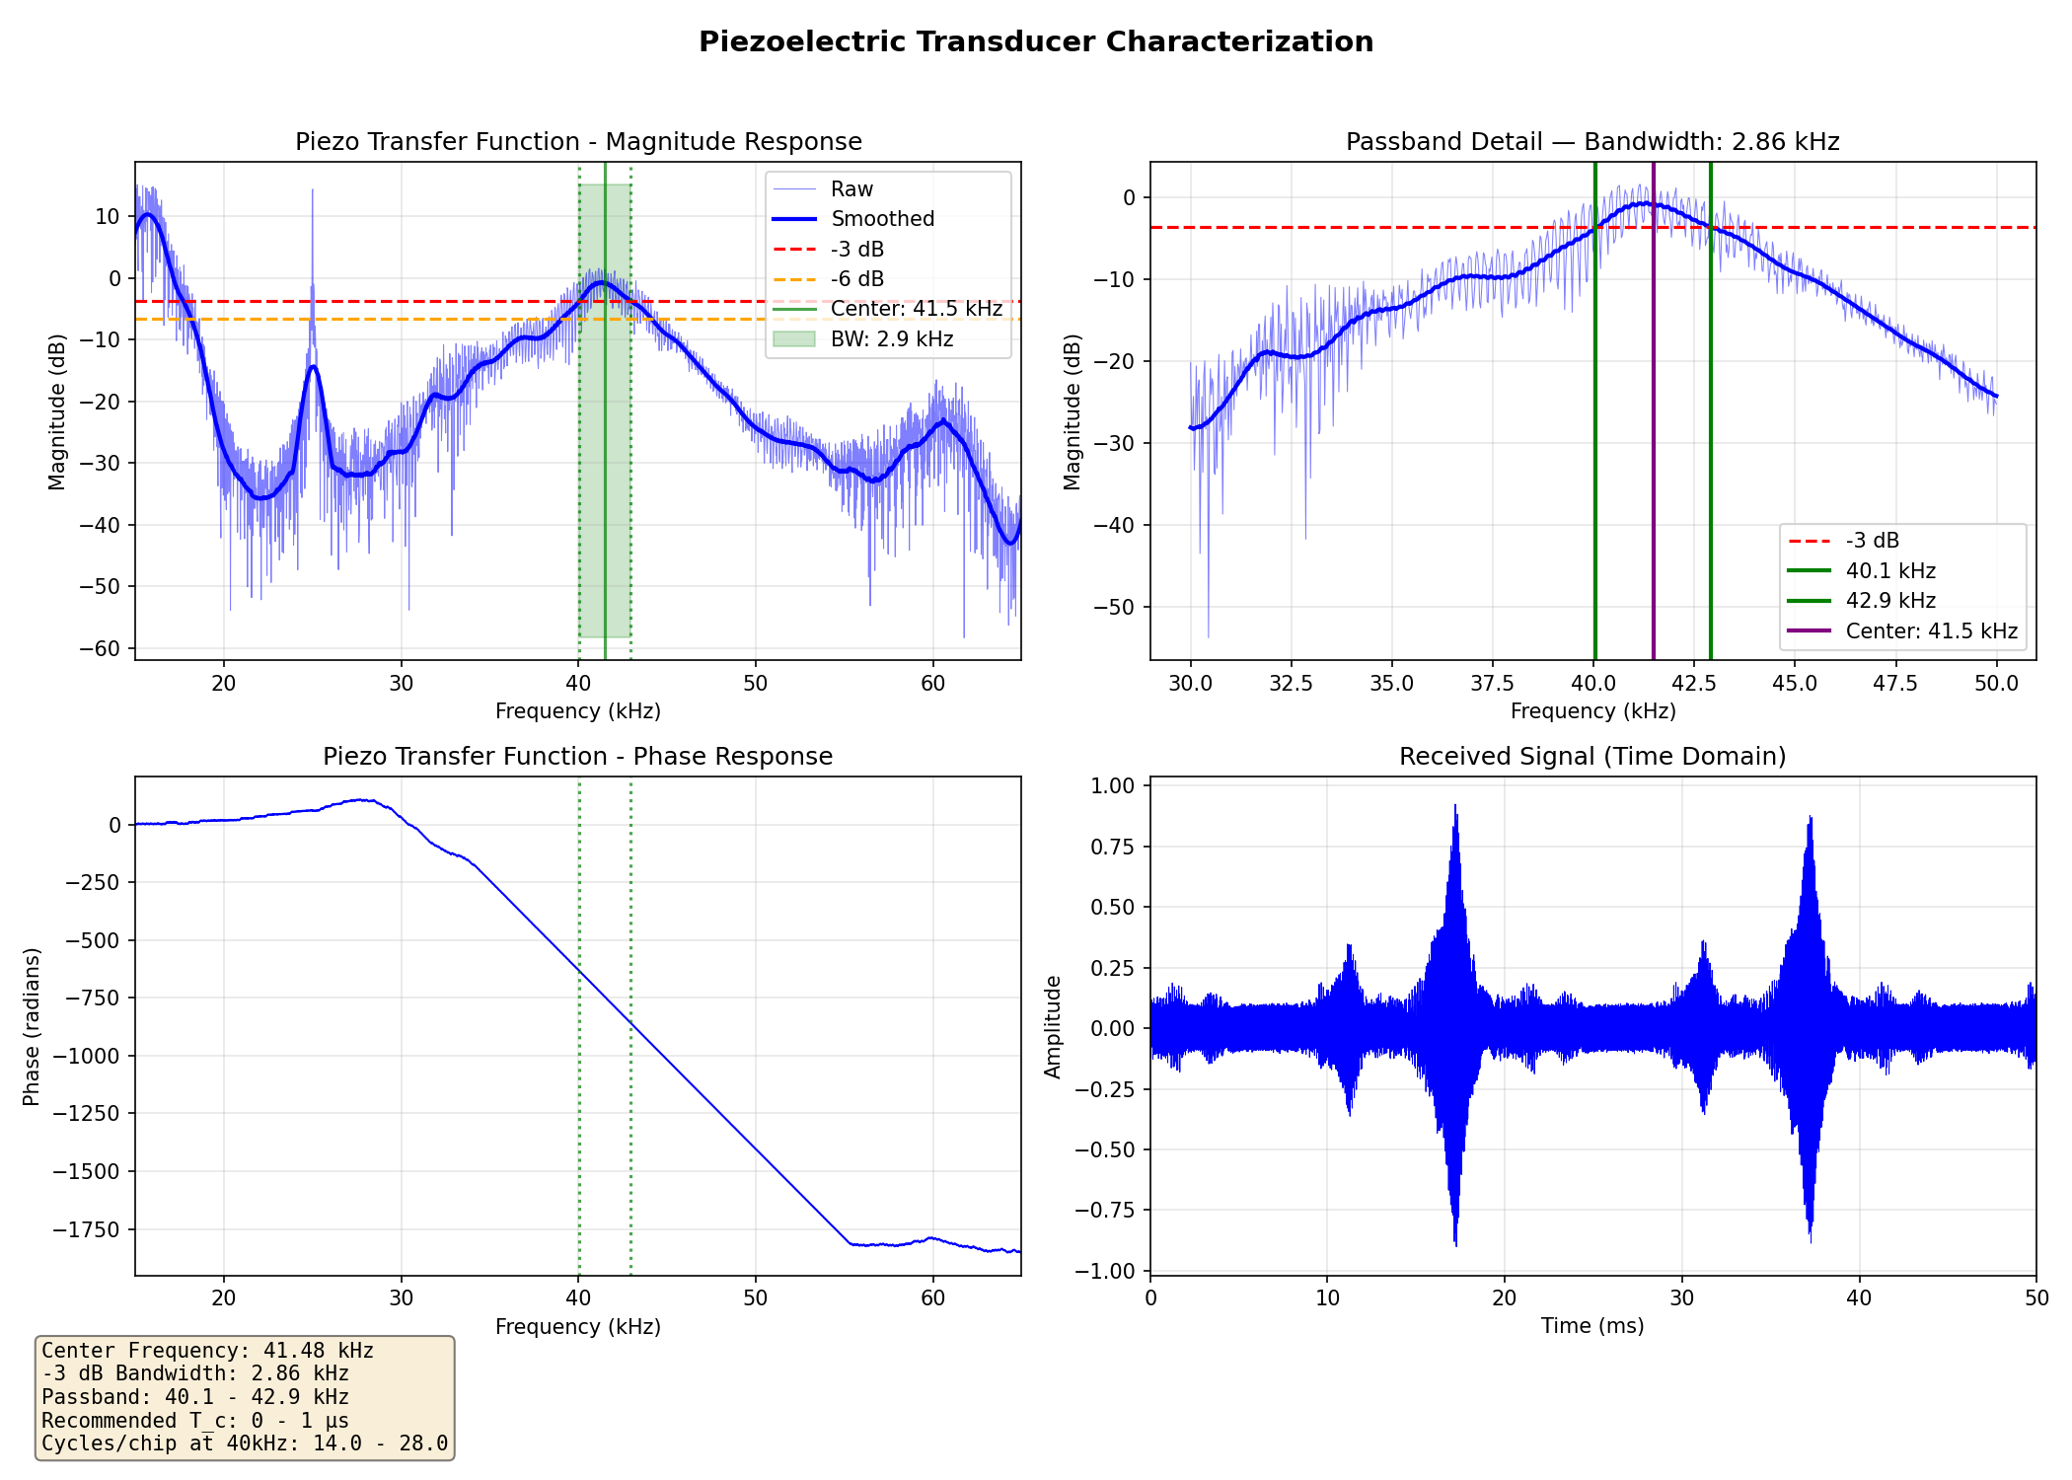
Piezoelectric Transducer: Frequency Response H(f)
Stepped-sine characterization (20–65 kHz, 50 Hz steps) · f₀ = 41.3 kHz · Q ≈ 22.8 · −3 dB BW = 2.95 kHz · two-way peak group delay ≈ 343 μs

Slide 8
Measurement Metrics
FWHM_corr Full width at half max of TOF peak in per-period autocorrelation.
11-pt least-squares parabolic fit (DoF = 8) around argmax gives sub-sample
precision. Single-ping measurement; independent of between-ping conditions.
δ_peak 1σ uncertainty on FWHM_corr from the parabola fit residuals:
δ_peak = RMS_residual / (|a| · √Σx²) where a is the quadratic coefficient.
Typical values: 15–300 ns.
σ_TOF Standard deviation of per-period TOF estimates across N consecutive pings.
The key temperature precision metric:
σ_T = σ_TOF / (2L · (dc/dT) / c²) ≈ σ_TOF / 10.3 μs·°C⁻¹
σ(Δτ) Stubbs pipeline: σ(τ_return − τ_launch) over evaluation periods.
Cancels common-mode alignment jitter. Better than σ_TOF for long recordings.
SNR (CR) Cramér-Rao implied SNR: FWHM / (3.33 × σ_TOF).
Measures how close σ_TOF is to the instrument noise floor.
meas/CR ≈ 1–3: instrument-limited. meas/CR >> 3: environment-limited.

Slide 9
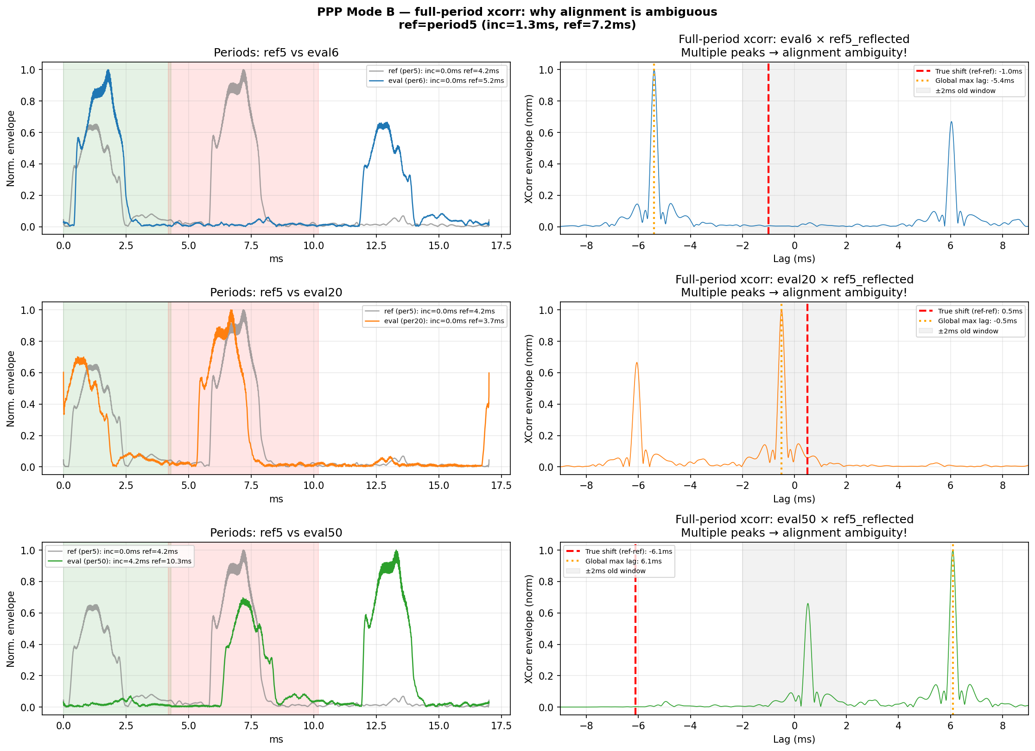
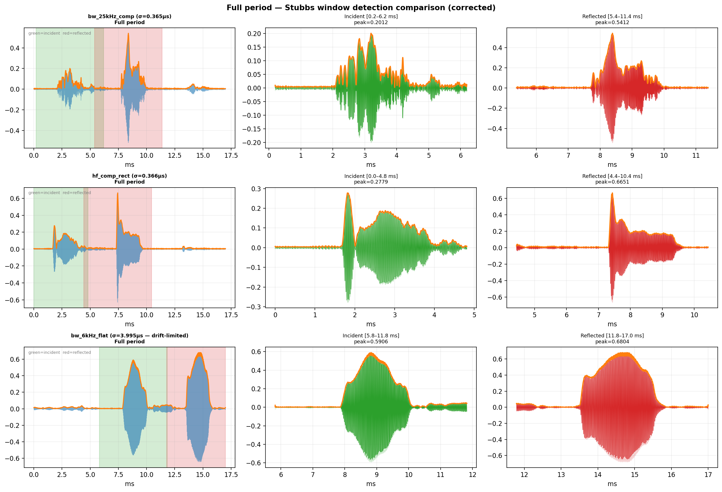
Analysis Methods
Per-period autocorrelation (fast, online)
  • Autocorrelate each received period with itself
  • TOF peak at lag ≈ 5.7 ms (2m round-trip); FWHM and position extracted with 11-pt parabolic fit
  • σ_TOF from scatter of per-period peak positions
Stubbs matched-filter pipeline (30s, offline)
  • Adaptive period slicer: finds actual incident peaks, not fixed-boundary clocks (fixes SDG↔UltraMic drift)
  • Co-add 100 aligned periods → T_launch, T_return templates (√N SNR gain)
  • Evaluate: xcorr each period with templates → τ_launch, τ_return, Δτ = τ_R − τ_L
  • τ_launch ≈ 0 is alignment diagnostic; σ(Δτ) = temperature precision
Three alignment failure modes in the Stubbs pipeline — all fixed in current implementation
Fixed: correct incident / reflected window identification across all waveform types

Slide 10
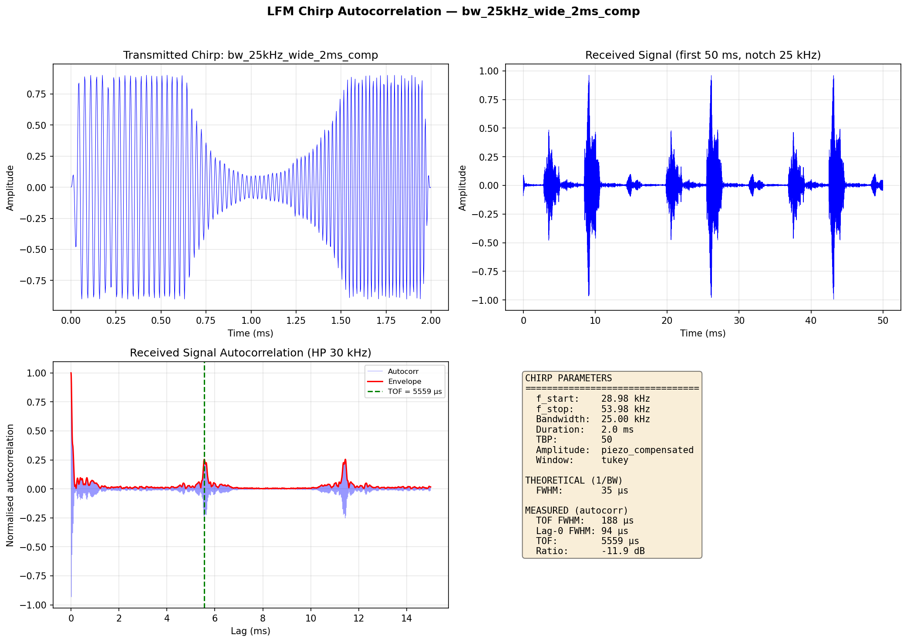
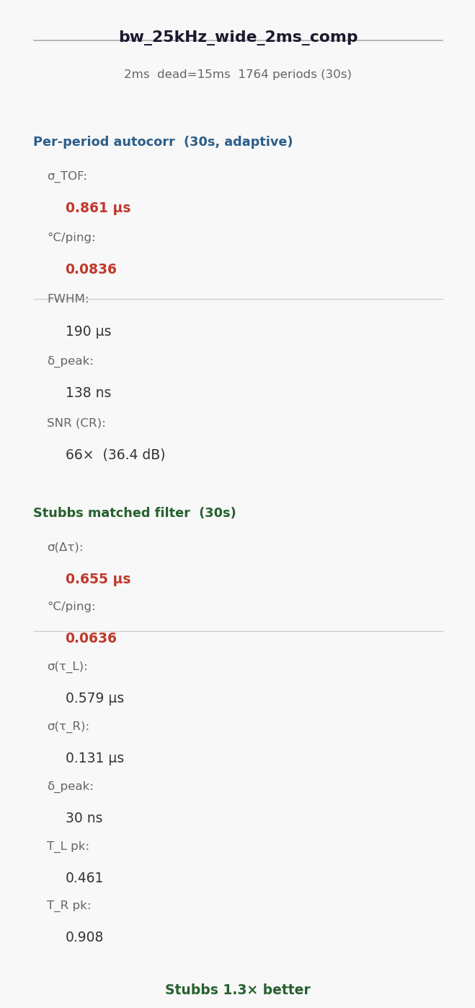
Results: bw_25kHz_wide_2ms_comp — Autocorrelation
f = 29–54 kHz | BW = 25 kHz | T = 2 ms | TBP = 50 | comp (1/H, 10% floor) | 6.22 Vpp

Slide 11
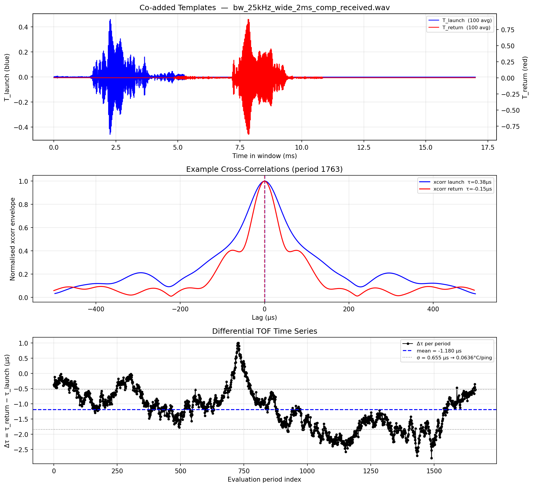
Results: bw_25kHz_wide_2ms_comp — Stubbs Matched Filter

Slide 12
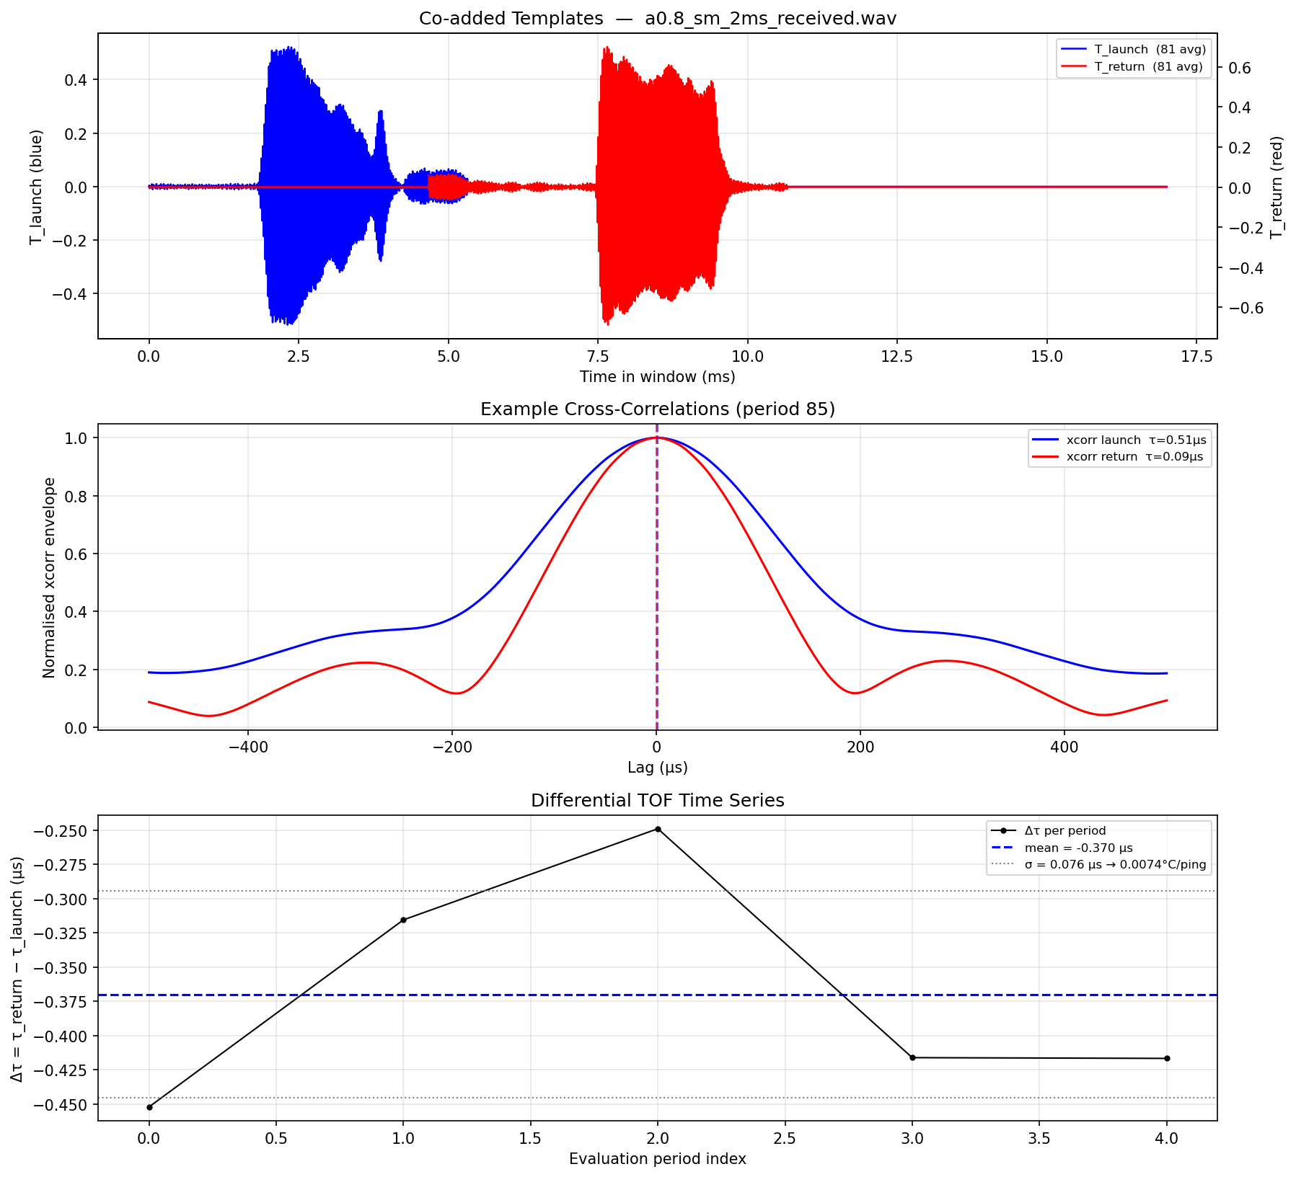
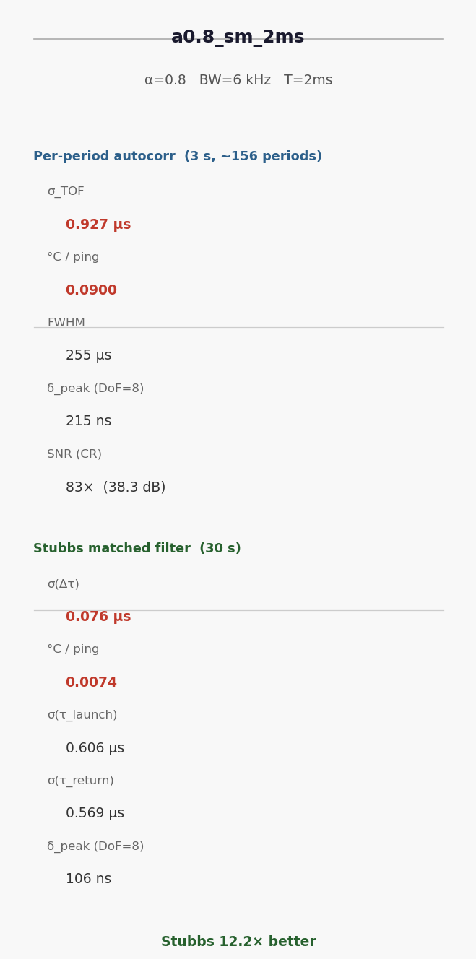
Results: a0.8_sm_2ms — Best Stubbs Result (0.007 °C/ping)
α = 0.8 | sm BW = 6 kHz (38.5–44.5 kHz) | T = 2 ms | H(f)^{−0.8} compensation

Slide 13
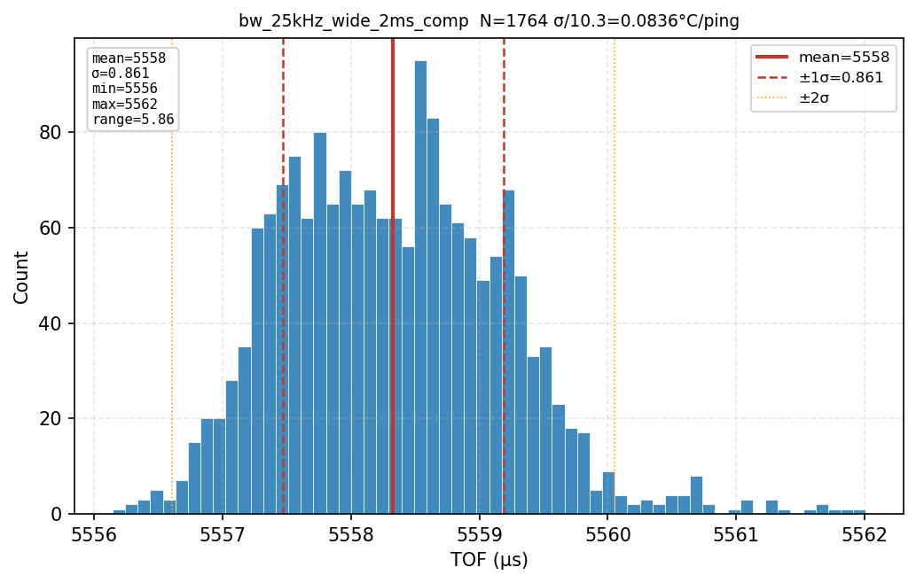
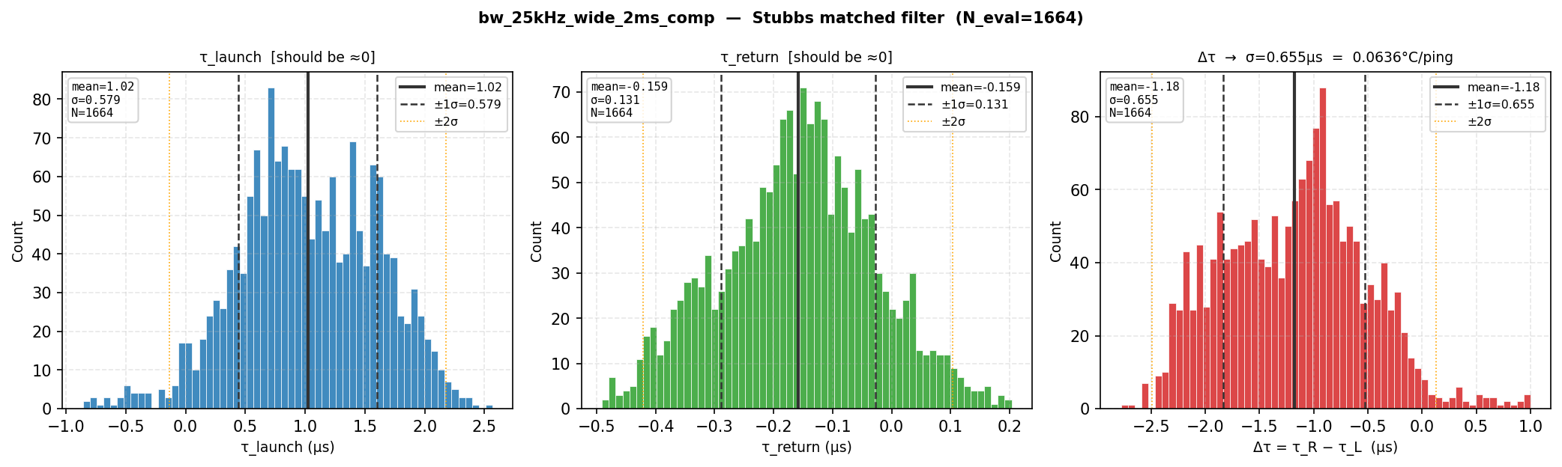
Statistical Distributions — bw_25kHz_comp (Autocorr + Stubbs)
Per-period autocorr (N=1764, σ=0.861 μs → 0.084 °C/ping)
Stubbs matched filter (N=1665 eval, σ(Δτ)=0.655 μs → 0.064 °C/ping)

Slide 14
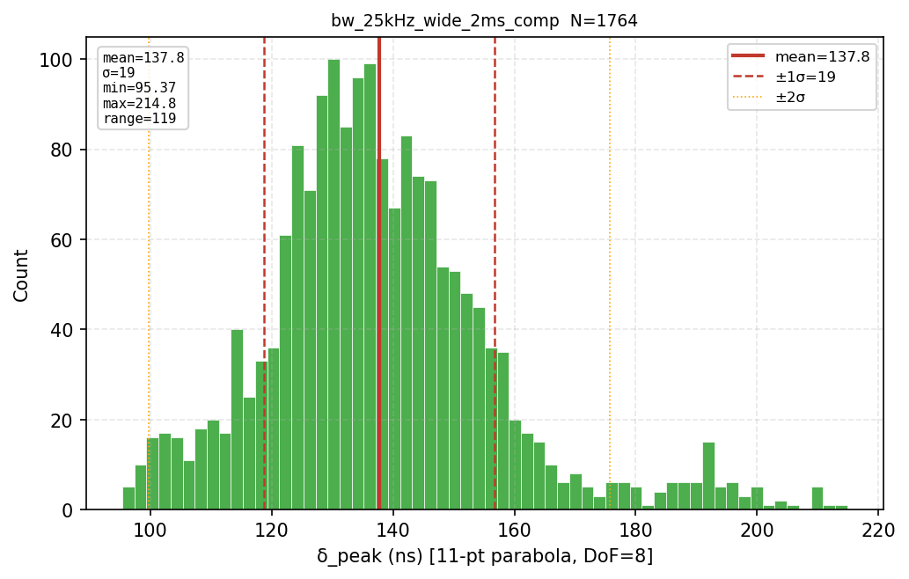
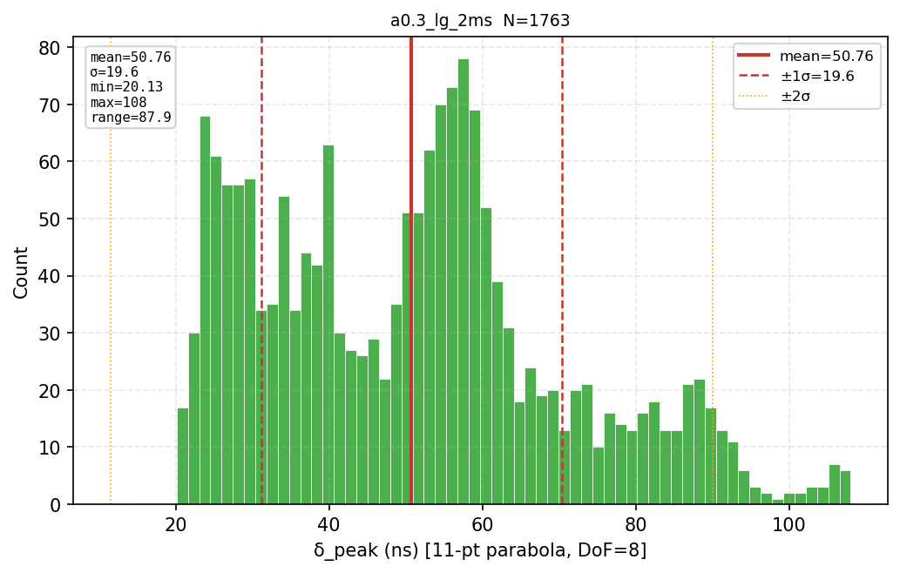
Fit Uncertainty δ_peak Distributions (DoF = 8, 11-pt Parabola)
bw_25kHz_comp (δ_peak ≈ 138 ns)
a0.3_lg_2ms (δ_peak ≈ 51 ns — sharpest)
All valid waveforms: 0 periods clipped at 5σ — no outliers dragging distributions wide.

Slide 15
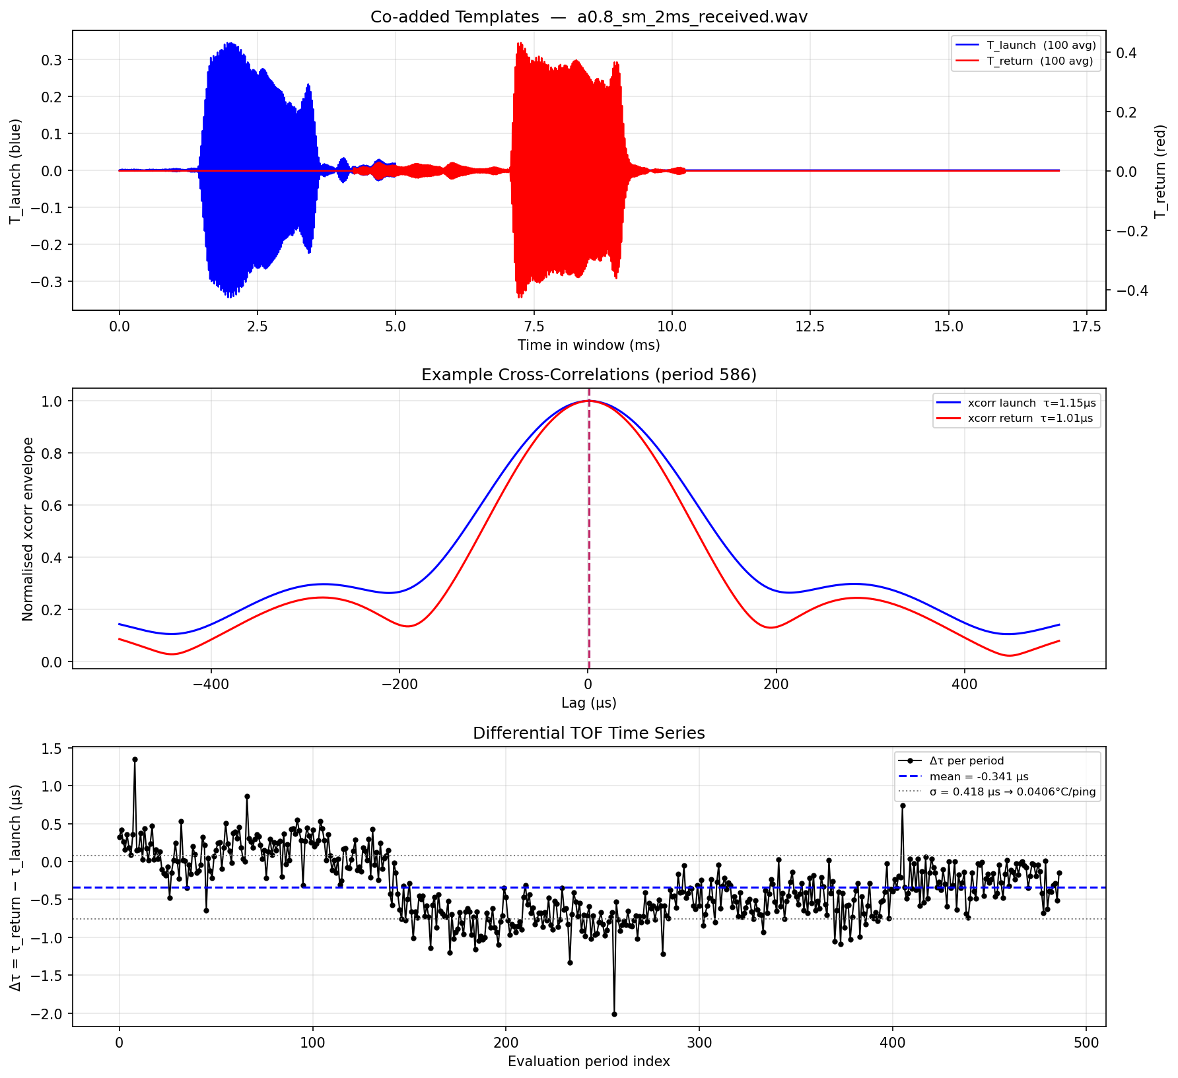
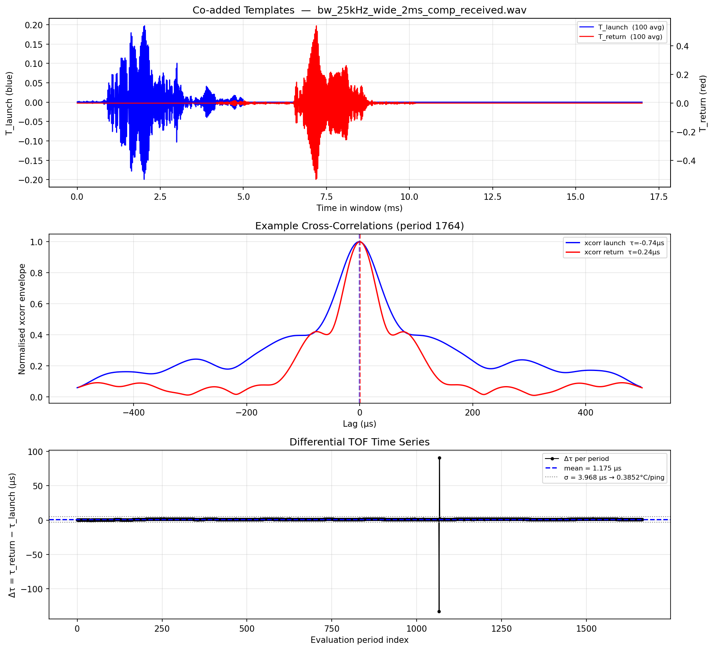
Differential TOF Time Series (Δτ = τ_return − τ_launch)
  • Mean Δτ ≠ 0 reflects temperature offset between template epoch and evaluation window
  • Increasing Δτ = cooling (slower sound); decreasing Δτ = warming
  • Slow drift (~1–2 μs over 30s) = real lab thermal fluctuation (~0.1–0.2 °C) — environment-limited, not instrument-limited
  • σ(Δτ) per ping; uncertainty on mean temperature over 30s: σ/√N ≈ 0.009 μs → 0.0009 °C

Slide 16
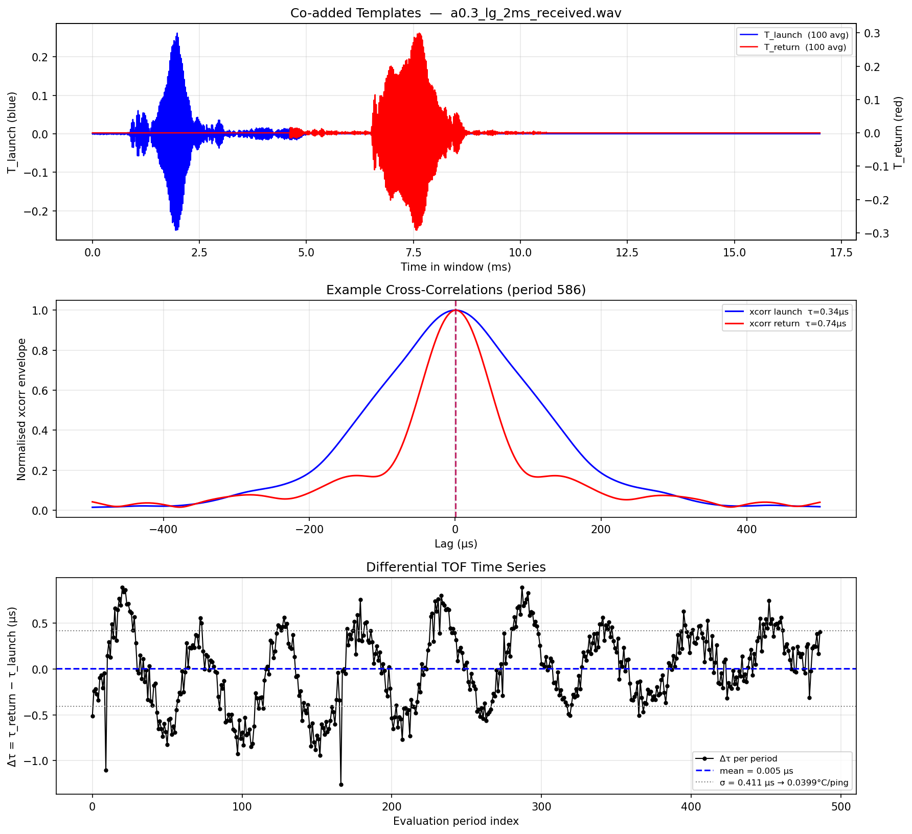
Δτ Time Series — Additional Examples

Slide 17
Supplemental: Waveform Naming Guide
Bandwidth / frequency range
bw_6kHz 6 kHz, symmetric around 41.5 kHz resonance
bw_20kHz 20 kHz, 31.5–51.5 kHz
bw_25kHz 25 kHz, 29–54 kHz (widest standard)
hf_m15dB_asym High-freq asymmetric; cutoff at −15 dB on the H(f) curve — extends further on low-freq side
Amplitude shaping
comp 1/H(f) piezo compensation, 10% floor (max 20 dB boost)
comp_light 1/H(f), 20% floor (max 14 dB boost) — less ring-down
comp_rect comp + rectangular window (no Tukey taper)
diff Diffraction-compensated: adds f/f₀ pre-emphasis on top of 1/H(f)
flat Constant amplitude — no compensation
Alpha sweep (a{α}_{bw}_{dur})
a0.2…a0.8 H(f)^{−α}: α=0 flat, α=1 full 1/H(f)
sm / md / lg 6 / 12 / 20 kHz bandwidth
Duration: 2ms / 4ms — chirp duration before dead time (TBP = BW × T)
Voltage calibration (July 8–9)
Calibrated per-waveform to 90% UltraMic full scale (2.15–8.64 Vpp).
Recorded in 8th column of CHIRP_CONFIGS (chirp_sweep.py) and VOLTAGE_MAP (alpha_sweep.py).

