Slide 1
cs351 Project 1 Domino
Chih-Yu Shen (101816071)

Slide 2
Classes
Main: Control work flow
Domino: Represent one domino
Player: Possess and control dominos
Boneyard: Control free dominos
Board: Show used dominos

Slide 3
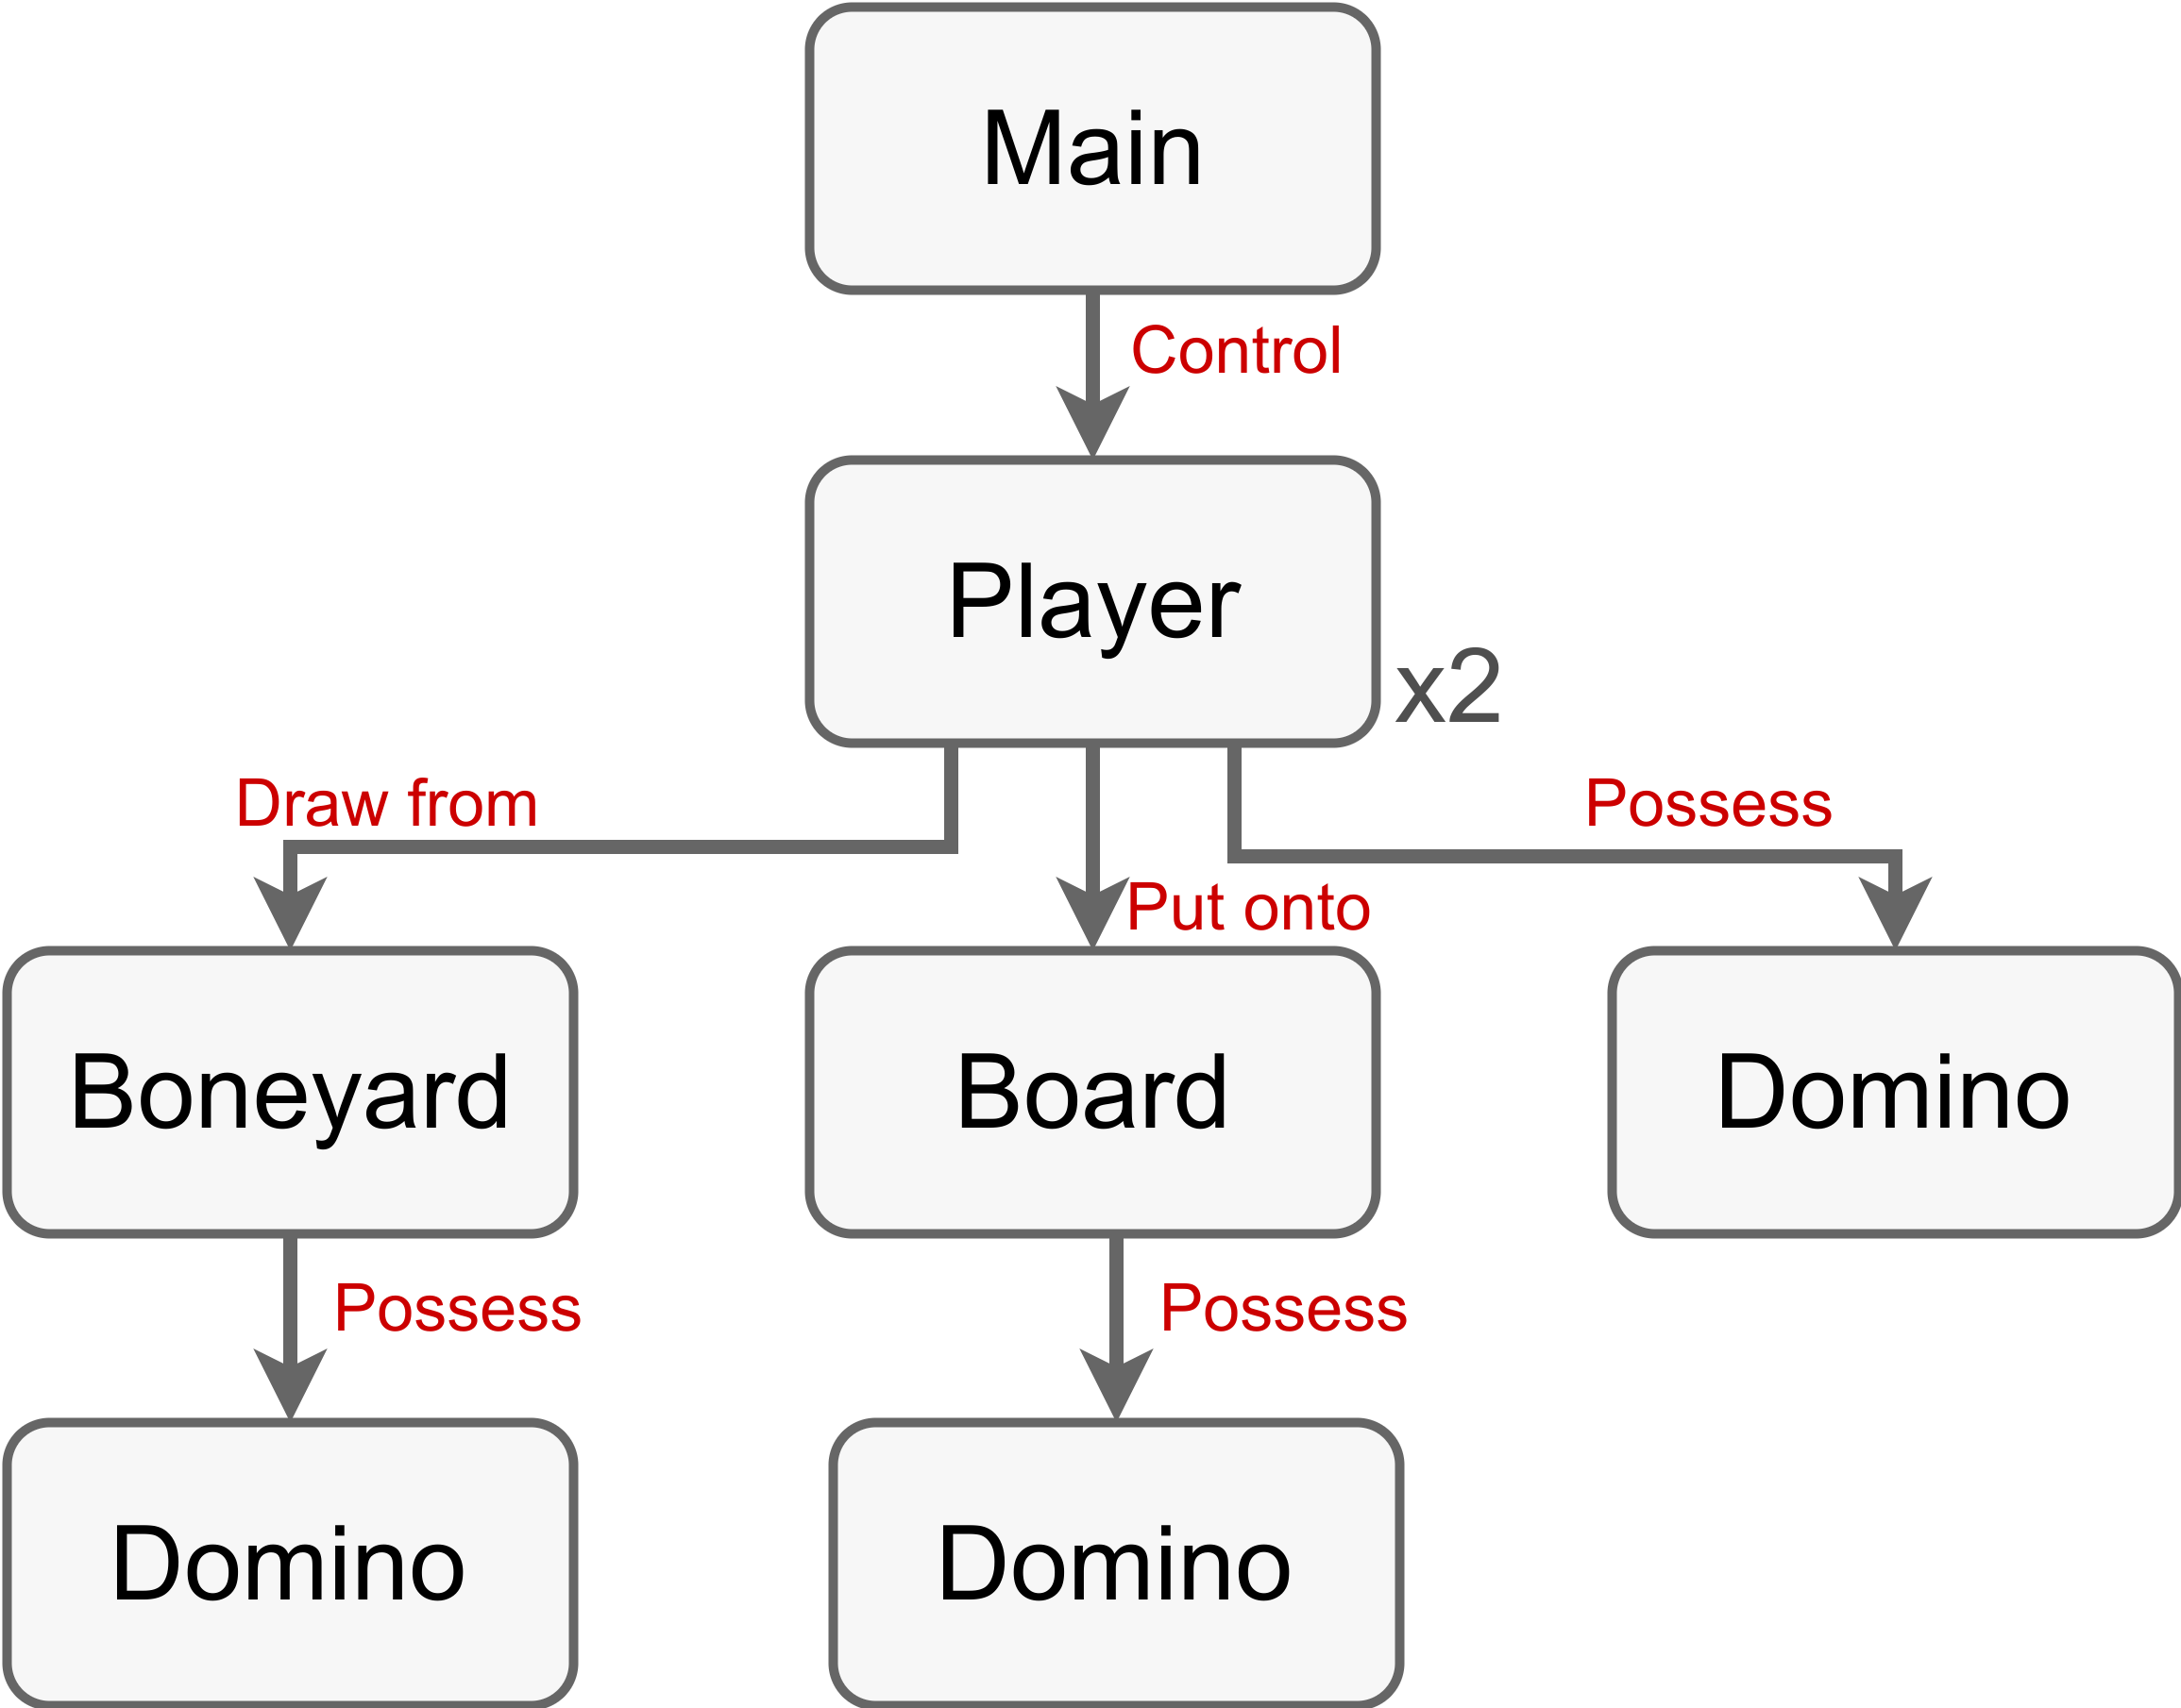
Design Structure

Slide 4
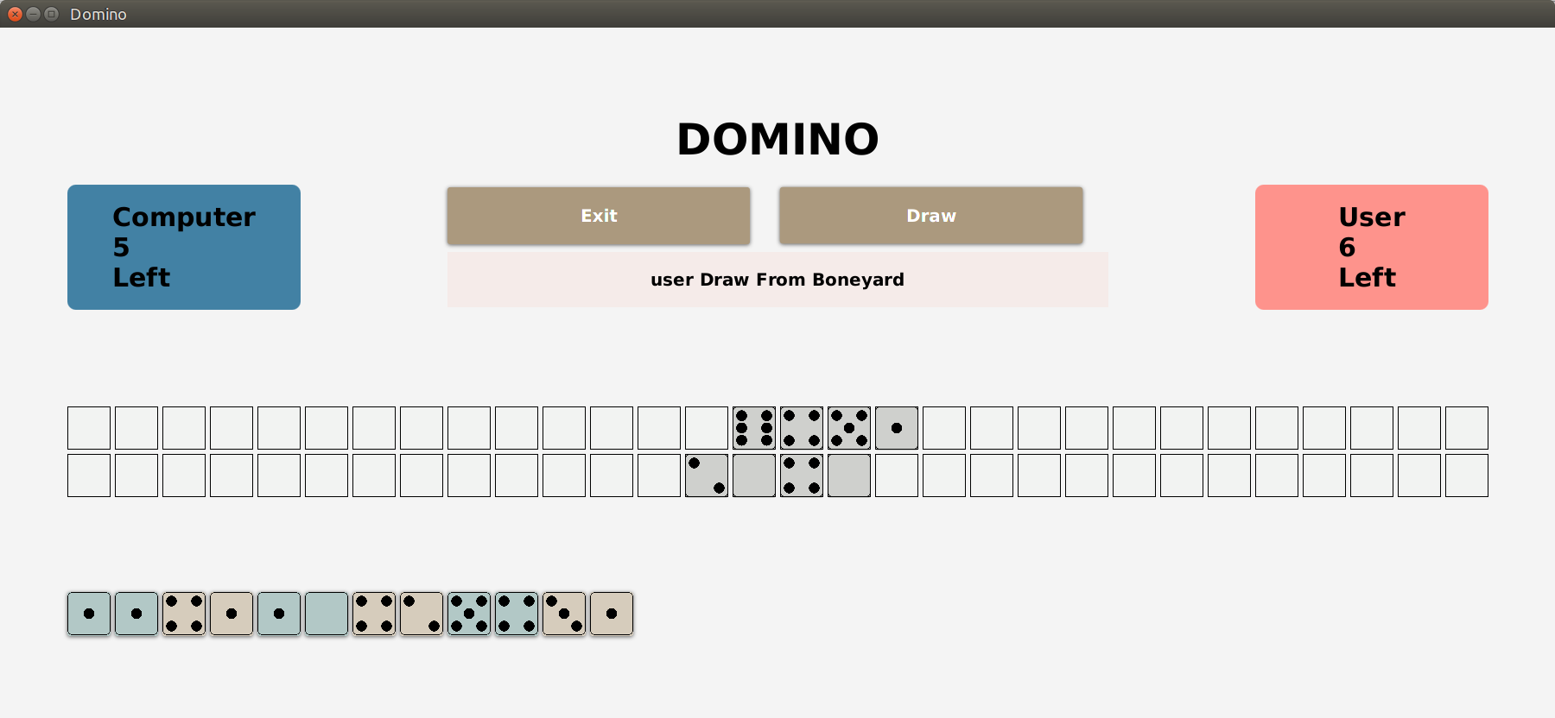
Visualization

