Slide 1
6.2.4 Mark-Interior/Border-Pixel Operator
Function
It marks all interior pixels with the label i, and all border pixels with the label b
Classification
Non-Rec.
symbolic data domain(input : binary-label/output : number-label)

Slide 2
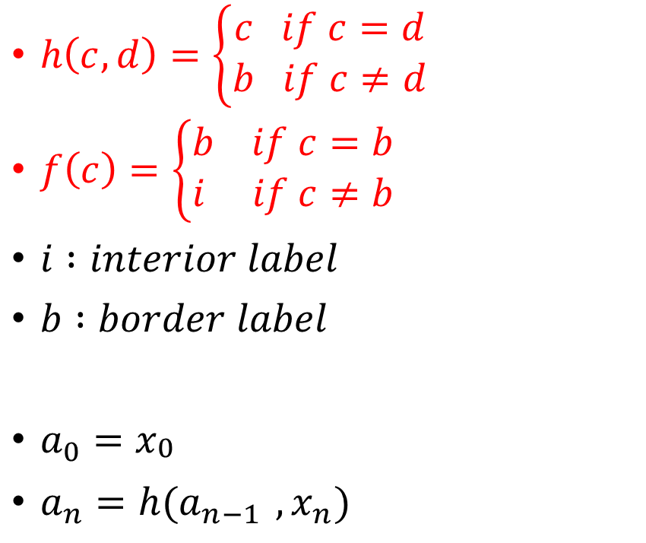
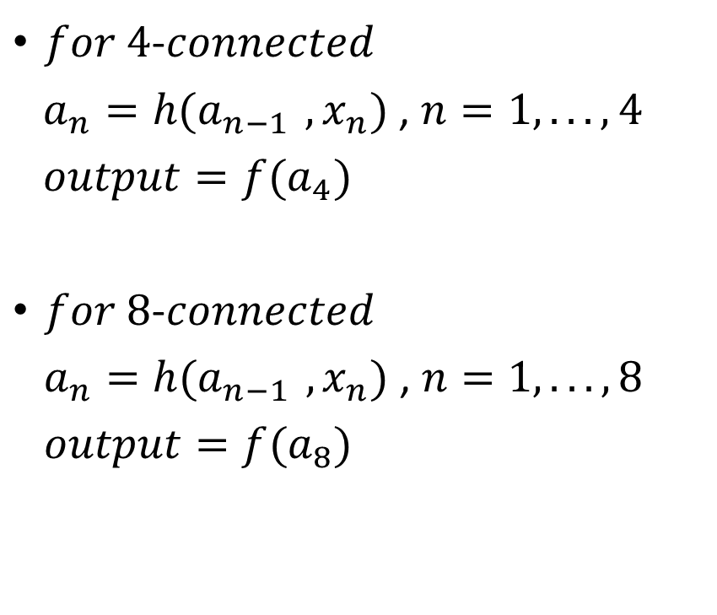
6.2.4 Mark-Interior/Border-Pixel Operator
$h\left(c,d\right)=\left\{\begin{aligned}c if c=d \\ b if c≠d\end{aligned}\right.$
$f\left(c\right)=\left\{\begin{aligned}b if c=b \\ i if c≠b\end{aligned}\right.$
$i :interior label$
$b :border label$
$a_{0}=x_{\begin{aligned}0 \\ \end{aligned}}$
$a_{n}=h(a_{n−1 },x_{n})$
$for 4$-$connected$
$a_{n}=h(a_{n−1 },x_{n})$ , $n=1,... ,4$
${output=f(a}_{4})$
$for 8$-$connected$
$a_{n}=h(a_{n−1 },x_{n})$ , $n=1,... ,8$
${output=f(a}_{8})$

Slide 3
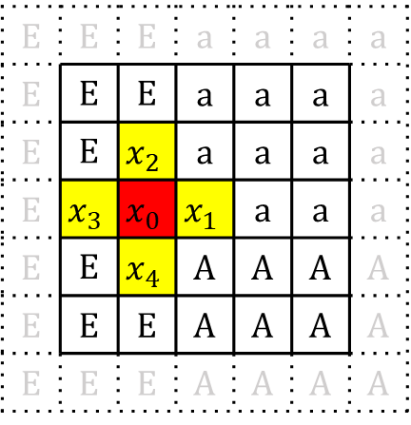
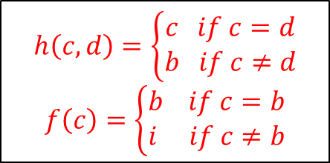
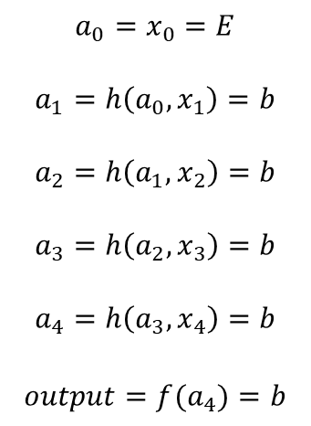
Case 1
Mark interior/border-Pixel Operator
(at one point)
E | E | E | a | a | a | a
E | E | E | a | a | a | a
E | E | E | a | a | a | a
E | E | E | a | a | a | a
E | E | E | A | A | A | A
E | E | E | A | A | A | A
E | E | E | A | A | A | A
E | E | E | a | a | a | a
E | E | E | a | a | a | a
E | E | E | a | a | a | a
E | E | b | a | a | a | a
E | E | E | A | A | A | A
E | E | E | A | A | A | A
E | E | E | A | A | A | A
$$a_{0}=x_{0}=E$$
$$a_{1}=h\left({a_{0},x}_{1}\right)=b$$
$$a_{2}=h\left({a_{1},x}_{2}\right)=b$$
$$a_{3}=h\left({a_{2},x}_{3}\right)=b$$
$$a_{4}=h\left({a_{3},x}_{4}\right)=b$$
$$output={f(a}_{4})=b$$
a
input
output
E | E | E | a | a | a | a
E | E | E | a | a | a | a
E | E | $$x_{2}$$ | a | a | a | a
E | $$x_{3}$$ | $$x_{0}$$ | $$x_{1}$$ | a | a | a
E | E | $$x_{4}$$ | A | A | A | A
E | E | E | A | A | A | A
E | E | E | A | A | A | A
$$h\left(c,d\right)=\left\{\begin{aligned}c if c=d \\ b if c≠d\end{aligned}\right.$$
$$f\left(c\right)=\left\{\begin{aligned}b if c=b \\ i if c≠b\end{aligned}\right.$$
for 4-connectivity
i: interior label
b: border label
Index

Slide 4
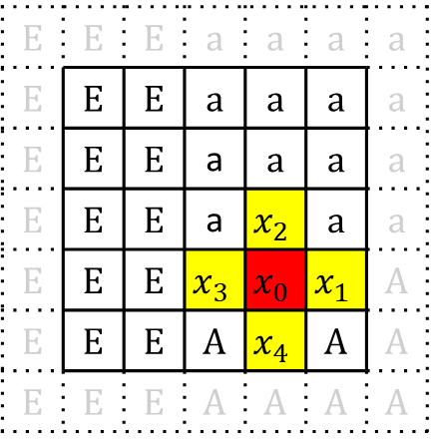
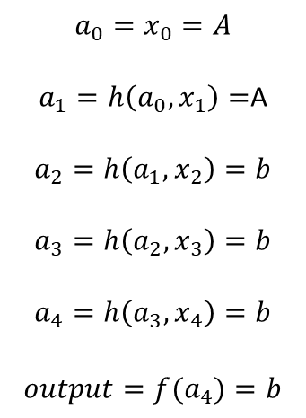
Case 2
Mark interior/border-Pixel Operator
(at one point)
E | E | E | a | a | a | a
E | E | E | a | a | a | a
E | E | E | a | a | a | a
E | E | E | a | a | a | a
E | E | E | A | A | A | A
E | E | E | A | A | A | A
E | E | E | A | A | A | A
E | E | E | a | a | a | a
E | E | E | a | a | a | a
E | E | E | a | a | a | a
E | E | E | a | a | a | a
E | E | E | A | b | A | A
E | E | E | A | A | A | A
E | E | E | A | A | A | A
$$a_{0}=x_{0}=A$$
$a_{1}=h\left({a_{0},x}_{1}\right)=$A
$$a_{2}=h\left({a_{1},x}_{2}\right)=b$$
$$a_{3}=h\left({a_{2},x}_{3}\right)=b$$
$$a_{4}=h\left({a_{3},x}_{4}\right)=b$$
$$output={f(a}_{4})=b$$
a
input
output
E | E | E | a | a | a | a
E | E | E | a | a | a | a
E | E | E | a | a | a | a
E | E | E | a | $$x_{2}$$ | a | a
E | E | E | $$x_{3}$$ | $$x_{0}$$ | $$x_{1}$$ | A
E | E | E | A | $$x_{4}$$ | A | A
E | E | E | A | A | A | A
$$h\left(c,d\right)=\left\{\begin{aligned}c if c=d \\ b if c≠d\end{aligned}\right.$$
$$f\left(c\right)=\left\{\begin{aligned}b if c=b \\ i if c≠b\end{aligned}\right.$$
for 4-connectivity
i: interior label
b: border label
Index

Slide 5
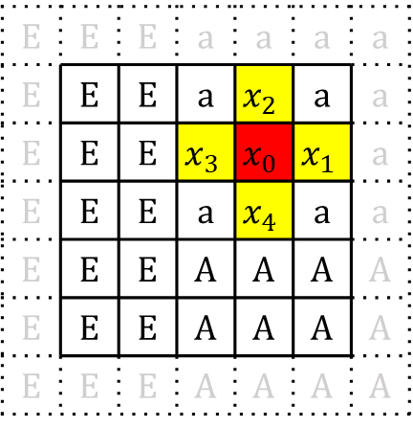
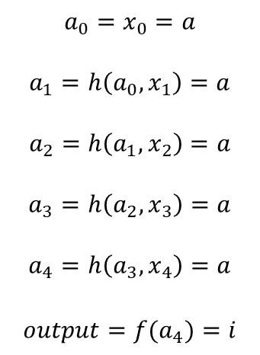
Case 3
Mark interior/border-Pixel Operator
(at one point)
E | E | E | a | a | a | a
E | E | E | a | a | a | a
E | E | E | a | a | a | a
E | E | E | a | a | a | a
E | E | E | A | A | A | A
E | E | E | A | A | A | A
E | E | E | A | A | A | A
E | E | E | a | a | a | a
E | E | E | a | a | a | a
E | E | E | a | i | a | a
E | E | E | a | a | a | a
E | E | E | A | A | A | A
E | E | E | A | A | A | A
E | E | E | A | A | A | A
$$a_{0}=x_{0}=a$$
$$a_{1}=h\left({a_{0},x}_{1}\right)=a$$
$$a_{2}=h\left({a_{1},x}_{2}\right)=a$$
$$a_{3}=h\left({a_{2},x}_{3}\right)=a$$
$$a_{4}=h\left({a_{3},x}_{4}\right)=a$$
$$output={f(a}_{4})=i$$
a
input
output
E | E | E | a | a | a | a
E | E | E | a | $$x_{2}$$ | a | a
E | E | E | $$x_{3}$$ | $$x_{0}$$ | $$x_{1}$$ | a
E | E | E | a | $$x_{4}$$ | a | a
E | E | E | A | A | A | A
E | E | E | A | A | A | A
E | E | E | A | A | A | A
$$h\left(c,d\right)=\left\{\begin{aligned}c if c=d \\ b if c≠d\end{aligned}\right.$$
$$f\left(c\right)=\left\{\begin{aligned}b if c=b \\ i if c≠b\end{aligned}\right.$$
for 4-connectivity
i: interior label
b: border label
Index

Slide 6
<Legend>
i: interior label
b: border label
E | E | E | a | a | a | a
E | E | E | a | a | a | a
E | E | E | a | a | a | a
E | E | E | a | a | a | a
E | E | E | A | A | A | A
E | E | E | A | A | A | A
E | E | E | A | A | A | A
E | E | E | a | a | a | a
E | i | b | b | i | i | a
E | i | b | b | i | i | a
E | i | b | b | b | b | a
E | i | b | b | b | b | A
E | i | b | b | i | i | A
E | E | E | A | A | A | A
Mark interior/border-Pixel Operator
(for all points)
input
output

Slide 7
6.2.7 Pair Relationship Operator
Function
Relabels with a specified label all border pixels that are next to an interior pixel
Classification
Non-Rec.
symbolic data domain

Slide 8
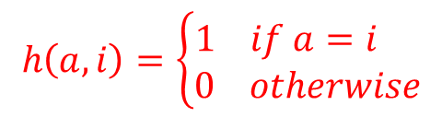

 | b | b | b | b | b | b
 | b | i | i | i | i | b
 | b | b | b | i | i | b | b
 | b |  |  | b | b | i | b
 | b |  |  |  | b | b | b
 | b |  |  |  |  |  | b
 | q | p | p | p | p | q
 | p | q | q | q | q | p
 | q | p | p | q | q | p | q
 | q |  |  | p | p | q | p
 | q |  |  |  | q | p | q
 | q |  |  |  |  |  | q
for 4-connectivity
$$output=\left\{\begin{aligned}q if \sum_{n=1}^{4}{h\left(x_{n},i\right)<1∨ x_{0}≠b} \\ p if \sum_{n=1}^{4}{h\left(x_{n},i\right)≥1 ∧ x_{0}=b}\end{aligned}\right.$$
$$Let l =b , m=i , θ=1$$
$$h\left(a,i\right)=\left\{\begin{aligned}1 if a=i \\ 0 otherwise\end{aligned}\right.$$
Notes:
排除內部與無關

Slide 9


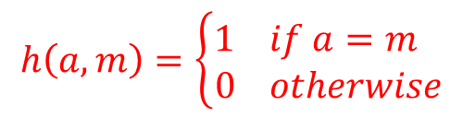
6.2.7 Pair Relationship Operator
for 4-connected
$$output=\left\{\begin{aligned}q if \sum_{n=1}^{4}{h\left(x_{n},m\right)<θ ∨ x_{0}≠l} \\ p if \sum_{n=1}^{4}{h\left(x_{n},m\right)≥θ ∧ x_{0}=l}\end{aligned}\right.$$
for 8-connected
$$output=\left\{\begin{aligned}q if \sum_{n=1}^{8}{h\left(x_{n},m\right)<θ ∨ x_{0}≠l} \\ p if \sum_{n=1}^{8}{h\left(x_{n},m\right)≥θ ∧ x_{0}=l}\end{aligned}\right.$$
$$h\left(a,m\right)=\left\{\begin{aligned}1 if a=m \\ 0 otherwise\end{aligned}\right.$$
Assign p to those pixels satisfy pixel value = l
and have more than $θ$ neighbors whose pixel value = m

Slide 10
6.2.6 Connected Shrink Operator
Function
The connected shrink operator labels only those border pixels that can be deleted from a connected region without disconnected the region
Classification
Rec.
symbolic data domain(input/output : binary image)
Notes:
Shrink: 收縮
刪除pixel後還是不會斷開

Slide 11


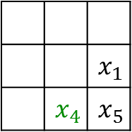
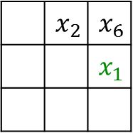
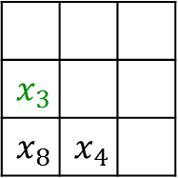
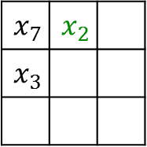
6.2.6 Connected Shrink Operator
Corner Neighborhood
(for corresponding $x_{i}$)
for 4-connectivity
$h\left(b,c,d,e\right)=\left\{\begin{aligned}1 if b=c∧(b≠d ∨ b≠e) \\ 0 otherwise \end{aligned}\right.$
for 8-connectivity
$h\left(b,c,d,e\right)=\left\{\begin{aligned}1 if b≠c∧(b=d ∨ b=e) \\ 0 otherwise \end{aligned}\right.$
$a_{1}=h(x_{0},x_{1},x_{6},x_{2})$
$a_{1}=h(x_{0},x_{2},x_{7},x_{3})$
$a_{1}=h(x_{0},x_{3},x_{8},x_{4})$
$a_{1}=h(x_{0},x_{4},x_{5},x_{1})$
$output=f\left(a_{1},a_{2},a_{3},a_{4},x_{0}\right)=\left\{\begin{aligned}g if exactly one of a_{1},a_{2},a_{3}{,a}_{4}=1 \\ x_{0} otherwise \end{aligned}\right.$
 | $$x_{2}$$ | $$x_{6}$$
 |  | $$x_{1}$$
$$x_{7}$$ | $$x_{2}$$
$$x_{3}$$
$$x_{3}$$
$$x_{8}$$ | $$x_{4}$$
 |  | $$x_{1}$$
 | $$x_{4}$$ | $$x_{5}$$
Yokoi Connectivity Number
:label 1(edge)
Scan: top-down left-right
Input: last-step output (not the original image)

Slide 12
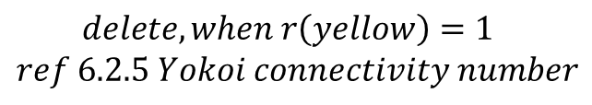

Padded with
$$background label$$
 |  |  | * | *
 |  | * | * | * | *
 | * | * | * | * | * | *
 |  | * | * |  | * | *
 |  |  | * |  | * | *
 |  |  | * |  | * | *
 |  |  | * |  | * | *
 |  |  |  | *
 |  | * | * | * | *
 | * | * | * | * | * | *
 |  | * | * |  | * | *
 |  |  | * |  | * | *
 |  |  | * |  | * | *
 |  |  | * |  | * | *
 |  | * | * | * | *
 | * | * | * | * | * | *
 |  | * | * |  | * | *
 |  |  | * |  | * | *
 |  |  | * |  | * | *
 |  |  | * |  | * | *
$$delete, when r\left(yellow\right)=1$$
$$ref 6.2.5 Yokoi connectivity number$$

Slide 13
 |  |  | * | * | *
 | * | * | * | * | * | *
 |  | * | * |  | * | *
 |  |  | * |  | * | *
 |  |  | * |  | * | *
 |  |  | * |  | * | *
 |  |  |  | * | *
 | * | * | * | * | * | *
 |  | * | * |  | * | *
 |  |  | * |  | * | *
 |  |  | * |  | * | *
 |  |  | * |  | * | *
 |  |  |  |  | *
 | * | * | * | * | * | *
 |  | * | * |  | * | *
 |  |  | * |  | * | *
 |  |  | * |  | * | *
 |  |  | * |  | * | *
$$delete, when r\left(yellow\right)=1$$
$$ref 6.2.5 Yokoi connectivity number$$

Slide 14
 | * | * | * | * | * | *
 |  | * | * |  | * | *
 |  |  | * |  | * | *
 |  |  | * |  | * | *
 |  |  | * |  | * | *
 |  | * | * | * | * | *
 |  | * | * |  | * | *
 |  |  | * |  | * | *
 |  |  | * |  | * | *
 |  |  | * |  | * | *
 |  |  | * | * | * | *
 |  | * | * |  | * | *
 |  |  | * |  | * | *
 |  |  | * |  | * | *
 |  |  | * |  | * | *
$$delete, when r\left(yellow\right)=1$$
$$ref 6.2.5 Yokoi connectivity number$$

Slide 15
 |  |  | * | * | * | *
 |  | * | * |  | * | *
 |  |  | * |  | * | *
 |  |  | * |  | * | *
 |  |  | * |  | * | *
 |  |  | * | * | * | *
 |  | * | * |  | * | *
 |  |  | * |  | * | *
 |  |  | * |  | * | *
 |  |  | * |  | * | *
 |  |  | * | * | * | *
 |  | * | * |  | * | *
 |  |  | * |  | * | *
 |  |  | * |  | * | *
 |  |  | * |  | * | *
$$delete, when r\left(yellow\right)=1$$
$$ref 6.2.5 Yokoi connectivity number$$

Slide 16
 |  |  | * | * | *
 |  | * | * |  | * | *
 |  |  | * |  | * | *
 |  |  | * |  | * | *
 |  |  | * |  | * | *
 |  |  | * | * | *
 |  |  | * |  | * | *
 |  |  | * |  | * | *
 |  |  | * |  | * | *
 |  |  | * |  | * | *
 |  |  | * | * | *
 |  | * | * |  | * | *
 |  |  | * |  | * | *
 |  |  | * |  | * | *
 |  |  | * |  | * | *
$$delete, when r\left(yellow\right)=1$$
$$ref 6.2.5 Yokoi connectivity number$$

Slide 17
 |  |  | * | * | *
 |  |  | * |  | * | *
 |  |  | * |  | * | *
 |  |  | * |  | * | *
 |  |  | * |  | * | *
 |  |  | * | * | *
 |  |  | * |  | *
 |  |  | * |  | * | *
 |  |  | * |  | * | *
 |  |  | * |  | * | *
 |  |  | * | * | *
 |  |  | * |  | *
 |  |  | * |  | * | *
 |  |  | * |  | * | *
 |  |  | * |  | * | *
$$delete, when r\left(yellow\right)=1$$
$$ref 6.2.5 Yokoi connectivity number$$

Slide 18
 |  |  | * | * | *
 |  |  | * |  | *
 |  |  | * |  | * | *
 |  |  | * |  | * | *
 |  |  | * |  | * | *
 |  |  | * | * | *
 |  |  | * |  | *
 |  |  | * |  | *
 |  |  | * |  | * | *
 |  |  | * |  | * | *
 |  |  | * | * | *
 |  |  | * |  | *
 |  |  | * |  | *
 |  |  | * |  | * | *
 |  |  | * |  | * | *
$$delete, when r\left(yellow\right)=1$$
$$ref 6.2.5 Yokoi connectivity number$$

Slide 19
 |  |  | * | * | *
 |  |  | * |  | *
 |  |  | * |  | *
 |  |  | * |  | * | *
 |  |  | * |  | * | *
 |  |  | * | * | *
 |  |  | * |  | *
 |  |  | * |  | *
 |  |  | * |  | *
 |  |  | * |  | * | *
 |  |  | * | * | *
 |  |  | * |  | *
 |  |  | * |  | *
 |  |  | * |  | *
 |  |  |  |  | * | *
$$delete, when r\left(yellow\right)=1$$
$$ref 6.2.5 Yokoi connectivity number$$

Slide 20

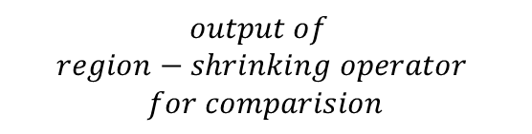
$$output of$$
$$region−shrinking operator$$
$$for comparision$$
$$final output$$
 |  |  | * | * | *
 |  |  | * |  | *
 |  |  | * |  | *
 |  |  | * |  | *
 |  |  |  |  | * | *
 |  |  | * | * | *
 |  |  | * |  | *
 |  |  | * |  | *
 |  |  | * |  | *
 |  |  |  |  | *
 |  |  | * | *
 |  | * | * | * | *
 | * | * | * | * | * | *
 |  | * | * |  | * | *
 |  |  | * |  | * | *
 |  |  | * |  | * | *
 |  |  | * |  | * | *
$$delete, when r\left(yellow\right)=1$$
$$ref 6.2.5 Yokoi connectivity number$$
green region are those pixels deleted

Slide 21
6.2.8 Thinning Operator(HW) due Nov. 20
Composition of three operator
6.2.4 mark-interior/border-pixel operator
6.2.7 pair relationship operator
6.2.6 marked-pixel connected shrink operator

Slide 22
6.2.8 Thinning Operator
Step1
input : original symbolic image
marked-interior/border-pixel operator
output : interior/border image
Step2
input : interior/border image
pair relationship operator
output : marked image
Step3
input : original symbolic image +marked image
marked-pixel connected shrink operator
removable(by connected shrink operator on original symbolic image)
marked(by marked image)
delete those pixels satisfied the two conditions mentioned above
output : thinned output image
use thinned output image as next original symbolic image
repeat step1, step2, step3 until the last output never changed

Slide 23





Step1 & Step2 : produce two input images for Step3
$$original symbolic image$$
$$Interior/border image$$
$$marked image$$
 | * | * | * | * | * | *
 | * | * | * | * | * | *
 | * | * | * | * | * | * | *
 | * |  |  | * | * | * | *
 | * |  |  |  | * | * | *
 | * |  |  |  |  |  | *
 | b | b | b | b | b | b
 | b | i | i | i | i | b
 | b | b | b | b | i | b | b
 | b |  |  | b | b | i | b
 | b |  |  |  | b | b | b
 | b |  |  |  |  |  | b
 | * | * | * | * | * | *
 | * | * | * | * | * | *
 | * | * | * | * | * | * | *
 | * |  |  | * | * | * | *
 | * |  |  |  | * | * | *
 | * |  |  |  |  |  | *
$$8\text{−}connected$$
$$8\text{−}connected$$

Slide 24



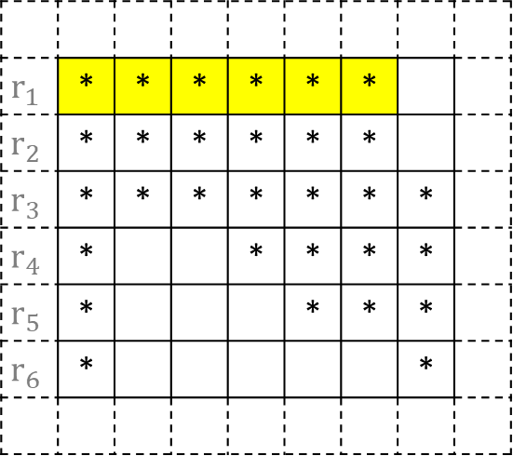
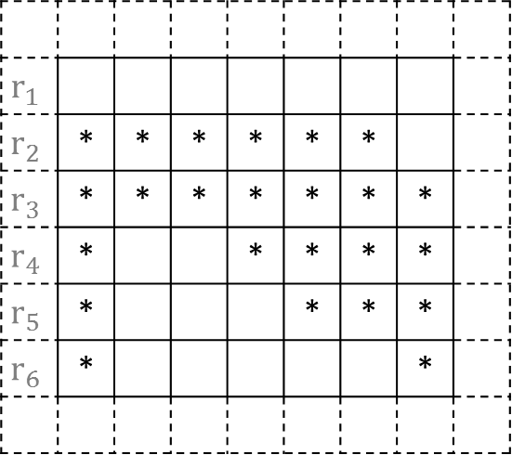
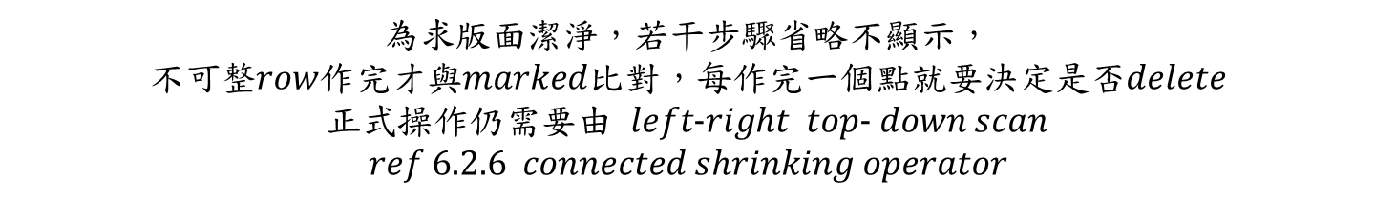

Step3 : marked-pixel connected shrink operator
$$original symbolic image$$
$$marked image for r_{1}$$
$$output after r_{1}$$
$$r_{1}$$ | * | * | * | * | * | *
$$r_{2}$$ | * | * | * | * | * | *
$$r_{3}$$ | * | * | * | * | * | * | *
$$r_{4}$$ | * |  |  | * | * | * | *
$$r_{5}$$ | * |  |  |  | * | * | *
$$r_{6}$$ | * |  |  |  |  |  | *
 | * | * | * | * | * | *
 | * | * | * | * | * | *
 | * | * | * | * | * | * | *
 | * |  |  | * | * | * | *
 | * |  |  |  | * | * | *
 | * |  |  |  |  |  | *
$$r_{1}$$
$$r_{2}$$ | * | * | * | * | * | *
$$r_{3}$$ | * | * | * | * | * | * | *
$$r_{4}$$ | * |  |  | * | * | * | *
$$r_{5}$$ | * |  |  |  | * | * | *
$$r_{6}$$ | * |  |  |  |  |  | *
$$removable$$
為求版面潔淨，若干步驟省略不顯示，
不可整$row$作完才與$marked$比對，每作完一個點就要決定是否$delete$
正式操作仍需要由 $left\text{−}right top\text{− }down scan$
$$ref 6.2.6 connected shrinking operator$$

Slide 25
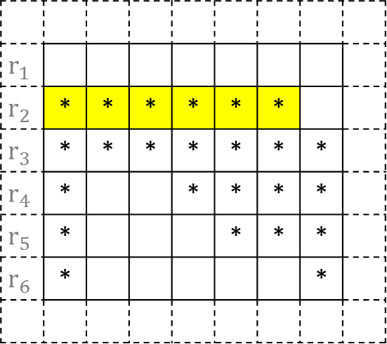



$$original symbolic image$$
$$marked image for r_{2}$$
$$output after r_{2}$$
$$r_{1}$$
$$r_{2}$$ | * | * | * | * | * | *
$$r_{3}$$ | * | * | * | * | * | * | *
$$r_{4}$$ | * |  |  | * | * | * | *
$$r_{5}$$ | * |  |  |  | * | * | *
$$r_{6}$$ | * |  |  |  |  |  | *
 | * | * | * | * | * | *
 | * | * | * | * | * | *
 | * | * | * | * | * | * | *
 | * |  |  | * | * | * | *
 | * |  |  |  | * | * | *
 | * |  |  |  |  |  | *
$$r_{1}$$
$$r_{2}$$ |  | * | * | * | *
$$r_{3}$$ | * | * | * | * | * | * | *
$$r_{4}$$ | * |  |  | * | * | * | *
$$r_{5}$$ | * |  |  |  | * | * | *
$$r_{6}$$ | * |  |  |  |  |  | *
$$removable$$

Slide 26
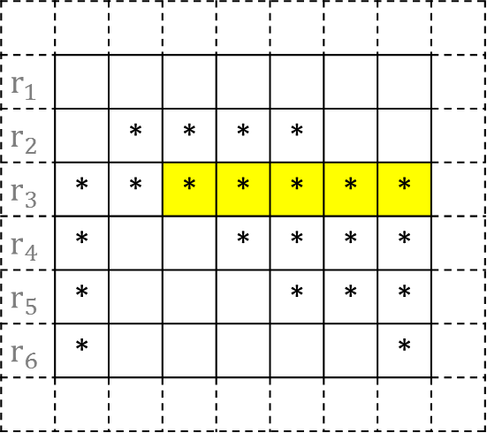



$$original symbolic image$$
$$marked image for r_{3}$$
$$output after r_{3}$$
$$r_{1}$$
$$r_{2}$$ |  | * | * | * | *
$$r_{3}$$ | * | * | * | * | * | * | *
$$r_{4}$$ | * |  |  | * | * | * | *
$$r_{5}$$ | * |  |  |  | * | * | *
$$r_{6}$$ | * |  |  |  |  |  | *
 | * | * | * | * | * | *
 | * | * | * | * | * | *
 | * | * | * | * | * | * | *
 | * |  |  | * | * | * | *
 | * |  |  |  | * | * | *
 | * |  |  |  |  |  | *
$$r_{1}$$
$$r_{2}$$ |  | * | * | * | *
$$r_{3}$$ | * | * |  |  | *
$$r_{4}$$ | * |  |  | * | * | * | *
$$r_{5}$$ | * |  |  |  | * | * | *
$$r_{6}$$ | * |  |  |  |  |  | *
$$removable$$

Slide 27
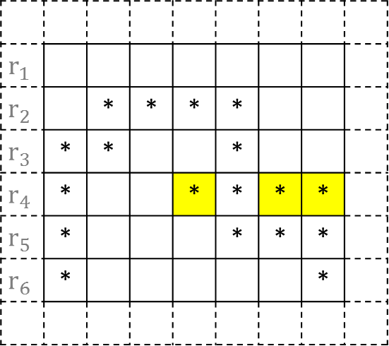



$$original symbolic image$$
$$marked image for r_{4}$$
$$output after r_{4}$$
$$r_{1}$$
$$r_{2}$$ |  | * | * | * | *
$$r_{3}$$ | * | * |  |  | *
$$r_{4}$$ | * |  |  | * | * | * | *
$$r_{5}$$ | * |  |  |  | * | * | *
$$r_{6}$$ | * |  |  |  |  |  | *
 | * | * | * | * | * | *
 | * | * | * | * | * | *
 | * | * | * | * | * | * | *
 | * |  |  | * | * | * | *
 | * |  |  |  | * | * | *
 | * |  |  |  |  |  | *
$$r_{1}$$
$$r_{2}$$ |  | * | * | * | *
$$r_{3}$$ | * | * |  |  | *
$$r_{4}$$ | * |  |  |  | * | *
$$r_{5}$$ | * |  |  |  | * | * | *
$$r_{6}$$ | * |  |  |  |  |  | *
$$removable$$

Slide 28
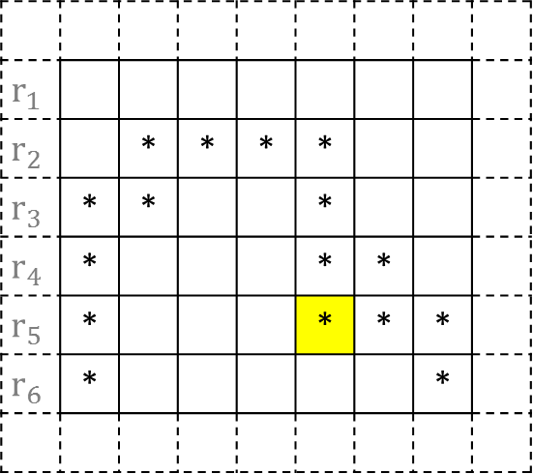



$$original symbolic image$$
$$marked image for r_{5}$$
$$output after r_{5}$$
$$r_{1}$$
$$r_{2}$$ |  | * | * | * | *
$$r_{3}$$ | * | * |  |  | *
$$r_{4}$$ | * |  |  |  | * | *
$$r_{5}$$ | * |  |  |  | * | * | *
$$r_{6}$$ | * |  |  |  |  |  | *
 | * | * | * | * | * | *
 | * | * | * | * | * | *
 | * | * | * | * | * | * | *
 | * |  |  | * | * | * | *
 | * |  |  |  | * | * | *
 | * |  |  |  |  |  | *
$$r_{1}$$
$$r_{2}$$ |  | * | * | * | *
$$r_{3}$$ | * | * |  |  | *
$$r_{4}$$ | * |  |  |  | * | *
$$r_{5}$$ | * |  |  |  |  | * | *
$$r_{6}$$ | * |  |  |  |  |  | *
$$removable$$

Slide 29

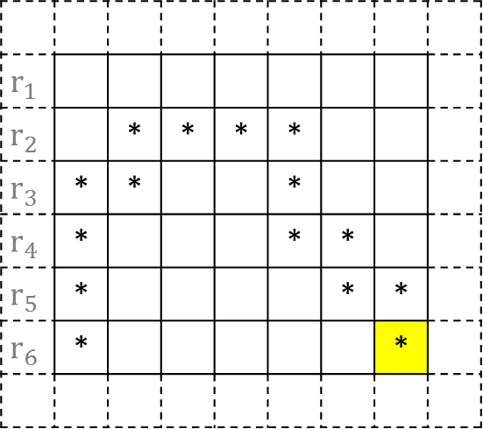


$$original symbolic image$$
$$marked image for r_{6}$$
$$output after r_{6}$$
$$r_{1}$$
$$r_{2}$$ |  | * | * | * | *
$$r_{3}$$ | * | * |  |  | *
$$r_{4}$$ | * |  |  |  | * | *
$$r_{5}$$ | * |  |  |  |  | * | *
$$r_{6}$$ | * |  |  |  |  |  | *
 | * | * | * | * | * | *
 | * | * | * | * | * | *
 | * | * | * | * | * | * | *
 | * |  |  | * | * | * | *
 | * |  |  |  | * | * | *
 | * |  |  |  |  |  | *
$$r_{1}$$
$$r_{2}$$ |  | * | * | * | *
$$r_{3}$$ | * | * |  |  | *
$$r_{4}$$ | * |  |  |  | * | *
$$r_{5}$$ | * |  |  |  |  | * | *
$$r_{6}$$ | * |  |  |  |  |  | *
$$removable$$
$$check stop criterion…$$

Slide 30


$$original symbolic image$$
$$output$$
$$comparison$$
 | * | * | * | * | * | *
 | * | * | * | * | * | *
 | * | * | * | * | * | * | *
 | * |  |  | * | * | * | *
 | * |  |  |  | * | * | *
 | * |  |  |  |  |  | *
 |  | * | * | * | *
 | * | * |  |  | *
 | * |  |  |  | * | *
 | * |  |  |  |  | * | *
 | * |  |  |  |  |  | *
 | * | * | * | * | * | *
 | * | * | * | * | * | *
 | * | * | * | * | * | * | *
 | * |  |  | * | * | * | *
 | * |  |  |  | * | * | *
 | * |  |  |  |  |  | *

Slide 31
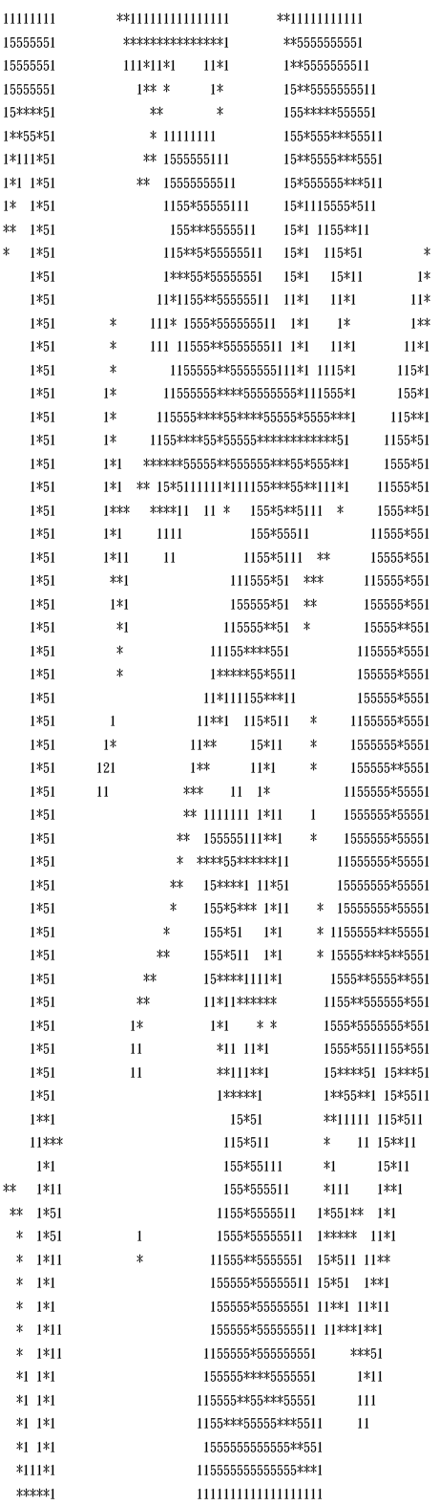


6.2.8 Thinning Operator HW due: Nov. 20
lena.thin

