Slide 1
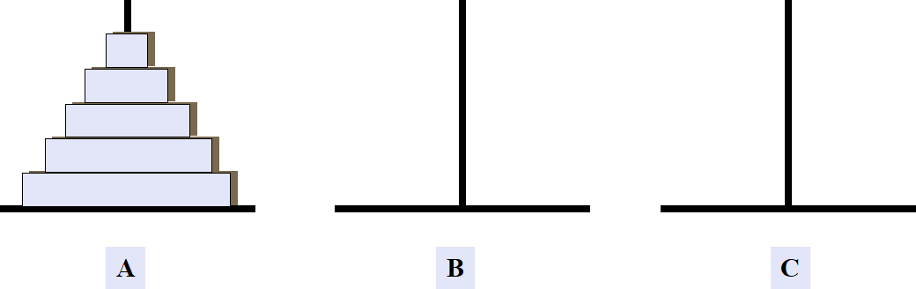
// 汉诺塔

Slide 2
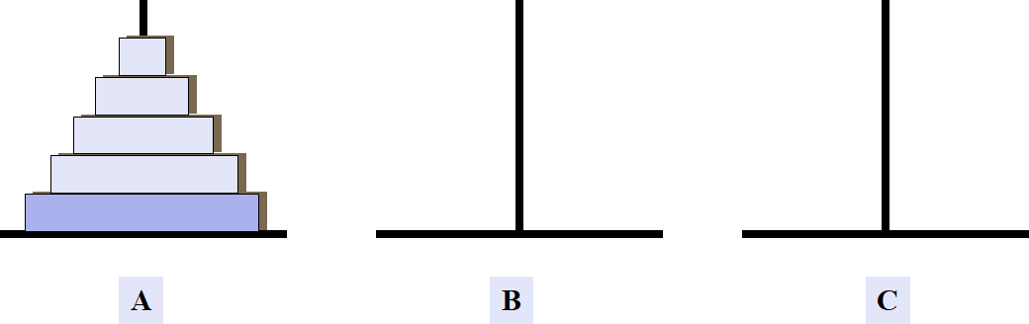
// 汉诺塔

Slide 3
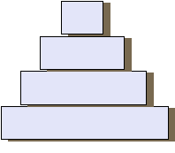
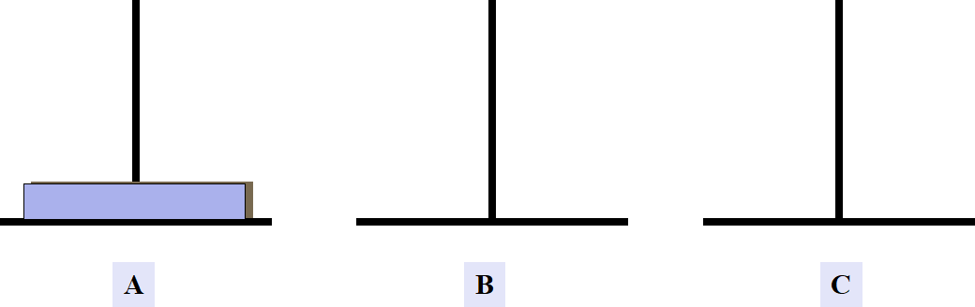
// 汉诺塔

Slide 4
// 汉诺塔

Slide 5
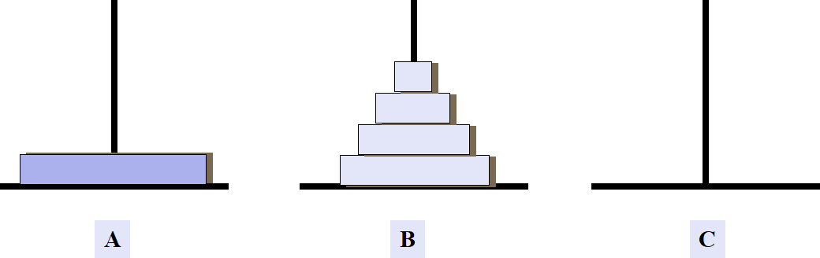
// 汉诺塔

Slide 6
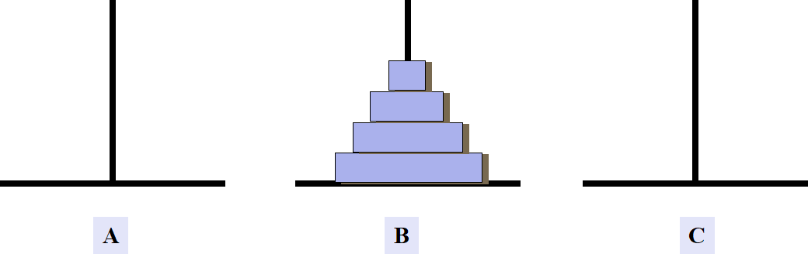
// 汉诺塔

Slide 7
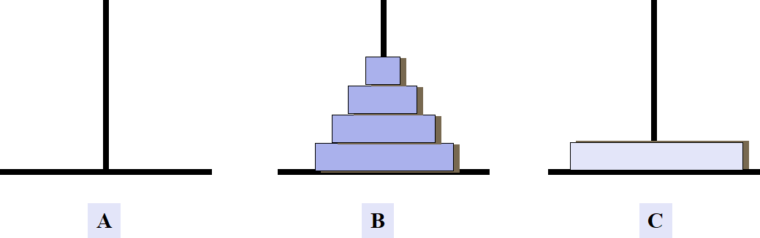
// 汉诺塔

Slide 8
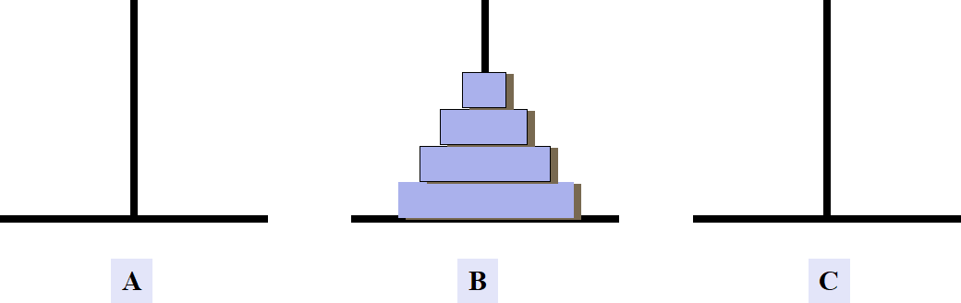
// 汉诺塔

Slide 9
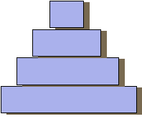
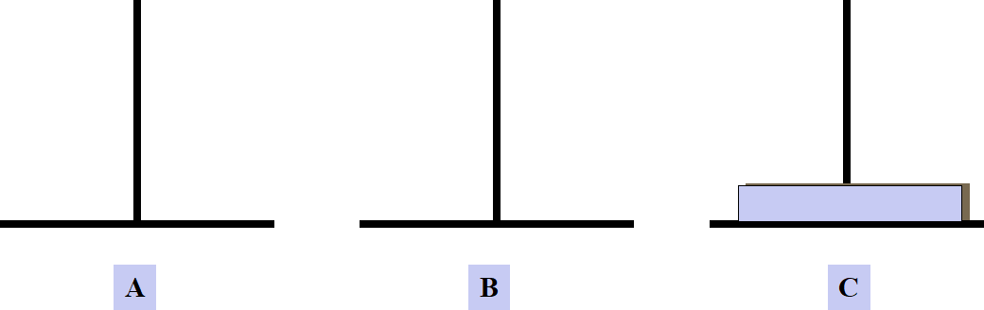
// 汉诺塔

Slide 10

// 汉诺塔

Slide 11
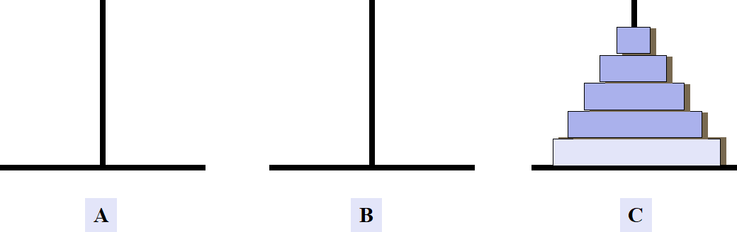
// 汉诺塔

Slide 12
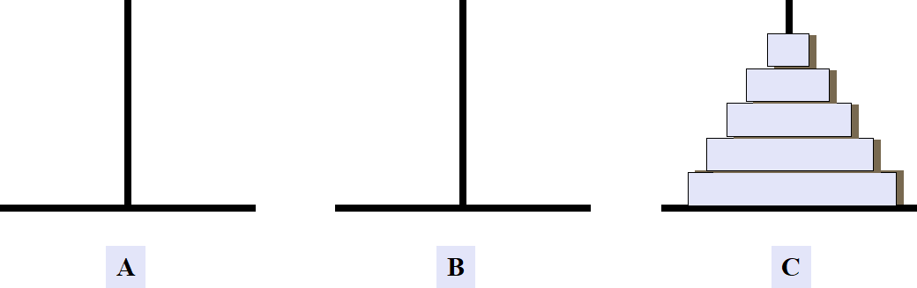
// 汉诺塔

Slide 13
// 汉诺塔
# include < stdio.h >
void hanoi ( int n, char a, char b, char c )
{ if ( n >= 1 )
{ hanoi ( n-1, a, c, b ) ;
printf(“%c --> %c\n”, a , c) ;
hanoi ( n-1, b, a, c ) ;
}
}
void main ()
{ int n ;
printf( " Input the number of diskes:\n “) ;
scanf(“%d”,&n) ;
hanoi ( n, 'A' , 'B' , 'C' ) ;
}

Slide 14
// 汉诺塔
void main ()
{ int n ;
printf( " Input the number of diskes:\n “) ;
scanf(“%d”,&n) ;
hanoi ( n, 'A' , 'B' , 'C' ) ;
}
Stack
Output
n a b c

Slide 15
// 汉诺塔
void main ()
{ int n ;
printf( " Input the number of diskes:\n “) ;
scanf(“%d”,&n) ;
hanoi ( n, 'A' , 'B' , 'C' ) ;
}
H(n,A,B,C)
H ( 3, A, B, C )
Stack
Output
3 A B C
n a b c

Slide 16
void hanoi ( int n, char a, char b, char c )
{ if ( n >= 1 )
{ hanoi ( n-1, a, c, b) ;
printf(“%c -->%c\n“,a,c);
hanoi (n-1, b, a, c) ;
}
}
// 汉诺塔
H(n,A,B,C)
H ( 3, A, B, C )
Stack
Output
3 A B C
n a b c

Slide 17
void hanoi ( int n, char a, char b, char c )
{ if ( n >= 1 )
{ hanoi ( n-1, a, c, b) ;
printf(“%c -->%c\n“,a,c);
hanoi (n-1, b, a, c) ;
}
}
H(n,A,B,C)
H ( 3, A, B, C )
Stack
Output
H(n-1,a,c,b)
H ( 2, A, C, B )
0 A C B
1 A B C
H(n-1,a,c,b)
H ( 1, A, B, C )
2 A C B
3 A B C
n a b c
H(n-1,a,c,b)
H ( 0, A, C, B )

Slide 18
void hanoi ( int n, char a, char b, char c )
{ if ( n >= 1 )
{ hanoi ( n-1, a, c, b) ;
printf(“%c -->%c\n“,a,c);
hanoi (n-1, b, a, c) ;
}
}
H(n,A,B,C)
H ( 3, A, B, C )
Stack
Output
H(n-1,a,c,b)
H ( 2, A, C, B )
0 A C B
1 A B C
H(n-1,a,c,b)
H ( 1, A, B, C )
2 A C B
3 A B C
n a b c
H(n-1,a,c,b)
H ( 0, A, C, B )

Slide 19
void hanoi ( int n, char a, char b, char c )
{ if ( n >= 1 )
{ hanoi ( n-1, a, c, b) ;
printf(“%c -->%c\n“,a,c);
hanoi (n-1, b, a, c) ;
}
}
H(n,A,B,C)
H ( 3, A, B, C )
Stack
Output
A → C
H(n-1,a,c,b)
H ( 2, A, C, B )
1 A B C
H(n-1,a,c,b)
H ( 1, A, B, C )
2 A C B
3 A B C
cout
n a b c

Slide 20
void hanoi ( int n, char a, char b, char c )
{ if ( n >= 1 )
{ hanoi ( n-1, a, c, b) ;
printf(“%c -->%c\n“,a,c);
hanoi (n-1, b, a, c) ;
}
}
H(n,A,B,C)
H ( 3, A, B, C )
Stack
Output
A → C
H(n-1,a,c,b)
H ( 2, A, C, B )
0 B A C
1 A B C
H(n-1,a,c,b)
H ( 1, A, B, C )
2 A C B
3 A B C
n a b c
H(n-1,b,a,c)
H ( 0, B , A, C )

Slide 21
void hanoi ( int n, char a, char b, char c )
{ if ( n >= 1 )
{ hanoi ( n-1, a, c, b) ;
printf(“%c -->%c\n“,a,c);
hanoi (n-1, b, a, c) ;
}
}
H(n,A,B,C)
H ( 3, A, B, C )
Stack
Output
A → C
H(n-1,a,c,b)
H ( 2, A, C, B )
0 B A C
1 A B C
H(n-1,a,c,b)
H ( 1, A, B, C )
2 A C B
3 A B C
n a b c
H(n-1,b,a,c)
H ( 0, B , A, C )

Slide 22
void hanoi ( int n, char a, char b, char c )
{ if ( n >= 1 )
{ hanoi ( n-1, a, c, b) ;
printf(“%c -->%c\n“,a,c);
hanoi (n-1, b, a, c) ;
}
}
H(n,A,B,C)
H ( 3, A, B, C )
Stack
Output
A → C
H(n-1,a,c,b)
H ( 2, A, C, B )
1 A B C
H(n-1,a,c,b)
H ( 1, A, B, C )
2 A C B
3 A B C
n a b c

Slide 23
void hanoi ( int n, char a, char b, char c )
{ if ( n >= 1 )
{ hanoi ( n-1, a, c, b) ;
printf(“%c -->%c\n“,a,c);
hanoi (n-1, b, a, c) ;
}
}
H(n,A,B,C)
H ( 3, A, B, C )
Stack
Output
A → C
H(n-1,a,c,b)
H ( 2, A, C, B )
A → B
cout
2 A C B
3 A B C
n a b c

Slide 24
void hanoi ( int n, char a, char b, char c )
{ if ( n >= 1 )
{ hanoi ( n-1, a, c, b) ;
printf(“%c -->%c\n“,a,c);
hanoi (n-1, b, a, c) ;
}
}
H(n,A,B,C)
H ( 3, A, B, C )
Stack
Output
A → C
H(n-1,a,c,b)
H ( 2, A, C, B )
A → B
1 C A B
H(n-1,b,a,c)
H ( 1, C, A, B )
2 A C B
3 A B C
n a b c

Slide 25
void hanoi ( int n, char a, char b, char c )
{ if ( n >= 1 )
{ hanoi ( n-1, a, c, b) ;
printf(“%c -->%c\n“,a,c);
hanoi (n-1, b, a, c) ;
}
}
H(n,A,B,C)
H ( 3, A, B, C )
Stack
Output
A → C
H(n-1,a,c,b)
H ( 2, A, C, B )
0 C B A
A → B
1 C A B
H(n-1,b,a,c)
H ( 1, C, A, B )
2 A C B
3 A B C
n a b c
H(n-1,a,c,b)
H ( 0, C, B , A)

Slide 26
void hanoi ( int n, char a, char b, char c )
{ if ( n >= 1 )
{ hanoi ( n-1, a, c, b) ;
printf(“%c -->%c\n“,a,c);
hanoi (n-1, b, a, c) ;
}
}
H(n,A,B,C)
H ( 3, A, B, C )
Stack
Output
A → C
H(n-1,a,c,b)
H ( 2, A, C, B )
0 C B A
A → B
1 C A B
H(n-1,b,a,c)
H ( 1, C, A, B )
2 A C B
3 A B C
n a b c
H(n-1,a,c,b)
H ( 0, C, B , A)

Slide 27
void hanoi ( int n, char a, char b, char c )
{ if ( n >= 1 )
{ hanoi ( n-1, a, c, b) ;
printf(“%c -->%c\n“,a,c);
hanoi (n-1, b, a, c) ;
}
}
H(n,A,B,C)
H ( 3, A, B, C )
Stack
Output
A → C
H(n-1,a,c,b)
H ( 2, A, C, B )
A → B
1 C A B
C → B
H(n-1,b,a,c)
H ( 1, C, A, B )
2 A C B
3 A B C
cout
n a b c

Slide 28
void hanoi ( int n, char a, char b, char c )
{ if ( n >= 1 )
{ hanoi ( n-1, a, c, b) ;
printf(“%c -->%c\n“,a,c);
hanoi (n-1, b, a, c) ;
}
}
H(n,A,B,C)
H ( 3, A, B, C )
Stack
Output
A → C
H(n-1,a,c,b)
H ( 2, A, C, B )
0 A C B
A → B
1 C A B
C → B
H(n-1,b,a,c)
H ( 1, C, A, B )
2 A C B
3 A B C
n a b c
H(n-1,b,a,c)
H ( 0, A, C , B )

Slide 29
void hanoi ( int n, char a, char b, char c )
{ if ( n >= 1 )
{ hanoi ( n-1, a, c, b) ;
printf(“%c -->%c\n“,a,c);
hanoi (n-1, b, a, c) ;
}
}
H(n,A,B,C)
H ( 3, A, B, C )
Stack
Output
A → C
H(n-1,a,c,b)
H ( 2, A, C, B )
0 A C B
A → B
1 C A B
C → B
H(n-1,b,a,c)
H ( 1, C, A, B )
2 A C B
3 A B C
n a b c
H(n-1,b,a,c)
H ( 0, A, C , B )

Slide 30
void hanoi ( int n, char a, char b, char c )
{ if ( n >= 1 )
{ hanoi ( n-1, a, c, b) ;
printf(“%c -->%c\n“,a,c);
hanoi (n-1, b, a, c) ;
}
}
H(n,A,B,C)
H ( 3, A, B, C )
Stack
Output
A → C
H(n-1,a,c,b)
H ( 2, A, C, B )
A → B
1 C A B
C → B
H(n-1,b,a,c)
H ( 1, C, A, B )
2 A C B
3 A B C
n a b c

Slide 31
void hanoi ( int n, char a, char b, char c )
{ if ( n >= 1 )
{ hanoi ( n-1, a, c, b) ;
printf(“%c -->%c\n“,a,c);
hanoi (n-1, b, a, c) ;
}
}
H(n,A,B,C)
H ( 3, A, B, C )
Stack
Output
A → C
H(n-1,a,c,b)
H ( 2, A, C, B )
A → B
C → B
2 A C B
3 A B C
n a b c

Slide 32
void hanoi ( int n, char a, char b, char c )
{ if ( n >= 1 )
{ hanoi ( n-1, a, c, b) ;
printf(“%c -->%c\n“,a,c);
hanoi (n-1, b, a, c) ;
}
}
H(n,A,B,C)
H ( 3, A, B, C )
Stack
Output
cout
A → C
H(n-1,a,c,b)
H ( 2, A, C, B )
A → B
C → B
2 A C B
A → C
3 A B C
n a b c

Slide 33
void hanoi ( int n, char a, char b, char c )
{ if ( n >= 1 )
{ hanoi ( n-1, a, c, b) ;
printf(“%c -->%c\n“,a,c);
hanoi (n-1, b, a, c) ;
}
}
H(n,A,B,C)
H ( 3, A, B, C )
Stack
Output
A → C
H(n-1,b,a,c)
H ( 2, B, A, C )
A → B
C → B
2 B A C
A → C
3 A B C
n a b c

Slide 34
void hanoi ( int n, char a, char b, char c )
{ if ( n >= 1 )
{ hanoi ( n-1, a, c, b) ;
printf(“%c -->%c\n“,a,c);
hanoi (n-1, b, a, c) ;
}
}
H(n,A,B,C)
H ( 3, A, B, C )
Stack
Output
A → C
H(n-1,b,a,c)
H ( 2, B, A, C )
0 B A C
A → B
1 B C A
C → B
H(n-1,a,c,b)
H ( 1, B, C, A )
2 B A C
A → C
3 A B C
n a b c
H(n-1,a,c,b)
H ( 0, B, A, C )

Slide 35
void hanoi ( int n, char a, char b, char c )
{ if ( n >= 1 )
{ hanoi ( n-1, a, c, b) ;
printf(“%c -->%c\n“,a,c);
hanoi (n-1, b, a, c) ;
}
}
H(n,A,B,C)
H ( 3, A, B, C )
Stack
Output
A → C
H(n-1,b,a,c)
H ( 2, B, A, C )
0 B A C
A → B
1 B C A
C → B
H(n-1,a,c,b)
H ( 1, B, C, A )
2 B A C
A → C
3 A B C
n a b c
H(n-1,a,c,b)
H ( 0, B, A, C )

Slide 36
void hanoi ( int n, char a, char b, char c )
{ if ( n >= 1 )
{ hanoi ( n-1, a, c, b) ;
printf(“%c -->%c\n“,a,c);
hanoi (n-1, b, a, c) ;
}
}
H(n,A,B,C)
H ( 3, A, B, C )
Stack
Output
A → C
H(n-1,b,a,c)
H ( 2, B, A, C )
A → B
1 B C A
C → B
H(n-1,a,c,b)
H ( 1, B, C, A )
2 B A C
A → C
3 A B C
B → A
cout
n a b c

Slide 37
void hanoi ( int n, char a, char b, char c )
{ if ( n >= 1 )
{ hanoi ( n-1, a, c, b) ;
printf(“%c -->%c\n“,a,c);
hanoi (n-1, b, a, c) ;
}
}
H(n,A,B,C)
H ( 3, A, B, C )
Stack
Output
A → C
H(n-1,b,a,c)
H ( 2, B, A, C )
0 C B A
A → B
1 B C A
C → B
H(n-1,a,c,b)
H ( 1, B, C, A )
2 B A C
A → C
3 A B C
B → A
n a b c
H(n-1,b,a,c)
H ( 0, C , B , A)

Slide 38
void hanoi ( int n, char a, char b, char c )
{ if ( n >= 1 )
{ hanoi ( n-1, a, c, b) ;
printf(“%c -->%c\n“,a,c);
hanoi (n-1, b, a, c) ;
}
}
H(n,A,B,C)
H ( 3, A, B, C )
Stack
Output
A → C
H(n-1,b,a,c)
H ( 2, B, A, C )
0 C B A
A → B
1 B C A
C → B
H(n-1,a,c,b)
H ( 1, B, C, A )
2 B A C
A → C
3 A B C
B → A
n a b c
H(n-1,b,a,c)
H ( 0, C , B , A)

Slide 39
void hanoi ( int n, char a, char b, char c )
{ if ( n >= 1 )
{ hanoi ( n-1, a, c, b) ;
printf(“%c -->%c\n“,a,c);
hanoi (n-1, b, a, c) ;
}
}
H(n,A,B,C)
H ( 3, A, B, C )
Stack
Output
A → C
H(n-1,b,a,c)
H ( 2, B, A, C )
A → B
1 B C A
C → B
H(n-1,a,c,b)
H ( 1, B, C, A )
2 B A C
A → C
3 A B C
B → A
n a b c

Slide 40
void hanoi ( int n, char a, char b, char c )
{ if ( n >= 1 )
{ hanoi ( n-1, a, c, b) ;
printf(“%c -->%c\n“,a,c);
hanoi (n-1, b, a, c) ;
}
}
H(n,A,B,C)
H ( 3, A, B, C )
Stack
Output
A → C
H(n-1,b,a,c)
H ( 2, B, A, C )
A → B
cout
1 B C A
C → B
H(n-1,a,c,b)
H ( 1, B, C, A )
2 B A C
A → C
3 A B C
B → A
n a b c
B → C

Slide 41
void hanoi ( int n, char a, char b, char c )
{ if ( n >= 1 )
{ hanoi ( n-1, a, c, b) ;
printf(“%c -->%c\n“,a,c);
hanoi (n-1, b, a, c) ;
}
}
H(n,A,B,C)
H ( 3, A, B, C )
Stack
Output
A → C
H(n-1,b,a,c)
H ( 2, B, A, C )
A → B
1 A B C
C → B
H(n-1,b,a,c)
H ( 1, A, B, C )
2 B A C
A → C
3 A B C
B → A
n a b c
B → C

Slide 42
void hanoi ( int n, char a, char b, char c )
{ if ( n >= 1 )
{ hanoi ( n-1, a, c, b) ;
printf(“%c -->%c\n“,a,c);
hanoi (n-1, b, a, c) ;
}
}
H(n,A,B,C)
H ( 3, A, B, C )
Stack
Output
A → C
H(n-1,b,a,c)
H ( 2, B, A, C )
0 A C B
A → B
1 A B C
C → B
H(n-1,b,a,c)
H ( 1, A, B, C )
2 B A C
A → C
3 A B C
B → A
n a b c
B → C
H(n-1,a,c,b)
H ( 0, A, C , B)

Slide 43
void hanoi ( int n, char a, char b, char c )
{ if ( n >= 1 )
{ hanoi ( n-1, a, c, b) ;
printf(“%c -->%c\n“,a,c);
hanoi (n-1, b, a, c) ;
}
}
H(n,A,B,C)
H ( 3, A, B, C )
Stack
Output
A → C
H(n-1,b,a,c)
H ( 2, B, A, C )
0 A C B
A → B
1 A B C
C → B
H(n-1,b,a,c)
H ( 1, A, B, C )
2 B A C
A → C
3 A B C
B → A
n a b c
B → C
H(n-1,a,c,b)
H ( 0, A, C, B )

Slide 44
void hanoi ( int n, char a, char b, char c )
{ if ( n >= 1 )
{ hanoi ( n-1, a, c, b) ;
printf(“%c -->%c\n“,a,c);
hanoi (n-1, b, a, c) ;
}
}
H(n,A,B,C)
H ( 3, A, B, C )
Stack
Output
A → C
H(n-1,b,a,c)
H ( 2, B, A, C )
A → B
1 A B C
C → B
H(n-1,b,a,c)
H ( 1, A, B, C )
2 B A C
A → C
3 A B C
B → A
cout
n a b c
B → C
A → C

Slide 45
// 汉诺塔
void hanoi ( int n, char a, char b, char c )
{ if ( n >= 1 )
{ hanoi ( n-1, a, c, b) ;
cout<<a<<" --> "<<c<<endl;
hanoi (n-1, b, a, c) ;
}
}
H(n,A,B,C)
H ( 3, A, B, C )
Stack
Output
A → C
H(n-1,b,a,c)
H ( 2, B, A, C )
0 B A C
A → B
1 A B C
C → B
H(n-1,b,a,c)
H ( 1, A, B, C )
2 B A C
A → C
3 A B C
B → A
n a b c
B → C
H(n-1,b,a,c)
H ( 0, B , A , C)
A → C

Slide 46
void hanoi ( int n, char a, char b, char c )
{ if ( n >= 1 )
{ hanoi ( n-1, a, c, b) ;
printf(“%c -->%c\n“,a,c);
hanoi (n-1, b, a, c) ;
}
}
H(n,A,B,C)
H ( 3, A, B, C )
Stack
Output
A → C
H(n-1,b,a,c)
H ( 2, B, A, C )
0 B A C
A → B
1 A B C
C → B
H(n-1,b,a,c)
H ( 1, A, B, C )
2 B A C
A → C
3 A B C
B → A
n a b c
B → C
H(n-1,b,a,c)
H ( 0, B , A , C)
A → C

Slide 47
void hanoi ( int n, char a, char b, char c )
{ if ( n >= 1 )
{ hanoi ( n-1, a, c, b) ;
printf(“%c -->%c\n“,a,c);
hanoi (n-1, b, a, c) ;
}
}
H(n,A,B,C)
H ( 3, A, B, C )
Stack
Output
A → C
H(n-1,b,a,c)
H ( 2, B, A, C )
A → B
1 A B C
C → B
H(n-1,b,a,c)
H ( 1, A, B, C )
2 B A C
A → C
3 A B C
B → A
n a b c
B → C
A → C

Slide 48
void hanoi ( int n, char a, char b, char c )
{ if ( n >= 1 )
{ hanoi ( n-1, a, c, b) ;
printf(“%c -->%c\n“,a,c);
hanoi (n-1, b, a, c) ;
}
}
H(n,A,B,C)
H ( 3, A, B, C )
Stack
Output
A → C
H(n-1,b,a,c)
H ( 2, B, A, C )
A → B
C → B
2 B A C
A → C
3 A B C
B → A
n a b c
B → C
A → C

Slide 49
void hanoi ( int n, char a, char b, char c )
{ if ( n >= 1 )
{ hanoi ( n-1, a, c, b) ;
printf(“%c -->%c\n“,a,c);
hanoi (n-1, b, a, c) ;
}
}
Over
H(3,A,B,C)
H ( 3, A, B, C )
Stack
Output
A → C
A → B
C → B
A → C
3 A B C
B → A
n a b c
B → C
A → C

Slide 50
void hanoi ( int n, char a, char b, char c )
{ if ( n >= 1 )
{ hanoi ( n-1, a, c, b) ;
printf(“%c -->%c\n“,a,c);
hanoi (n-1, b, a, c) ;
}
}
// 汉诺塔
Over
Stack
Output
A → C
A → B
C → B
A → C
B → A
n a b c
B → C
A → C

