Slide 1
What makes an AP-1 site respond to ageing?
In-silico mutagenesis of every cardiomyocyte AP-1 element with AlphaGenome
3,678 sites · 364 mutations each · validated against snATAC, RNA and a fibroblast MPRA
Notes:
Mouse cardiomyocytes, young sedentary / aged sedentary / aged exercise. Sites defined by TOBIAS footprints of Fos motifs.

Slide 2
Two ways to call a site responsive, and they disagree
Threshold (binary call)
The TOBIAS footprint crosses the calling threshold between conditions. Age Up 396, Age Down 179, Exercise Up 186, Exercise Down 276. Stable = called in all three conditions, 2,907 sites.
Δscore (graded)
The top fifth of the change in binding score, whether or not the call ever crossed the line. 736 sites each way.
Only 22% of Δscore-Up sites ever cross the threshold, and 40% of threshold-Stable sites show a large score change.
Every comparison below matches each responsive site to a Stable site on predicted accessibility, peak width, TSS distance and measured accessibility.
Which to believe?
Δscore tracks the measured snATAC change about twice as well, so it is the better description of what actually changed. The threshold call is what the field reports, so both are carried through and every result below is labelled with the one it comes from.
ρ 0.57
ρ 0.31
Δscore vs the measured snATAC change with age
threshold class vs the same measured change
Notes:
The two definitions pick out largely different sites. Report every result labelled by which definition it comes from.

Slide 3
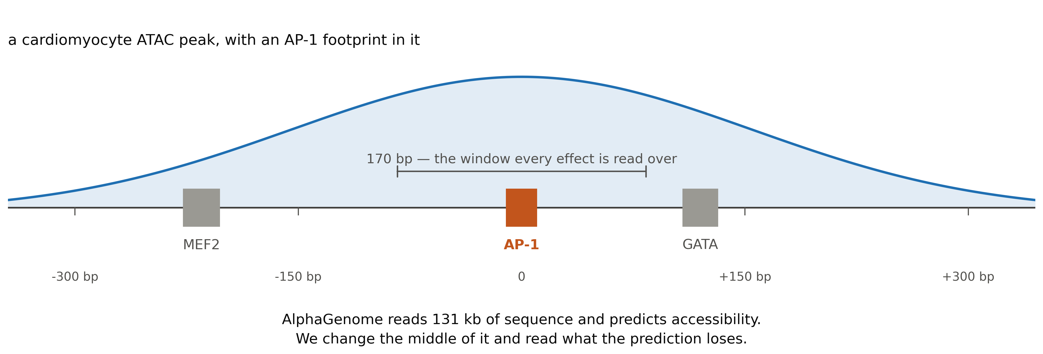
What one site looks like
3,678
364
772 / 2,907
cardiomyocyte AP-1 sites
edits of each one
Dynamic against Stable sites
Takeaway every edit is read as the change in predicted accessibility over the surrounding 170 bp
Notes:
The 131 kb window is what AlphaGenome takes as input; we only ever edit the middle 600 bp. Each tile is 3 replicate random replacements, averaged. Effects are log2(edited / native).

Slide 4
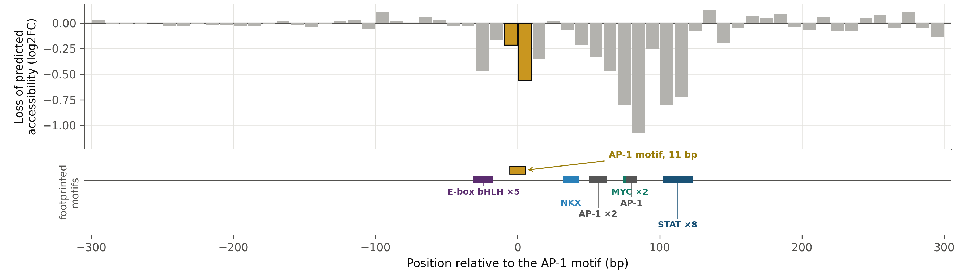
The same thing at one real element
Every 10 bp window from −300 to +300 bp is replaced by random bases in turn, three times, and the bar is what the prediction loses over the surrounding 170 bp. Gold is the called AP-1 motif. The lane below is every other footprinted motif TOBIAS calls in this element, which is what the windows are read against.
chr2:167,698,004 · the motif window costs −0.56 against a median of −0.66 across all 3,678 sites, and the deepest window is a neighbour — as it is at 69% of sites
Takeaway the motif is one window among sixty, and usually not the deepest — everything that follows is this, repeated over 3,678 sites
Notes:
A demonstration, not a result, but chosen to be typical rather than striking: the motif window, the total dependence and the deepest-neighbour pattern all sit near the median. An earlier version used a site in the top 8% for motif depth, which made the motif look far more dominant than it is. The footprint lane is every named family TOBIAS calls here, with overlapping calls of one family merged and counted; only the two catch-all bins (Other, Zinc finger other) are dropped. The same scan is also read over the 11 bp motif and over the whole peak, and the titration and single-base experiments run on the same 3,678 sites.

Slide 5
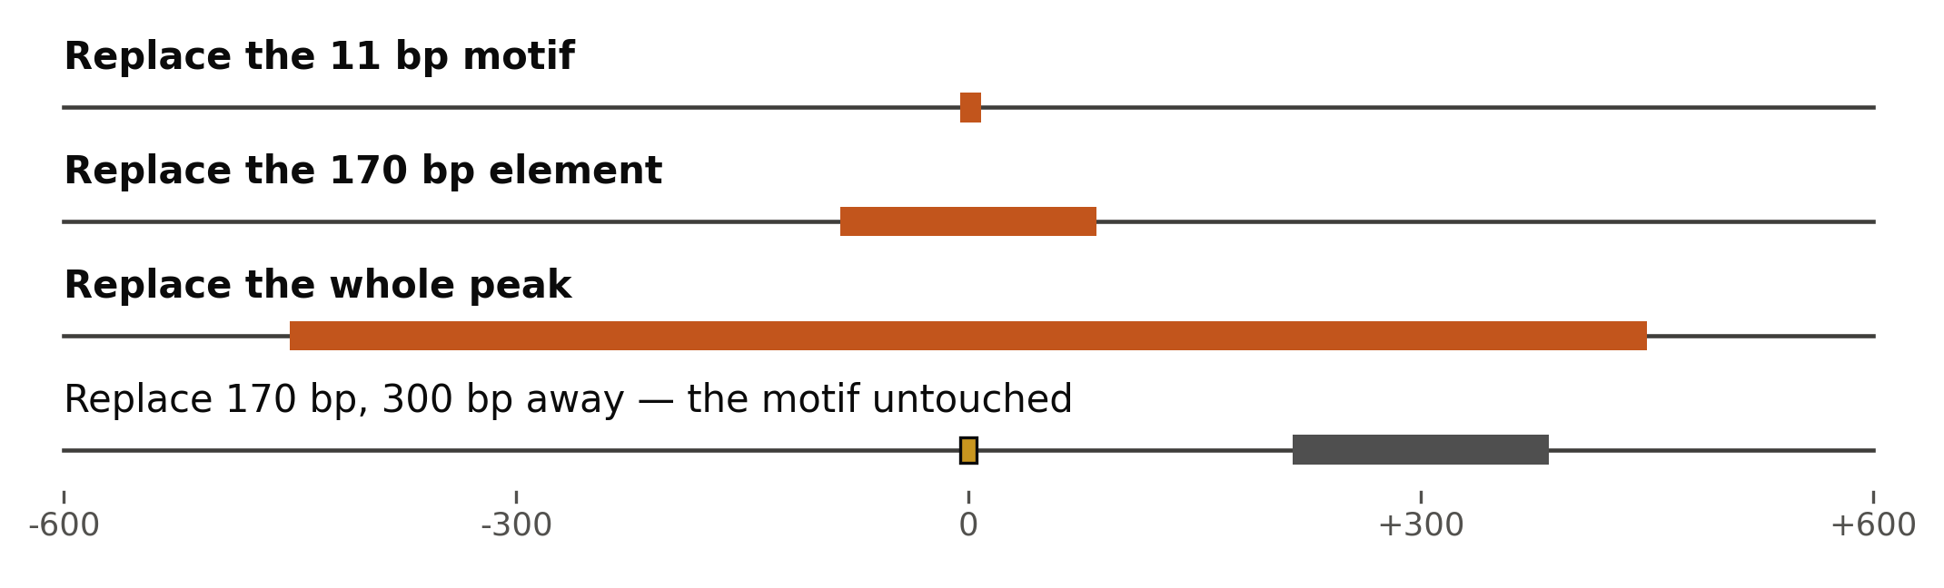
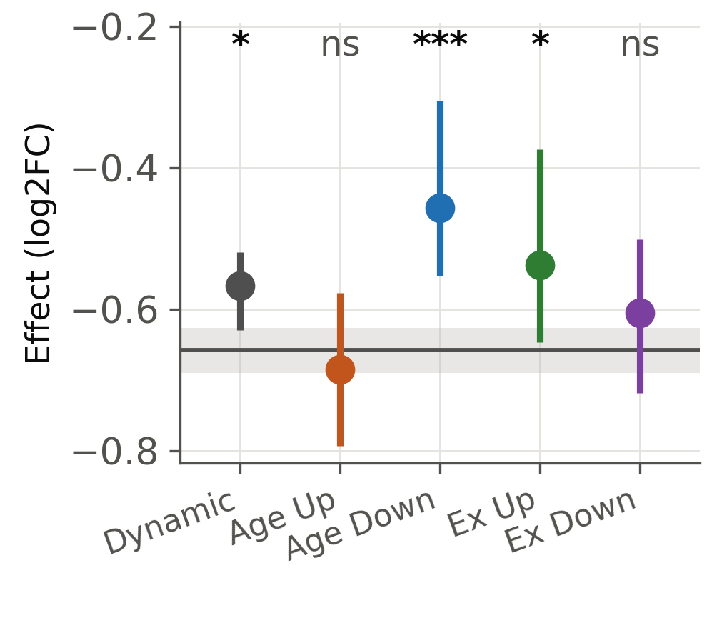
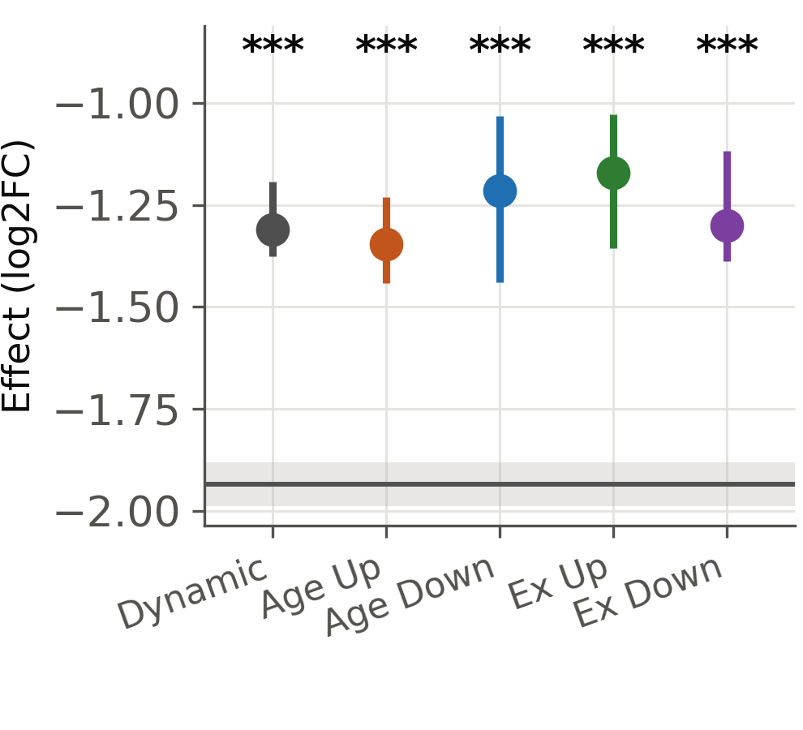
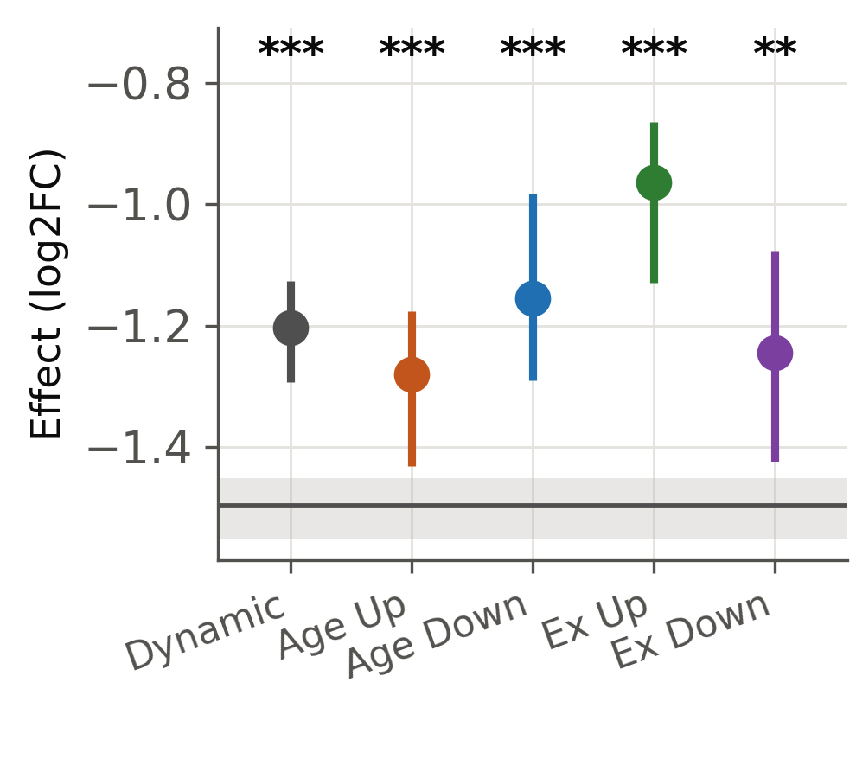
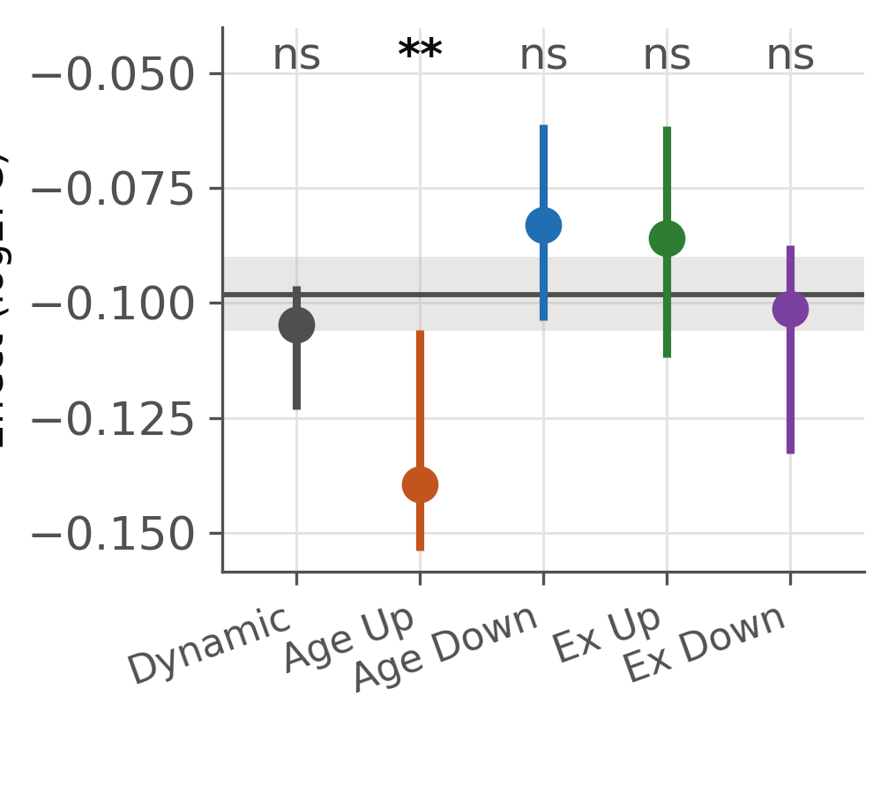
Responsive sites lose less to every edit of their element
The three edits, and the control
Replace the 11 bp motif
Replace the 170 bp element
Replace the whole peak
Edit 300 bp away
the motif alone
the element around it
everything, read over the peak
the control: nothing at stake
Dynamic (all)
Age Up
Age Down
Exercise Up
Exercise Down
Stable (all 2,907 sites)
grey line and band: all 2,907 Stable sites, median with a 95% bootstrap CI. Each class is every site carrying that call, tested against that reference by Mann–Whitney, BH across all 20 tests on this figure. *** p<0.001 ** p<0.01 * p<0.05 ns ≥ 0.05
Takeaway every class loses less than Stable sites do at every scale, and the 300 bp control shows it is not a global offset
Notes:
Top row is the uncontrolled comparison: if the accessibility difference is itself biology, it lives there. Bottom row matches each class to its own Stable controls on predicted and measured accessibility, peak width and TSS distance. The 300 bp control is the thing to check: Age Up differs slightly even there (-0.152 vs -0.111 matched), but that offset is 0.04 against a 0.26 effect at 170 bp and runs the opposite way, so it does not explain the result.

Slide 6

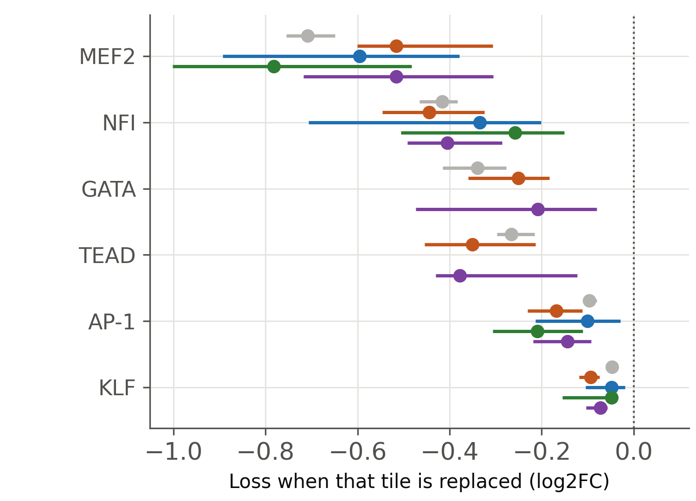
Both classes lean on the same partners
Stable
Age Up
Age Down
Exercise Up
Exercise Down
six families shown; tests run over all 20 class-by-family comparisons, smallest FDR 0.02
Takeaway the ranking is the validation — MEF2, GATA, NFI, TEAD, none of it told to the model; the class split is the question, and no class leans on a different partner
Notes:
2.49 million footprinted cardiomyocyte TFBS mapped onto the scan. Dynamic is split into its four directional classes because a gain and a loss could cancel in the pooled comparison. Tests run over all 88 matched class-by-family comparisons, not just the six families drawn. CTCF was reported as a lead earlier and is now retracted twice over: the original tile-level significance was pseudo-replication, and with the full scan and measured-accessibility matching the point estimate itself is zero (Dynamic -0.551 vs matched Stable -0.548, p = 0.98). The nearest thing to a real signal is MEF2 in Age Up, -0.53 against -0.84 in matched controls, p = 0.03 uncorrected, and in Exercise Down, p = 0.06 - the same two classes that are short of a close MEF2 on the previous slide. Neither survives correction on its own; they are worth quoting only because the proximity test points the same way.

Slide 7
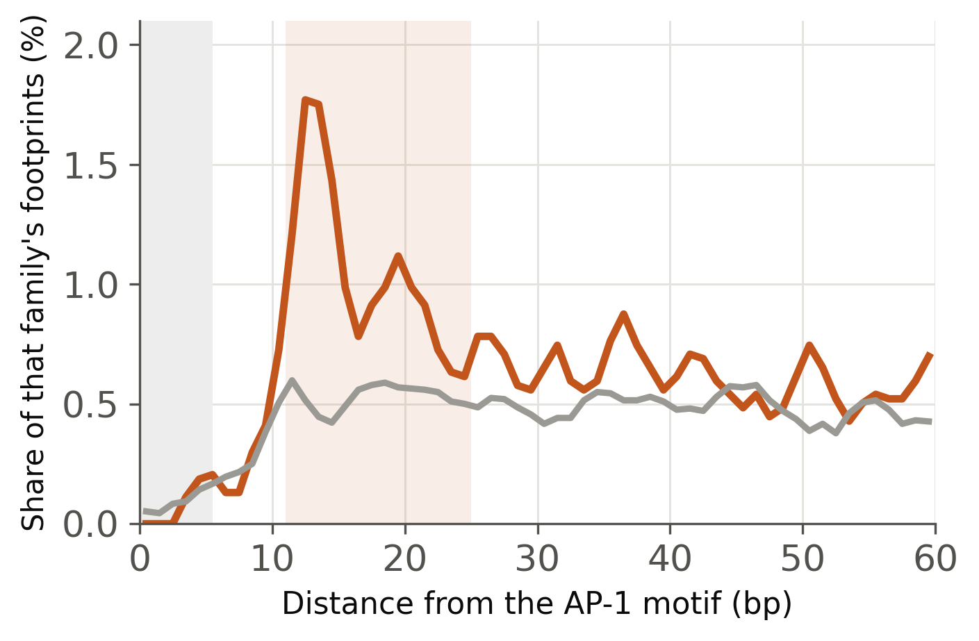
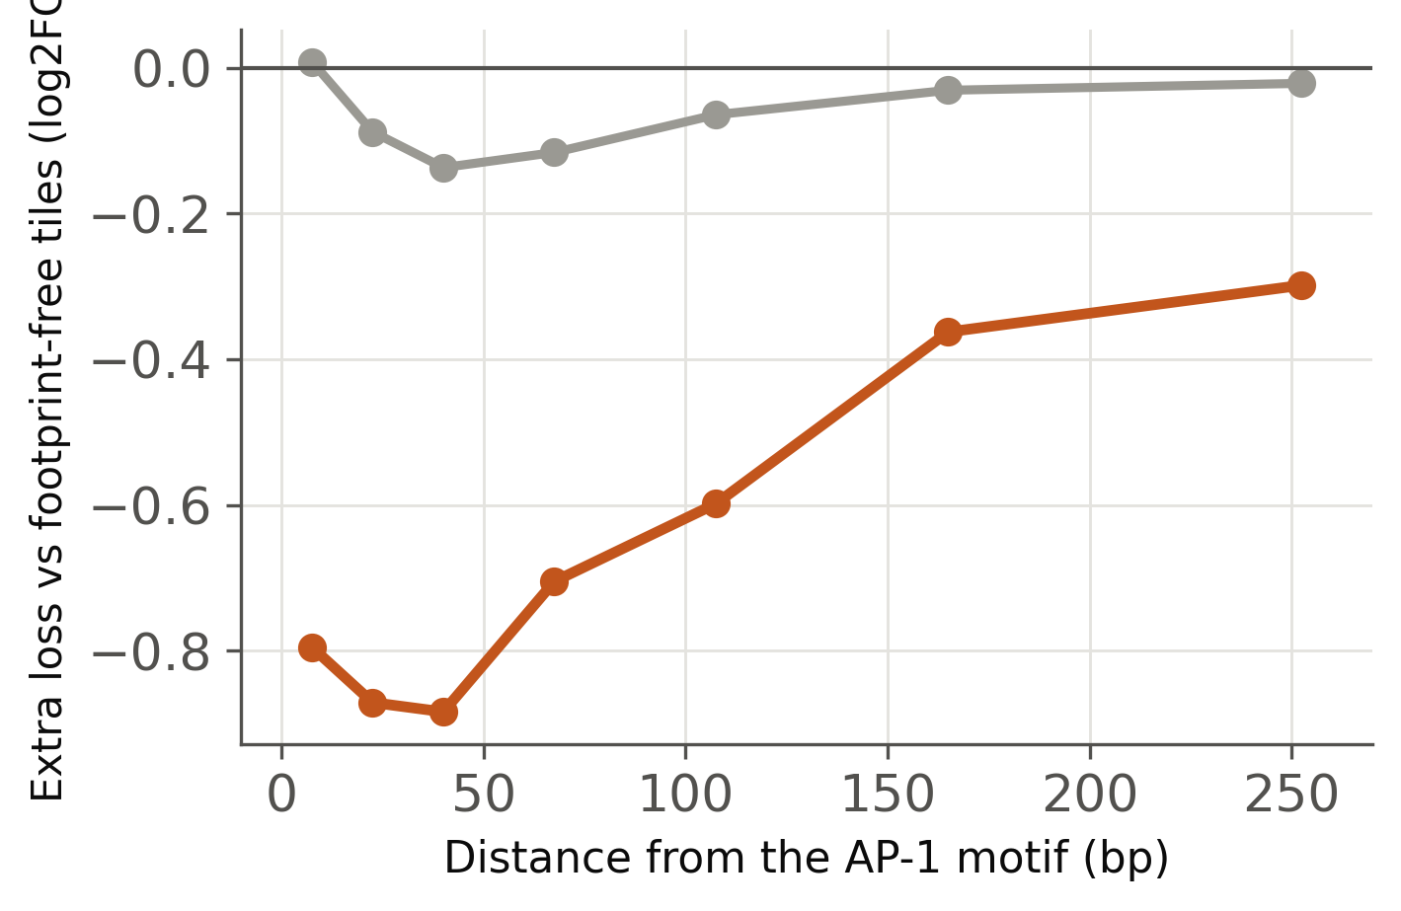
MEF2 sits right beside the AP-1 motif, and it matters
How often a partner sits there
How much it matters there
every footprint of that family, important or not
against footprint-free tiles the same distance away
MEF2
KLF / SP
shaded band on the left: 11–25 bp, where a neighbour abuts the motif. MEF2 is 2.67× enriched there against 1.47× for KLF/SP (FDR 0.004).
Takeaway MEF2 is 2.67× enriched at 11–25 bp and is worth −0.9 log2 there; KLF/SP is the commonest neighbour and is worth nothing anywhere
Notes:
Left panel counts every MEF2 footprint, important or not: it is occurrence, not importance. Middle panel is importance, measured against footprint-free tiles at the same distance, so the general fall-off with distance is removed. Right panel: 5.6% of Age Up sites carry a MEF2 footprint within 25 bp against 13.7% of their matched Stable controls (Fisher p 0.004, FDR 0.03); Exercise Down is similar but weaker. No 10-11 bp repeat survives correction, so no fixed protein-protein register.

Slide 8
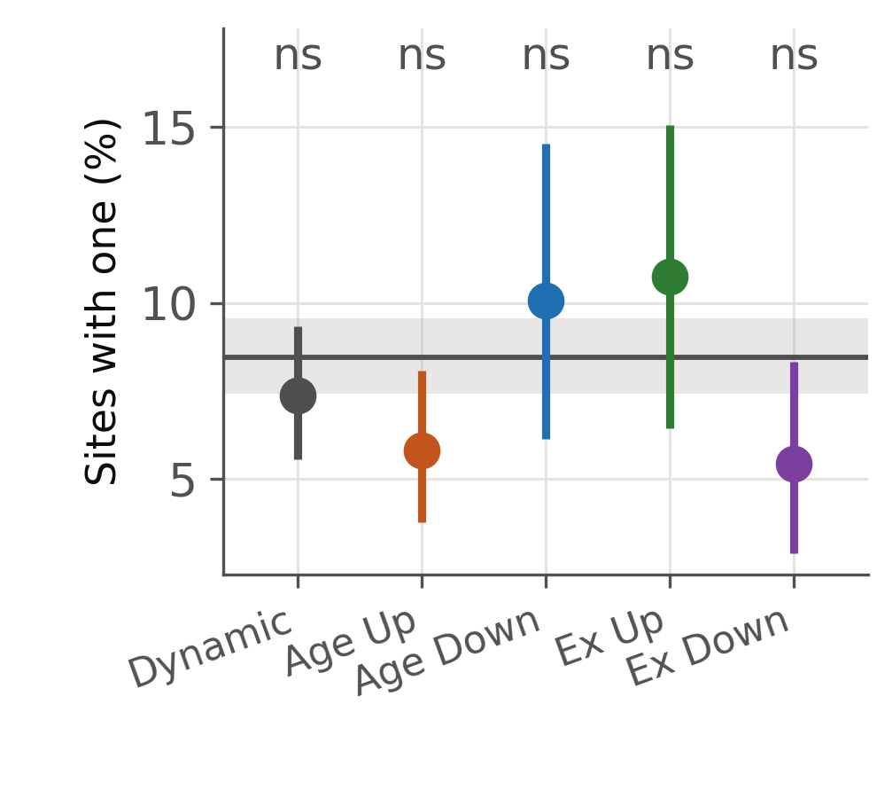
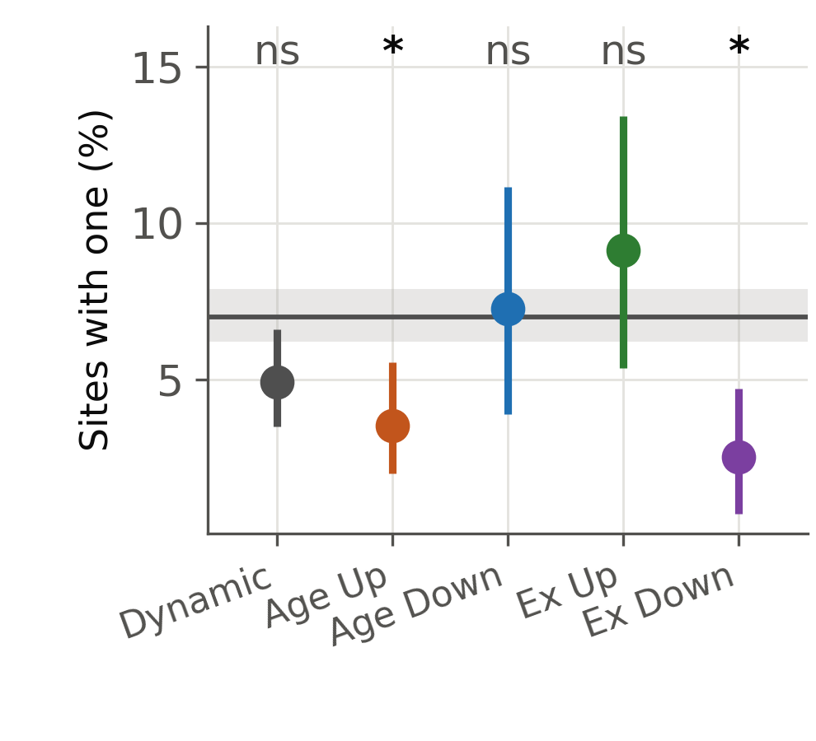
Age-gained sites are short of that MEF2
A MEF2 footprint within 25 bp
...one the model actually leans on
counting footprints, used by the model or not
restricted to tiles worth more than 0.2 log2
Dynamic (all)
Age Up
Age Down
Exercise Up
Exercise Down
Stable (all 2,907 sites)
grey line and band: all 2,907 Stable sites with a 95% bootstrap CI. Fisher's exact test against that reference, BH across all 10 tests on this figure. *** p<0.001 ** p<0.01 * p<0.05 ns ≥ 0.05
Takeaway Age Up 5.8% and Exercise Down 5.4% carry a close MEF2, against 8.5% of Stable sites — and the gap is sharper when only the MEF2 the model uses is counted
Notes:
Matched tests are exact McNemar on the paired sites, raw tests are Fisher, BH across all 20. Surviving: Age Up on both definitions (FDR 0.021 leaned-on, 0.045 footprint-present) and Exercise Down on the leaned-on definition (FDR 0.026); Exercise Down footprint-present does not (FDR 0.12). Age Down and Exercise Up show nothing either way. An earlier quote of p = 0.003 and p = 0.0005 for these came from Fisher applied to the matched groups as if unpaired; McNemar is the right test and gives p = 0.0021 and p = 0.0013.

Slide 9
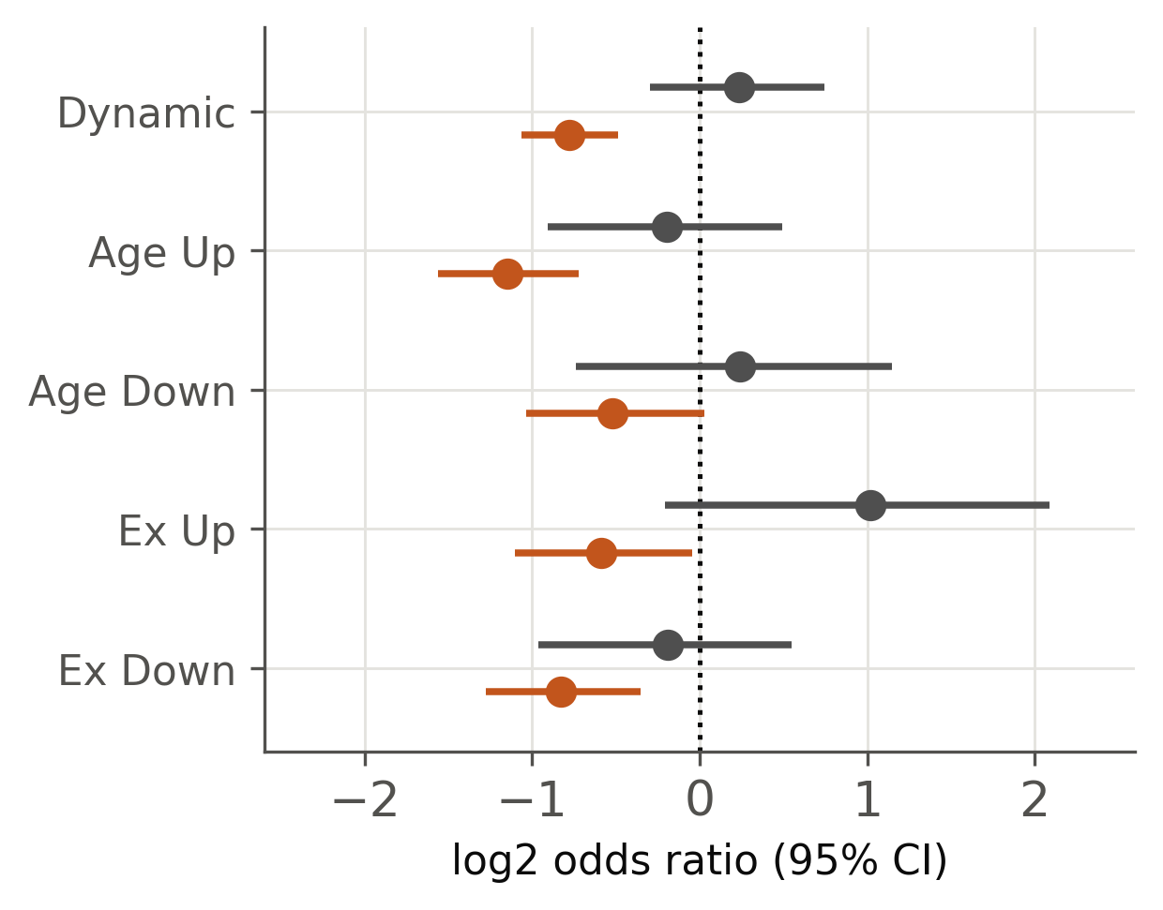
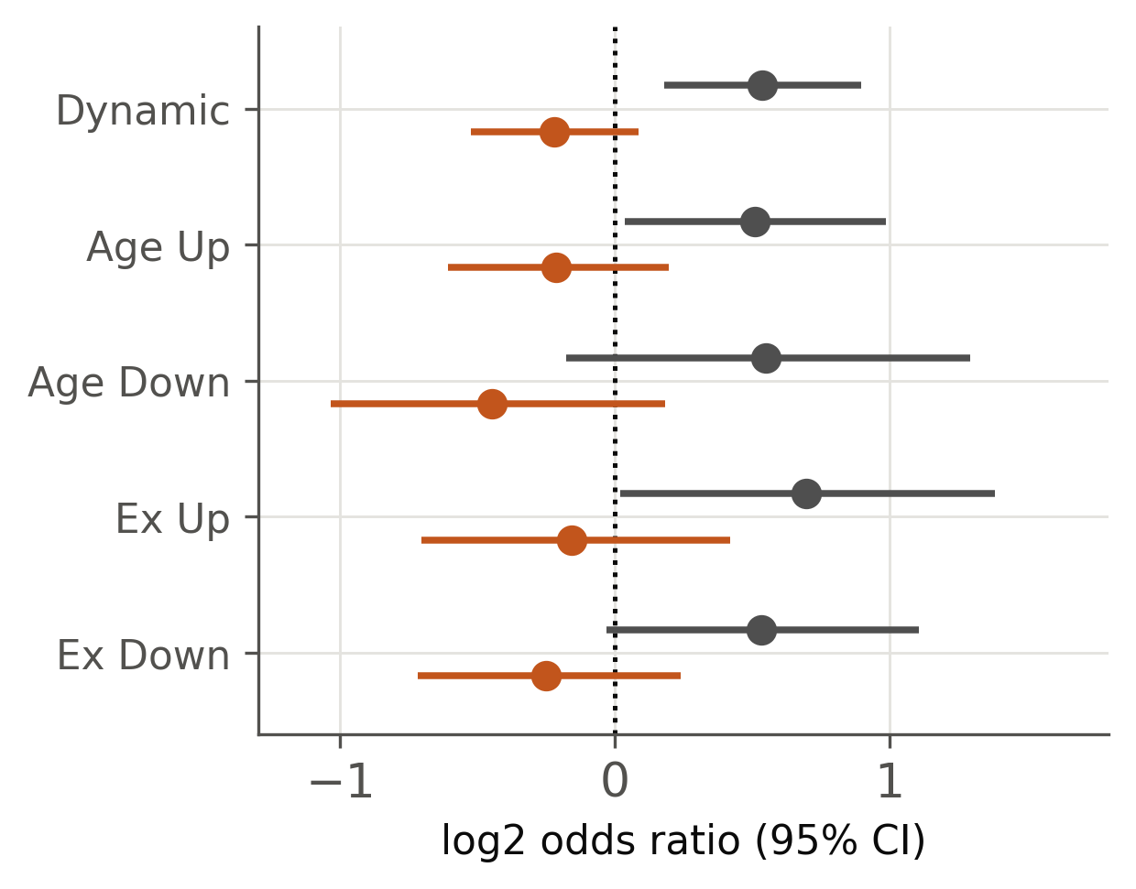
Is the partner missing, or just worth less?
Rank the 60 windows within each element, take the three most damaging, and ask whether any covers that family’s footprint. A within-element question, so a class with less total dependence is not penalised for it.
MEF2
A second AP-1 footprint
does the element have one at all
when it has one, is it ranked top
log2 odds ratio against all Stable sites with a 95% CI; dotted line = no difference, so −1 is half the odds and +1 is double. MEF2, does it have one: Age Up OR 0.45, Exercise Down 0.56, Dynamic 0.58, all FDR ≤ 0.005. AP-1, when it has one: Dynamic OR 1.45, FDR 0.036.
Takeaway the MEF2 deficit is about having one, not about how it is ranked — and responsive elements lean more on a second AP-1 site when they have one
Notes:
Presence vs rank is the point. MEF2, does the element have one: Dynamic OR 0.58, Age Up 0.45, Exercise Down 0.56, all surviving BH. Given a MEF2 is present, every class ranks it in the top three about equally often (0.87-2.03, nothing significant). AP-1 given present: Dynamic 1.45x, FDR 0.036, with the direction repeating in all four directional classes (1.43-1.62). CTCF is the reason to keep the matched analysis in the report even though it is off the slides: OR 3.0-6.5 here with FDR < 0.001, and exactly 1.0 once accessibility is matched.

Slide 10
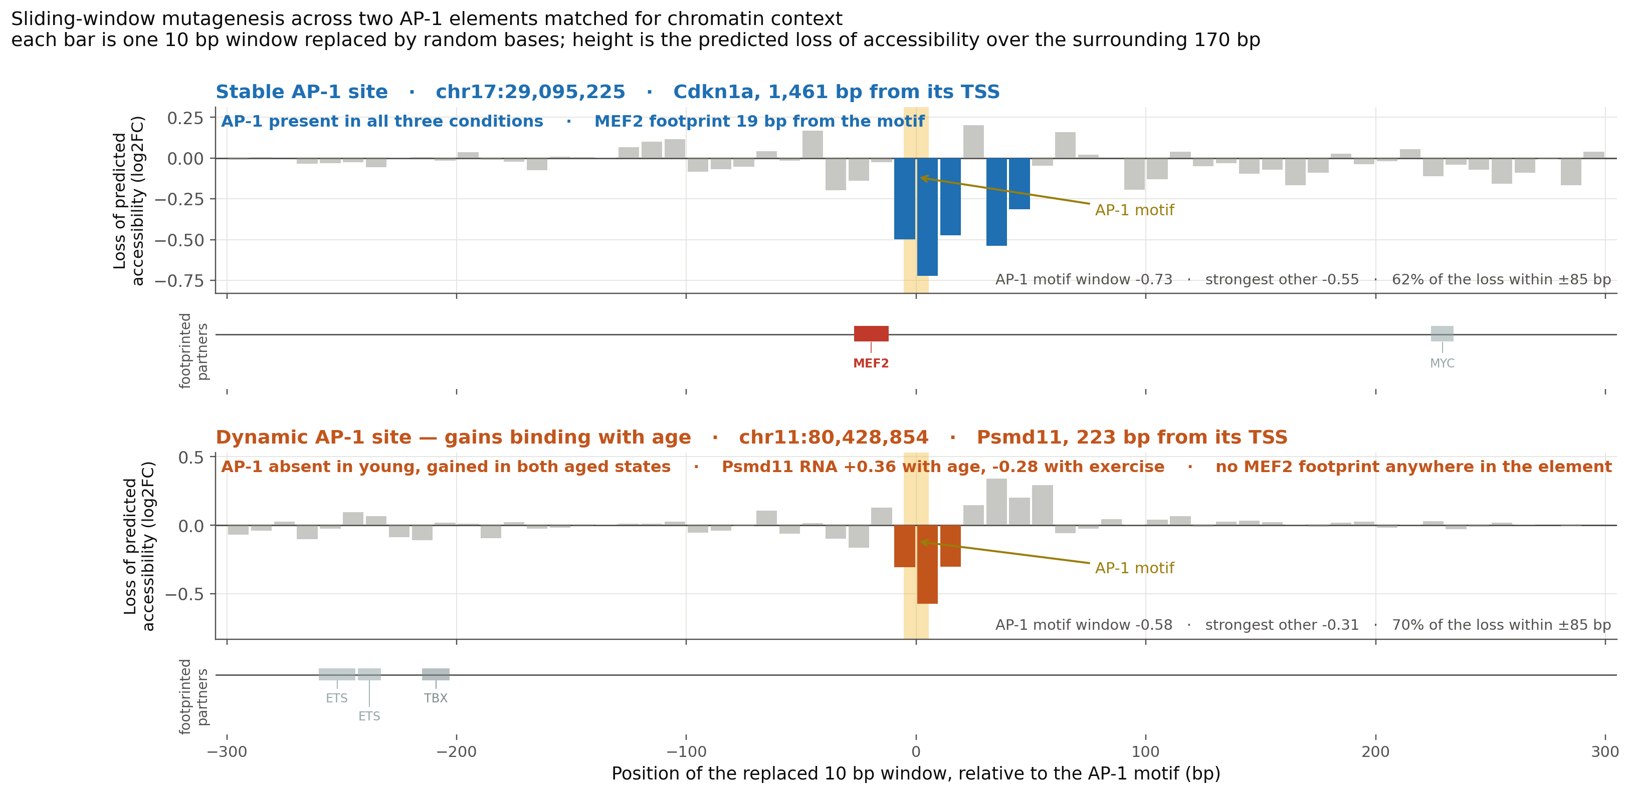
The same contrast at one pair of promoters
Takeaway the stable site has MEF2 abutting its AP-1 motif at 19 bp; the age-gained site has no MEF2 anywhere in the element
Notes:
Both are promoters a few hundred bp from a TSS, matched on predicted accessibility (0.96 vs 1.12) and peak width (1359 vs 1329 bp). At the Sqstm1 promoter AP-1 is bound in all three conditions, the motif window is worth -1.00 and 81% of the loss sits within 85 bp. At the Psmd11 promoter AP-1 is absent in young and gained in both aged states, the motif is still the strongest window but only -0.58, and the loss is smeared over 114 bp against 83. Psmd11 rises with age, matching the AP-1 gain; the exercise direction does not match, so do not claim it.

Slide 11
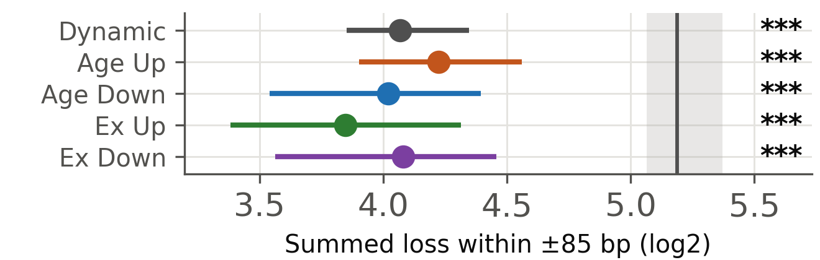
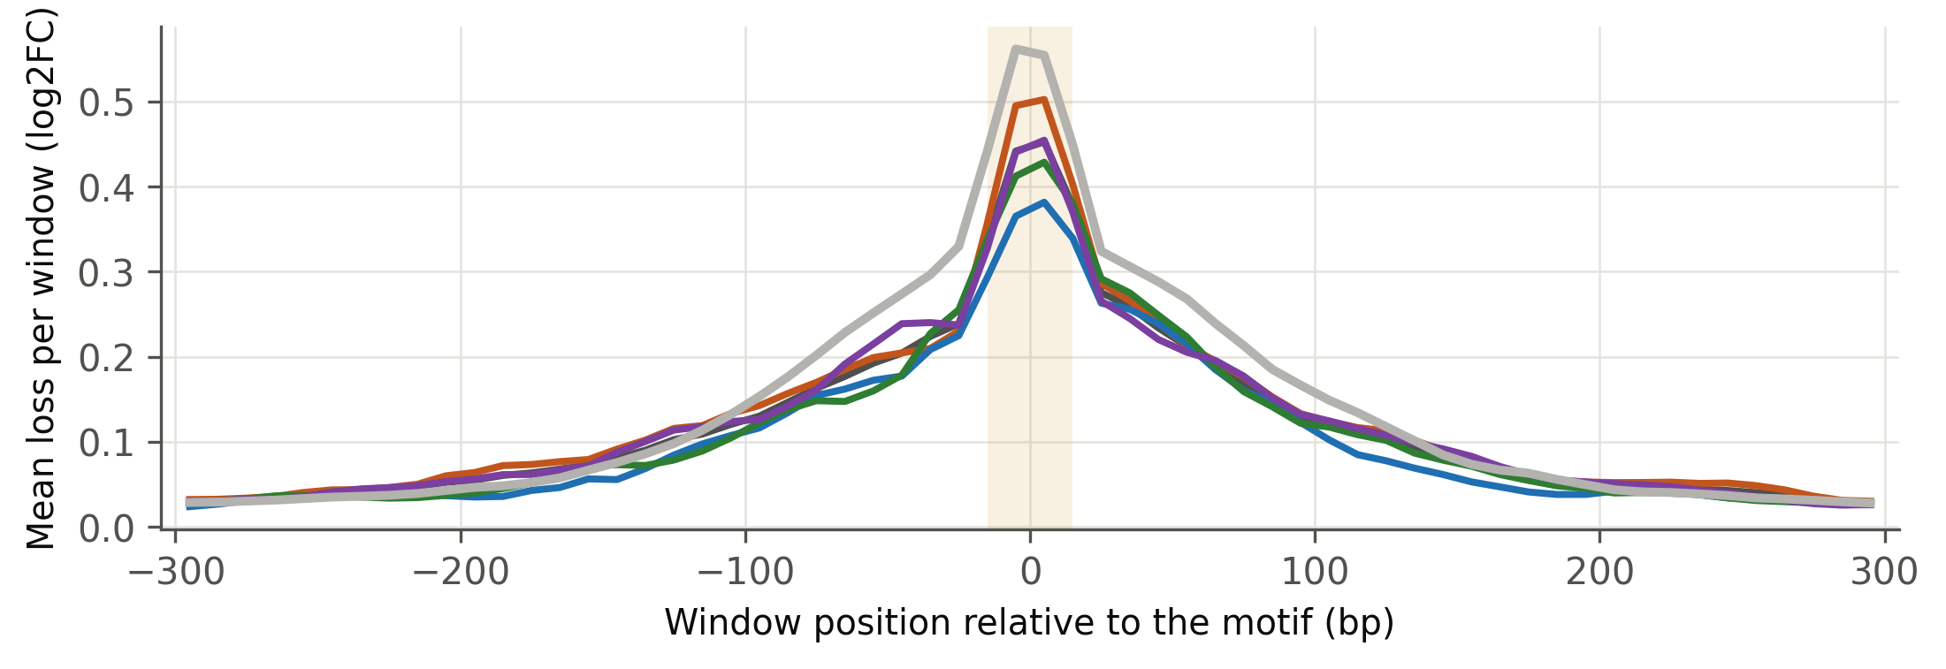
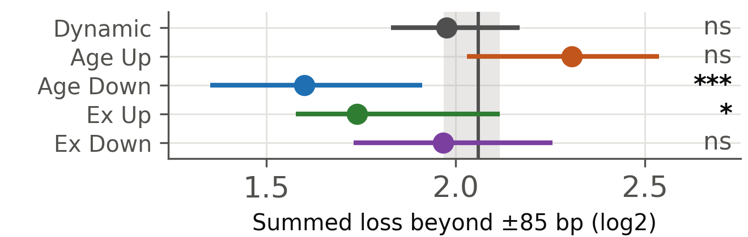
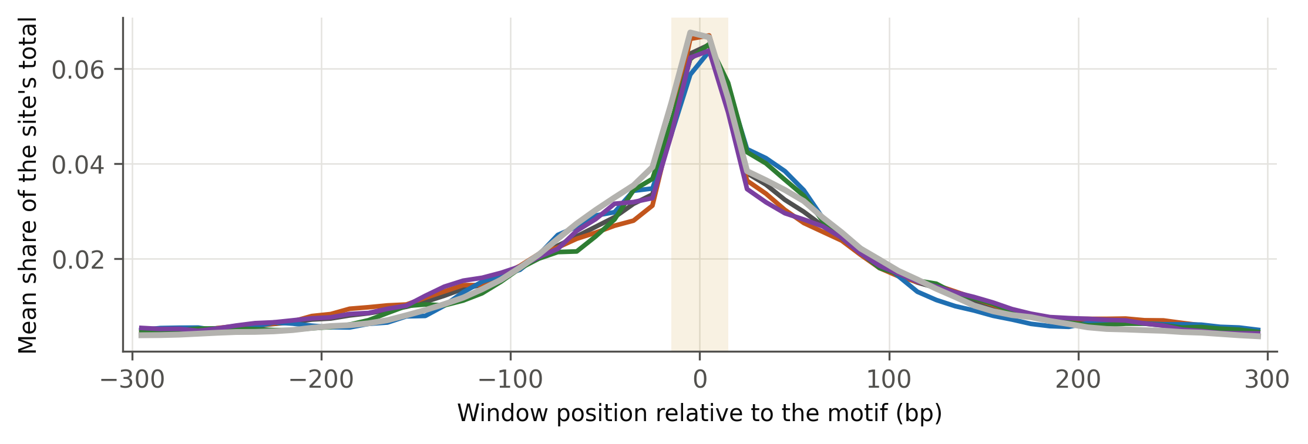
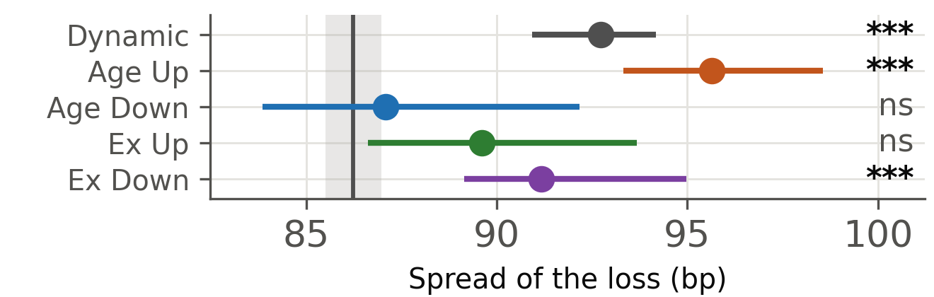
Responsive sites spread their dependence out
Where the dependence sits across the element
Dependence near the motif
mean loss at each of the 60 windows, smoothed over 3 — summed across windows, exactly the quantity on the right. Gold = the ±15 bp core.
Dependence out in the context
...and the same as a share of each site’s own total
depth divided out, so only the shape is compared
Spread along the element
Dynamic (all)
Age Up
Age Down
Exercise Up
Exercise Down
Stable (all 2,907 sites)
Takeaway Stable sites peak highest at the core; Age Up, Exercise Down and Dynamic carry more of their dependence out in the flanks — Age Down simply has less of everything
Notes:
The profiles are means, not medians, so the area under a curve equals the per-site totals in the panels on the right; with medians the two panels are different functions and do not correspond. Note where the difference lives: at the single deepest window Stable and Age Up are almost identical (0.68 vs 0.63 mean), and the 18% gap in loss within 85 bp comes from the shoulders, not the peak. Spread is the standard deviation of window position when each of the 60 windows is weighted by its share of that site's total loss, measured about the centre of mass of the loss rather than about the motif. For scale: all the loss in one window gives 0 bp, confined to the central 90 bp gives 26, to the central 170 bp gives 49, and spread evenly over the whole 600 bp gives 173. Observed values run 29 to 216 with a median of 87, so a typical element draws on a window well over 100 bp wide.

Slide 12
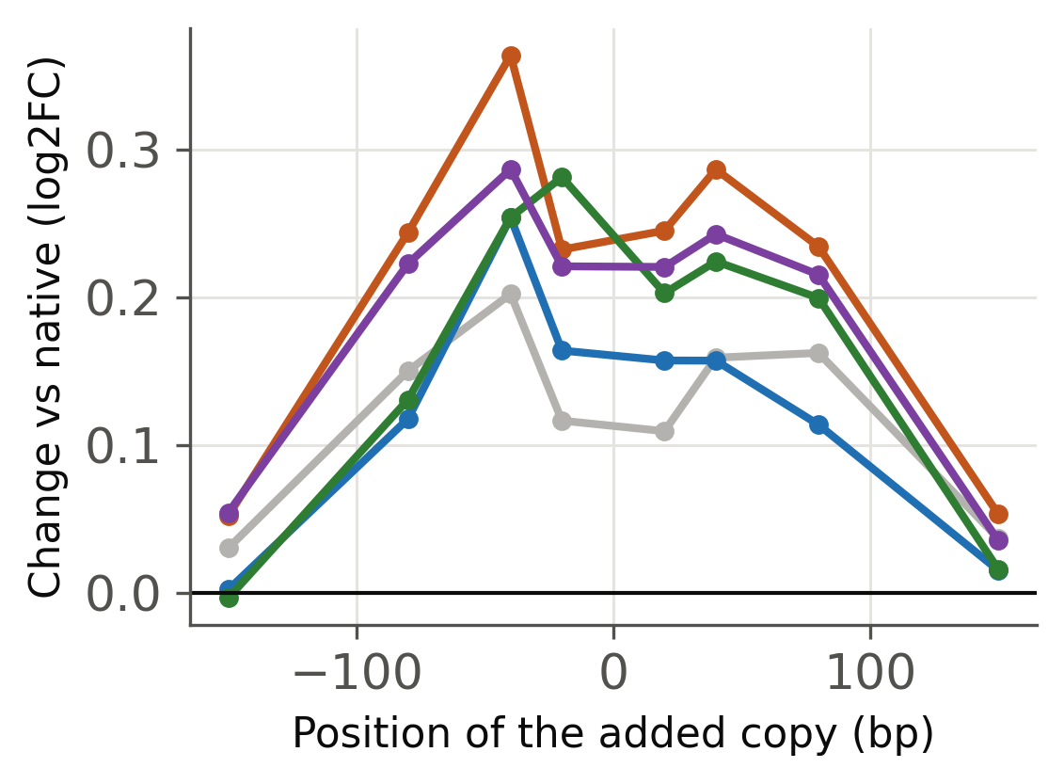
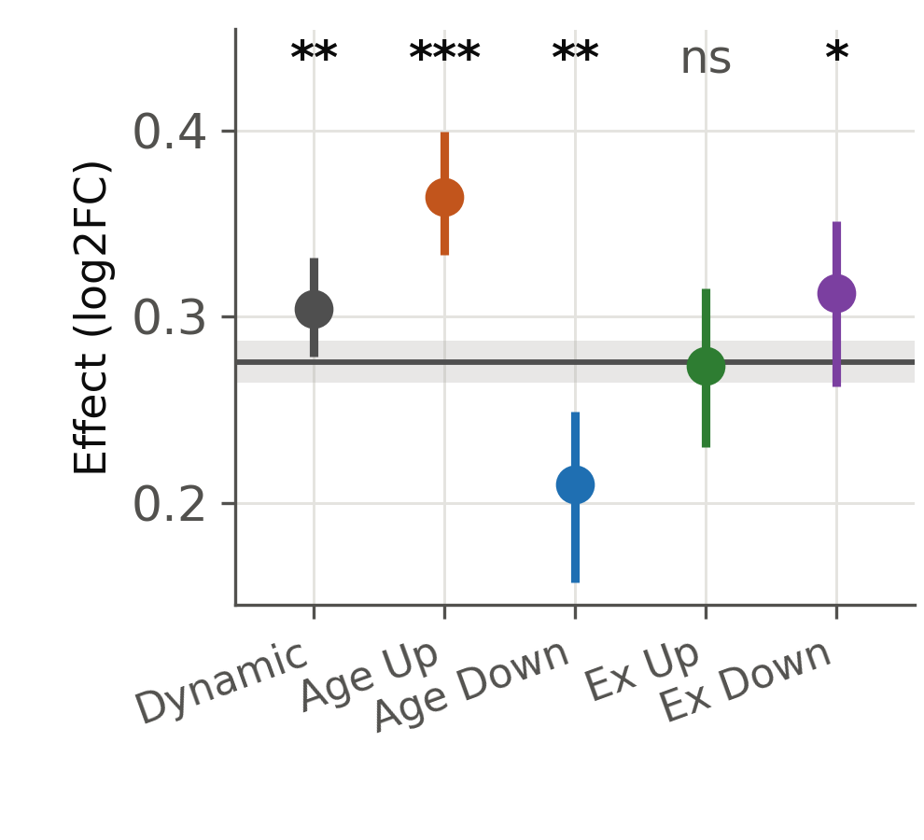
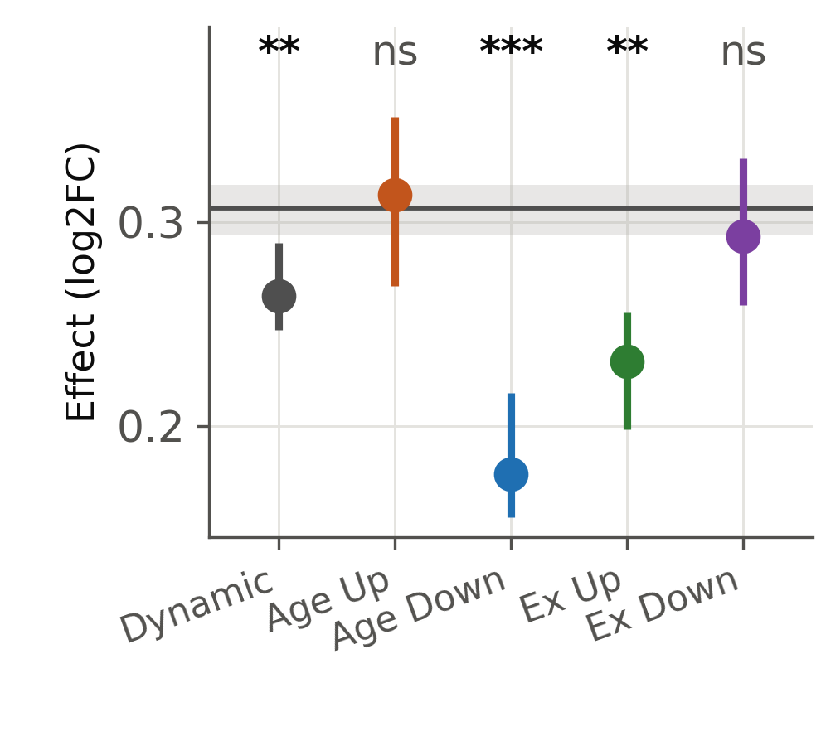
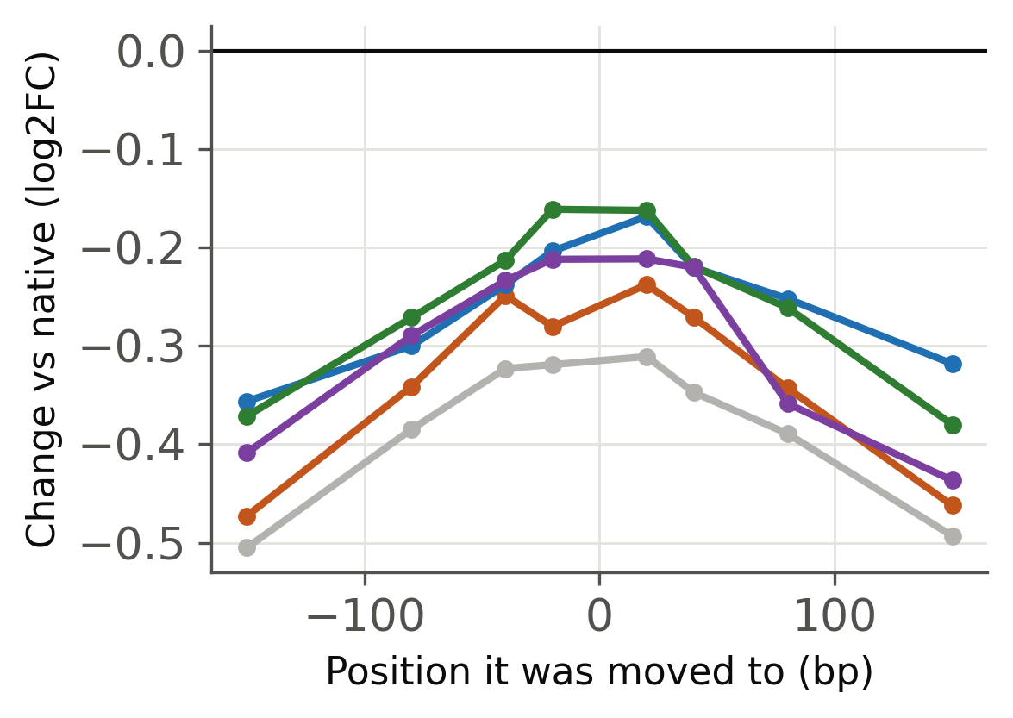
Position is a dial, and a moved motif never replaces the original
Where the added copy works best
A second copy added
The motif moved elsewhere
net of a shuffled-sequence control
the motif destroyed and re-inserted, net of the same control
...and where it lands when moved
Dynamic (all)
Age Up
Age Down
Exercise Up
Exercise Down
Stable (all 2,907 sites)
grey line and band: all 2,907 Stable sites, median with a 95% bootstrap CI. Each class is every site carrying that call, tested against that reference by Mann–Whitney, BH across all 10 tests on this figure. *** p<0.001 ** p<0.01 * p<0.05 ns ≥ 0.05
both curves drawn once per class; colours as in the legend
Takeaway a second copy is worth most at ±20–40 bp and a moved motif recovers only a third of what destroying it cost
Notes:
The 1-base and 7-base core results are not repeated here: they say the same thing as the motif shuffle on the earlier slide. One wrong base costs -0.45 of the -0.56 total, the dose slope tracks core quality read from the genome at rho 0.30, and orientation is irrelevant as expected for a near-palindrome.

Slide 13
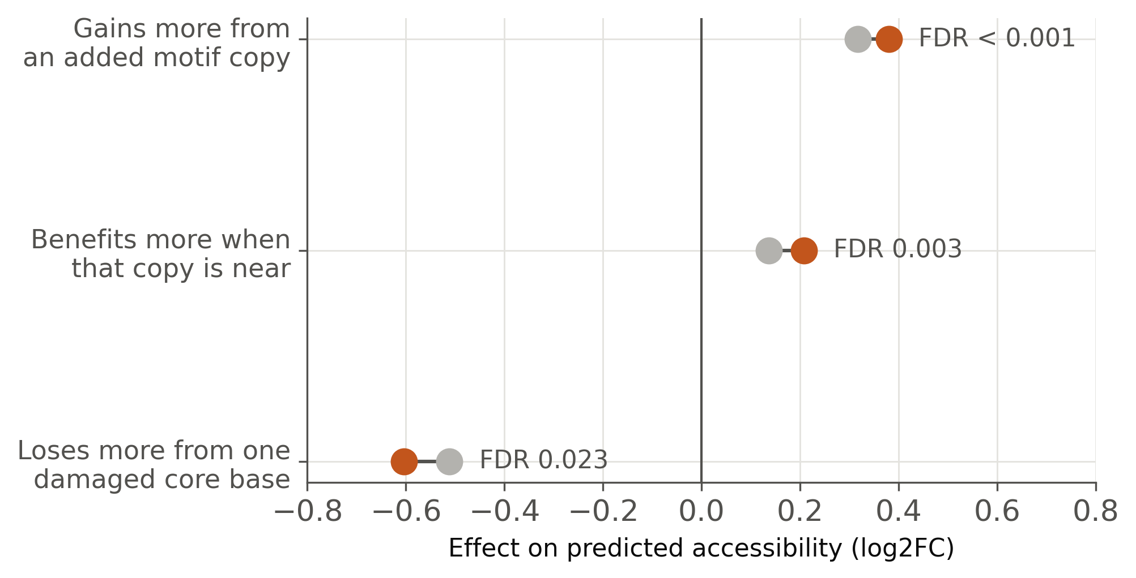
Age-gained sites read AP-1 dosage more sharply
Age-gained sites respond more to AP-1 dosage, both ways
Δscore definition: the top fifth of the change in TOBIAS binding score with age, against matched Unchanged sites
Matched Unchanged
Age-gained (Δscore)
Mass action if ageing raises AP-1 activity, occupancy rises first at the highest-affinity motifs — exactly the sites that gain. Losing binding is not the reverse: age-lost sites show no sequence signature at all.
Notes:
The titration experiment was designed before this hypothesis existed, so this is a prediction rather than a fit. Caveat: the motif-sensitivity result does not survive matching on measured accessibility; the core-quality result does.

Slide 14
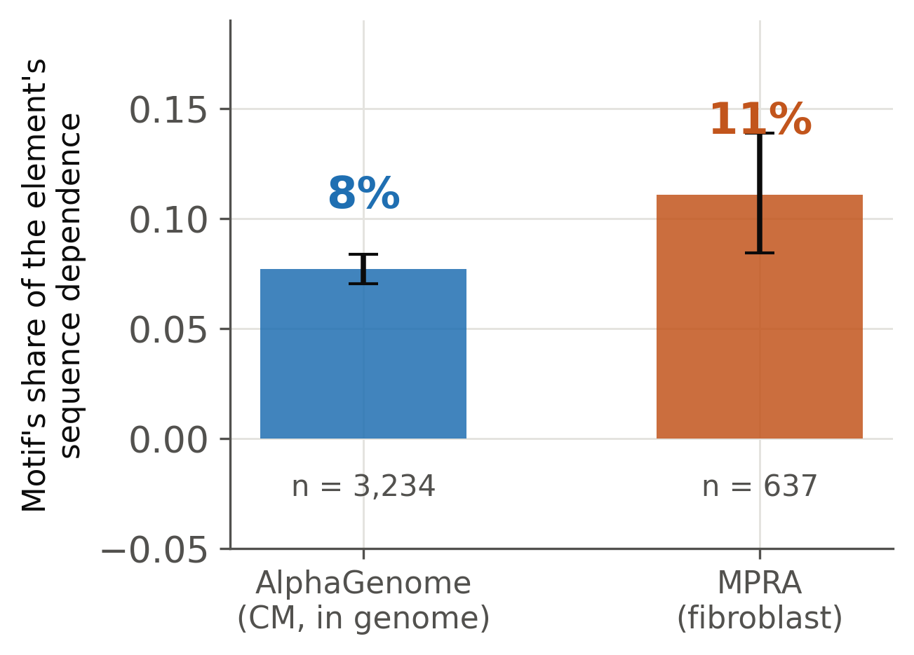
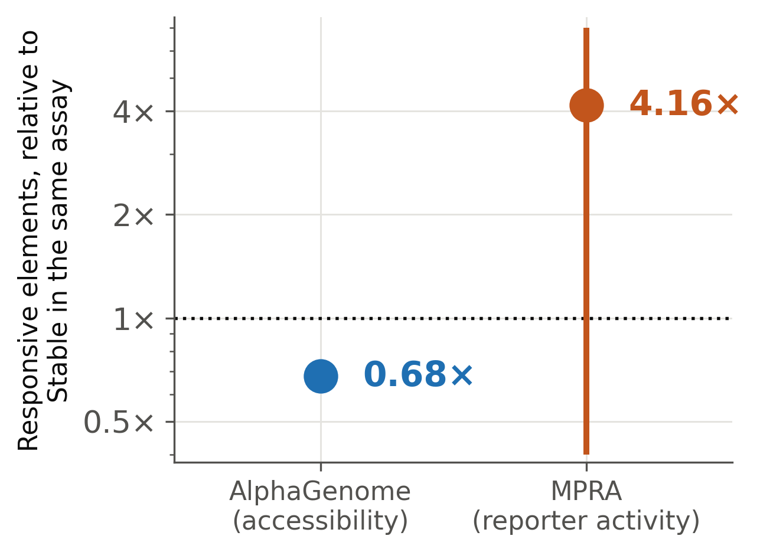
An independent reporter assay agrees
7.5%
9.3%
AlphaGenome: the motif's share of local dependence
fibroblast MPRA: the same quantity, measured in the lab
Same answer: the motif is a small part
But they disagree on which elements depend more
below 1×: responsive elements lose less than Stable ones · above 1×: they lose more · both p < 0.001
Takeaway two assays, different cell types and readouts, both put the AP-1 motif under a tenth of its 170 bp surroundings
Notes:
The comparable quantity is a ratio within each element, so assay scale cancels. The class direction disagrees: in the MPRA responsive elements depend MORE on their sequence, which separates intrinsic potential from what sets accessibility in the genome.

Slide 15
What this changes
A responsive AP-1 site is a marginal one, not a differently-built one
Weaker AP-1 motif, fewer AP-1 motifs around it, and its dependence spread thinly across the element instead of anchored on the motif. The same partners matter, in the same order, in every class.
Two things survive matching, and only two
Scale: the 11 bp motif and the whole peak are worth the same to both classes, but replacing the 170 bp element costs a Dynamic site 0.24 less — what you expect when the dependence is spread wider. Partner: age-gained sites lack a MEF2 abutting the motif, 5.6% against 13.7% of matched controls.
That is why it fluctuates
A weak motif with no close MEF2 to hold it sits near the occupancy threshold, so its binding tracks how much AP-1 protein is available — which is what ageing changes.
Gain and loss are different events
Age-gained sites have better cores and read AP-1 dosage more sharply. Age-lost sites show no sequence signature of their own.
Notes:
The mutation-response profile is a null and a well-controlled one: given the same chromatin, the two classes lose the same amount to the same kind of edit. What is not null is the scale at which that is true and the one missing partner.

Slide 16
Where this goes next
Fine-tuned condition-aware head
A frozen-trunk probe on our own cardiomyocyte and fibroblast ATAC already reaches profile r = 0.65 against 0.59 for the built-in heart head, training 0.01% of the model. Next: 1 bp insertion targets, then LoRA.
Does AP-1 activity actually rise with age?
The mass-action reading rests on it. One check against the RNA.
Fibroblast scan
If MEF2 also tops the partner ranking in fibroblasts, the ranking is a model artefact rather than cardiac biology. This is the sharpest available control.
Notes:
Also open: whether the MEF2 deficit at Dynamic sites is detection or genuine differential occupancy of equally-present motifs.

