Slide 1
AP-1 sites in cardiac fibroblasts
What AlphaGenome says separates Stable from Dynamic sites
Fine-tuned 1 bp ATAC head (held-out Spearman 0.68, against 0.27 for the built-in head) · 5,018 fibroblast AP-1 sites · all effects are predicted accessibility, not measured
Notes:
Everything here is in silico: AlphaGenome's predicted ATAC signal after we edit the sequence. The head was fine-tuned on our own 1 bp Tn5 insertion data with Borzoi fold-3 region-based splits, so the numbers quoted are on held-out regions. Site classes are the TOBIAS categories as given - Stable = bound in all three conditions; Dynamic = anything else; Age Up / Age Down are the directional age classes.

Slide 2
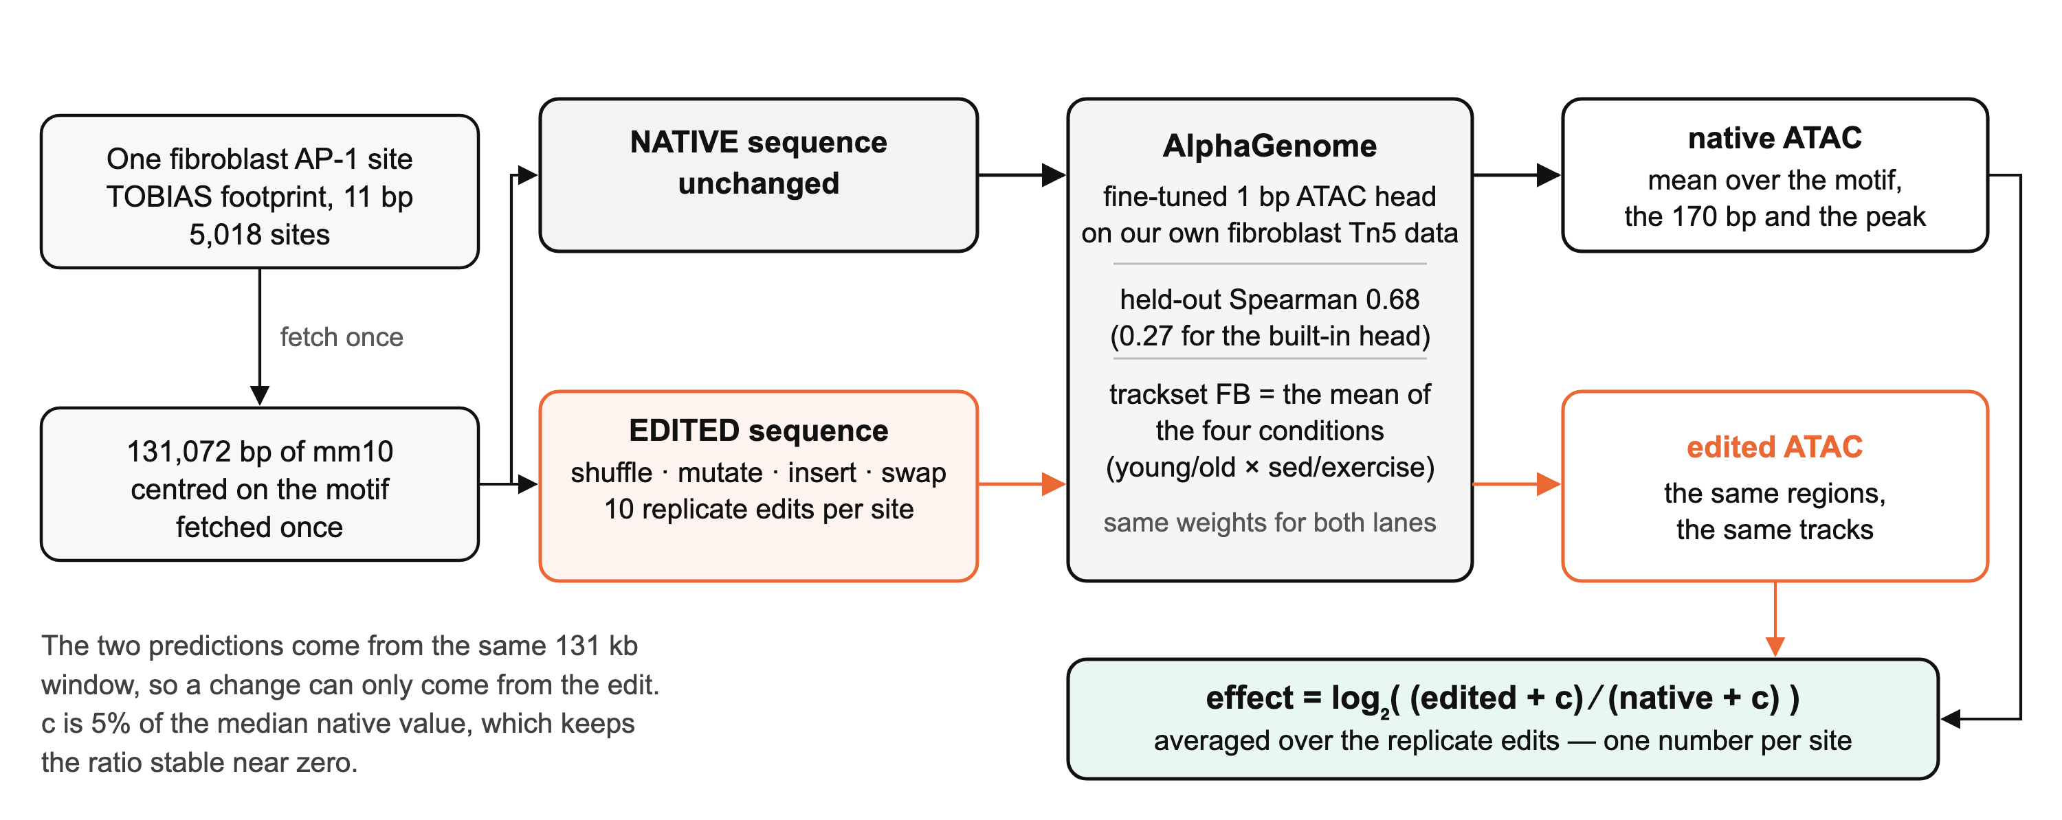
Everything here is one prediction minus another
No edit is ever compared against another site. The native and the edited sequence are the same 131 kb window through the same weights, so whatever changes in the prediction came from the edit.
Notes:
Worth saying out loud at the start, because it is what makes the rest defensible: the comparison is always within one window, and the model never sees a label.
The head is ours - fine-tuned on our own 1 bp fibroblast Tn5 insertions with Borzoi fold-3 region-based splits, so 0.68 is on held-out regions. The built-in AlphaGenome ATAC head manages 0.27 on the same data, which is why none of this was run on it.
FB is the mean of the four conditions (young/old x sedentary/exercise), not a single track.
TOBIAS is used only to say WHERE a footprint is and which family it belongs to. No footprint score enters any calculation on these slides.

Slide 3
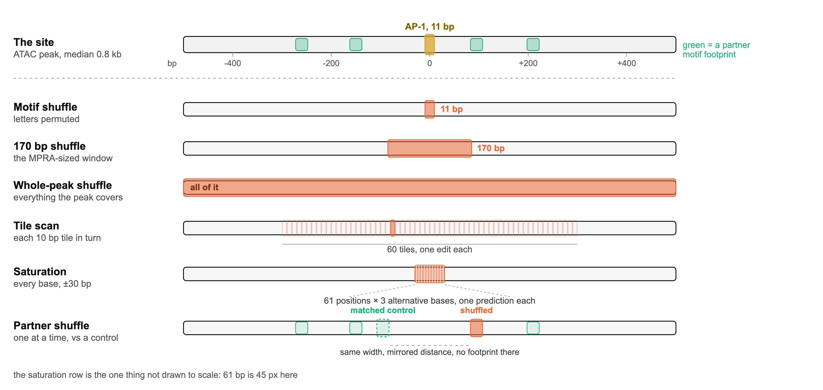
Edits made where the element stands
Three widths of shuffle, a tile scan across 600 bp, single-base saturation, and one partner motif at a time against a footprint-free window of the same width at the mirrored distance.
Notes:
Reading order: the three shuffles ask how much sequence you have to destroy; the tile scan and the saturation ask where in the sequence the dependence lives; the partner shuffle asks which other motifs matter.
The partner control is the part to dwell on. Dynamic sites are about half as accessible as Stable ones, so any measure that compares a Dynamic number against a Stable number is open to that confound. Scoring a shuffled partner against a matched footprint-free window at the mirrored distance keeps the whole comparison inside one site, so accessibility cannot reach it.
Every shuffle is repeated 10 times per site and averaged, so a single lucky permutation cannot carry a result.

Slide 4
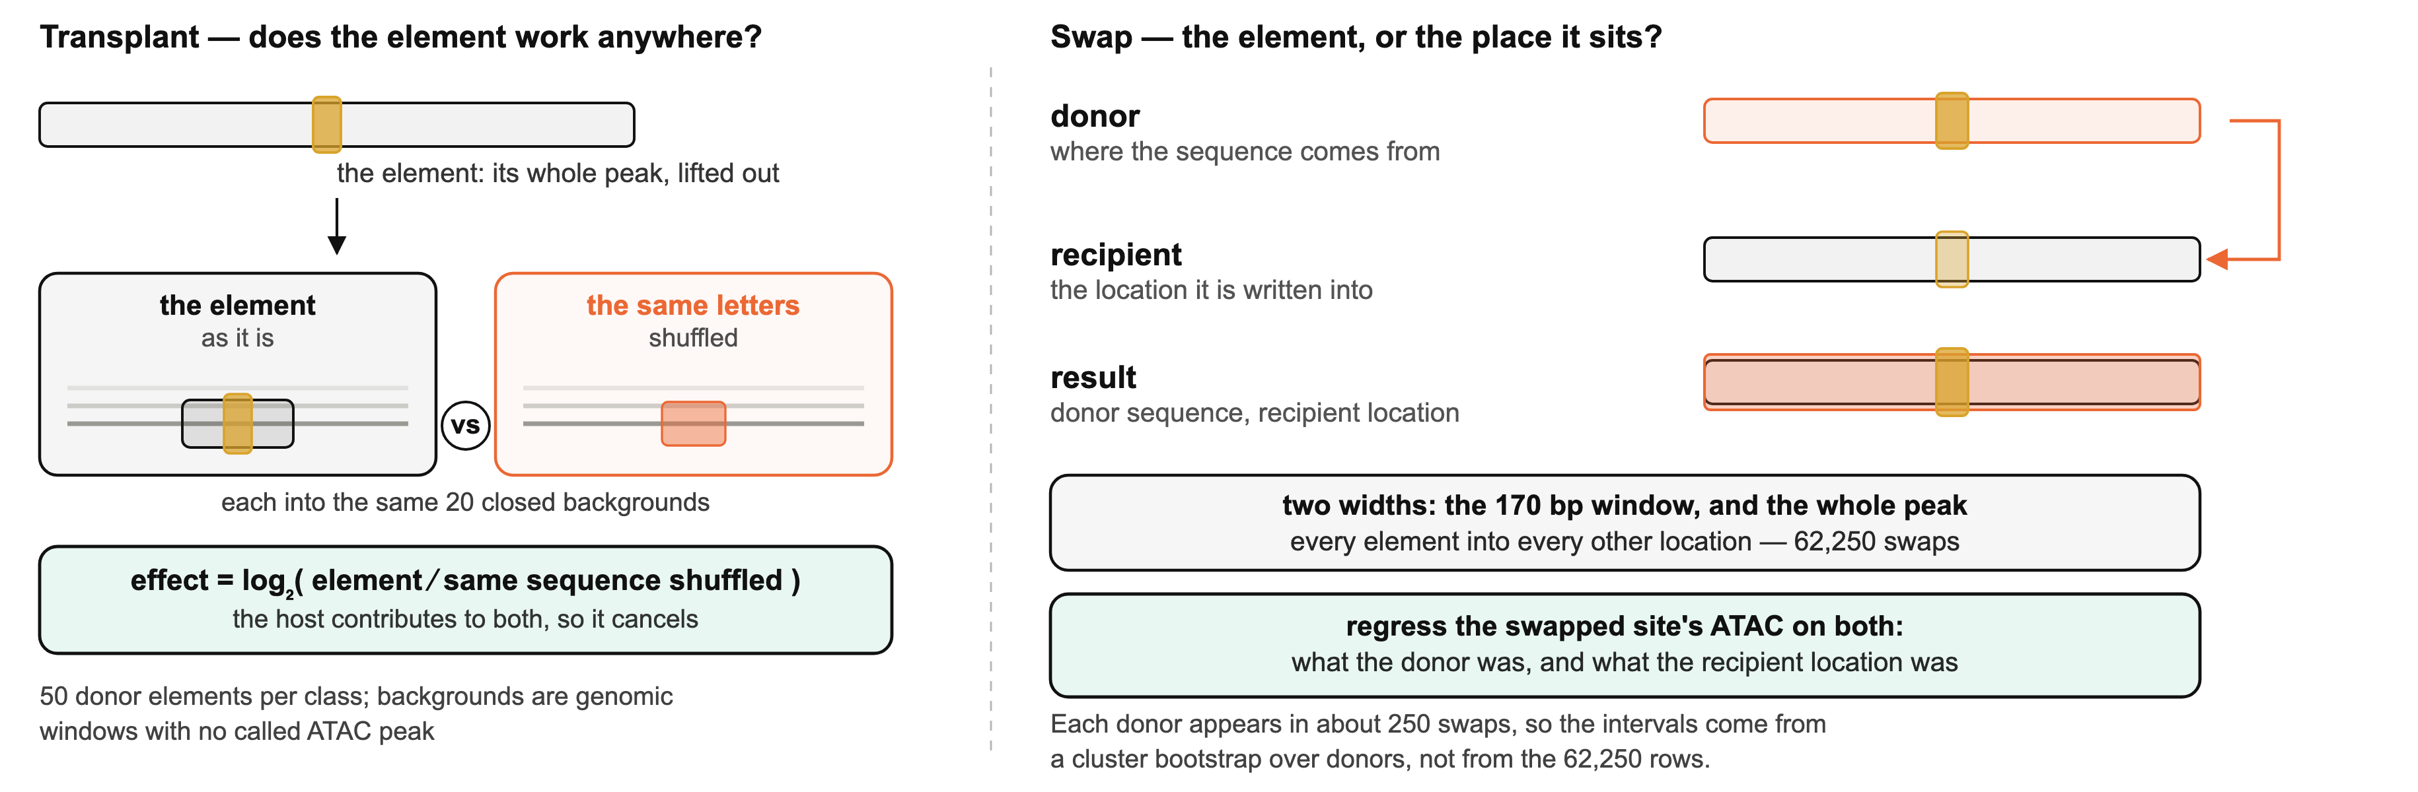
Edits that move the element somewhere else
Transplant asks whether an element can build a site on its own, by dropping it into chromatin that has none. Swap asks whether a site's level is set by the sequence or by the address.
Notes:
Transplant: the control is the SAME sequence shuffled, dropped into the SAME host, so the host's own contribution cancels in the ratio. 20 hosts per element, 50 donors per class. Hosts are genomic windows with no called ATAC peak.
Swap: every donor element written into every recipient location, both at 170 bp and at the whole peak, 62,250 combinations. Self-swaps are excluded. Because each donor appears in about 250 of those rows, the confidence intervals come from a cluster bootstrap over donors - an OLS standard error on 62,250 rows would be far too small.
Caveat to have ready for the transplant slide: the donors are NOT matched on accessibility. That is handled separately and the slide carries the matched number.

Slide 5
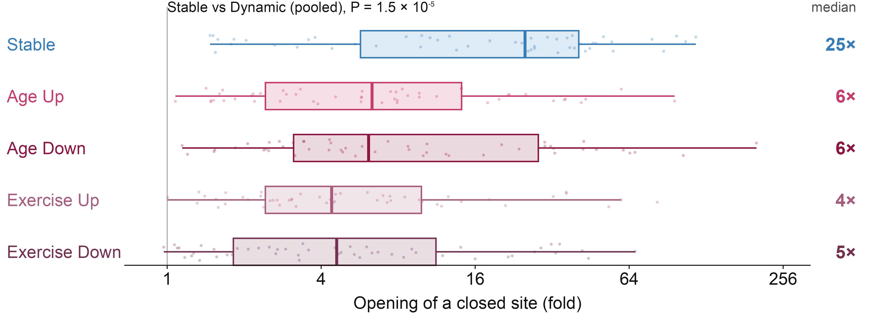
A Stable element opens closed chromatin on its own
Each element moved into 20 closed backgrounds and scored against the same sequence shuffled; one point per donor, whole-peak width. Box, median and IQR, whiskers 1.5 × IQR; 50 donors per class — Up = AP-1 gained, Down = AP-1 lost; Mann–Whitney, Stable against the four Dynamic classes pooled.
Stable AP-1 elements carry enough sequence to build their own accessible site. Dynamic ones do not — they need the neighbourhood they came from. That is "context, not sequence autonomy", shown by moving the sequence.
Stable donors also come from more accessible loci. Holding that constant (measured ATAC, 224 donors) a Stable element still gains 1.8× more than a Dynamic one, P = 0.005 — the direction holds, but about a third of the gap above is accessibility rather than sequence.
Notes:
Per-donor medians over 20 hosts: Stable +4.65 log2 (25x), Dynamic pooled +2.35 (5.1x), p = 1.5e-5.
By class, as plotted: Stable 25x, Age Up 6.3x, Age Down 6.1x, Exercise Down 4.6x, Exercise Up 4.4x. Every Dynamic class sits well below Stable and they are close to each other, which is why pooling them is fair here.
IMPORTANT CAVEAT, be ready for this question: the donors are not matched on accessibility - Stable donors come from loci about 1.8x more accessible (measured ATAC: 32.2 vs 18.0 CPM/kb). Matching on MEASURED fibroblast ATAC (model-independent), the residual Stable advantage is +0.84 +- 0.30 log2, i.e. about 1.8x, p = 0.005 (covariance adjustment, 224 donors). The 47 matched pairs point the same way (+0.99) but are underpowered (p = 0.13). So: direction solid, magnitude about a third to a half of the raw gap. Do not defend 25x vs 5x as a sequence effect.
Also worth knowing: 0 of 50 Stable donors lack a measured ATAC peak, against 5-8 per Dynamic class.

Slide 6
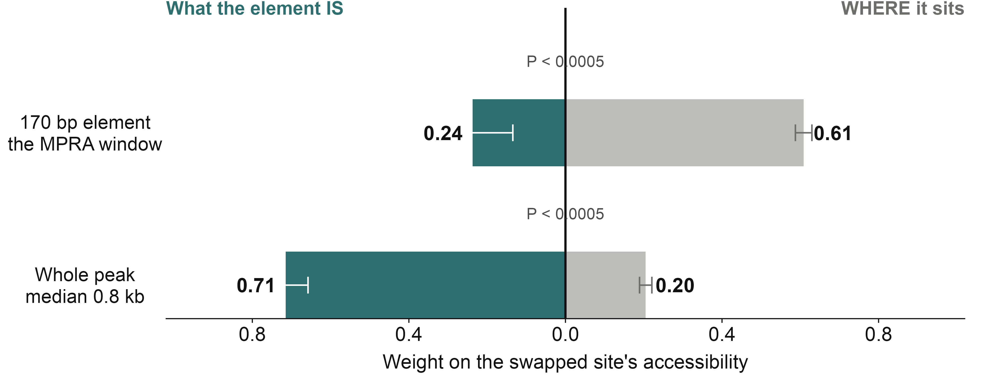
The element's identity lives at peak scale, not in 170 bp
Every element swapped into every other site's location: the swapped site's accessibility regressed on the donor element and on the recipient location. The two weights are drawn pulling against each other from a common zero. 62,250 swaps; 95% CI from a cluster bootstrap over the 250 donors.
At 170 bp an element mostly takes on the level of wherever you put it; at full peak width it imposes its own. The information that opens chromatin is spread over the whole peak — which is why a 170 bp assay cannot see it.
Notes:
62,250 swaps. 170 bp: beta(element) 0.24 vs beta(location) 0.61, R2 = 0.20. Whole peak: 0.71 vs 0.20, R2 = 0.46. Transfer fraction 0.29 at 170 bp, 0.83 at peak.
Link to the MPRA, if asked: the MPRA library is 170 bp, and its class difference there is tiny (flank shuffle 0.128 vs 0.016 log2, d = 0.14). Both assays agree that 170 bp is a poor window for this question. They are NOT the same measurement - the MPRA is episomal activity, this is chromatin accessibility in genomic context.
AVOID on a slide: our in-situ 170 bp shuffle has Stable sites losing more (-2.51 vs -1.96, p = 4e-40), which is the opposite direction to the MPRA flank result. Different assay, but it reads as a contradiction. Keep it off unless someone asks.

Slide 7
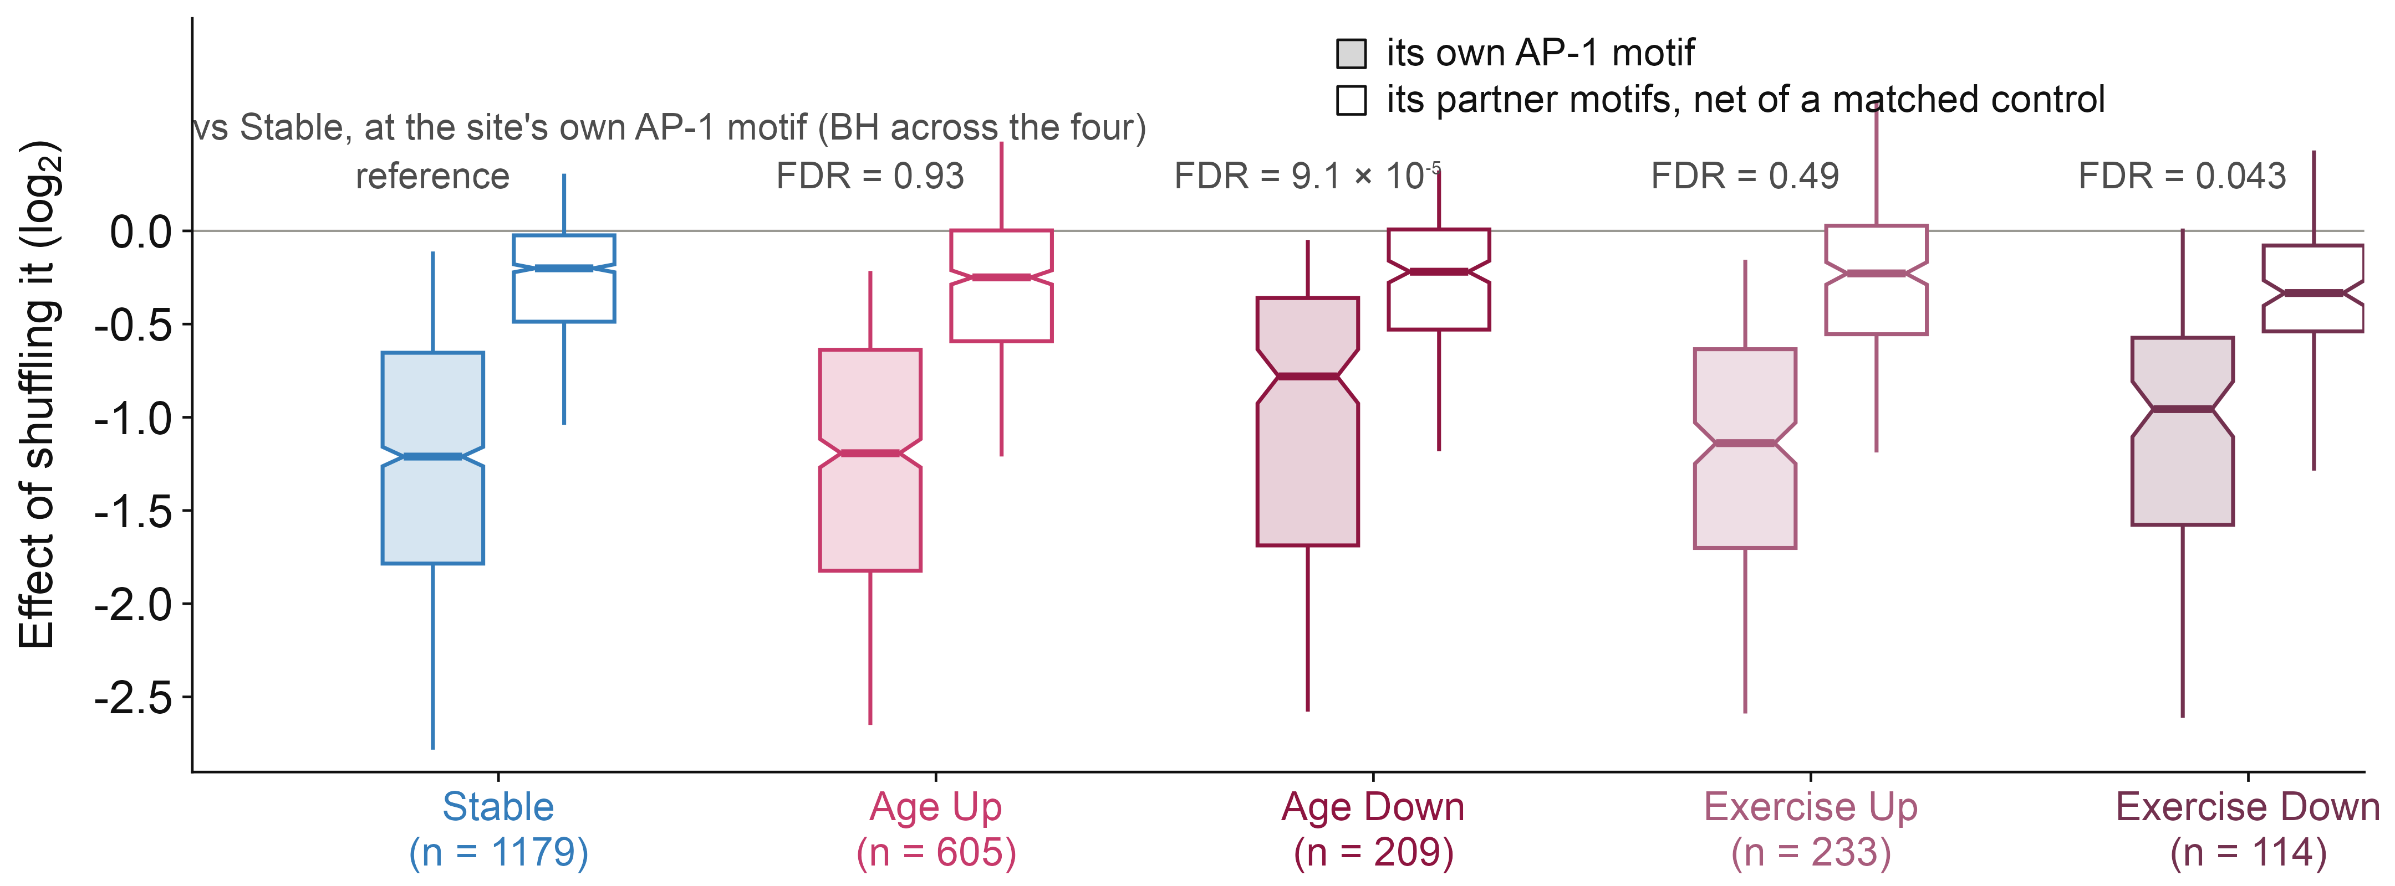
The sites that lose AP-1 let go of it — whether with age or exercise
The site's own AP-1 motif and each partner motif shuffled separately inside the same window; partners net of a width- and distance-matched footprint-free control. Box, median and IQR, whiskers 5th–95th centile, notch a 95% interval on the median. Classes as given: Up = AP-1 gained, Down = AP-1 lost.
It is the direction that matters, not the stimulus. Both losing classes depend less on their own AP-1 motif — Age Down by 36%, Exercise Down by 21% — while both gaining classes are indistinguishable from Stable. No class differs at its partner motifs.
Notes:
2,340 sites. Own AP-1 motif, median log2, with BH-adjusted P against Stable:
Stable -1.21 (n=1179, reference) · Age Up -1.19 (n=605, FDR 0.93) · Age Down -0.78 (n=209, FDR 9.1e-5) · Exercise Up -1.14 (n=233, FDR 0.49) · Exercise Down -0.96 (n=114, FDR 0.043)
Partner motifs, net of control: -0.20 / -0.25 / -0.22 / -0.23 / -0.33. Nothing survives BH (smallest adjusted 0.20), so the deficit is AP-1-specific in both losing classes. So the deficit is AP-1-specific, not general weakness. No single partner family takes over: nothing survives FDR in the per-family split.
Agreement: pooled Stable vs Dynamic at the motif is a null, which matches the manuscript's core-scramble result (no class difference). Age-gained being on par with Stable is the sequence-level version of 'age-gained reporter activity on par with stable'.
Note on the split: a site that is dynamic with both age and exercise is counted under its age class, so the two exercise groups are the sites that are NOT also age-dynamic. Splitting them is what separated the old 'other Dynamic' group (p = 0.055, n = 347) into Exercise Up, which looks like Stable, and Exercise Down, which does not.
Caveat: the own-AP-1 bar has no matched control, because one at distance 0 would overlap the motif. That inflates AP-1 relative to the partners in every class equally, so the class comparison is unaffected.

Slide 8
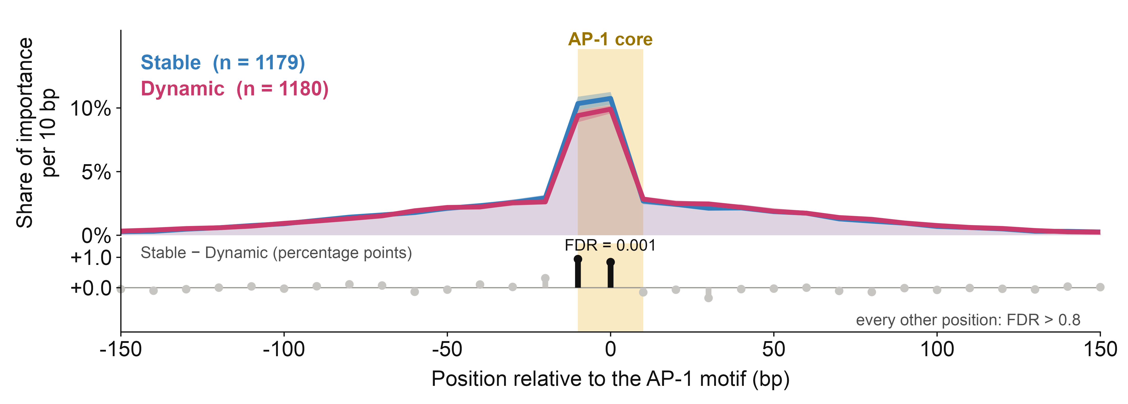
Where the dependence sits: on the motif, and more so if Stable
Each 10 bp tile replaced in turn; each site's own noise floor removed, then normalised to its own total, so the curve is where the dependence sits, not how much there is. Median per site, band a bootstrap 95% CI; Mann–Whitney per position, BH-FDR across the 60. Cropped to ±150 bp.
A spike on the AP-1 core sitting on a shallow shoulder that reaches ±100 bp — and the model was never told where the motif was. The spike is taller for Stable sites, and the two tiles covering the core are the only positions in the whole window where the classes differ at all.
Holding accessibility constant the gap halves but holds: 33.1% vs 31.3% of importance within ±25 bp, P = 0.006 over 860 matched pairs. The older ratio version of this measure did not survive that check (P = 0.11); this one does, because the noise floor is removed per site first.
Notes:
NUMBERS TO ANNOTATE WITH, strongest first:
- the peak tile carries 10.8% (Stable) / 9.9% (Dynamic) of a site's importance, against 1.7% for an average tile - about 6x enrichment
- within +-25 bp (5 of 60 tiles, 8% of the sequence): Stable 33.8% vs Dynamic 30.7%, p = 2.0e-6
- accessibility-matched, 860 pairs: 33.1% vs 31.3%, paired difference +1.5 points, Wilcoxon p = 0.006
- only 2 of 60 positions differ at FDR < 0.05, and they are the two tiles over the core (FDR = 0.001). Every other position FDR > 0.8
- in 56% of Stable and 52% of Dynamic sites the single most important tile IS a core tile, against a chance of 3.3% - 16x. That one does NOT differ by class (Fisher p = 0.063; matched McNemar p = 0.21), so quote it as the shared fact, not as a difference. Figure for it is on disk as r_fb_top_tile.png if anyone wants to see it.
2,359 sites, 60 tiles of 10 bp from -300 to +290, fine-tuned FB head, readout atac_170.
Why the floor subtraction matters, if asked: Dynamic sites are about half as accessible, so their log2 ratios are noisier, and noise is flat across position. Without removing each site's own floor (median |effect| beyond +-200 bp: 0.047 Dynamic, 0.037 Stable) a Dynamic profile looks more distributed whether or not it is. That is exactly the artefact this corrects for.
Agreement: this is the AlphaGenome version of 'attention is more distributed at dynamic enhancers'. Same direction, different model and different readout.
Honest size: the matched difference is 1.5 percentage points on a base of about a third. Real, repeatedly so, but small - do not oversell it as two different architectures.

Slide 9
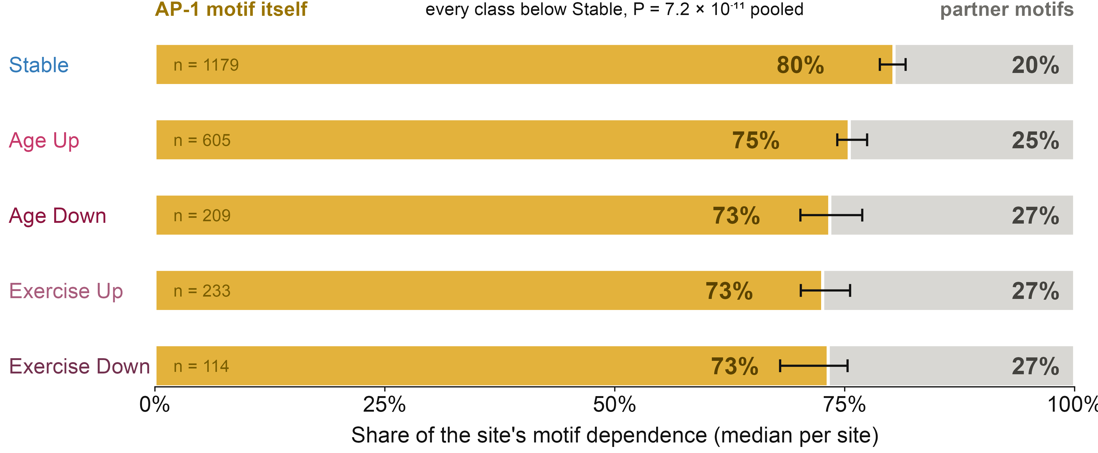
Dynamic sites hand more of the load to the partner motifs
Per site: |own AP-1| / (|own AP-1| + |partner motifs|), the share of its motif dependence that sits inside the AP-1 motif rather than outside it. Both terms are AlphaGenome shuffle effects measured inside the same window, so accessibility cannot drive the comparison. Median per site; error bar, bootstrap 95% CI; Mann–Whitney.
Outside the motif is where every class differs: a Stable site leaves 20% of its motif dependence to partners, each of the four Dynamic classes 25–27% — about a third more — and all four sit on the same side, gaining and losing alike. AP-1 still leads everywhere; it just carries less of the load.
Notes:
Stable 0.804 (n=1179) vs Dynamic pooled 0.745 (n=1161), p = 7.2e-11. By class: Age Up 0.755 (p = 7.9e-5), Age Down 0.734 (p = 4.1e-6), Exercise Up 0.726 (p = 1.9e-5), Exercise Down 0.732 (p = 8.7e-6).
Worth contrasting with the previous slide out loud: there, only the LOSING classes moved. Here all four move, including both gaining classes. So the absolute dependence on AP-1 and the share of the total it carries are two different statements, and only the second separates every Dynamic class from Stable.
The 40%: partner share 19.6% for Stable against 24.5 / 26.6 / 27.3% for the Dynamic classes, so 27.3/19.6 = 1.39x. It is the same number as 80 vs 73, read from the other end - say it whichever way, but do not say both as if they were two results.
Detection check, in case it is asked: footprint calling needs signal, so Stable sites carry more detected partners (5.89 vs 5.01 per site, p = 2e-82). Restricting to the 1,808 sites that hit the cap of 6 detected partners, the gap is unchanged: 0.806 vs 0.736, p = 2.1e-13. Not a detection artefact.
Note this is a DIFFERENT statement from slide 5. There, only the AP-1-losing class drops in absolute AP-1 dependence. Here, all Dynamic classes are modestly less AP-1-centric in relative terms.
The equivalent tile-scan measure (motif share vs a 10-50 bp collar) does NOT survive accessibility matching (p = 0.11); the collar is mostly noise at low-accessibility sites. This version is better powered because it only scores footprinted motifs.

Slide 10
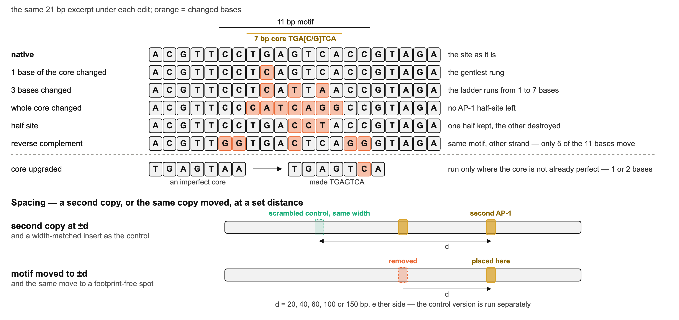
The AP-1 ladder, and the spacing experiments
Rather than only destroying the motif, weaken it one base at a time, strengthen it, flip it, duplicate it or move it — each against a control that changes the same amount of sequence but no motif.
Notes:
This is where the next slide's numbers come from. 2,359 sites; 860 accessibility-matched pairs at caliper 0.1 log10.
The ladder (1 to 7 bases of the core) is what gives a dose-response rather than a single on/off contrast - it is how we can say the Dynamic curve is SHALLOWER rather than just lower.
Two controls worth naming if asked:
- the second copy is paired with a scrambled insert of the same width at the same distance, so the comparison is 'a motif there' against 'that much sequence there'
- moving the motif is paired with moving it to a spot that has no footprint
The reverse complement is the sanity check on the head: a TRE is a near-palindrome, only 5 of the 11 bases actually move, and the predicted cost is -0.03 log2 (p = 0.89). If that had come out large, nothing else here would be trustworthy.

Slide 11
Two differences that turned out to be accessibility
A second AP-1 copy looked worth more to Dynamic sites
  +0.72 vs +0.60 log2, p < 1e-4 — matched on accessibility, p = 0.93. Gone.
Upgrading an imperfect core to a perfect TGAGTCA looked worth more to Dynamic sites
  +0.66 vs +0.52, p < 1e-4 — matched, p = 0.94. Gone.
What did survive matching
  Destroying the motif costs Dynamic sites less (+0.16, p = 4e-4); the dose-response is shallower; relocating the motif helps them less.
Two clean negatives worth having
  Reverse-complementing the whole motif costs nothing in either class (-0.03 log2, p = 0.89) — expected for a palindromic TRE, and a sanity check on the head.
  The spacing preference for a second copy is identical: best at ±20–40 bp, decaying by ±150 bp, with no class difference at any distance (all FDR > 0.58).
Notes:
From the fibroblast titration, 2,359 sites, 860 accessibility-matched pairs (caliper 0.1 log10). This slide is the argument for why the matched analysis is worth doing - two of the five largest raw class differences in the titration were entirely explained by the accessibility gap.
Age Down is the outlier again, consistently with the other arms: one base of the core changed -0.62 vs Stable -0.83; motif gone -0.72 vs -1.07.

Slide 12
How this sits with the MPRA work
Agrees
  Dynamic elements have weaker endogenous chromatin, and depend on context rather than being sequence-autonomous.
  Shuffling the AP-1 core alone does not separate pooled Stable from pooled Dynamic.
  Age-gained elements behave like Stable ones — here, at their own AP-1 motif.
  C/EBP is the strongest partner motif at fibroblast AP-1 sites (net −0.71 log2, ahead of MEF2 and NFI).
Adds
  The class difference is a whole-peak property, not a 170 bp one.
  Within Dynamic, the AP-1-LOSING sites are the ones that are sequence-different, with age and with exercise alike; the gaining ones look like Stable. Direction, not stimulus.
  Unprompted, AlphaGenome makes the AP-1 core the most important 10 bp in over half of all sites — equally in both classes. The classes differ in how much of the dependence sits there, not in whether AP-1 leads.
  Dynamic sites spread their dependence slightly wider, and it survives accessibility matching (33.1% vs 31.3% within ±25 bp, P = 0.006) — the sequence-model version of “attention is more distributed at dynamic enhancers”.
Keep off the slides
  Our in-situ 170 bp shuffle costs Stable sites more (−2.51 vs −1.96, p = 4e-40), the opposite of the MPRA flank result. Different assay — episomal activity vs chromatin accessibility — but it reads as a contradiction.
Notes:
If the flank question comes up: the MPRA destroys the flanks of a 170 bp fragment on a plasmid and reads transcription; we move an intact ~0.8 kb element into closed chromatin and read accessibility. There is no chromatin to open in the MPRA. The honest shared conclusion is that neither assay finds much class information in 170 bp.
Everything here is predicted accessibility from a model fine-tuned on our own fibroblast ATAC, not a measurement, and not the MPRA-trained probe used in the manuscript.

