Slide 1
X-Informatics Introduction: What is Big Data, Data Analytics and X-Informatics? Part I
January 7 2013
Geoffrey Fox
gcf@indiana.edu
http://www.infomall.org/X-InformaticsSpring2013/index.html
Associate Dean for Research and Graduate Studies, School of Informatics and Computing
Indiana University Bloomington
2013

Slide 2
Jobs

Slide 3
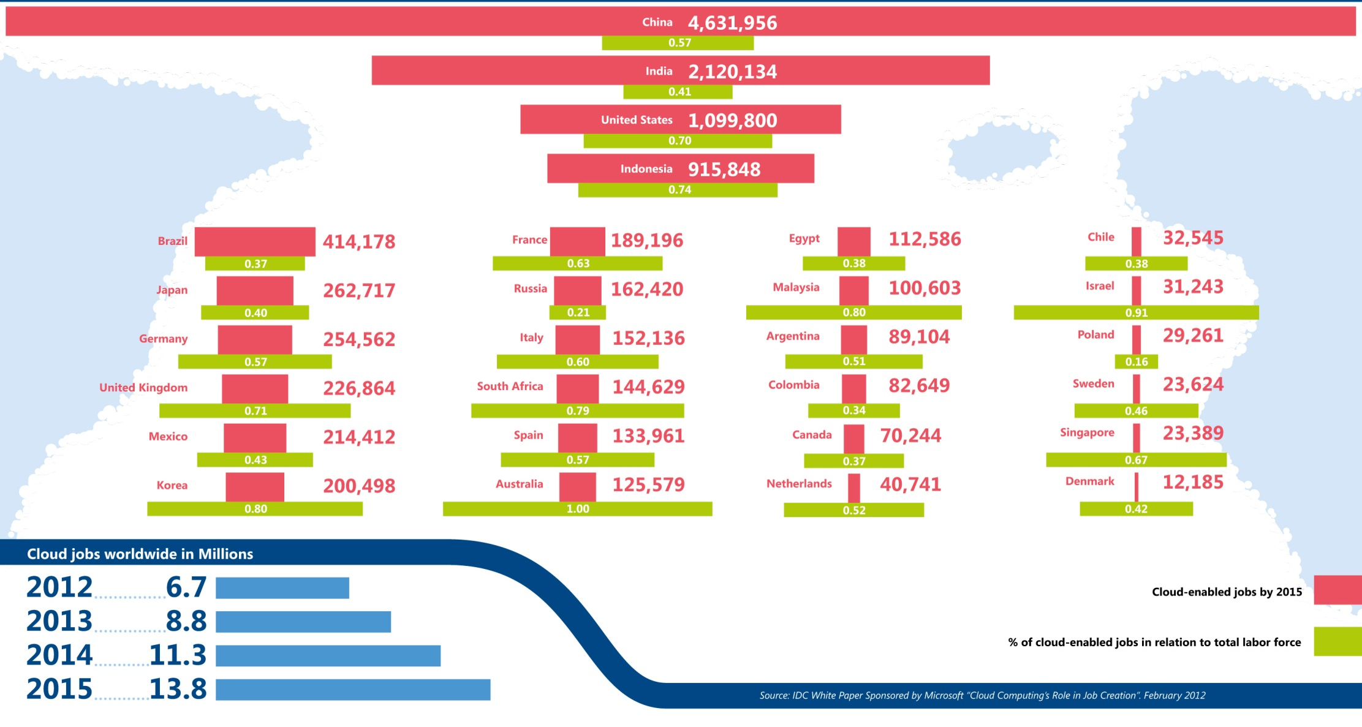
Jobs v. Countries
http://www.microsoft.com/en-us/news/features/2012/mar12/03-05CloudComputingJobs.aspx

Slide 4
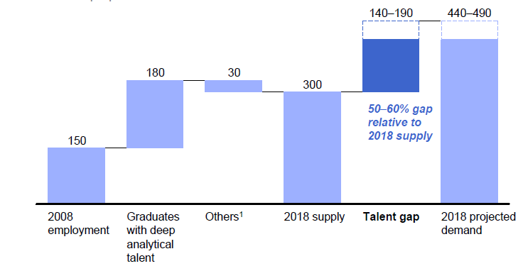
McKinsey Institute on Big Data Jobs
There will be a shortage of talent necessary for organizations to take advantage of big data. By 2018, the United States alone could face a shortage of 140,000 to 190,000 people with deep analytical skills as well as 1.5 million managers and analysts with the know-how to use the analysis of big data to make effective decisions.
This course aimed at 1.5 million jobs. Computer Science covers the 140,000 to 190,000
http://www.mckinsey.com/mgi/publications/big_data/index.asp.

Slide 5
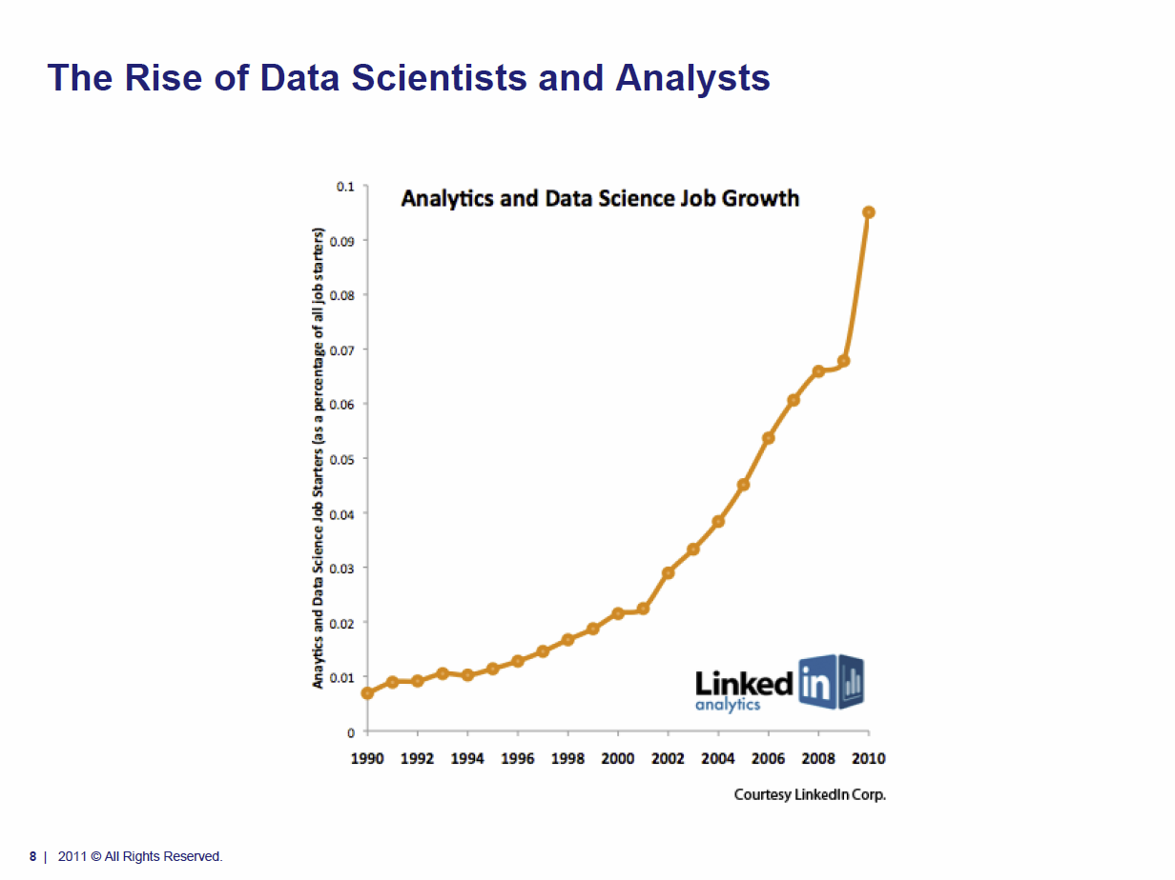
Tom Davenport Harvard Business School http://fisheritcenter.haas.berkeley.edu/Big_Data/index.html Nov 2012

Slide 6
Data Deluge General Structure

Slide 7

Some Data sizes
~40 10⁹ Web pages at ~300 kilobytes each = 10 Petabytes
Youtube 48 hours video uploaded per minute;
in 2 months in 2010, uploaded more than total NBC ABC CBS
~2.5 petabytes per year uploaded?
LHC 15 petabytes per year
Radiology 69 petabytes per year
Square Kilometer Array Telescope will be 100 terabits/second
Earth Observation becoming ~4 petabytes per year
Earthquake Science – few terabytes total today
PolarGrid – 100’s terabytes/year
Exascale simulation data dumps – terabytes/second

Slide 8
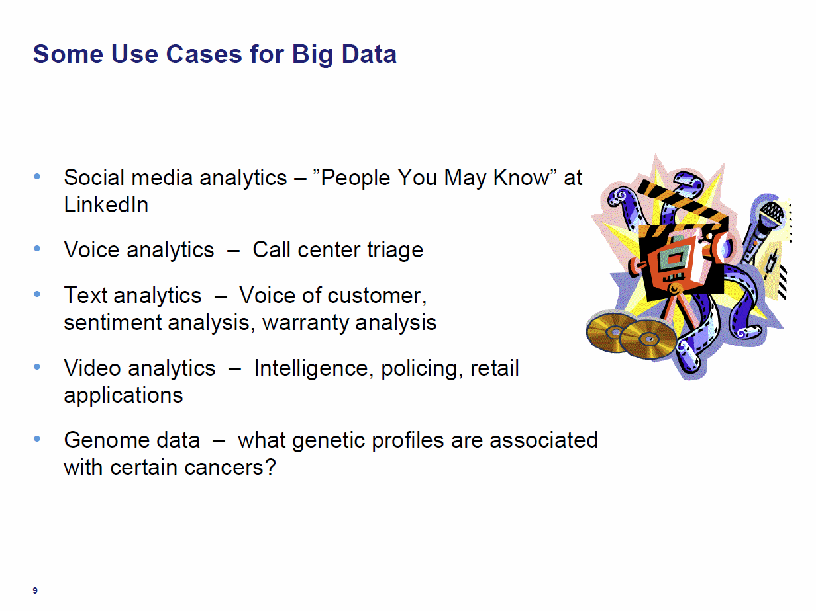
Tom Davenport Harvard Business School http://fisheritcenter.haas.berkeley.edu/Big_Data/index.html Nov 2012

Slide 9
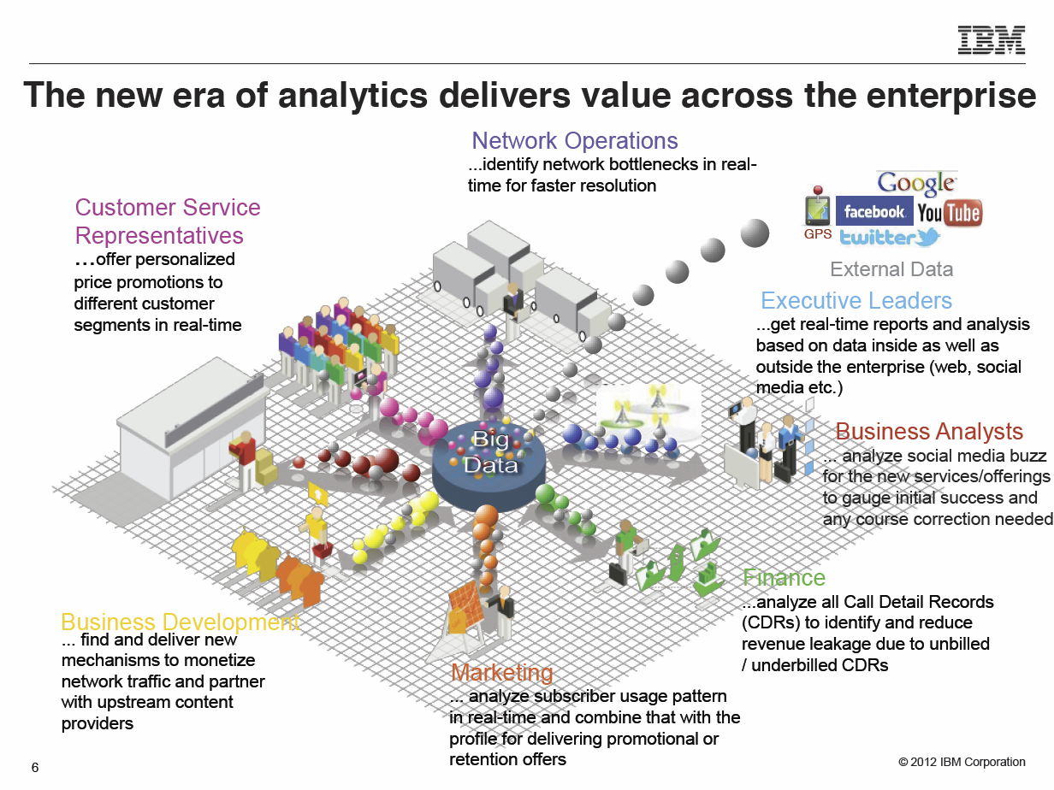
Anjul Bhambhri, VP of Big Data, IBM http://fisheritcenter.haas.berkeley.edu/Big_Data/index.html

