Slide 1
X-Informatics Introduction: What is Big Data, Data Analytics and X-Informatics? Part I
January 7 2013
Geoffrey Fox
gcf@indiana.edu
http://www.infomall.org/X-InformaticsSpring2013/index.html
Associate Dean for Research and Graduate Studies, School of Informatics and Computing
Indiana University Bloomington
2013

Slide 2
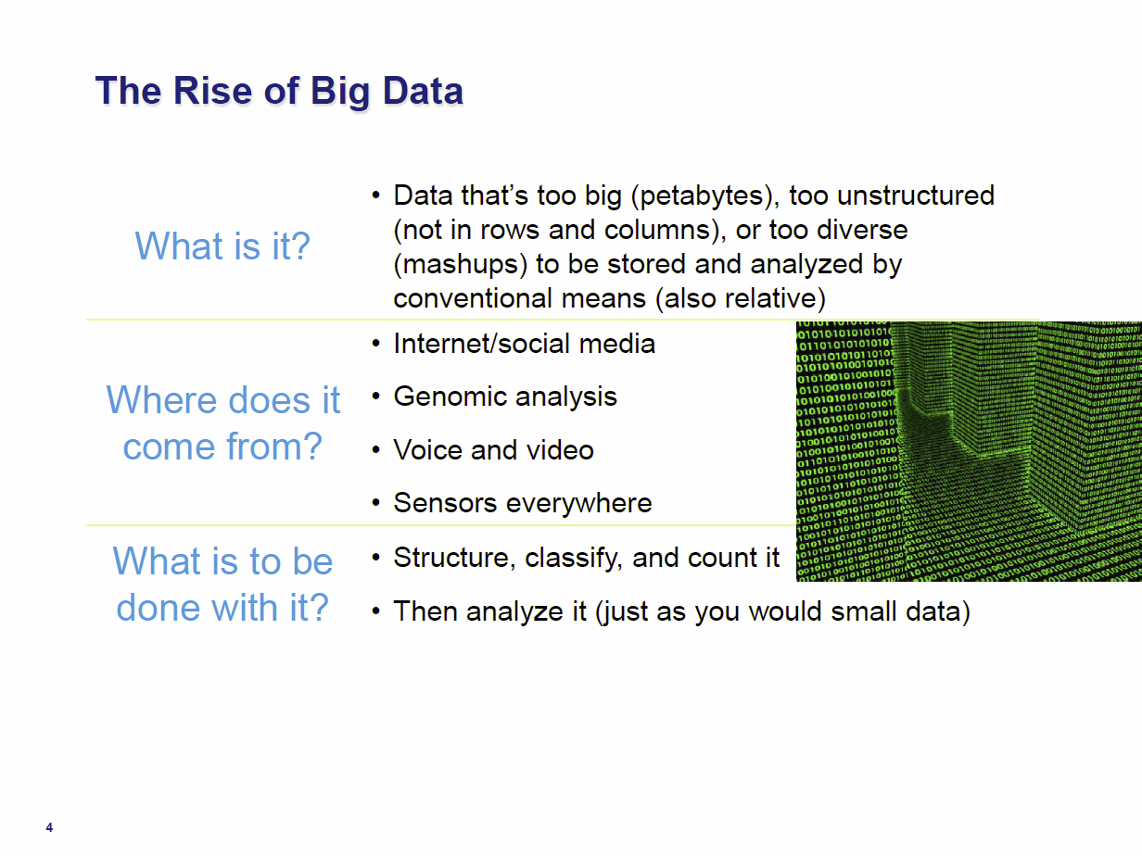
Tom Davenport Harvard Business School http://fisheritcenter.haas.berkeley.edu/Big_Data/index.html Nov 2012

Slide 3
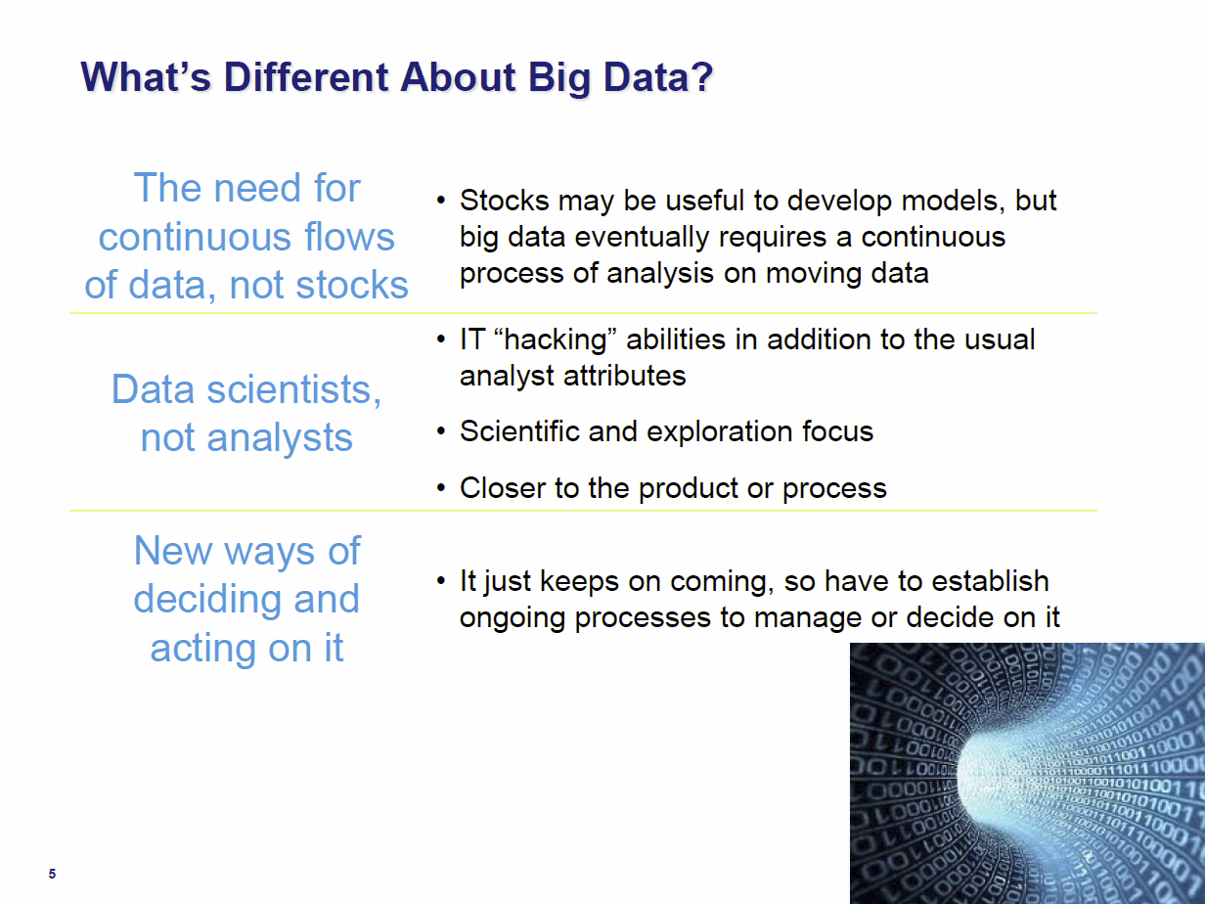
Tom Davenport Harvard Business School http://fisheritcenter.haas.berkeley.edu/Big_Data/index.html Nov 2012

Slide 4
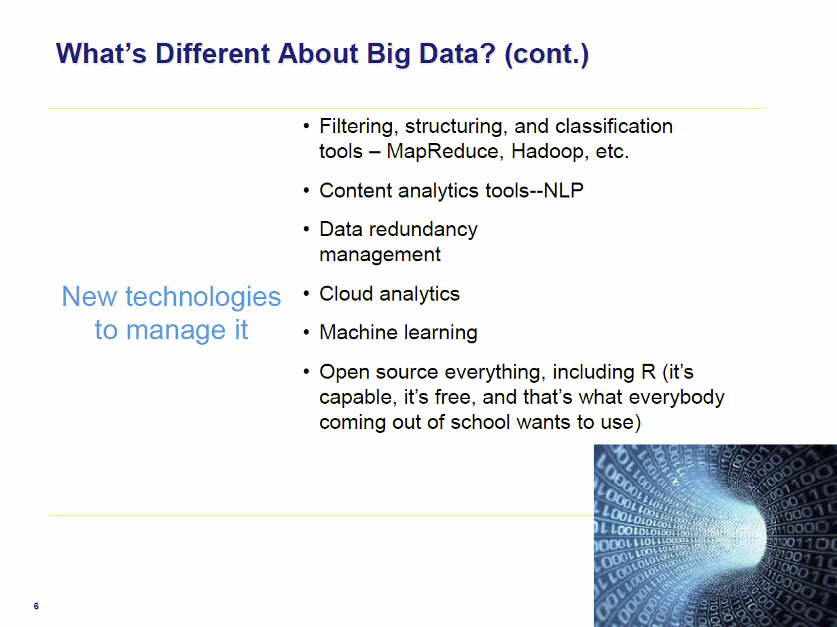
Tom Davenport Harvard Business School http://fisheritcenter.haas.berkeley.edu/Big_Data/index.html Nov 2012

Slide 5

The data deluge: The Economist Feb 25 2010 http://www.economist.com/node/15579717/
According to one estimate, mankind created 150 exabytes (billion gigabytes) of data in 2005. This year(2010), it will create 1,200 exabytes. Merely keeping up with this flood, and storing the bits that might be useful, is difficult enough. Analyzing it, to spot patterns and extract useful information, is harder still. Even so, the data deluge is already starting to transform business, government, science and everyday life.
20120117berkeley1.pdf
Jeff Hammerbacher

Slide 6
Data Science Process

Slide 7
DIKW Process
Data becomes
Information becomes
Knowledge becomes
Wisdom or Decisions
Community acceptance of results or approach important here
Volume of bits&bytes decreases as we proceed down DIKW pipeline

Slide 8
Data Deluge is also Information/Knowledge/Wisdom/Decision Deluge?

Slide 9
Example of Google Maps/Navigation
Data comes from traditional maps (US Geological Survey), Satellites (overlays) and street cams
Information is presented by basic Google Maps web page
Knowledge is a particular optimized route
Decisions (wisdom) comes from deciding to drive a particular route

