Slide 1
Some Terms
Data: the raw bits and bytes produced by instruments, web , e-mail, social media
Information: The cleaned up data without deep processing applied to it
Knowledge/wisdom/decisions comes from sophisticated analysis of Information
Data Analytics is the process of converting data to Information and Knowledge and then decisions or policy
Data Science describes the whole process
X-Informatics is use of Data Science to produce wisdom in field X

Slide 2
The Course in One Sentence
Study Clouds running Data Analytics processing Big Data to solve problems in X-Informatics

Slide 3
Structure of Course
Based on informal survey, course will cover
Use of (Big) data in application areas (the X in X-Informatics)
Some examples will be based on “academic study”
Some examples will use online resources
Other examples will involve Python

Slide 4
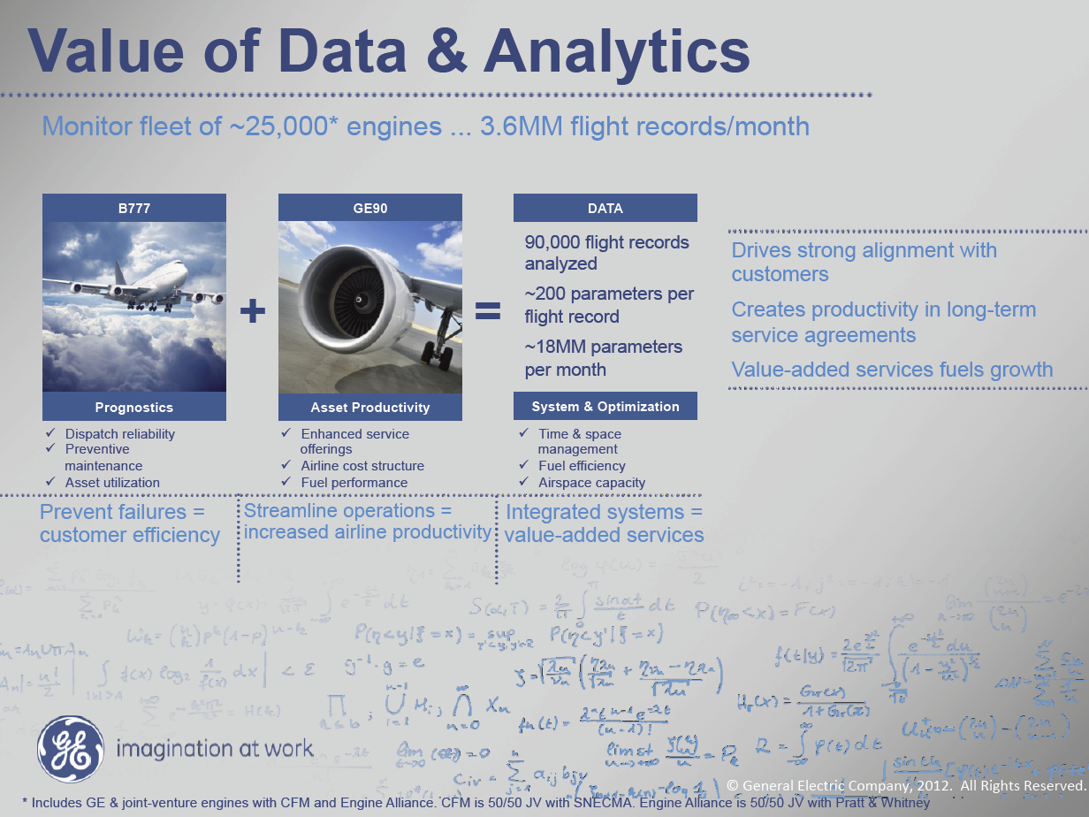
MM = Million
Ruh VP Software GE http://fisheritcenter.haas.berkeley.edu/Big_Data/index.html

Slide 5
Previous slide (sensors in engines) was last one
Continue Big Data in Business (a statistics summary slide followed by eBay)

Slide 6
Trend: Analytical Software Solutions
Integrated software solutions for business problems
What are the opportunities for statisticians?
Problem | Industry
Fraud detection | Banking
Credit and operational risk | Banking
Credit scoring | Financial services
Warranty analysis | Manufacturing
Customer retention | Telecommunications
Markdown optimization | Retail
http://www.hsph.harvard.edu/ncb2011/files/ncb2011-z03-rodriguez.pptx
Notes:
Size and price optimization for retail industry
Fraud detection and credit and operational risk for banks
Credit scoring for financial services
Warranty analysis and supply chain optimization for manufacturing

Slide 7
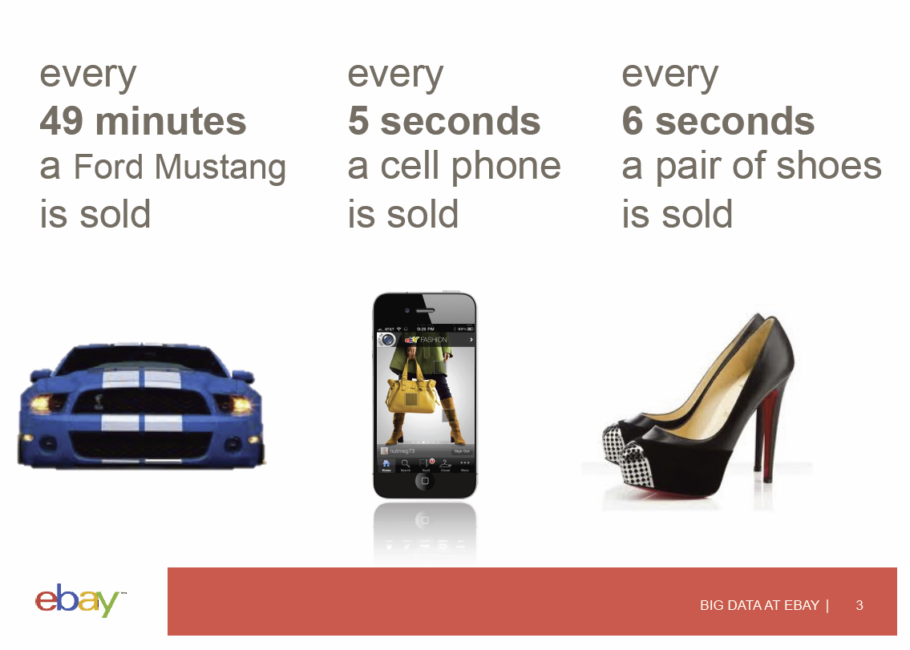
http://fisheritcenter.haas.berkeley.edu/Big_Data/Williams.pdf

Slide 8
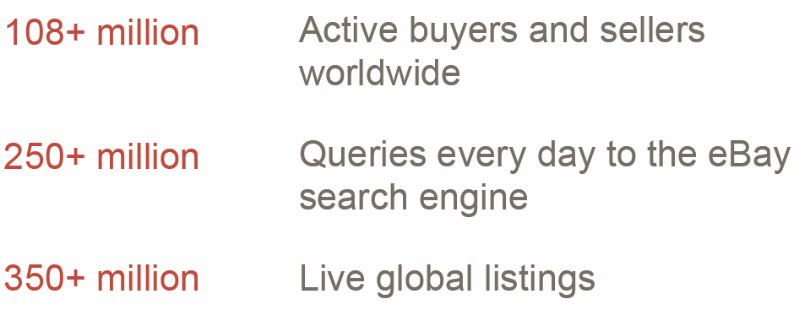
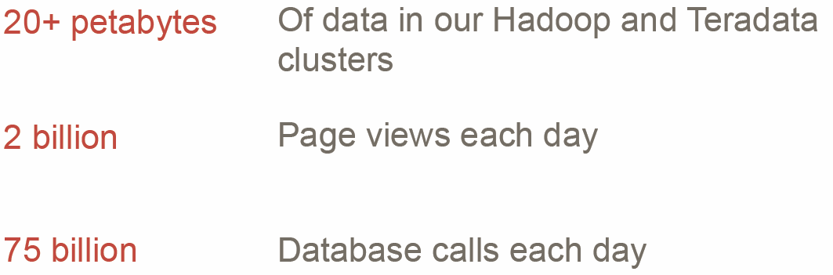


Slide 9
