Slide 1
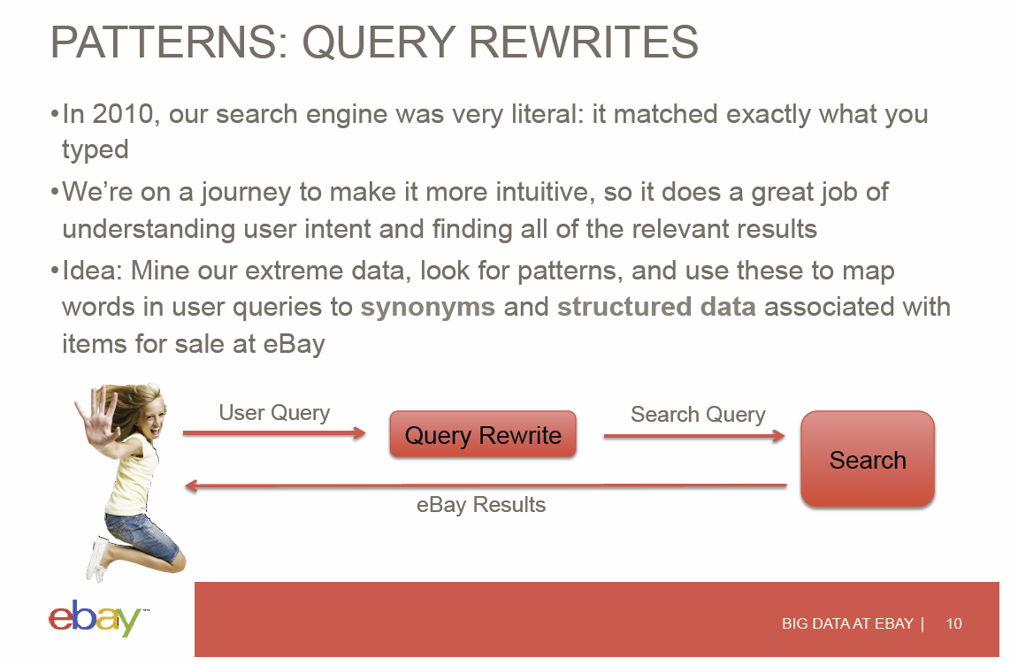

Slide 2


Slide 3
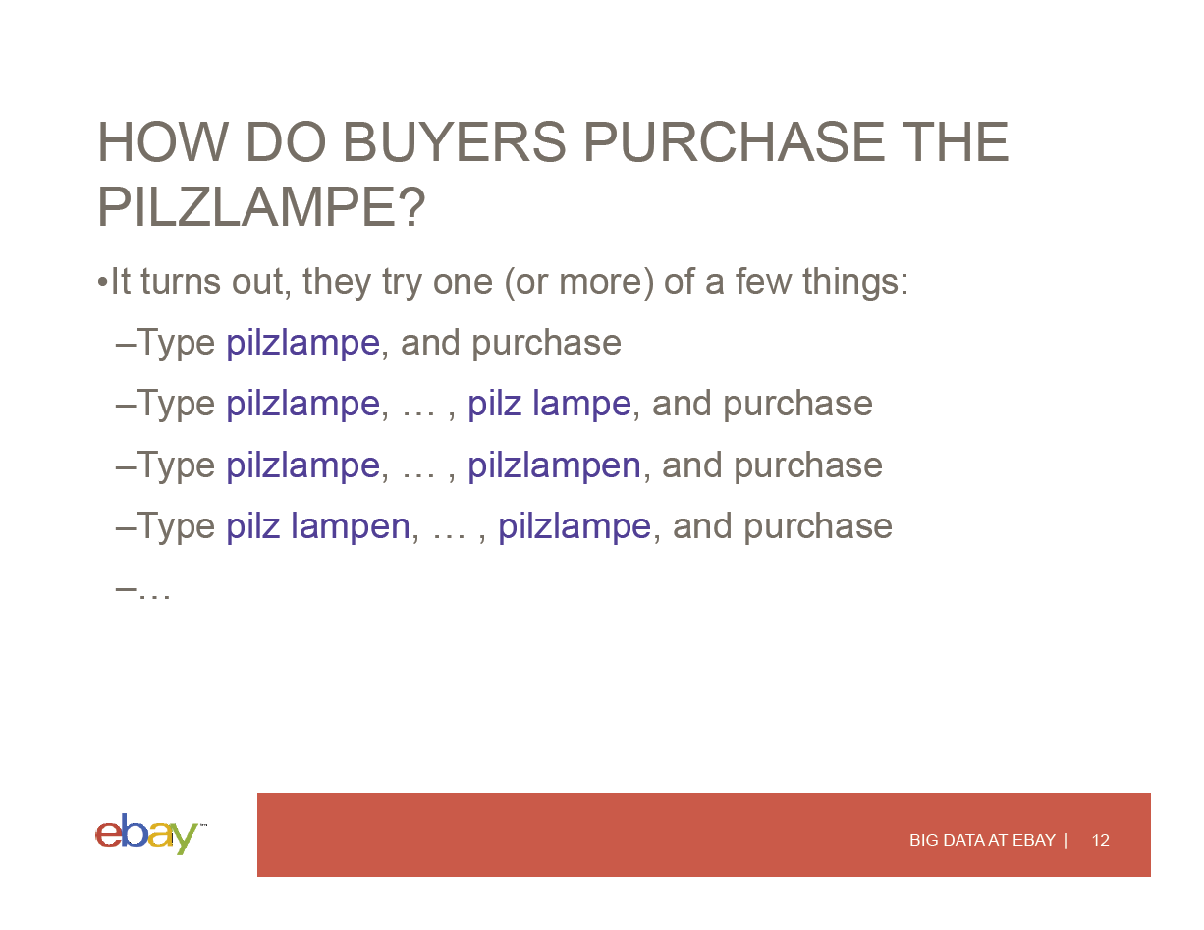

Slide 4
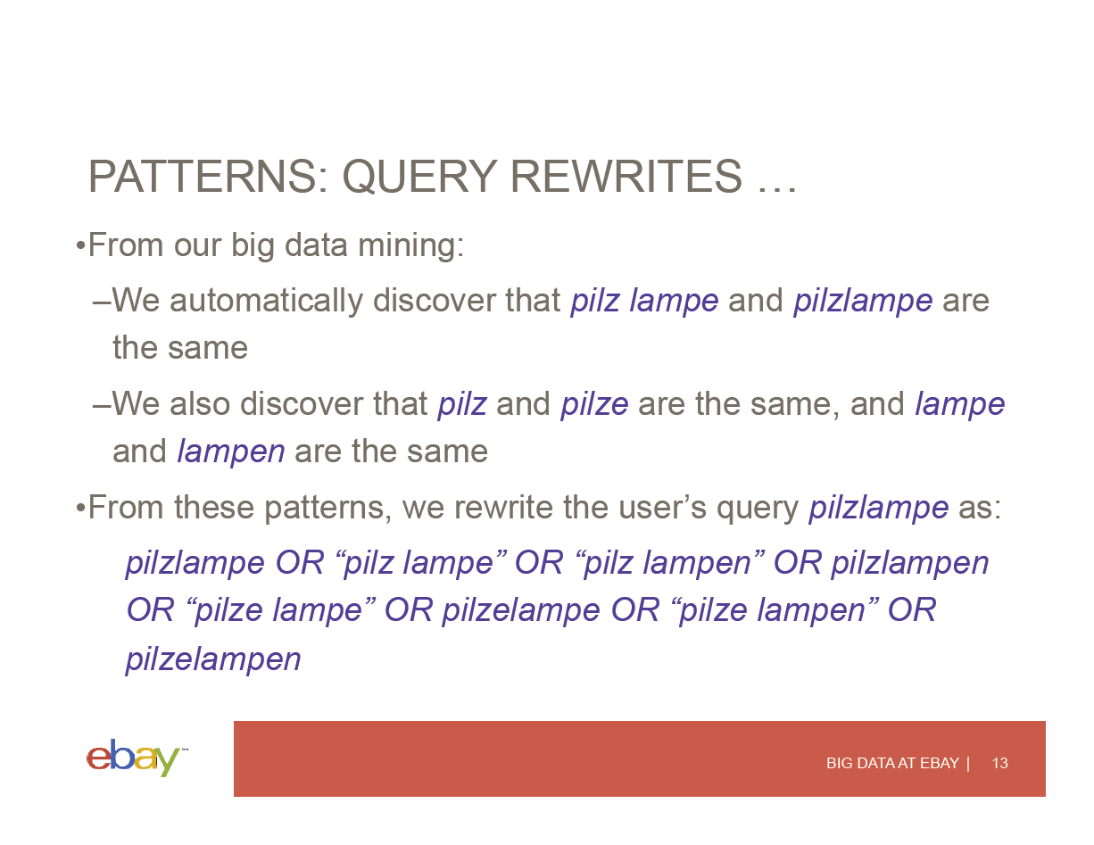

Slide 5
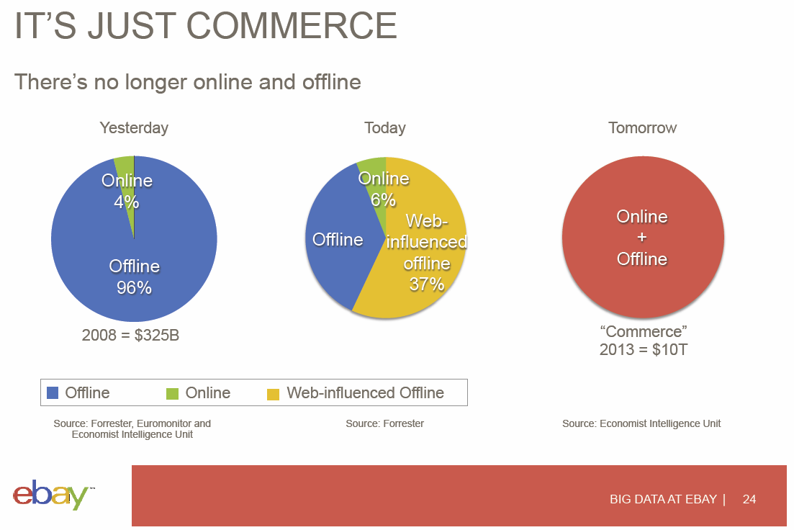

Slide 6
Data Deluge Science & Research

Slide 7
The data deluge: The Economist Feb 25 2010 http://www.economist.com/node/15579717
WHEN the Sloan Digital Sky Survey started work in 2000, its telescope in New Mexico collected more data in its first few weeks than had been amassed in the entire history of astronomy. Now, a decade later, its archive contains a whopping 140 terabytes of information. A successor, the Large Synoptic Survey Telescope, due to come on stream in Chile in 2016, will acquire that quantity of data every five days.
Such astronomical amounts of information can be found closer to Earth too. Wal-Mart, a retail giant, handles more than 1m customer transactions every hour, feeding databases estimated at more than 2.5 petabytes—the equivalent of 167 times the books in America's Library of Congress (see article for an explanation of how data are quantified). Facebook, a social-networking website, is home to 40 billion photos. And decoding the human genome involves analysing 3 billion base pairs—which took ten years the first time it was done, in 2003, but can now be achieved in one week.

Slide 8
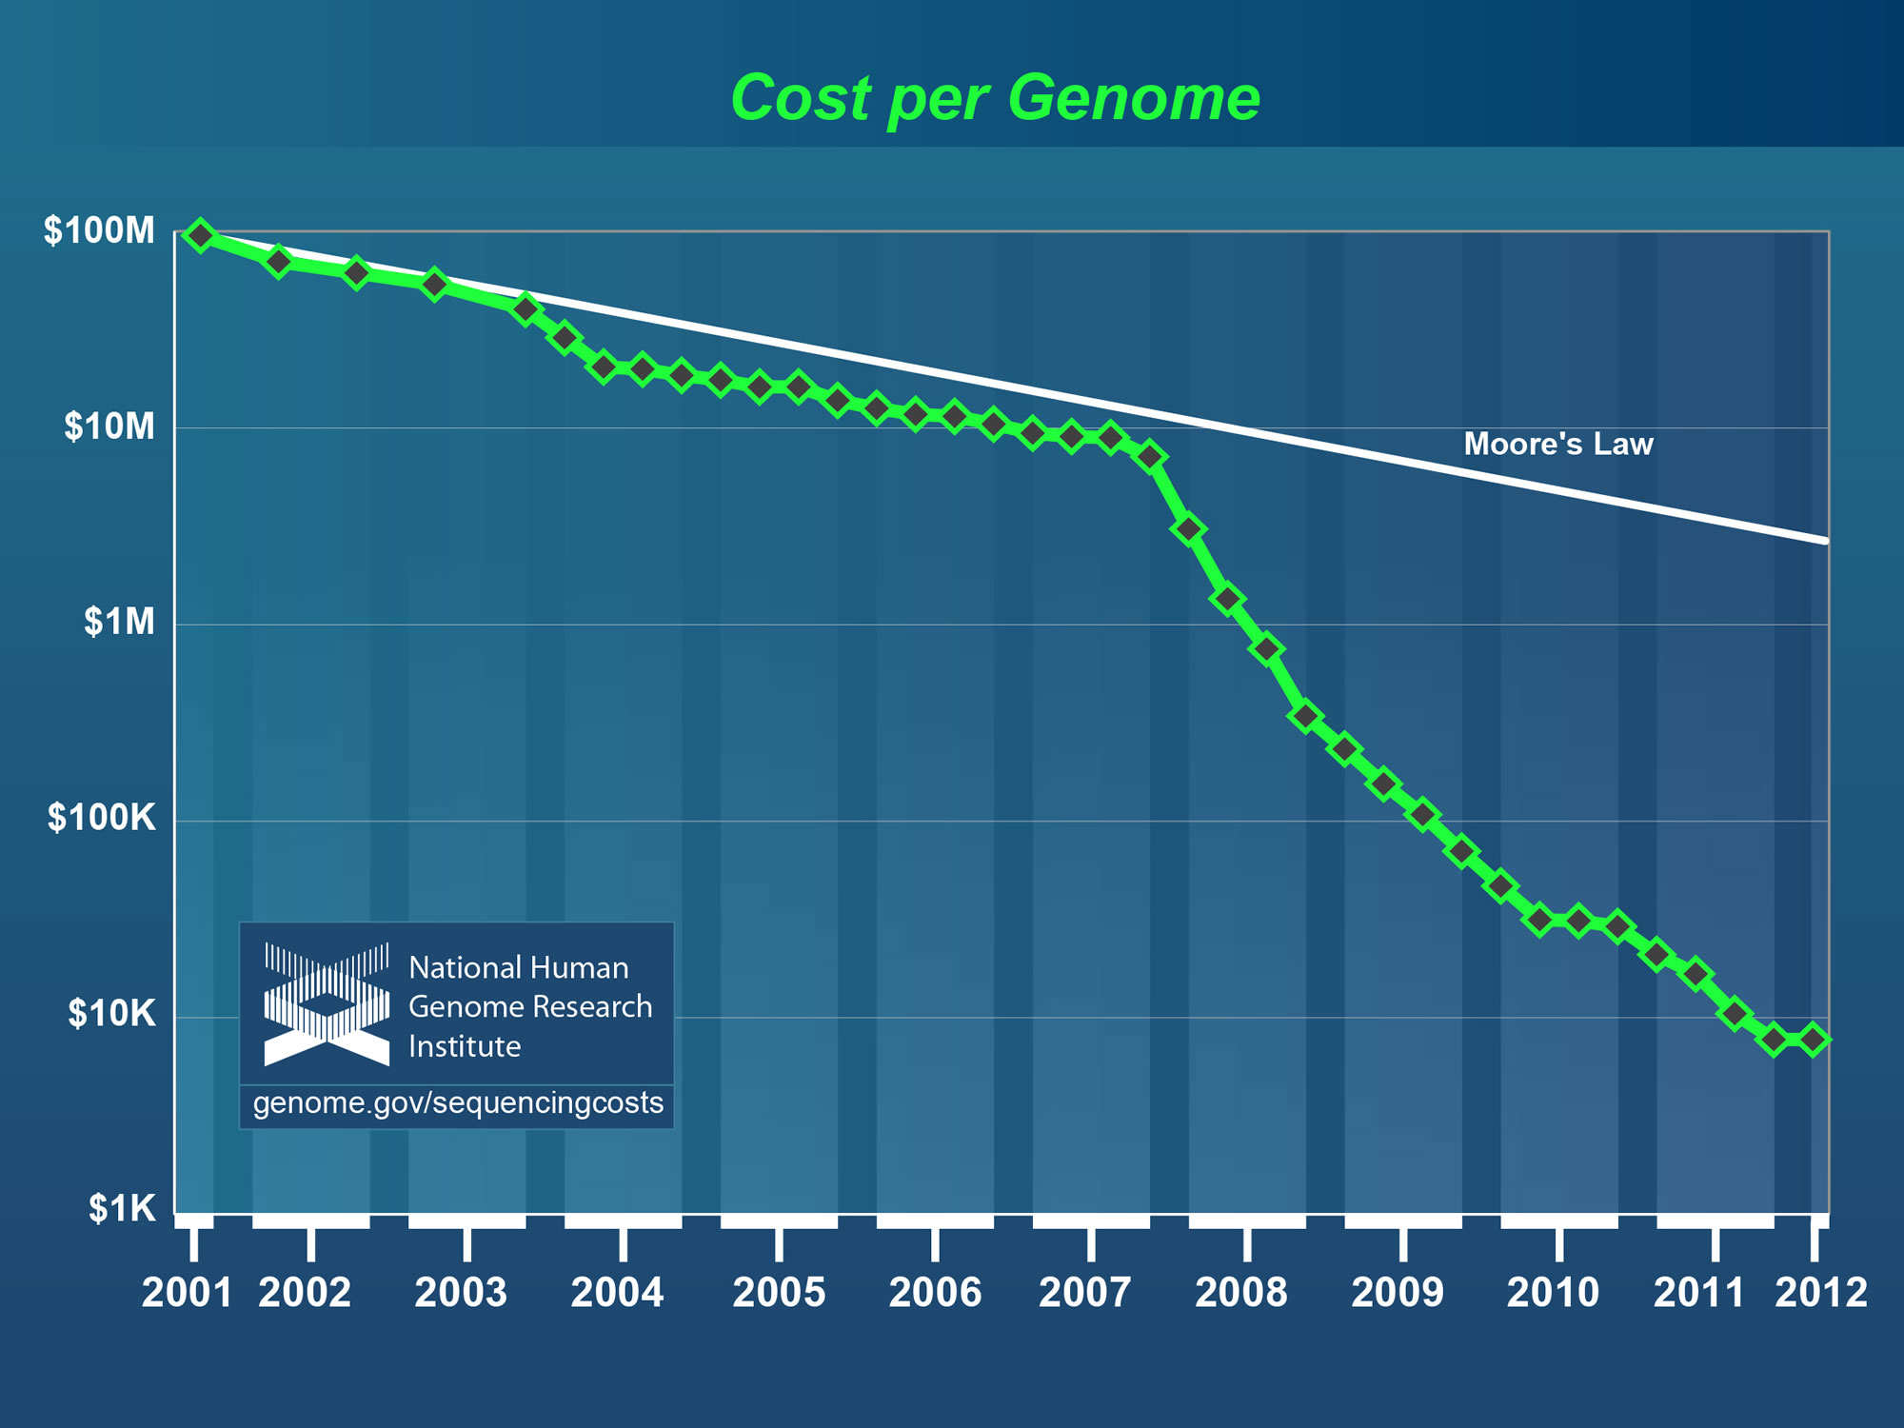
Why need cost effective
Computing!
Full Personal Genomics: 3 petabytes per day
http://www.genome.gov/sequencingcosts/

Slide 9
Ninety-six percent of radiology practices in the USA are filmless and Table below illustrates the annual volume of data across the types of diagnostic imaging; this does not include cardiology which would take the total to over 10⁹ GB (an Exabyte).
http://grids.ucs.indiana.edu/ptliupages/publications/Where%20does%20all%20the%20data%20come%20from%20v7.pd
Modality | Part B non HMO | All Medicare | All Population | Per 1000 persons | Ave study size (GB) | Total annual data generated in GB
CT | 22 million | 29 million | 87 million | 287 | 0.25 | 21,750,000
MR | 7 million | 9 million | 26 million | 86 | 0.2 | 5,200,000
Ultrasound | 40 million | 53 million | 159 million | 522 | 0.1 | 15,900,000
Interventional | 10 million | 13 million | 40 million | 131 | 0.2 | 8,000,000
Nuclear Medicine | 10 million | 14 million | 41 million | 135 | 0.1 | 4,100,000
PET | 1 million | 1 million | 2 million | 8 | 0.1 | 200,000
Xray, total incl. mammography | 84 million | 111 million | 332 million | 1,091 | 0.04 | 13,280,000
All Diagnostic Radiology | 174 million | 229 million | 687 million | 2,259 | 0.1 | 68,700,000 68.7 PETAbytes

