Slide 1
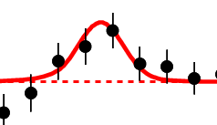
Personal Note
As a naïve undergraduate in 1964, I was told by Professor that bumps like
Were particles. I was amazed and found this more intriguing than anything else I had heard about so I decided to do PhD in area.
Note errors; measurements have errors that are SQRT(N) ( N~2000 measured # of events)
– Central Limit theorem that dominates design and study of all such event-based experiments
Note: methodology is use of histograms and I used to write (Fortran) code to do all this processing – See routine Papoose at http://salsahpc.indiana.edu/dlib/articles/00001935/ from 1978
Run on CDC 7600 – the supercomputer from that time accessed over “Internet”
Note perforated paper. Program on cards discarded

Slide 2
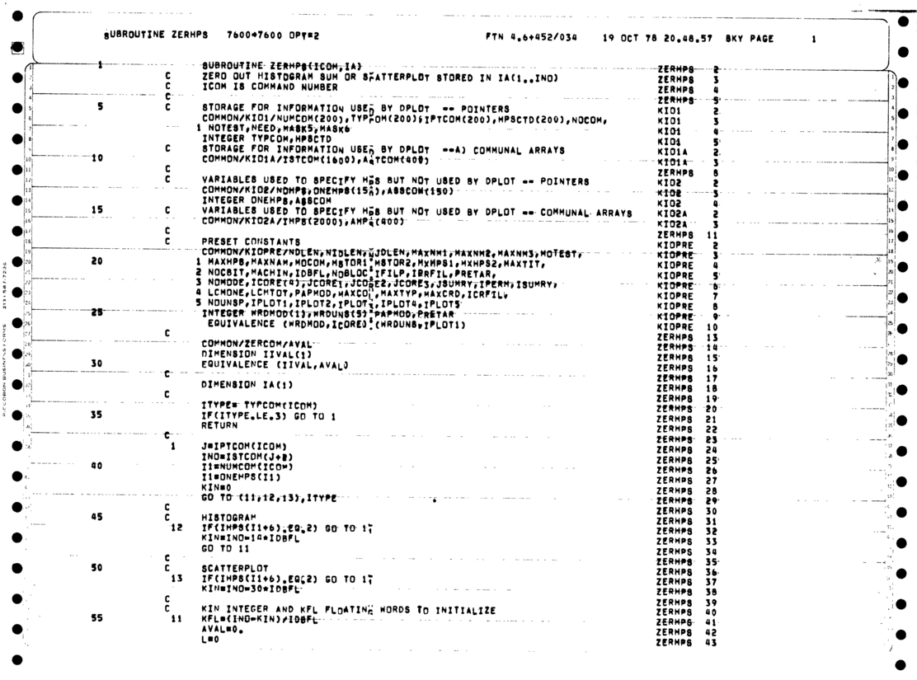
Personal Note
As a naïve undergraduate in 1964, I was told by Professor that bumps like
Were particles. I was amazed and found this more intriguing than anything else I had heard about so I decided to do PhD in area.
Note errors; measurements have errors that are SQRT(N) ( N~2000 measured # of events)
Central Limit theorem that dominates design and study of all such event-based experiments
Note methodology is use of histograms and I used to write (Fortran) code to do all this processing – See routine Papoose at http://salsahpc.indiana.edu/dlib/articles/00001935/ from 1978
Run on CDC 7600 – the supercomputer from that time accessed over over “Internet”
Note perforated paper. Program on cards discarded

Slide 3
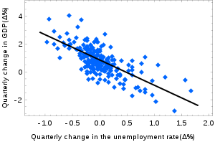
Models and Theory
Newton’s laws such Mass . Acceleration = Force is a theory as is Einstein’s special relativity and gravitational (general relativity) theory
Physicists just discovered a new particle – the Higgs or God particle whose existence was predicted by the “Grand Unified Theory”
Its search was handicapped as theory did not predict mass and a model is needed to calculate this (I used to build such models)
A model is a hopefully theoretically motivated “phenomenological” approach that allows predictions. Models often have parameters that are fit to existing data to predict new data (see FFF paper)
http://en.wikipedia.org/wiki/Simple_linear_regression: Okun's law in macroeconomics is an example of the simple linear regression. Here the dependent variable (GDP growth) is presumed to be in a linear relationship with the changes in the unemployment rate.

Slide 4
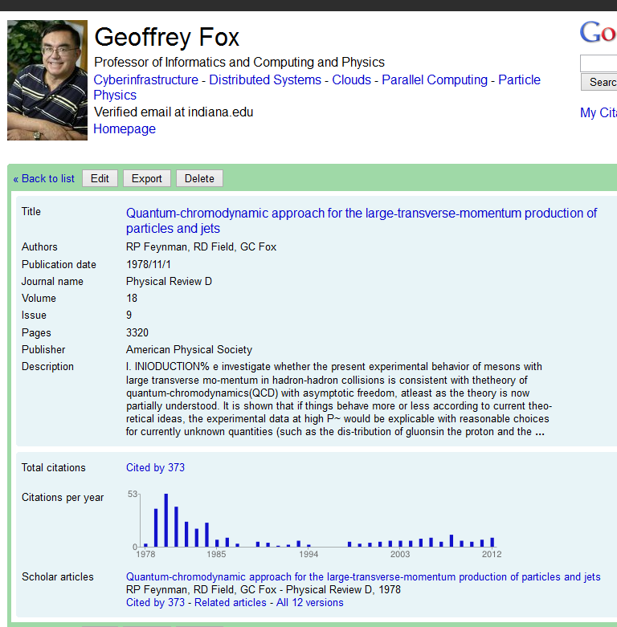
Models and Theory
Newton’s laws such Mass . Acceleration = Force is a theory as is Einstein’s special relativity and gravitational (general relativity) theory
Physicists just discovered a new particle – the Higgs or God particle whose existence was predicted by the “Grand Unified Theory”
Its search was handicapped as theory did not predict mass and a model is needed to calculate this (I used to build such models)
A model is a hopefully theoretically motivated “phenomenological” approach that allows predictions. Models often have parameters that are fit to existing data to predict new data (see FFF paper)
http://en.wikipedia.org/wiki/Simple_linear_regression: Okun's law in macroeconomics is an example of the simple linear regression. Here the dependent variable (GDP growth) is presumed to be in a linear relationship with the changes in the unemployment rate.

