Slide 1
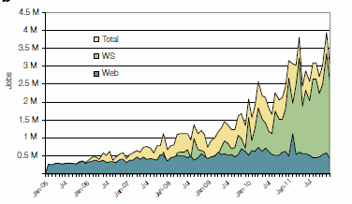
2005-20011 Job request at European Bioinformatics Institute EBI for Web hits and automated services WS
http://www.ebi.ac.uk/Information/Brochures/

Slide 2
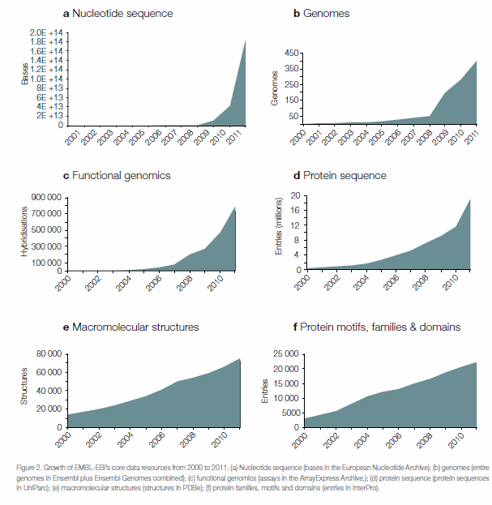
2005-20011 Data stored at European Bioinformatics Institute EBI
http://www.ebi.ac.uk/Information/Brochures/

Slide 3
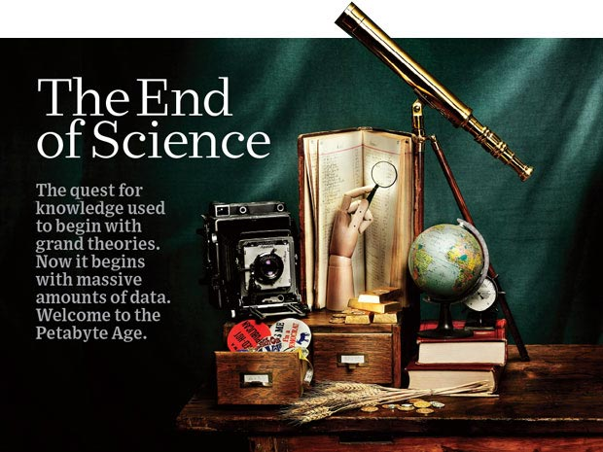
http://www.wired.com/wired/issue/16-07

Slide 4
The 4 paradigms of Scientific Research
Theory
Experiment or Observation
E.g. Newton observed apples falling to design his theory of mechanics
Simulation of theory or model
Data-driven (Big Data) or The Fourth Paradigm: Data-Intensive Scientific Discovery (aka Data Science)
http://research.microsoft.com/en-us/collaboration/fourthparadigm/
A free book
More data; less models

Slide 5
Another Personal Note
In 1990, only methods 1 and 2 were recognized but due to increasing power of computers, method 3 (computation science) was being recognized
I tried to persuade Caltech to adopt a “computational science curriculum” but failed
I left Caltech partly for this reason
I now realize that perhaps not such a good idea as not huge numbers of jobs in area.
However starting in 2005-2010, method 4 and data science emerges
There are lots of jobs in data science so curricula perhaps more interesting

Slide 6
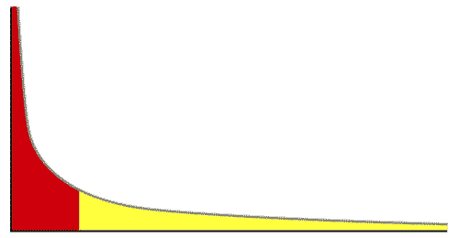
The Long Tail of Science
High energy physics, astronomy
genomics
The long tail: economics, social science, ….
Collectively “long tail” science is generating a lot of data
Estimated at over 1PB per year and it is growing fast.
80-20 rule: 20% users generate 80% data but not necessarily 80% knowledge
Gannon Talk

