Slide 1
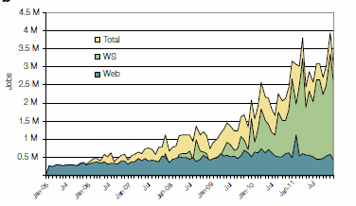
2005-20011 Job request at European Bioinformatics Institute EBI for Web hits and automated services WS
http://www.ebi.ac.uk/Information/Brochures/

Slide 2

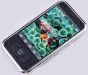
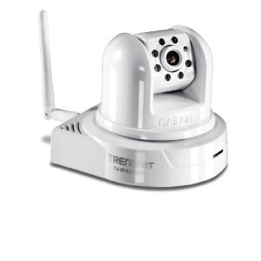
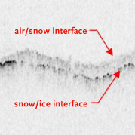
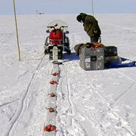

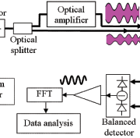

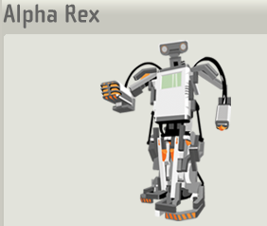
Sensors (Things) as a Service
Output Sensor
Sensors as a Service
Sensor Processing as a Service (could use MapReduce)
A larger sensor ………
https://sites.google.com/site/opensourceiotcloud/ Open Source Sensor (IoT) Cloud

