Slide 1
X-Informatics Introduction: What is Big Data, Data Analytics and X-Informatics? (Continued)
January 14 2013
Geoffrey Fox
gcf@indiana.edu
http://www.infomall.org/X-InformaticsSpring2013/index.html
Associate Dean for Research and Graduate Studies, School of Informatics and Computing
Indiana University Bloomington
2013

Slide 2
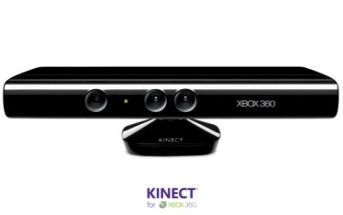

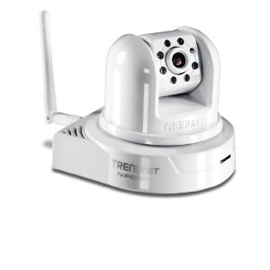
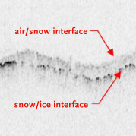
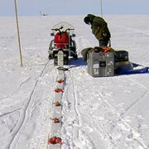

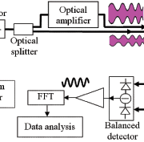

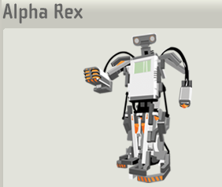
Sensors (Things) as a Service
Output Sensor
Sensors as a Service
Sensor Processing as a Service (could use MapReduce)
A larger sensor ………
https://sites.google.com/site/opensourceiotcloud/ Open Source Sensor (IoT) Cloud

Slide 3
Clouds

Slide 4
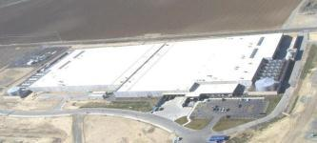
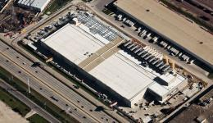
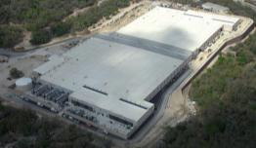
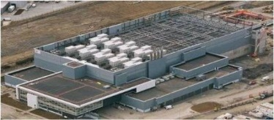
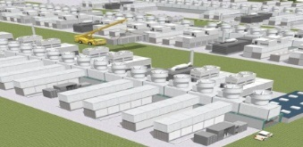
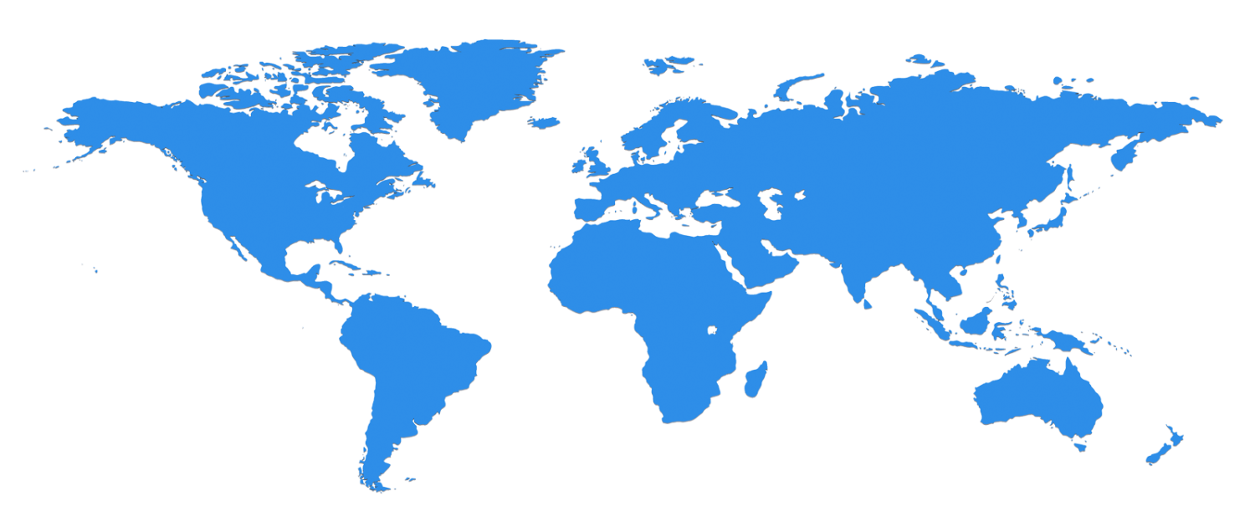
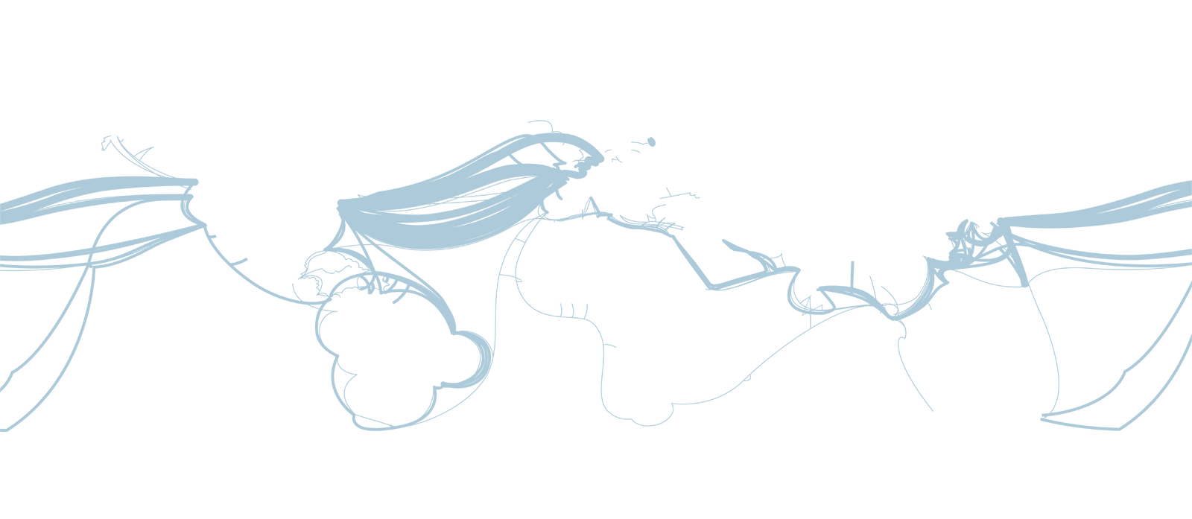

The Microsoft Cloud is Built on Data Centers
~100 Globally Distributed Data Centers
Range in size from “edge” facilities to megascale (100K to 1M servers)
Quincy, WA
Chicago, IL
San Antonio, TX
Dublin, Ireland
Generation 4 DCs
Gannon Talk

Slide 5
The Microsoft Cloud is Built on Data Centers
~100 Globally Distributed Data Centers
Range in size from “edge” facilities to megascale (100K to 1M servers)
Quincy, WA
Chicago, IL
San Antonio, TX
Dublin, Ireland
Generation 4 DCs
Gannon Talk

Slide 6
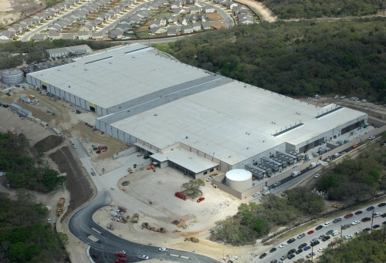
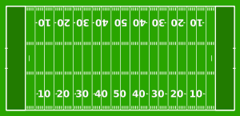
Data Centers Clouds & Economies of Scale I
Range in size from “edge” facilities to megascale.
Economies of scale
Approximate costs for a small size center (1K servers) and a larger, 50K server center.
Technology | Cost in small-sized Data Center | Cost in Large Data Center | Ratio
Network | $95 per Mbps/ month | $13 per Mbps/ month | 7.1
Storage | $2.20 per GB/ month | $0.40 per GB/ month | 5.7
Administration | ~140 servers/ Administrator | >1000 Servers/ Administrator | 7.1
Each data center is
11.5 times
the size of a football field

Slide 7
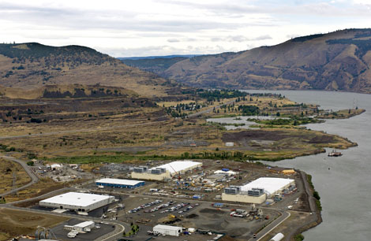
Data Centers Clouds & Economies of Scale I
Range in size from “edge” facilities to megascale.
Economies of scale
Approximate costs for a small size center (1K servers) and a larger, 50K server center.
2 Google warehouses of computers on the banks of the Columbia River, in The Dalles, Oregon
Such centers use 20MW-200MW
(Future) each with 150 watts per CPU
Save money from large size, positioning with cheap power and access with Internet
Technology | Cost in small-sized Data Center | Cost in Large Data Center | Ratio
Network | $95 per Mbps/ month | $13 per Mbps/ month | 7.1
Storage | $2.20 per GB/ month | $0.40 per GB/ month | 5.7
Administration | ~140 servers/ Administrator | >1000 Servers/ Administrator | 7.1
Each data center is
11.5 times
the size of a football field

Slide 8
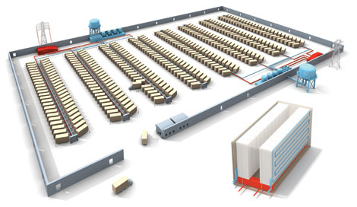
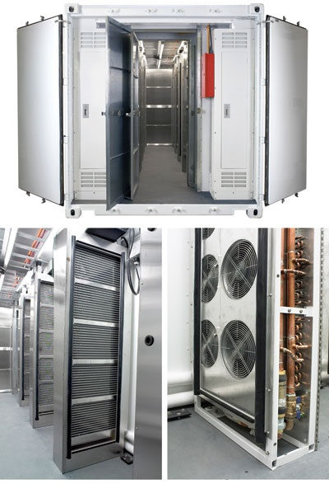
Data Centers, Clouds & Economies of Scale II
Builds giant data centers with 100,000’s of computers; ~ 200-1000 to a shipping container with Internet access
“Microsoft will cram between 150 and 220 shipping containers filled with data center gear into a new 500,000 square foot Chicago facility. This move marks the most significant, public use of the shipping container systems popularized by the likes of Sun Microsystems and Rackable Systems to date.”

