Slide 1
Clouds Offer From different points of view
Features from NIST:
On-demand service (elastic);
Broad network access;
Resource pooling;
Flexible resource allocation;
Measured service
Economies of scale in performance and electrical power (Green IT)
Powerful new software models
Platform as a Service is not an alternative to Infrastructure as a Service – it is instead an incredible valued added
New programming ideas including MapReduce and new storage ideas like NOSQL, Bigtable etc. designed for Big Data as invented by Google and internet companies to solve Cloud applications like information retrieval, e-commerce and Social Media

Slide 2
Features of Data Deluge

Slide 3
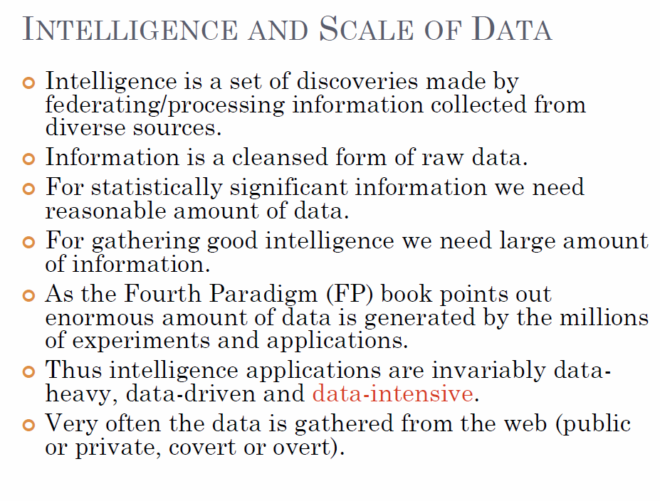
Bina Ramamurthy http://www.cse.buffalo.edu/~bina/cse487/fall2011/

Slide 4
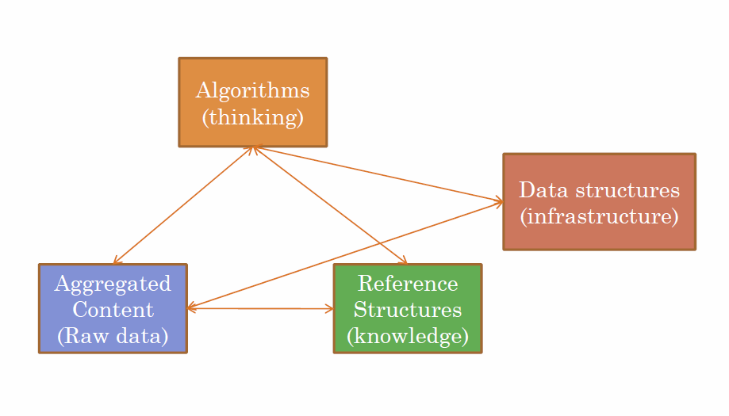
Bina Ramamurthy http://www.cse.buffalo.edu/~bina/cse487/fall2011/

Slide 5
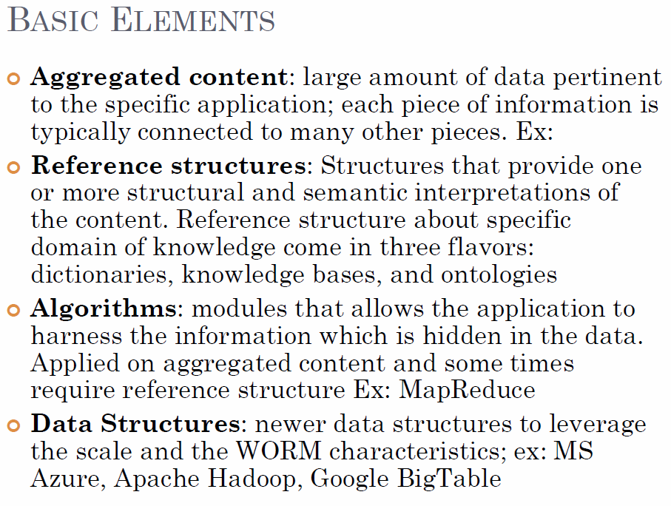
Bina Ramamurthy
http://www.cse.buffalo.edu/~bina/cse487/fall2011/

