Slide 1
Semantic Web/Grid v. Big Data
Original vision of Semantic Web was that one would annotate (curate) web pages by extra “meta-data” (data about data) to tell web browser (machine, person) the “real meaning” of page
The success of Google Search is “Big Data” approach; one mines the text on page to find “real meaning”
Obviously combination is powerful but the pure “Big Data” method is more powerful than expected 15 years ago

Slide 2
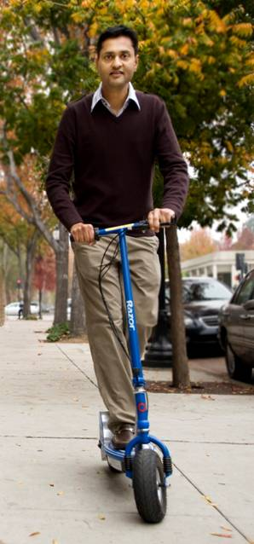
More data usually beats better algorithms
Here's how the competition works. Netflix has provided a large data set that tells you how nearly half a million people have rated about 18,000 movies. Based on these ratings, you are asked to predict the ratings of these users for movies in the set that they have not rated. The first team to beat the accuracy of Netflix's proprietary algorithm by a certain margin wins a prize of $1 million!
Different student teams in my class adopted different approaches to the problem, using both published algorithms and novel ideas. Of these, the results from two of the teams illustrate a broader point. Team A came up with a very sophisticated algorithm using the Netflix data. Team B used a very simple algorithm, but they added in additional data beyond the Netflix set: information about movie genres from the Internet Movie Database(IMDB). Guess which team did better?
Anand Rajaraman is Senior Vice President at Walmart Global eCommerce, where he heads up the newly created @WalmartLabs,
http://anand.typepad.com/datawocky/2008/03/more-data-usual.html
20120117berkeley1.pdf Jeff Hammerbacher

Slide 3
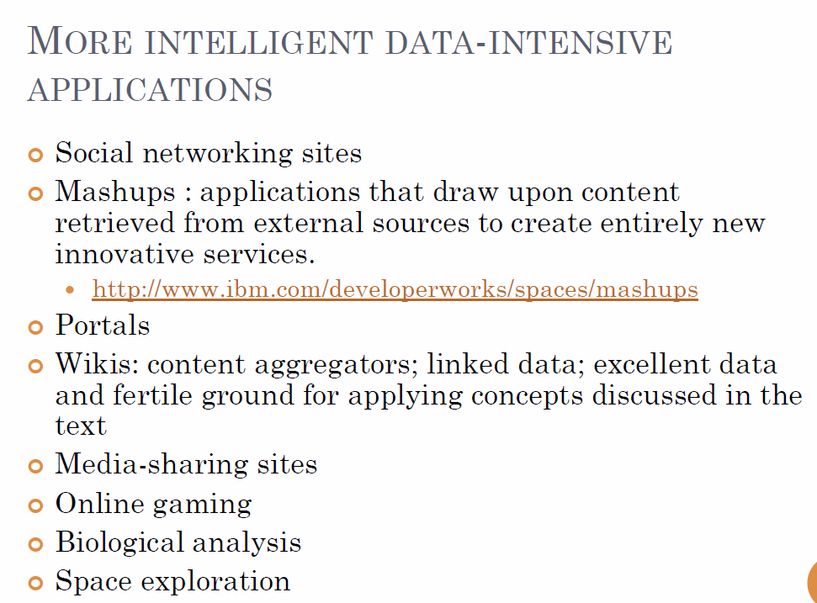
Bina Ramamurthy
http://www.cse.buffalo.edu/~bina/cse487/fall2011/

Slide 4
Types of Data Deluge
Traditional business transaction data from credit cards to stock market
Interaction data as in LinkedIn and Facebook
Information retrieval with topic and language etc. enhancements
Recommender and user customization systems
Marketing information as produced in operation of Walmart
Pervasive sensors in vehicles and people (health)
Scientific Instruments such as satellites, telescopes, Large Hadron Colliders, Gene Sequencers
Military sensors and satellites

