Slide 1
Big Data Processing

Slide 2
20120119berkeley.pdf Jeff Hammerbacher

Slide 3
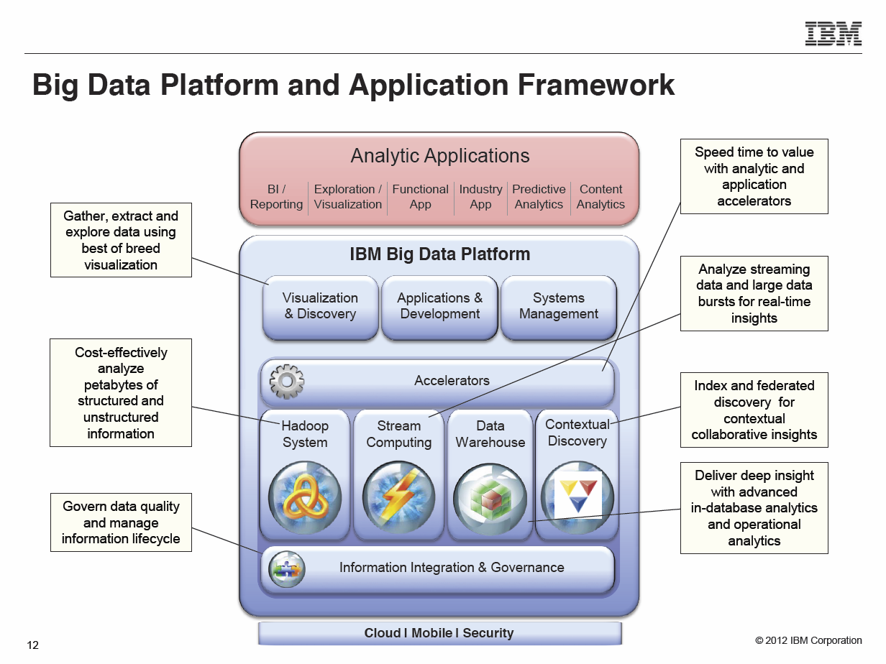
Anjul Bhambhri, VP of Big Data, IBM http://fisheritcenter.haas.berkeley.edu/Big_Data/index.html

Slide 4
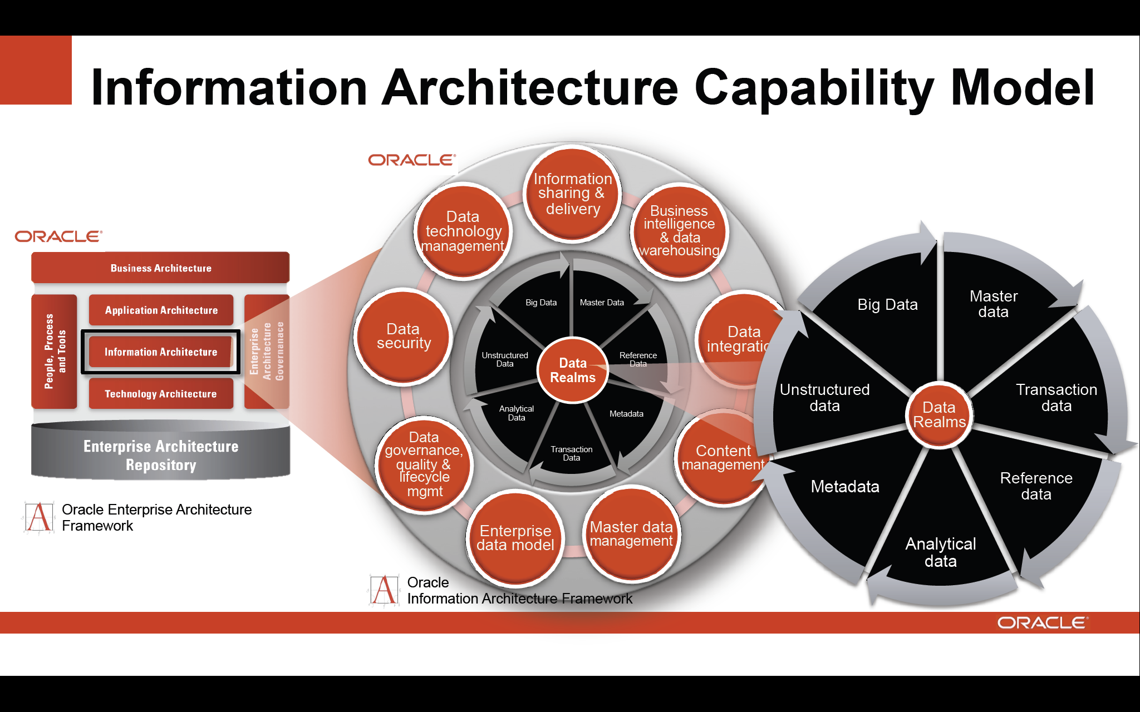
http://cs.metrostate.edu/~sbd/ Oracle

Slide 5


Slide 6
