Slide 1
X-Informatics Introduction: What is Big Data, Data Analytics and X-Informatics? (Continued) Physics Use Case (Start)
January 16 2013
Geoffrey Fox
gcf@indiana.edu
http://www.infomall.org/X-InformaticsSpring2013/index.html
Associate Dean for Research and Graduate Studies, School of Informatics and Computing
Indiana University Bloomington
2013

Slide 2
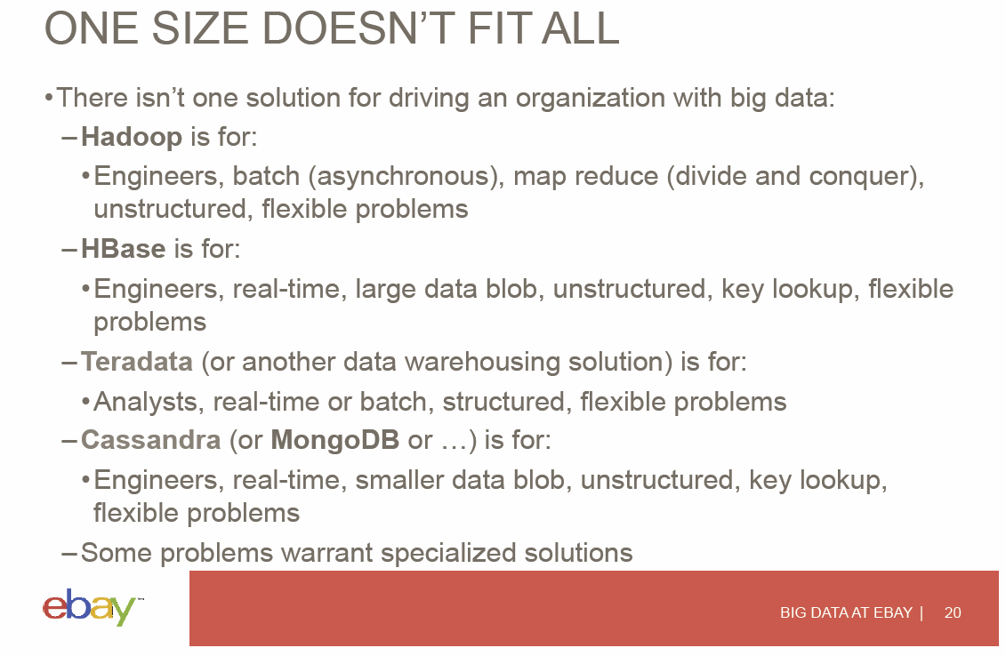

Slide 3
Data Science Process (Continued)

Slide 4
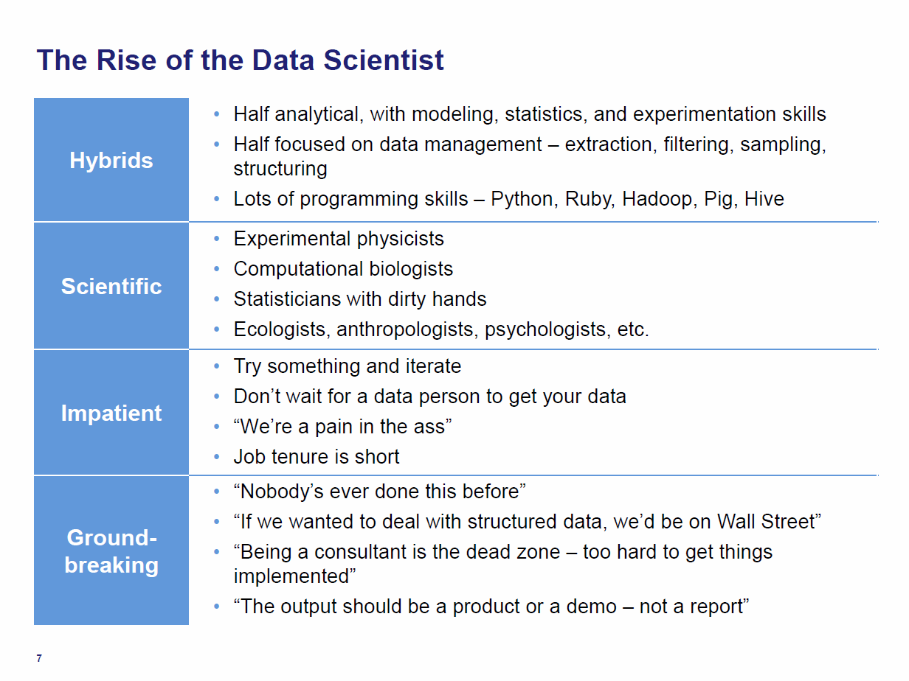
Tom Davenport Harvard Business School http://fisheritcenter.haas.berkeley.edu/Big_Data/index.html Nov 2012

Slide 5
Is Davenport Correct?
There are the 1.5 million decision makers/managers of McKinsey report
Up to 190,000 “nerds”
Davenport appears to describe nerds not the larger 1.5M body of “generalists”

Slide 6
Jeff Hammerbacher’s Process
Identify problem
Instrument data sources
Collect data
Prepare data (integrate, transform, clean, impute, filter, aggregate)
Build model
Evaluate model
Communicate results
20120117berkeley1.pdf Jeff Hammerbacher

Slide 7
Another Jeff Hammerbacher Process
Obtain
Scrub
Explore
Model
Interpret
20120117berkeley1.pdf Jeff Hammerbacher

Slide 8
Statistician Colin Mallows
Identify data to collect and its relevance to your problem
Statistical specification of the problem
Method selection
Analysis of method
Interpret results for non-statisticians
20120117berkeley1.pdf Jeff Hammerbacher

Slide 9
Ben Fry Data Visualization http://en.wikipedia.org/wiki/Benjamin_Fry
Acquire
Parse
Filter
Mine
Represent
Reﬁne
Interact
20120117berkeley1.pdf Jeff Hammerbacher

