Slide 1
Peter Huber Statistics (UCB)
Inspection
Error checking
Modiﬁcation
Comparison
Modeling and model ﬁtting
Simulation
What-if analyses
Interpretation
Presentation of conclusions
20120117berkeley1.pdf Jeff Hammerbacher

Slide 2
Jim Gray Microsoft Database/eScience
Capture
Curate
Communicate
Ted Johnson
Assemble an accurate and relevant data set
Choose the appropriate algorithm
20120117berkeley1.pdf Jeff Hammerbacher

Slide 3
Data Analytics

Slide 4
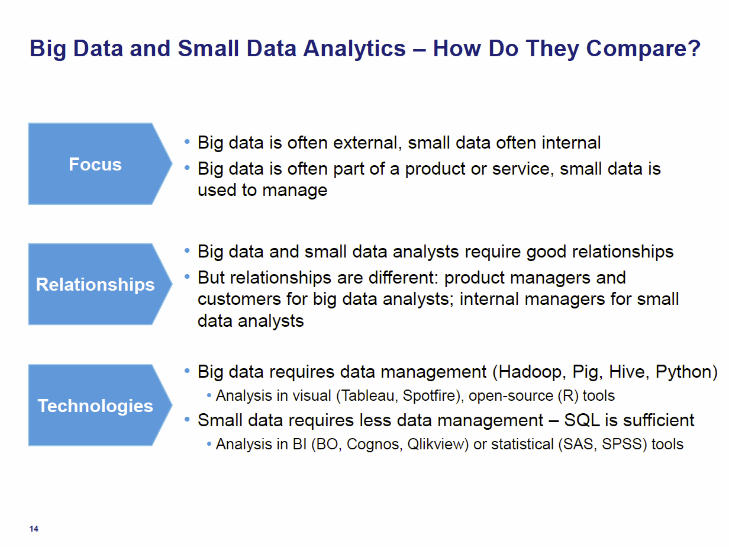
Tom Davenport Harvard Business School http://fisheritcenter.haas.berkeley.edu/Big_Data/index.html Nov 2012

Slide 5
General Remarks I
An immature (exciting) field: No agreement as to what is data analytics and what tools/computers needed
Databases or NOSQL?
Shared repositories or bring computing to data
What is repository architecture?
Sources: Data from observation or simulation
Different terms: Data analysis, Datamining, Data analytics., machine learning, Information visualization
Fields: Computer Science, Informatics, Library and Information Science, Statistics, Application Fields including Business
Approaches: Big data (cell phone interactions) v. Little data (Ethnography, surveys, interviews)
Topics: Security, Provenance, Metadata, Data Management, Curation

