Slide 1
Physics-Informatics Looking for Higgs Particle Counting Errors (start)

Slide 2
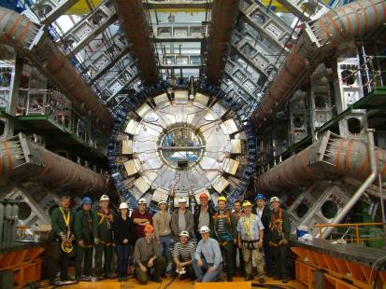
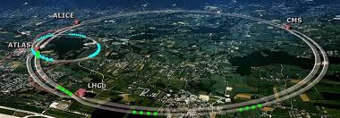
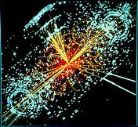
http://grids.ucs.indiana.edu/ptliupages/publications/Where%20does%20all%20the%20data%20come%20from%20v7.pdf
This analysis raw data → reconstructed data → AOD and TAGS → Physics is performed on the multi-tier LHC Computing Grid. Note that every event can be analyzed independently so that many events can be processed in parallel with some concentration operations such as those to gather entries in a histogram. This implies that both Grid and Cloud solutions work with this type of data with currently Grids being the only implementation today.
ATLAS Expt
Note LHC lies in a tunnel 27 kilometres (17 mi) in circumference
Higgs Event
The LHC produces some 15 petabytes of data per year of all varieties and with the exact value depending on duty factor of accelerator (which is reduced simply to cut electricity cost but also due to malfunction of one or more of the many complex systems) and experiments. The raw data produced by experiments is processed on the LHC Computing Grid, which has some 200,000 Cores arranged in a three level structure. Tier-0 is CERN itself, Tier 1 are national facilities and Tier 2 are regional systems. For example one LHC experiment (CMS) has 7 Tier-1 and 50 Tier-2 facilities.

Slide 3
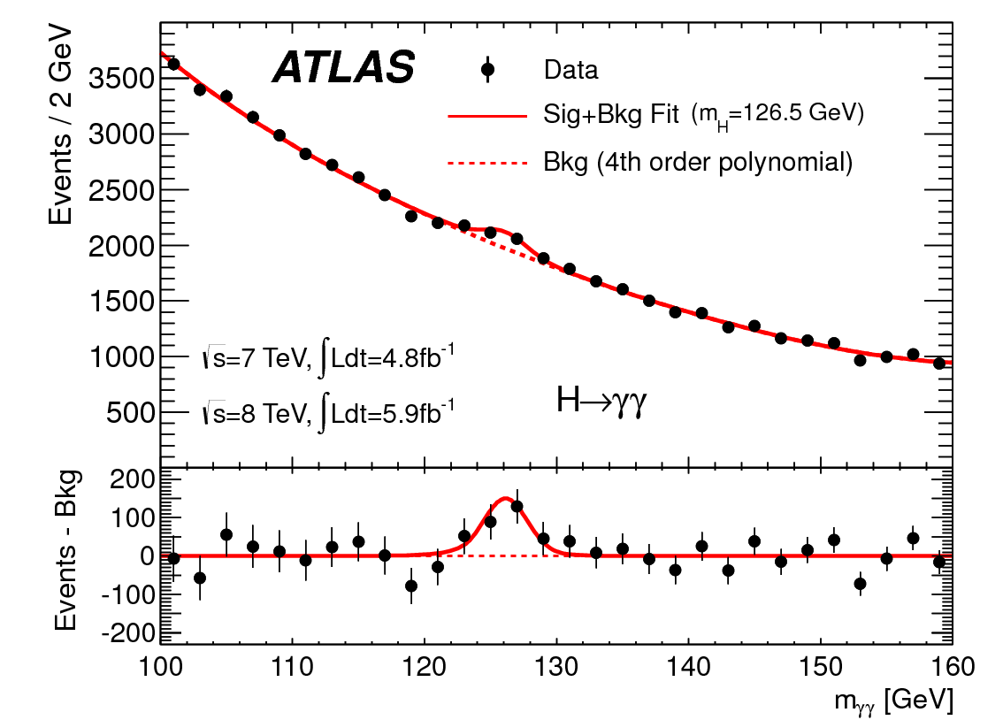
http://www.quantumdiaries.org/2012/09/07/why-particle-detectors-need-a-trigger/atlasmgg/
Model

Slide 4
Personal Note
As a naïve undergraduate in 1964, I was told by Professor that bumps like
Were particles. I was amazed and found this more intriguing than anything else I had heard about so I decided to do PhD in area.
Note errors; measurements have errors that are SQRT(N) ( N~2000 measured # of events)
Central Limit theorem that dominates design and study of all such event-based experiments

Slide 5
More Details
To get that acceleration, the scientists at CERN used the Large Hadron Collider, which is buried under the French/Swiss border. It’s a circular path that’s about 16.8 miles long and about 330 feet below the surface. The Collider has about 9,300 magnets, which are super-cooled to -456.25 degrees Fahrenheit. This enables the Collider to get protons to 99.99% of the speed of light. The protons run through six different detectors, which run different experiments and the amount of electricity that powers it is incredible – 120 Megawatts – about as much as all of the homes in the neighboring Swiss Canton of Geneva.
The Large Hadron Collider took about a decade to construct, for a total cost of about $4.75 billion. Computing power is also a significant part of the cost of running CERN – about $286 million annually. Electricity costs alone for the LHC run about $23.5 million per year. The total operating budget of the LHC runs to about $1 billion per year.
The Large Hadron Collider was first turned on in August of 2008, then stopped for repairs in September until November 2009. Taking all of those costs into consideration, the total cost of finding the Higgs boson ran about $13.25 billion. That’s a large amount, but there are over 50 billionaires on the Forbes list actually worth more than that.

Slide 6
Experiments
ATLAS (A Toroidal LHC Apparatus) is one of the seven particle detector experiments (ALICE, ATLAS, CMS, TOTEM, LHCb, LHCf and MoEDAL) constructed at the Large Hadron Collider (LHC), a particle accelerator at CERN (the European Organization for Nuclear Research) in Switzerland.
ATLAS is 45 metres long, 25 metres in diameter, and weighs about 7,000 tons. The experiment is a collaboration involving roughly 3,000 physicists at 175 institutions in 38 countries
The Compact Muon Solenoid (CMS) experiment is one of two large general-purpose particle physics detectors built on the Large Hadron Collider (LHC) at CERN in Switzerland and France.
Approximately 3,600 people, representing 183 scientific institutes and 38 countries, form the CMS collaboration who built and now operate the detector.
It is located in an underground cavern at Cessy in France, just across the border from Geneva.

Slide 7
Budgets
US Department of Energy particle physics budget $777M a year
LHC is flagship project but may not
ATLAS + CMS (2 largest experiments) are 6,000 people which is perhaps $500M a year

