Slide 1
Physics-Informatics Looking for Higgs Particle Counting Errors (Continued)
January 23 2013
Geoffrey Fox
gcf@indiana.edu
http://www.infomall.org/X-InformaticsSpring2013/index.html
Associate Dean for Research and Graduate Studies, School of Informatics and Computing
Indiana University Bloomington
2013

Slide 2
Top Topics
TOPICS
Medical/Health (medical records) | 11
Commerce (Target, Amazon) | 7
Internet/Search engine data | 7
Business | 6
Bio-informatics (metagenomics, forestry, disease) | 6
Sensors (music, videogames, 911 calls, traffic, automotive) | 5
Social informatics (social networks, communities) | 5
Environmental science | 4
Music Informatics | 4
Astronomy | 4
Science (LHC, modeling) | 3

Slide 3
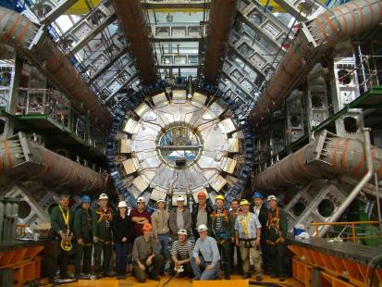
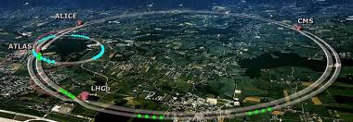
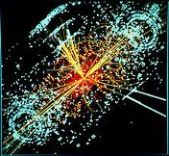
http://grids.ucs.indiana.edu/ptliupages/publications/Where%20does%20all%20the%20data%20come%20from%20v7.pd
This analysis raw data → reconstructed data → AOD and TAGS → Physics is performed on the multi-tier LHC Computing Grid. Note that every event can be analyzed independently so that many events can be processed in parallel with some concentration operations such as those to gather entries in a histogram. This implies that both Grid and Cloud solutions work with this type of data with currently Grids being the only implementation today.
ATLAS Expt
Note LHC lies in a tunnel 27 kilometres (17 mi) in circumference
Higgs Event
The LHC produces some 15 petabytes of data per year of all varieties and with the exact value depending on duty factor of accelerator (which is reduced simply to cut electricity cost but also due to malfunction of one or more of the many complex systems) and experiments. The raw data produced by experiments is processed on the LHC Computing Grid, which has some 200,000 Cores arranged in a three level structure. Tier-0 is CERN itself, Tier 1 are national facilities and Tier 2 are regional systems. For example one LHC experiment (CMS) has 7 Tier-1 and 50 Tier-2 facilities.

Slide 4
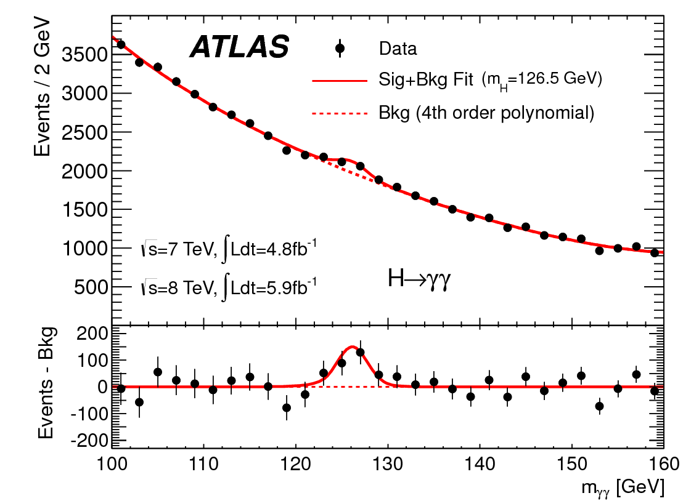
http://www.quantumdiaries.org/2012/09/07/why-particle-detectors-need-a-trigger/atlasmgg/
Model

Slide 5
