Slide 1
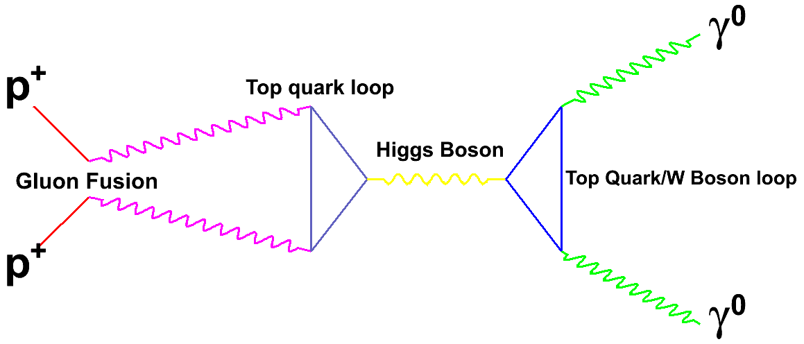
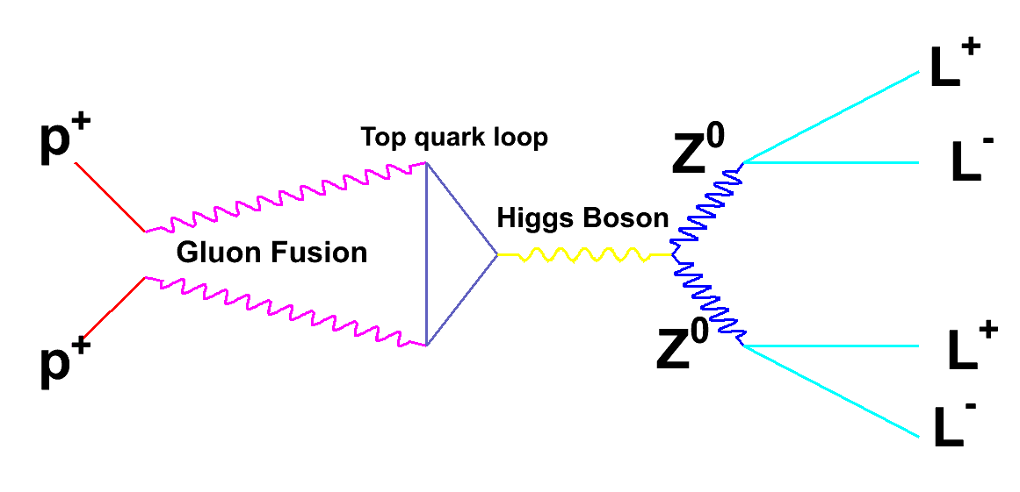
These “Feynman diagrams” define a model. It cannot be calculated exactly but approximate calculations are possible

Slide 2
Event Counting
A lot of data analysis consists of setting up a process that gives “events” as a result
Take a survey of what people feel; event is voting of an individual
Build a software system and categorize each of your data; event is this categorization
Sensor Nets; event is result of a sensor measurement
Often results are yes/no
Did person vote for Candidate X or not?
Did event fall into a certain bin of histogram or not?
Note event might have a result (cost of Hotel stay or Mass of Higgs) which is histogrammed; the decision as to which bin to go into is a yes/no decision

